Slide 1
Complete the retrieval questions
DNA- 5 minutes
MACBETH: ACT ONE 5-a-day RECALL STARTER
1: Can you finish the quotation: “Fair is foul, ______ _______ _____ ________ We hover through the __________ and the _________ air.”
2: List four things Lady Macbeth invites the spirits to do to her body.
3: Can you explain Lady Macbeth’s plan to commit regicide?
4: What type of bird does Lady Macbeth say: “croaks the fatal entrance of Duncan under my battlements”? A – Crow B - Raven C - Seagull
5: Explain the meaning of the term dramatic irony and give an example.

Slide 2
Look at the image in the middle of the screen and aim to spend 5 minutes writing descriptively about it. Consider writing about the senses as well as using details from the picture.
If you don’t know any of the words on the left had side then look them up and then try and use them.
First sentence should begin with an adverb
Lingering
Sparse
Second sentence an embedded clause
Skeletal
Wisps
Include a ; in your fifth sentence
Ethereal
Fronds
5 Minute Writing Challenge
Melancholy
Personify a leaf.
Describe the texture of the bark.

Slide 3
Read the information
Remember, the exam board recommend that you spend 15 MINUTES reading and annotating the text carefully.
1. Read the information box very carefully at the top of the page. What clues does it give you about the text?
2. CLOSE READ- At the side of every paragraph summarise in a couple of words what is happening and what the tone is.
You can then highlight a few points in the text but this should only be small amounts

Slide 4
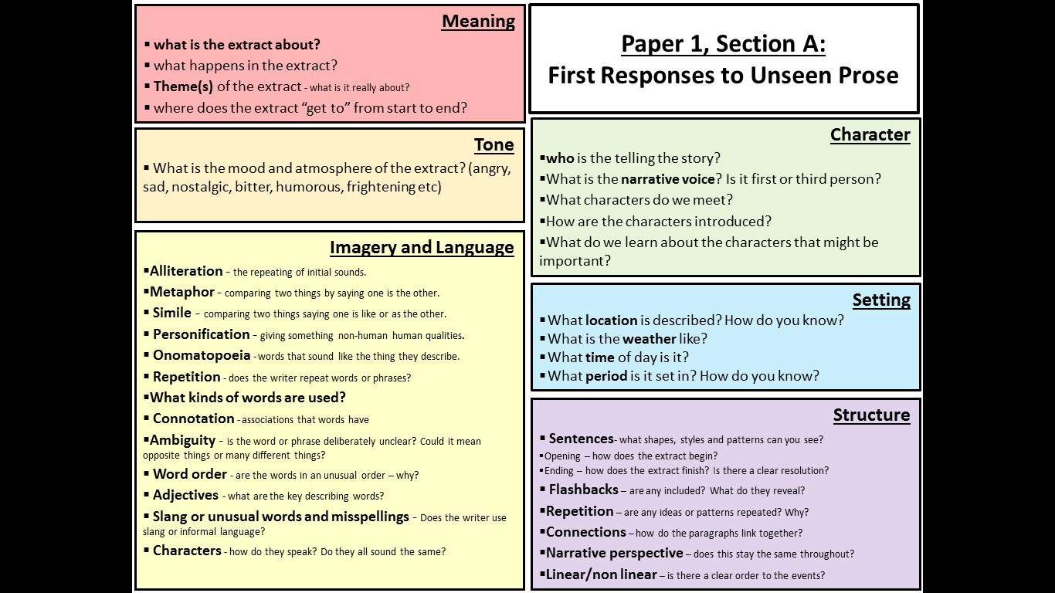
Remember, the exam board recommend that you spend 15 MINUTES reading and annotating the text carefully.
These are tools to help you to close read the extract independently. Look at the help sheet on the left which breaks down different things for you to look at and explore (there is a full slide copy on slide 6).
Then use the flow diagram to try and break the story down into the 6 key pivotal things that happen.

Slide 5
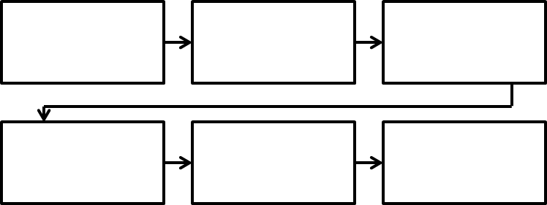
Sequence the main events of the narrative in a flow map.
Do this now for the WHOLE extract about Alice in the Pyrenees.

Slide 6
Paper 1, Section A: First Responses to Unseen Prose
Meaning
what is the extract about?
what happens in the extract?
Theme(s) of the extract - what is it really about?
where does the extract “get to” from start to end?
Tone
What is the mood and atmosphere of the extract? (angry, sad, nostalgic, bitter, humorous, frightening etc)
Character
who is the telling the story?
What is the narrative voice? Is it first or third person?
What characters do we meet?
How are the characters introduced?
What do we learn about the characters that might be important?
Imagery and Language
Alliteration - the repeating of initial sounds.
Metaphor - comparing two things by saying one is the other.
Simile - comparing two things saying one is like or as the other.
Personification - giving something non-human human qualities.
Onomatopoeia - words that sound like the thing they describe.
Repetition - does the writer repeat words or phrases?
What kinds of words are used?
Connotation - associations that words have
Ambiguity - is the word or phrase deliberately unclear? Could it mean opposite things or many different things?
Word order - are the words in an unusual order – why?
Adjectives - what are the key describing words?
Slang or unusual words and misspellings - Does the writer use slang or informal language?
Characters - how do they speak? Do they all sound the same?
Setting
What location is described? How do you know?
What is the weather like?
What time of day is it?
What period is it set in? How do you know?
Structure
Sentences- what shapes, styles and patterns can you see?
Opening – how does the extract begin?
Ending – how does the extract finish? Is there a clear resolution?
Flashbacks – are any included? What do they reveal?
Repetition – are any ideas or patterns repeated? Why?
Connections – how do the paragraphs link together?
Narrative perspective – does this stay the same throughout?
Linear/non linear – is there a clear order to the events?

Slide 7
AO1
4 Marks
4 Minutes
Read again the first part of the source from lines 1 - 4.
List four things about Alice and her surroundings from this part of the source..
A ___________________________________________________________________
_____________________________________________________________________
B____________________________________________________________________
_____________________________________________________________________
C____________________________________________________________________
_____________________________________________________________________
D____________________________________________________________________
_____________________________________________________________________
TASK - Time 4 MINUTES and complete this question. Remember to use the wording of the question for each point.
e.g. Alice is …
Her surroundings are …

Slide 8
AO1
4 Marks
4 Minutes
Read again the first part of the source from lines 1 - 4.
List four things about Alice and her surroundings from this part of the source..
Alice has a water bottle.
Alice drinks water in great gulps.
There is a heat haze.
There is a road below her.
The tarmac on the road is dented.
The sky is an endless blue.
The cicadas are hidden in the shade.
The grass is dry.
Mark your answers. If you didn’t get 4 then look back at the extract for where you could have picked up these ideas.

Slide 9
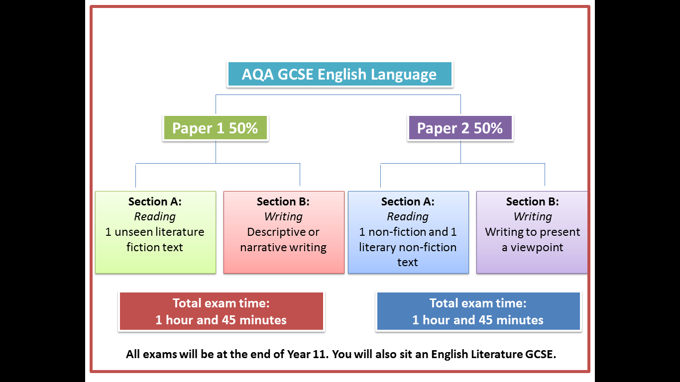
English Language, Paper 1 Section A
Read the information
Revisit learning objectives and Plenary
Select key quotations from the text.
Analyse the use of language in an extract.
Evaluate the effectiveness of a written response.
Create a Revision card…
How do you read an extract
How do you answer question 1?
Infer | Deduce | Writer | Reader

Slide 10
Complete the retrieval questions
MACBETH: ACT ONE 5-a-day RECALL STARTER
1: Can you explain what Macbeth’s hamartia is? (HINT: He says it is the only thing spurring him on to commit the regicide!)
2: Explain Lady Macbeth’s plan to frame Duncan’s own guards for his murder.
3: Can you think of THREE reasons Macbeth gives for NOT killing King Duncan in his soliloquy in Act 1 scene 7?
4: “Look like the innocent flower but be the serpent under’t.” * who is speaking? * to whom? * about what?
5: Explain the meaning of the term dramatic irony and give an example.

Slide 11
5 Minute Writing Challenge
Desolate
First sentence should begin with a verb.
Barren
Devoid
Tendrils
Third sentence a subordinate clause.
Inky
Wretched
Complete the writing challenge. Instructions are on slide 2 if you have forgotten what to do.
Macabre
Include a … in your sixth sentence
Personify a cloud.
Describe the taste of the smoke.

Slide 12
AO2
Consider the connotations of the following images. Write down the first five words that come to mind when you see the image. Then try and build up layers of meaning.
Mountains
Pink Flowers
Write the first thing you think…
The Sun
A secret

Slide 13
AO2
8 Marks
TASK - Read through the information about this question.
10 Minutes
Look in detail at this extract from lines 5 – 11 of the source.
How does the writer use language here to describe the mountain area?
You could include the writer’s choice of:
Words and phrases
Language features and techniques
Sentence forms
1) Use your topic sentence to make a point relevant to the question that says what the mountain was like
What
In this question you will need to:
Use the what, how, why? structure.
Use a range of quotations – at least three.
Comment on the effect of individual words.
Write about things like: words / phrases / language features / language techniques / sentence forms
2) Select evidence from the text – pick out a key quotation. Label the technique that the writer has used
How
Why
3) Explain the effect of the evidence – why has the writer used this evidence to describe the mountain area?

Slide 14
Character
Narrative voice | The perspective from which the story is told.
Archetype | A familiar/traditional character used seen in many stories across different cultures e.g. the villain.
Protagonist | The main character.
Setting
Pathetic fallacy | When the weather reflects the actions/mood of the story.
Structure
Declarative sentence | A statement e.g. The sky is blue.
Imperative sentence | A command e.g. Stop running.
Interrogative sentence | A question.
Exclamative sentence | A sentence ending with a !
Linear narrative | Narrative that follows a straight line e.g. beginning – middle – end.
Non-linear narrative | Often starts in the middle of the story and then goes back to the beginning may involve flashbacks.
Cyclical narrative | A story that ends where it begins.
Motif | Reoccurring ideas and themes throughout the story.
Asyndetic list | A list without conjunctions or connectives.
Climax | The point of greatest tension in the story.
Foreshadowing | Hints of what is to come in the story.
Imagery and Language
Alliteration | Words in a sentence/passage that begin with the same letter or sound.
Plosive alliteration | Repetition of the B or P sound at the beginning of words.
Sibilance | Repetition of the S or SH sound at the beginning of words.
Metaphor | Comparing one thing to another by saying it is something else e.g. the tree was a mountain.
Simile | Comparing one thing to another using like or as e.g. the tree was like a mountain.
Personification | Giving an inanimate object human qualities.
Onomatopoeia | Words that sound like what they are e.g. bang/crash/drip.
Repetition | Repeating a word or idea more than once.
Adjective | A describing word.
Verb (dynamic/modal) | A doing word.
Noun (abstract/concrete) | A naming word.
Pronoun | I/You/He/She/They etc.
Adverb | Describes a verb, usually ends in –ly.
Connotation | The associated meanings of a word e.g. the connotations of red might be love/danger/anger etc.
Colloquial language | Informal or slang language.
Semantic field | A group of words suggesting a theme/topic e.g. a semantic field of war – guns/bullets/army/soldier
These are the main techniques that you need to learn and remember for Paper 1, Section A.

Slide 15
AO2
8 Marks
10 Minutes
It’s her first time in the Pyrenees, although she feels very much at home. She’s been told that in the winter the jagged peaks of the mountains are covered with snow. In the spring, delicate flowers of pink and mauve and white peep out from their hiding places in the great expanses of rock. In early summer, the pastures are green and speckled with yellow buttercups. But now, the sun has flattened the land into submission, turning the greens to brown. It is a beautiful place she thinks, yet somehow an inhospitable one. It’s a place of secrets, one that has seen too much and concealed too much to be at peace with itself.
Read through this section for question 2 and begin to highlight the evidence you can use to answer the question from slide 13.
Then label the techniques.
Look at the next slide AFTER you have attempted this and use it to help you.

Slide 16
Use these suggested sections to focus on and annotate ready to answer the question.
It’s her first time in the Pyrenees, although she feels very much at home. She’s been told that in the winter the jagged peaks of the mountains are covered with snow. In the spring, delicate flowers of pink and mauve and white peep out from their hiding places in the great expanses of rock. In early summer, the pastures are green and speckled with yellow buttercups. But now, the sun has flattened the land into submission, turning the greens to brown. It is a beautiful place she thinks, yet somehow an inhospitable one. It’s a place of secrets, one that has seen too much and concealed too much to be at peace with itself.
Metaphor
Semantic Field
Dynamic Verb
Alliteration
Juxtaposition
Adjective
Simile

Slide 17
Support Sheet
When we analyse language techniques we need to explode specific words and phrases to break down what they tell us and the effects they have on us.
On the next slide are 3 pieces of evidence from the text and the sentence starters to help you to try and break them down.
Complete all THREE practise paragraphs using the help on the next slide.

Slide 18
Support Sheet
“delicate flowers of pink and mauve and white peep out”
The adjective “delicate” suggests…
The verb “peep” is interesting because…
“from their hiding places in the great expanse of rock”
The flowers are “hiding” which suggests…
The adjective “great” suggests…
“the sun has flattened the land into submission”
“The sun” is personified to suggest…
The verb “flattened” conveys…

Slide 19
AO2
TASK - Now have a go at the question – give yourself ten minutes for this. There is a sentence starter help sheet on the next slide if you need it.
8 Marks
10 Minutes
Look in detail at this extract from lines 5 – 11 of the source.
How does the writer use language here to describe the mountain area?
You could include the writer’s choice of:
Words and phrases
Language features and techniques
Sentence forms
In this question you will need to:
Use the what, how, why? structure.
Use a range of quotations – at least three.
Comment on the effect of individual words.
Write about things like: words / phrases / language features / language techniques / sentence forms

Slide 20
Need some help?
Step by Step Sentence Starters
The writer uses…
In the text the writer…
The writer uses language to create a …………. Atmosphere
Language is used effectively in the text to convey….
What?
For example, ….
This is illustrated in the quotation…
We can see this when…
This is evident in the quotation…
This metaphor/simile/personification is used to show...
The clever use of this adverb/verb/adjective/image represents...
How?
The writer is trying to symbolise...
This image is effective because...
The use of the adjective/noun/verb evokes a sense of…
Thus we can see that…
So this is important because…
This is significant because…
Why?

Slide 21
Have you included a range of quotations?
Q2 AO2 Explain & analyse language
Level 4 | 7-8 | Shows detailed, perceptive understanding of language features Analyses the effects of the writer’s choice of language features Selects a judicious range of examples . Uses a range of subject terminology appropriately
Level 3 | 5-6 | Shows clear understanding of language features Clearly explains the effects of the writer’s choice of language features Selects a range of relevant examples . Uses subject terminology accurately
Level 2 | 3-4 | Shows some understanding of language features Attempts to comment on the effect of language features Selects some relevant examples Uses some subject terminology, not always appropriately
Level 1 | `1-2 | Shows simple awareness of language Offers simple comment on the effect of language Simple references or examples Simple mention of subject terminology
Have you tried to develop a range of interpretations of the language?
Have you explained the effect of the language techniques on the reader?
Have you made a range of clear points about the language techniques used?

Slide 22
Question Three
Analyse the use of structure in an extract.
Recall different structural techniques.
Evaluate the quality of a written response.
Structure | Narrator | Non-linear | Omniscient

Slide 23
DNA- 5 minutes
MACBETH: ACT ONE 5-a-day RECALL STARTER
1: “he unseam’d him from the nave to the chaps.” * who is speaking? * to whom? * about what?
2: What different things does Lady Macbeth ask the spirits to do to her body?
3: Can you think of THREE reasons Macbeth gives for NOT killing King Duncan in his soliloquy in Act 1 scene 7?
4: “Go, pronounce his present death and with his former title greet Macbeth.” * who is speaking? * to whom? * about what?
5: Explain the meaning of the term hamartia. What is Macbeth’s hamartia?

Slide 24
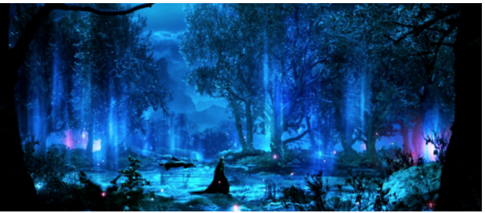
DNA
5 Minute Writing Challenge
Complete the writing challenge. Instructions are on slide 2 if you have forgotten what to do.
First sentence should begin with a preposition.
Needs to maintain a 3rd person narrative.
Include an exclamation mark.
Towered
Luminous
Clandestine
Amiable
Furtive
Meandering

Slide 25
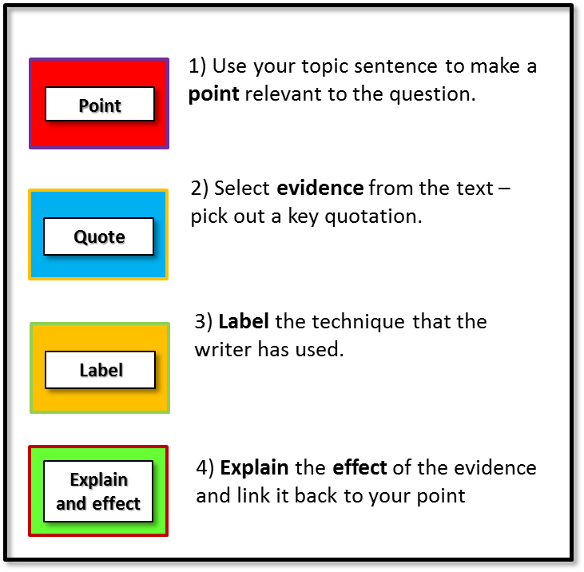
AO2
8 Marks
Read the information
10 Minutes
You now need to think about the whole of the text.
How has the writer structured the text to interest you as a reader?
In this question you will need to:
Use the what, how, why structure.
Use a range of quotations – at least three.
Use subject terminology.
Write about things like: beginnings / endings / perspective shifts, topic change / single sentence paragraphs, sentence length
Ideas:
What is the are you made to focus on at the beginning, middle and end?
Are long and short sentences used? How does the sentence use relate to the atmosphere created?
Are there threads, use of repetition or punctuation marks used for effect?
Perspective?
Setting?
Time?
Flashback?

Slide 26
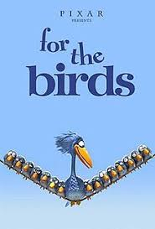
What is happening at the start? What is our attention drawn to? What is the mood?
Which characters are introduced next? What is introduced to the story? Why is it interesting?
What is our attention focused on now? Why is it interesting? What does the bird decide to do?
Finally what does the birds decide to do? What is revealed to the viewer?
How does the revelation at the end help us to understand the beginning?
At first
Then
The Birds Clip – Click here to watch the clip
Shifts away from
Now
Changes the scene to
At the top of the slides are questions for you to answer after you have watched the short clip. Aim to write at least 3 paragraphs and use the sentence starters in the small boxes on the left and right of this slide.
At this point
The author goes back to
Focuses in
Eventually
Wide view
Narrows down
The author then introduces
Finally

Slide 27
AO2
Demonstrate
8 Marks
10 Minutes
You now need to think about the whole of the text and look at the extract about Alice and her archaeological dig!
How has the writer structured the text to interest you as a reader?
In this question you will need to:
Use the what, how, why? structure.
Use a range of quotations – at least three.
Use subject terminology.
Write about things like: beginnings / endings / perspective shifts, topic change / single sentence paragraphs, sentence length
Ideas:
What is the are you made to focus on at the beginning, middle and end?
Are long and short sentences used? How does the sentence use relate to the atmosphere created?
Are there threads, use of repetition or punctuation marks used for effect?
Perspective?
Setting?
Time?
Flashback?

Slide 28
 | What happens? | Why is it Interesting? | Quotations
Beginning
Middle
End
Draw out this slide and then read through the Alice extract and then fill in these boxes. Remember to use the help sheet from slide 6 to help you to pick out structural techniques.
When you have had a go on your own have a look at the next slide which has some ideas for you.

Slide 29
 | What happens? | Why is it Interesting? | Quotations
Beginning | The main character, Alice is introduced. It is hot and the setting is remote. Alice is working hard. | The conditions are uncomfortable and there is an air of mystery surrounding the setting. Written in the present tense. Close focus on Alice.
Middle | The rest of the group are mentioned and are working at some distance away from Alice. Reference made to the object Alice has found. | Alice has chosen to isolate herself from the rest of the group and is working in secret despite being close friends with them. Reference made to the idea of fate/destiny.
End | Flash forward to after the discovery. The narrative comes back to focus on the heat and the water bottle which Alice has now finished. | The omniscient narrator knows more than Alice and seems to imply she will regret this discovery. Cyclical narrative except now the conditions are more extreme.

Slide 30
AO2
8 Marks
Answer the question. Give yourself 10 minutes and use the sentence starters on the next slide if you need to.
10 Minutes
You now need to think about the whole of the text.
How has the writer structured the text to interest you as a reader?
In this question you will need to:
Use the what, how, why structure.
Use a range of quotations – at least three.
Use subject terminology.
Write about things like: beginnings / endings / perspective shifts, topic change / single sentence paragraphs, sentence length
Ideas:
What is the are you made to focus on at the beginning, middle and end?
Are long and short sentences used? How does the sentence use relate to the atmosphere created?
Are there threads, use of repetition or punctuation marks used for effect?
Perspective?
Setting?
Time?
Flashback?

Slide 31
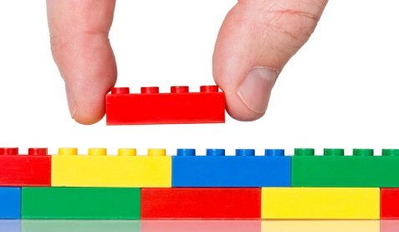
Support Sheet
Key Phrases
At first
Then
At this point
Changes the scene to
Shifts away from
Now
The author then introduces
Narrows down
Focuses in
Wide view
Eventually
The author goes back to
The writer has made this part of the story interesting because….
Finally
Notes:
Useful phrases to help answer question 3

Slide 32
Have you included a range of quotations?
Q2 AO2 Explain & analyse language
Level 4 | 7-8 | Shows detailed, perceptive understanding of structure features Analyses the effects of the writer’s choice of structure features Selects a judicious range of examples . Uses a range of subject terminology appropriately
Level 3 | 5-6 | Shows clear understanding of structure features Clearly explains the effects of the writer’s choice of structure features Selects a range of relevant examples . Uses subject terminology accurately
Level 2 | 3-4 | Shows some understanding of structure features Attempts to comment on the effect of structure features Selects some relevant examples Uses some subject terminology, not always appropriately
Level 1 | `1-2 | Shows simple awareness of structure Offers simple comment on the effect of structure Simple references or examples Simple mention of subject terminology
Have you tried to develop a range of interpretations of the structure?
Have you explained the effect of the structure techniques on the reader?
Have you made a range of clear points about the structure techniques used?

Slide 33
Question 4
Evaluate your personal response.
Analyse the methods used by a writer.
Evaluate the effectiveness of a written response.
Viewpoint | Evaluate | Perspective | Interpretation

Slide 34
DNA- 5 minutes
MACBETH: ACTS 1 and 2 5-a-day RECALL STARTER
1: “A little water clears us of this deed. How easy is it then!” * who is speaking? * to whom? * about what?
2: What is the meaning of the term hamartia? What does Macbeth say is his hamartia? (Bonus point if you can remember two words as a quotation!)
3: Banquo says of the night stars on the night of Duncan’s regicide: “The candles are all out.” What comment, made earlier by Lady Macbeth, does this comment link to?
4: “Go, pronounce his present death and with his former title greet Macbeth.” * who is speaking? * to whom? * about what?
5: Explain the meaning of the term hamartia. What is Macbeth’s hamartia?

Slide 35
5 Minute Writing Challenge
Slick
First sentence should begin with a preposition
Glassy
Iridescent
Myriad
Include a one line paragraph
Acrid
Prevailing
Gloomy
Third sentence should begin with an adverb
Personify a street light
Describe a faraway sound

Slide 36
TASK - Decide which number on the scale you are for each statement and then write 3 sentences which explain the reasons for your opinion.
1. A woman’s place is in the home.
1 | 2 | 3 | 4 | 5 | 6 | 7 | 8 | 9 | 10
2. Homework should be optional.
1 | 2 | 3 | 4 | 5 | 6 | 7 | 8 | 9 | 10
3. Personality is more important than beauty.
1 | 2 | 3 | 4 | 5 | 6 | 7 | 8 | 9 | 10
4. Money is more important than love.
1 | 2 | 3 | 4 | 5 | 6 | 7 | 8 | 9 | 10
DISAGREE
AGREE

Slide 37
AO4
20 Marks
20 Minutes
Read the information then complete the task.
Focus this part of your answer on the second part of the source, from line 21 to the end.
A reader said, ‘This part of the story, where Alice decides to continue digging for the object, is very mysterious, and suggests her discovery may be life-changing.’
To what extent do you agree?
In your response you could:
Consider the reasons why Alice decides to continue digging.
Evaluate how the writer creates a sense of mystery.
Support your opinions with quotations from the text.
There are 4 important points in this question – highlight them all

Slide 38
AO4
20 Marks
20 Minutes
Check you got the highlighting correct.
Focus this part of your answer on the second part of the source, from line 21 to the end.
A reader said, ‘This part of the story, where Alice decides to continue digging for the object, is very mysterious, and suggests her discovery may be life-changing.’
To what extent do you agree?
In your response you could:
Consider the reasons why Alice decides to continue digging.
Evaluate how the writer creates a sense of mystery.
Support your opinions with quotations from the text.
There are 4 important points in this question – highlight them all

Slide 39
BOIL the question down into two parts…
Why does she continue digging?
How does the writer create a sense of mystery?
TASK - See if you can make a list of reasons, with evidence for each of these steps. When you have had a go at this on your own have a look at the next slide for some helpful hints and suggestions.
EXTENSION: rank order the reasons from most to least important.

Slide 40
BOIL the question down into two parts…
Why does she continue digging?
How does the writer create a sense of mystery?
Doesn’t want to lose momentum and doesn’t think it’ll be much longer to go.
She continues to work despite her fatigue and the challenging conditions – why is she so desperate and determined?
She thinks her luck is about to change.
Her internal dilemma – she ignores the temptation to join her friends and carries on alone.
She has noticed something “glinting”.
The fact that the object is “glinting” suggests that it might be precious or expensive.
This is her destiny/drawn by a supernatural power.
The flash-forward seems to suggest her decision to keep going might have negative consequences.
She wants to prove herself as it’s her last day on the site.
It seems as though the object has been placed there for her alone to find – who would have done that?
EXTENSION: rank order the reasons from most to least important.

Slide 41
Step Three
How does the writer create a sense of mystery?
Each take a point on your table – some of you will have to do two
Find a quotation to support the point
Label the technique used
How does this link back to the question.
She continues to work despite her fatigue and the challenging conditions – why is she so desperate and determined?
Her internal dilemma – she ignores the temptation to join her friends and carries on alone.
The object is precious
The flash-forward seems to suggest her decision to keep going might have negative consequences.
It seems as though the object has been placed there for her alone to find – who would have done that?

Slide 42
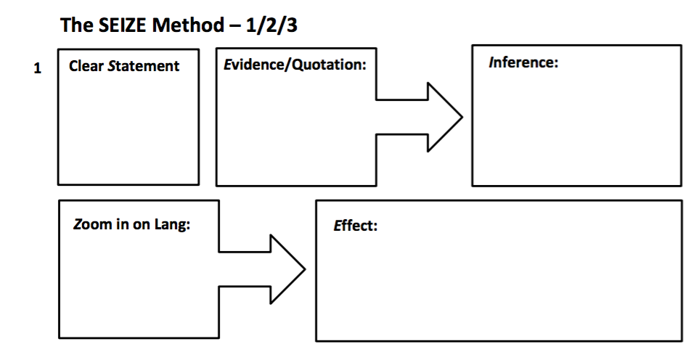
Use this flow chart now to help you plan out 5 possible paragraphs to answer the question on slide 38.

Slide 43
AO4
Demonstrate
20 Marks
20 Minutes
TASK – now give yourself 20 minutes to answer the question in full paragraphs. Remember to use evaluative language choices. There are some sentence starters on the next slide to help you.
Focus this part of your answer on the second part of the source, from line 21 to the end.
A reader said, ‘This part of the story, where Alice decides to continue digging for the object, is very mysterious, and suggests her discovery may be life-changing.’
To what extent do you agree?
In your response you could:
Consider the reasons why Alice decides to continue digging.
Evaluate how the writer creates a sense of mystery.
Support your opinions with quotations from the text.

Slide 44
Need some help?
Step by Step Sentence Starters
I agree/partially agree/totally agree with the statement as…
The writer uses…
In the text the writer…
The writer uses language to create a …………. Atmosphere
Language is used effectively in the text to convey….
Statement
For example, ….
This is illustrated in the quotation…
We can see this when…
This is evident in the quotation…
Evidence
Inference
This makes me agree with the statement as…
The writer is trying to symbolise...
This image is effective because...
This metaphor/simile/personification is used to show...
The clever use of this adverb/verb/adjective/image represents...
The use of the adjective/noun/verb evokes a sense of…
Thus we can see that…
So this is important because…
This is significant because…
Zoom and explain

Slide 45
Question Five
Communicate clearly, effectively and imaginatively
Organise information and ideas, using structural and grammatical features
Use a range of vocabulary and sentence structures with accurate spelling and punctuation

Slide 46
DNA- 5 minutes
MACBETH: ACTS 1 and 2 5-a-day RECALL STARTER
1: “He is to full of the milk of human kindness to catch the nearest way.” * who is speaking? * to whom? (Careful!) * about what?
2: What is the meaning of the phrase “the nearest way” in the quotation above?
3: Banquo says of the night stars on the night of Duncan’s regicide: “The candles are all out.” What comment, made earlier by Lady Macbeth, does this comment link to?
4: Finish this quotation: “Is this a dagger _______ _ ____ _________ ___ ?” What would be the dramatic effect of showing a floating dagger to the audience? Then, what would be the effect of NOT letting the audience see it?
5: What is significant about the word “Amen” getting stuck in Macbeth’s throat?

Slide 47
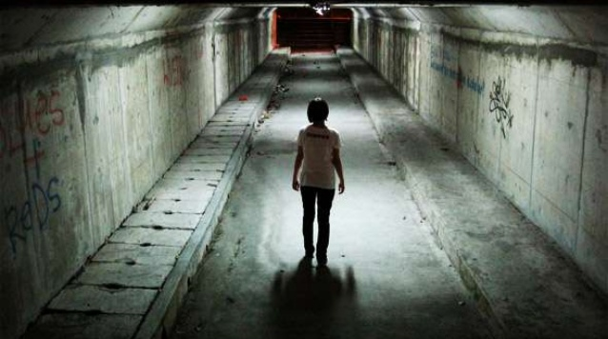
5 Minute Writing Challenge
grotesque
Make sure you have a minor sentence
luminous
subterranean
Include a list
tumultuous
paranoid
barbarous
Complete the writing challenge. Instructions are on slide 2 if you have forgotten what to do.
Third sentence should begin with a verb
Personify the light
Describe a smell

Slide 48
Question 5
Read the information.
Question 5 is worth a whole 40 marks
24 marks are for content and organisation
16 marks are for technical accuracy

Slide 49
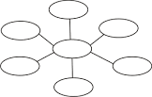
Question 5
This question is assessing your ability to carefully craft your writing.
Mind map everything you think you would get a mark for.

Slide 50
TASK – spend 45 minutes completing the question below. Remember to use a range of descriptive writing techniques and ALWAYS start by spending 5 minutes planning.
Question – Your school is asking for contributions for its creative writing webpage.
Write a description which is suggested/based on this picture.
40 Marks
45 Minutes

