Slide 1
CwK
Wednesday, 01 July 2020
Levers and Gears
Do Now Activity
An elephant has a mass of 2000 kg, and a mouse has a mass of 10 g. If they sit on either side of a seesaw, and the elephant is 0.5 m from the pivot, how far away should the mouse sit?

Slide 2
Self Assess
First we have to calculate the Force of the elephant using W=mg
W=2000 x 9.8
W=19600N
Then calculate the moment of the elephant
M=19600 x 0.5
M=9800Nm
Calculate the force of the mouse using W=mg
W=0.01 x 9.8= 0.0098
Now we can calculate the distance of the mouse
d= 19600/0.098
d=200000m

Slide 3
Progress Indicators
Good Progress
Recall the equation to calculate moments
Perform calculations, including rearrangement of the moment equation
Outstanding Progress
Apply the principle of moments to determine if an object is in equilibrium.

Slide 4
How do levers work
Levers work by moving objects around a pivot.
An effort is applied when you push down on one side and this makes the load move up
Notes:
10

Slide 5
How do Levers work?
Pivot
Effort
Notice how the distance between the effort and the pivot is much larger than the distance between the load and the pivot.
Larger distance = less force needed
Load
Notes:
10

Slide 6

How would you open this?
Notes:
10

Slide 7
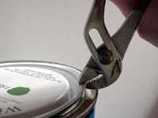
Would you use this?
Notes:
10

Slide 8
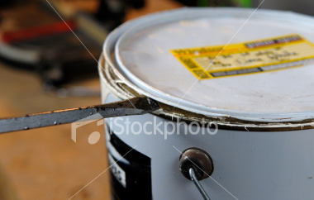
Why would this be a better tool?
Notes:
10

Slide 9

How do Gears work?
If the smaller wheel is turned, it turns the larger one slower but with more force (i.e. the distance to the pivot has been increased).
Notes:
10

Slide 10
How do Gears work?
High gear gives high speed and a low turning effect
Notes:
10

Slide 11
How do Gears work?
Low gear gives low speed and a high turning effect
Notes:
10

Slide 12
How do Gears work?
https://www.youtube.com/watch?v=P7xu9O0miEc&list=PLyFZg_M2zLmDHyw7SnAv_n4cWJA97GM_e
Notes:
10

Slide 13
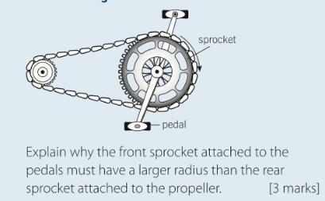
Question
Notes:
10

Slide 14
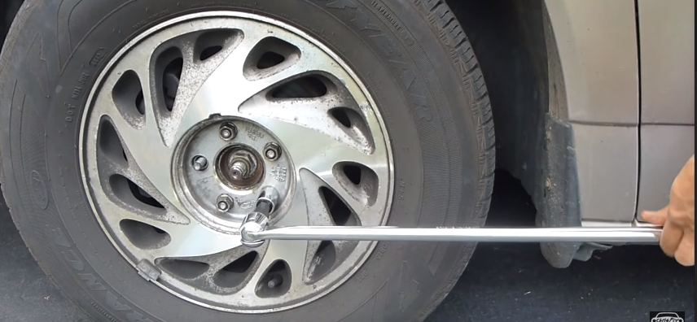
Exit Ticket
The diagram show a T bar used to undo a wheel nut on a car. Explain why the turning force on the wheel nut is much greater than the turning force applied to the T bar.
The moment of the force on a gear wheel of radius 40mm should always be less than 4.8Nm. Calculate the maximum force on the gear wheel to make it turn
Notes:
10

