Slide 1
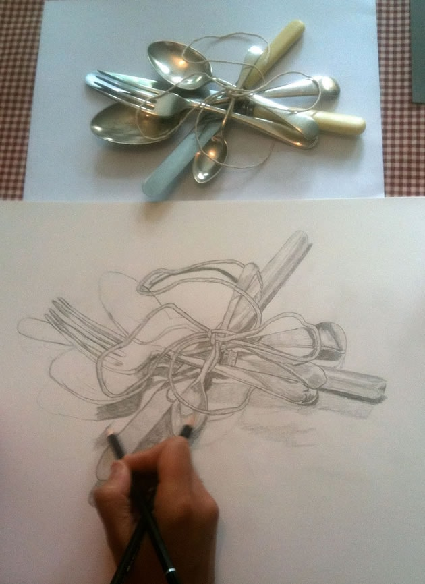
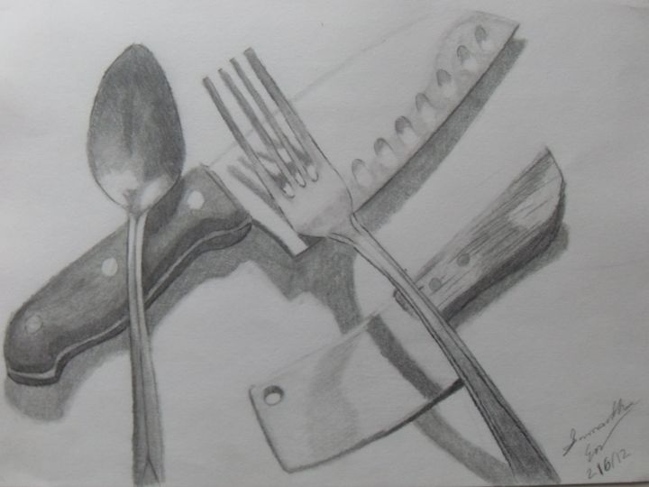
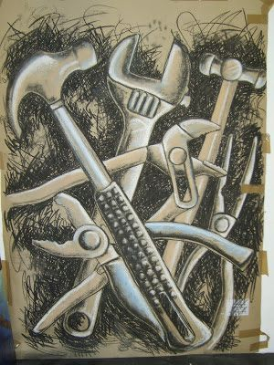
Task 6 - Observational drawing of kitchen utensils or garden/garage tools
Lay 3 kitchen utensils or garden/garage tools in front of you, on top of each other. Observe them and draw them
Draw the outline first then add shading to give the drawing a more 3D realistic look adding on reflections
Make sure your drawing is large (A4) to be able to add finer details
Use the images to help

Slide 2
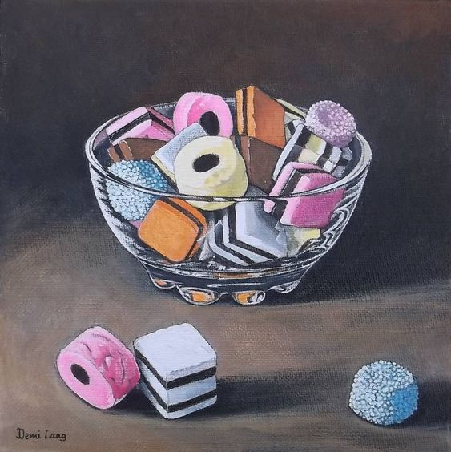
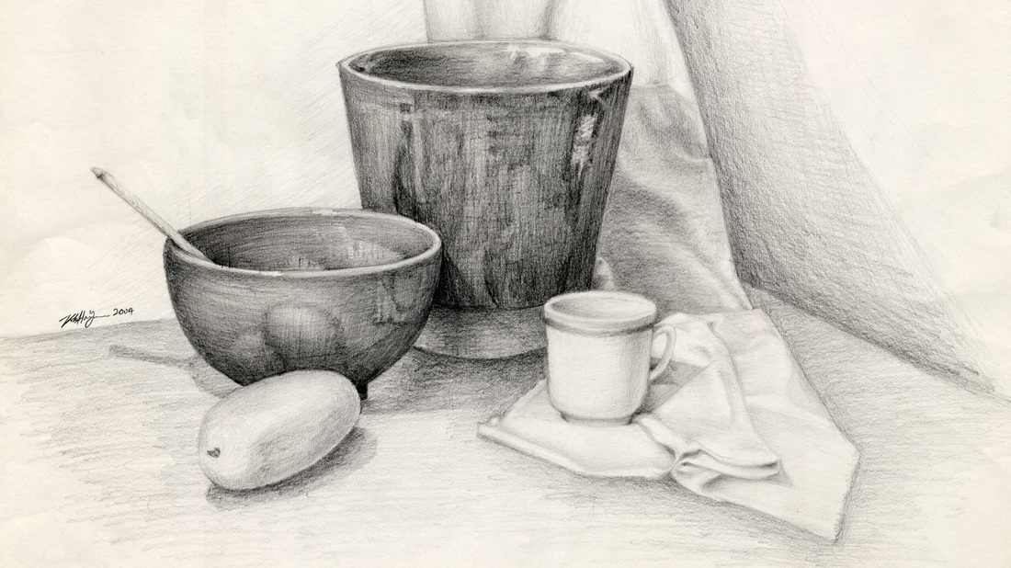
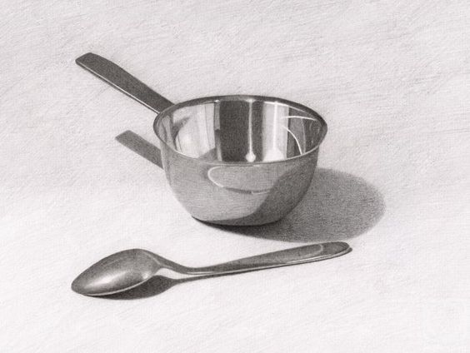
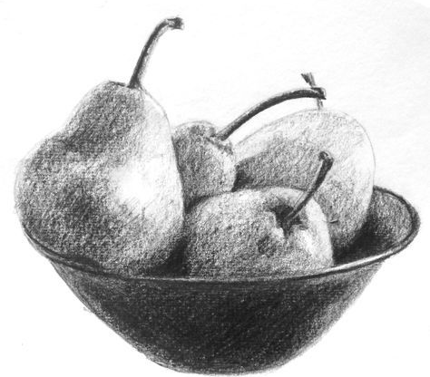
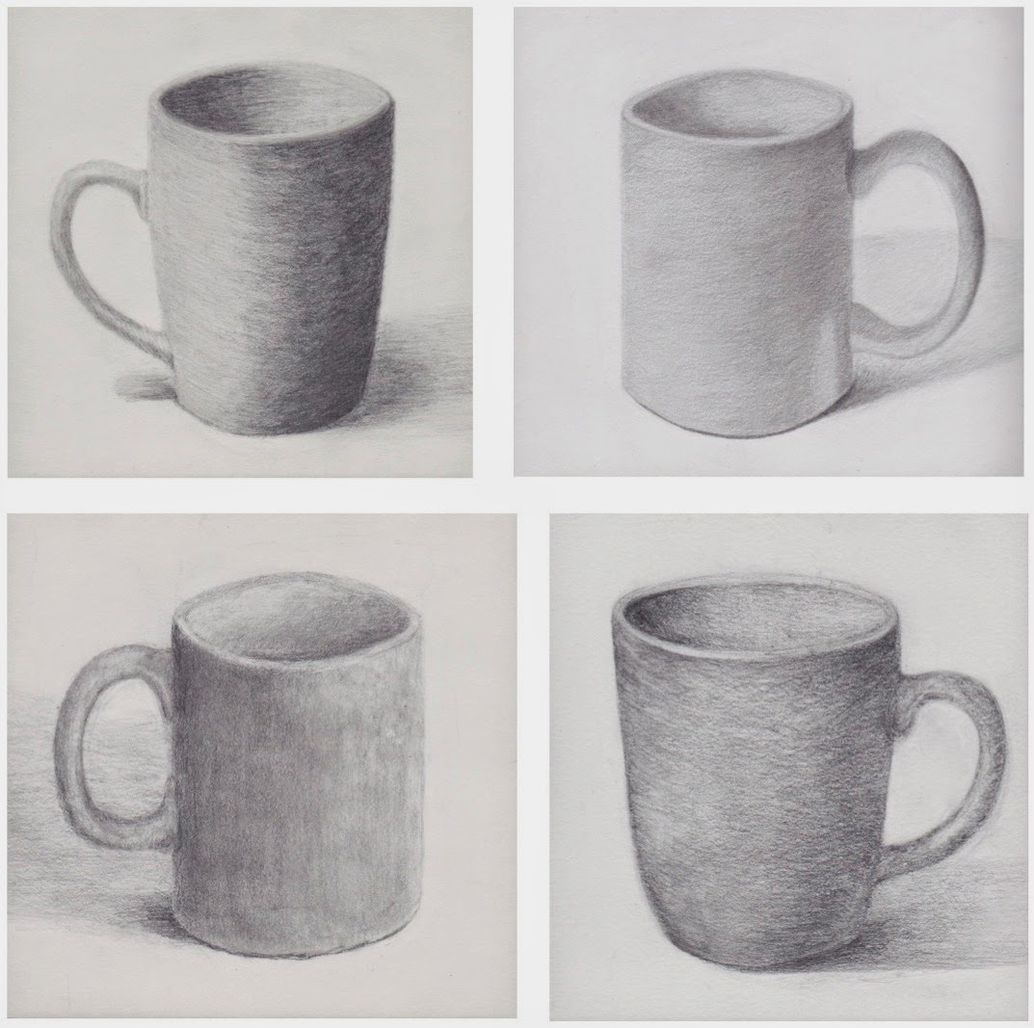
Task 7 - Observational drawing of a bowl and mug
With a bowl in front of you and a mug – observe them both next to each other and draw and shade them in.
You may wish to add a spoon into the bowl, or some cereals, fruit anything you want, but you must have a bowl and mug
Once you have completed the outline add shading to give the drawing a more realistic look and 3D
Make sure your drawing is large (A4) to be able to add finer details

