Slide 1
Moles
C/W
DNA: Calculate the percentage by mass of aluminium in aluminium oxide (Al₂O₃)
Ar of Al = 27
Mass of Al in Al₂O₃ = 27 x 2 = 54
Mr of Al₂O₃ = (27x2) +(16x3) = 102
Percentage of aluminium = 54/102 x 100 = 52.94%
3.2.1

Slide 2
Progress Outcomes
C/W
Good Progress
Describe with examples what a mol of a substance is. Calculate the number of moles in a given mass of a substance of given relative formula mass.
Outstanding Progress
Rearrange the mole equation to calculate mass or Mr
3.2.1

Slide 3
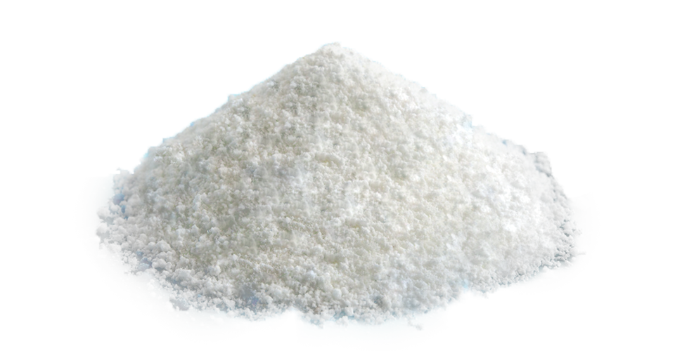
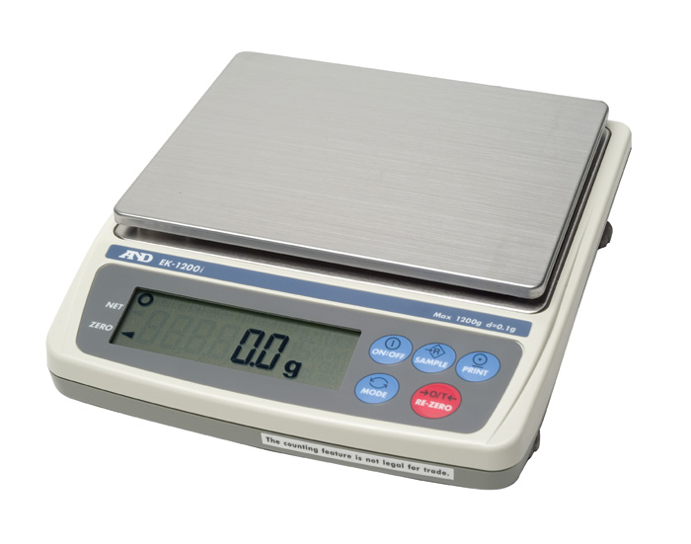
Moles – The Chemist’s Quantity
Q. How would you quantify this?
Mass (g)
For a chemist, just the mass of a substance isn’t particularly useful.
Instead, chemists like to use a unit called the mole.
The mole is an extremely useful quantity, as it allows chemists to calculate the required masses of reactants and, it allows them to predict the mass of products for chemical reactions.
However, you need to know the mass, to calculate the number of moles.
10.0

Slide 4
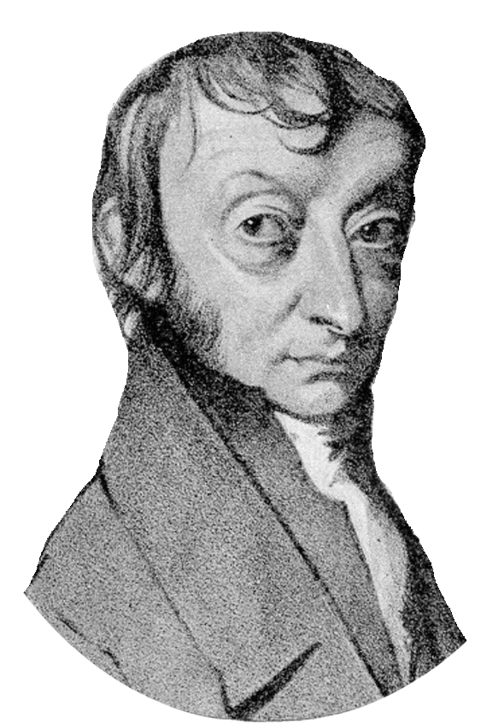
What is a mole?
1 mol = 6.02 x 10²³ atoms, molecules or ions.
Avogadro’s Number
602000000000000000000000

Slide 5
What is a mole?
Avogadro discovered that if you have 6.02 x 10²³ atoms (1 mol) of an element, it will weigh its relative atomic mass A_{r} in grams!
e.g. 1 mol (6.02 x 10²³ atoms of) sodium weighs 23g
23
Na
Sodium
11

Slide 6
What is a mole?
Avogadro discovered that if you have 6.02 x 10²³ atoms (1 mol) of an element, it will weigh its relative atomic mass A_{r} in grams!
e.g. 1 mol (6.02 x 10²³ atoms of) carbon weighs 12g
12
C
carbon
6

Slide 7
What is a mole?
If this applies to elements it also applies to compounds, via the relative formula mass - M_{r}
e.g. 1 mol (6.02 x 10²³ molecules of) carbon dioxide weighs 44g because:
CO₂
12
+ (2 x 16)
= 44 g/mol

Slide 8
Important Equation
Mass = M_{r} x mol
Real world mass (g)
Number of moles (mol)
Relative formula mass (g/mol)
Rearrange triangle:
mol = mass ÷ M_{r}
Mass
÷
÷
M_{r} = mass ÷ mol
M_{r}
x
mol

Slide 9
Calculating the number of moles.
If you know the M_{r} and the mass, you can calculate the number of moles.
Q1. How many moles are there in 100g of calcium (Ca)?
mol = mass ÷ M_{r}
100g ÷ 40 g/mol = 2.5 mol

Slide 10
Calculating the number of moles.
If you know the M_{r} and the mass, you can calculate the number of moles.
Q2. How many moles are there in 80g of Lithium chloride (LiCl)?
mol = mass ÷ M_{r}
M_{r} (LiCl) = 7 (Li) + 35.5 (Cl) = 42.5 g/mol
80 g ÷ 42.5 g/mol = 1.88 mol

Slide 11
Calculating the number of moles.
If you know the M_{r} and the mass, you can calculate the number of moles.
Q3. How many moles are there in 200g of Potassium Hydroxide (KOH)?
mol = mass ÷ M_{r}
M_{r} (KOH) = 39 (K) + 16 (O) + 1 (H) = 56 g/mol
200 g ÷ 56 g/mol = 3.57 mol

Slide 12
TASK: Calculating number of moles
Your Turn:
How many moles are in 24g of titanium (Ti)?
How many moles are in 50g of methane (CH₄)?
How many moles are in 120g of sodium cyanide (NaCN)?
How many moles are in 500g of iron (III) sulfate (Fe₂(SO₄)₃)
Mol = mass ÷ M_{r} so, 24g ÷ 48 g/mol = 0.5 mol
Mol = mass ÷ M_{r} M_{r} (CH₄) = 12 (C) + (4 x 1 (H)) = 16 g/mol 50g ÷ 16 g/mol = 3.125 mol
Mol = mass ÷ M_{r} M_{r} (NaCN) = 23 (Na) + 12 (C) + 14 (N) = 49 g/mol
120g ÷ 49 g/mol = 2.45 mol
Mol = mass ÷ M_{r} M_{r} (Fe₂(SO₄)₃) = (2 x 56 (Fe)) + (3 x ((32 (S)) + 4 x 16 (O))) = 400 g/mol
500g ÷ 400 g/mol = 1.25 mol

Slide 13
Calculating the mass of a substance
If you know the number of moles and the M_{r} you can calculate the mass of a substance
Q4. What is the mass of 0.25 moles of Copper Carbonate (CuCO₃)
Mass = M_{r} x mol
M_{r} (CuCO₃) = 63.5 (Cu) + 12 (C) + (3 x 16 (O)) = 123.5 g/mol
123.5 g/mol x 0.25 mol = 30.875 g

Slide 14
Calculating the mass of a substance
If you know the number of moles and the M_{r} you can calculate the mass of a substance
Q5. What is the mass of 3.4 moles of Magnesium hydroxide (Mg(OH)₂)
Mass = M_{r} x mol
M_{r} (Mg(OH)₂) = 24 (Mg) + (2 x (16 (O) + 1(H)) = 58 g/mol
58 g/mol x 3.4 mol = 197.2 g

Slide 15
TASK: Calculating the mass
Your Turn:
What is the mass of 1.25 moles of carbon dioxide (CO₂)
How much would 5 moles of iron oxide weigh? (Fe₂O₃)
15 moles of carbon monoxide was produced during incomplete combustion of methane, how much would it weigh?
Mass = M_{r} x mol M_{r} (CO₂) = 12 (C) + (2 x 16 (O)) = 44 g/mol
44 g/mol x 1.25 mol = 55 g of CO₂
Mass = M_{r} x mol M_{r} (Fe₂O₃) = (2 x 56 (Fe)) + (3 x 16 (O)) = 160 g/mol
160 g/mol x 5 mol = 800 g of Fe₂O₃
Mass = M_{r} x mol M_{r} (CO) = 12 (C) + 16 (O) = 28 g/mol
28 g/mol x 15 mol = 420 g of CO

Slide 16
Calculating the M_{r} of a substance
If you know the number of moles and the mass you can calculate the M_{r} of a substance
Q6. 5 moles of an unknown element was isolated, it had a mass of 100g. What was the element?
M_{r} = Mass ÷ mol
100 g ÷ 5 mol = 20 g/mol
Look on the periodic table, which element weighs 20g/mol?
Neon! (Ne)
20
Ne
neon
10

Slide 17
TASK: Calculating the M_{r} of a substance
Your Turn:
6 moles of an unknown element weighed 390g, what element is it?
11 moles of an unknown element has a mass of 924g, what element is it?
12 moles of a simple hydrocarbon weigh 192g, what hydrocarbon compound is it?
M_{r} = mass ÷ mol 390 g ÷ 6 mol = 65 g/mol = ZINC (Zn)
M_{r} = mass ÷ mol 924 g ÷ 11 mol = 84 g/mol = KRYPTON (Kr)
M_{r} = mass ÷ mol 192 g ÷ 12 mol = 16 g/mol = Methane (CH₄)

Slide 18
Multiple Choice Plenary
Q1. One mole contains 6.02 x 10²³ _____________________________.
Atoms
ions
molecules
Atoms, ions or molecules

Slide 19
Multiple Choice Plenary
Q2. 6.02 x 10²³ is also known as _______________________.
Avocado’s number
Arrhenius’ number
Avogadro’s number
Alberto’s number

Slide 20
Multiple Choice Plenary
Q3. One mole of carbon and one mole of carbon dioxide __________________
Weigh exactly the same
Contain the same number of atoms/molecules
Have the same relative formula mass
React in the same way.

Slide 21
Multiple Choice Plenary
Q4. The units for relative formula mass are:
Moles per gram
Grams
Moles
Grams per mole

Slide 22
Multiple Choice Plenary
Q5. One mole of potassium (K) weighs exactly _________.
39 grams
19 grams
78 grams
38 grams

Slide 23
Multiple Choice Plenary
Q6. two moles of potassium (K) weigh exactly _________.
39 grams
19 grams
78 grams
38 grams

