Slide 1
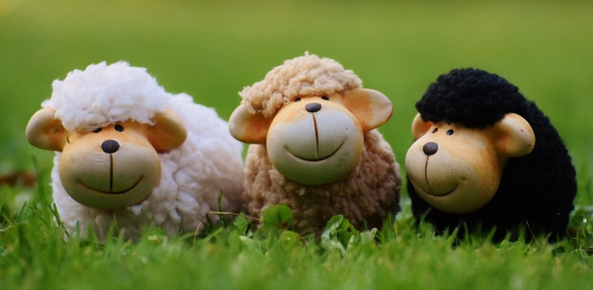
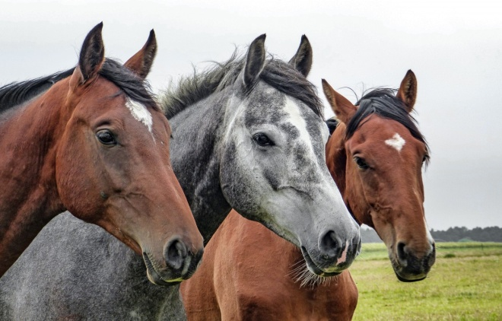
Variation
Progress indicators
Good progress: Classify characteristics as being due to genetic, environmental or a combination of these causes Give examples of continuous and discontinuous variation
Outstanding progress: Decide the best way to present information about variation in tables and charts
Do now activity:
What is genetic engineering?
Describe some the main steps in the genetic modification of bacteria to contain the human insulin gene
How do each of us vary from each other? What causes this variation?

Slide 2
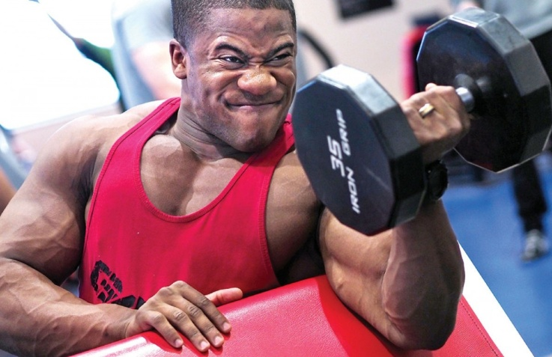
THINK > PAIR > SHARE: Note down ways in which these people vary and think about the reasons why

Slide 3
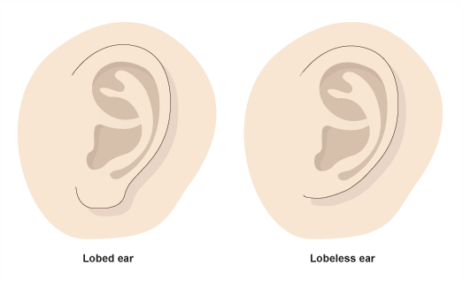
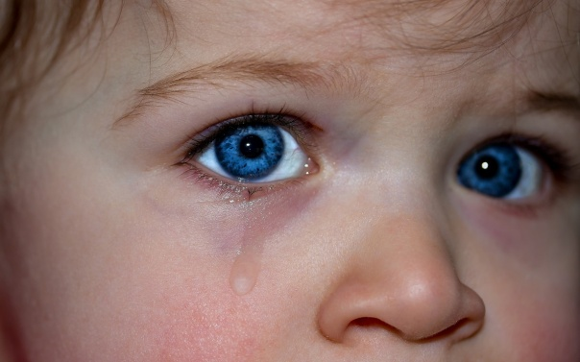
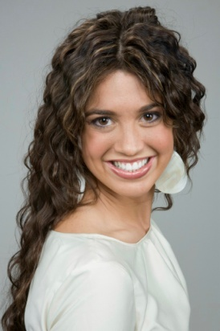
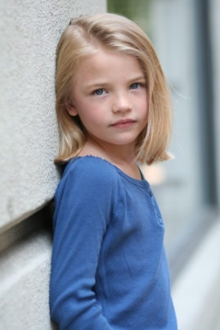
Inherited Variation
Inherited characteristics include:
Lobed/Lobeless ear
Eye colour
Hair Colour

Slide 4
Environmental Variation
Environmental Characteristics include:
Pierced ears
Weight
Strength

Slide 5
Inherited Variation
Which features have you inherited from your parents?
Discuss with you partner which features you think you have inherited from your parents
Illustrate these ideas by drawing a spider diagram in your book
Me and my mum have the same colour hair
I have the same colour eyes as my dad
Inherited Features
Me and my mum have the same shaped nose
Extra Challenge: Write down your thoughts about why we are not identical to our parents

Slide 6
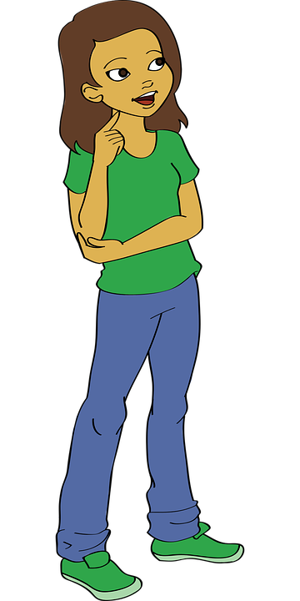
Inherited Variation
We are not identical to one parent because we inherit a mix of features from both our parents.
This is called inherited variation

Slide 7
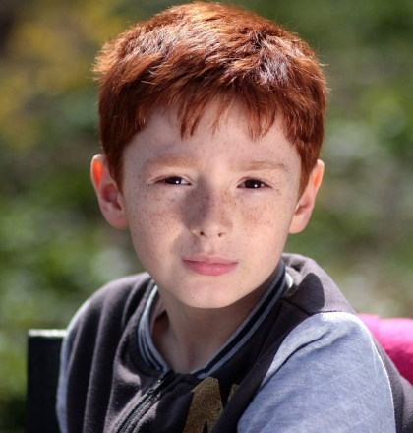
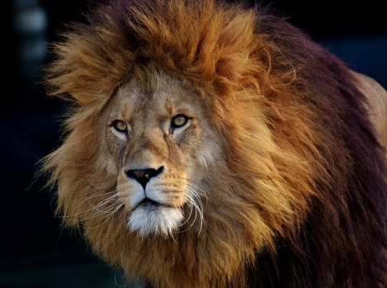
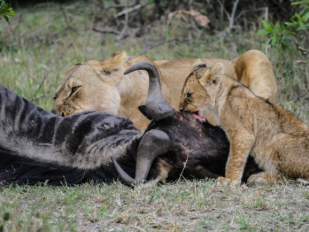
Environmental Variation
Environmental factors cause an organism to change, this is environmental variation
Weak Lion
Where you grow up
Strong Lion

Slide 8
Environmental Variation
Task: Draw the table below in your books
Environmental Factor | Environmental Variation
Task: Identify which environmental factors causes which environmental variation
E.g.
Environmental factor
Environmental variation
Where you grow up
Which football team you support

Slide 9
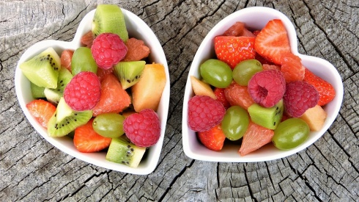
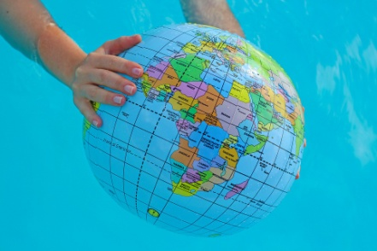
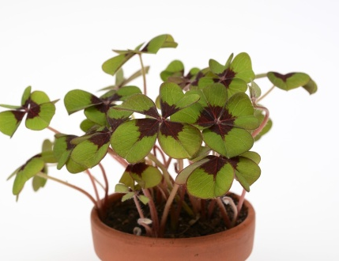
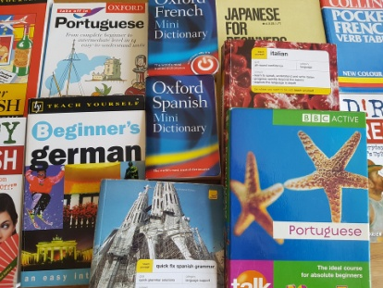
E.g.
Environmental factor
Environmental variation
Where you grow up
Which football team you support
Amount of sunshine
Food available
Country you grow up in
Height of a plant
Extension: Write some examples of environmental variation within the class
Weight of an organism
Language you speak

Slide 10
Environmental Variation
Environmental Factor | Environmental Variation
Country you grow up in
Language you speak
Amount of sunshine
Height of a plant
Weight of an organism
Food available

Slide 11
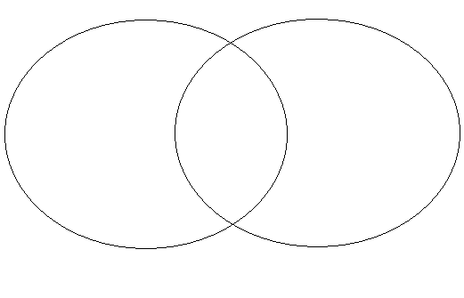
Environmental or Inherited?
Task : Compare the examples of variation – decide whether they are examples of inherited or environmental variation, or they could be both!
In pairs arrange the cards under the correct headings and complete the following Venn diagram in your books:
Inherited Variation
Environmental Variation

Slide 12
Inherited Variation
Environmental Variation
The accent you speak with
Your language
Tattoo
Scar
Religion
Pierced ears
Blood group
Male/female
Ears – lobed/lobeless
Eye colour
Hair colour
Hair length
Eye colour
Weight
Height
Freckles

Slide 13
Continuous Variation
Task: Line up in height order along the length of the classroom
There is a gradual change which shows CONTINUOUS VARIATION
Number of pupils
Height groups

Slide 14
Discontinuous Variation
Task: Stand up in two groups – those who CAN roll their tongue and those who CANNOT roll their tongue
There are a limited number of options which shows DISCONTINUOUS VARIATION
Number of pupils
Can roll tongue
Can’t roll tongue

Slide 15
Normal Distribution
Number of pupils
Height groups
The more pupils we measure the more the graph is shaped like a bell.
We call this normal distribution as it is what we expect to find

Slide 16
Task: At each station around the room, complete your information on the sheet provided
4. Handedness
3. Tongue Rolling?
5. Hand span
Back of the Room
2. Earlobe
6. Height
1. Foot length
Desk

Slide 17
Teams: In teams, take one set of results, bring back to a table and complete the tasks below:
Foot length
Tongue Rolling
Handedness
Earlobe
Hand Span
Height
Display the results of your trait with a graph
Determine if the trait is environmental or inherited
Be able to explain why your group decided this.

Slide 18
Plenary ~ Imagine a world where there was no variation, a world where everybody looked exactly the same as one another!!
Describe the advantages and disadvantages of this world, think about the personalities, jobs and hobbies people might have and whether you would like to live in a world like this!
Environmental
Inherited
Variation
Characteristics
Factors

Slide 19
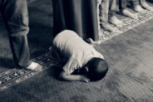
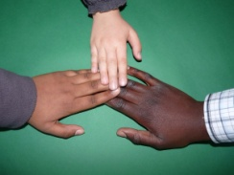
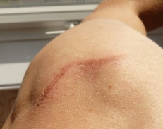
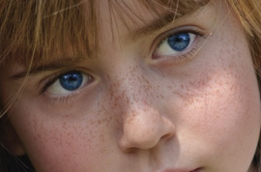
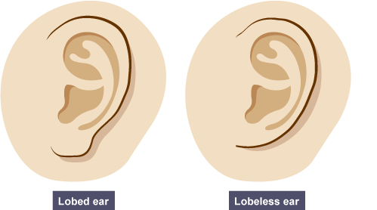
YOUR HEIGHT | YOUR RELIGION
YOUR WEIGHT | WHAT ACCENT YOU SPEAK WITH
YOUR HAIR COLOUR | WHAT LANGUAGE YOU SPEAK
YOUR EYE COLOUR | YOUR BLOOD GROUP
YOUR SKIN COLOUR | HAVING PIERCED EARS
HAVING LONG OR SHORT HAIR | HAVING A SCAR
HAVING EARS WITH LOBES … OR WITHOUT | HAVING FRECKLES
BEING MALE OR FEMALE | HAVING A TATTOO

Slide 20
Foot length
Height
Ear lobe
Name | Foot length (cm)
Name | Height (cm)
Name | Type of ear lobe

Slide 21
Handedness
Hand span
Tongue rolling
Name | Right or left?
Name | Length (cm)
Name | Can you roll your tongue?

