Slide 1
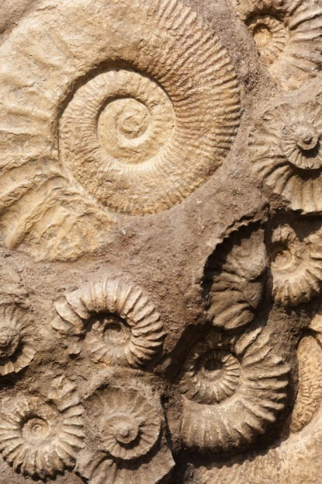
Evidence for evolution - Fossils
Progress indicators
Good progress: Define the term ‘fossil’. Describe how fossils may be formed.
Outstanding progress: Explain why scientists cannot be certain how life began on Earth.
Do now activity:
Which scientist came up with the theory of natural selection?
Describe how this theory explains the process of evolution
How do scientists today learn more about how evolution unfolded throughout history?

Slide 2
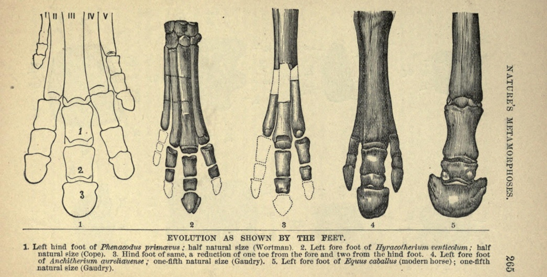
Early life forms
Fossils are the remains of plants and animals that lived millions of years ago. They provide information on animals that no longer exist.
Think > Pair > Share: How can the remains of these organisms be preserved for millions of years?
Notes:
Image by Clarke, William H. [Public domain], via Wikimedia Commons

Slide 3
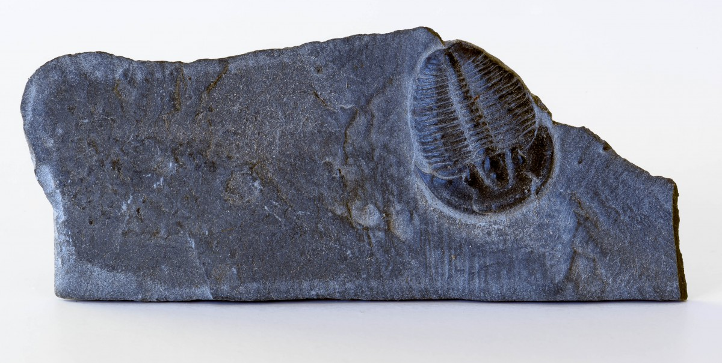
There are a number of ways that these remains can be preserved.
Task: You have each been given some information on one of these processes. Talk to each to summarise this information in your books.

Slide 4
So how are fossils formed?
http://www.bbc.co.uk/programmes/p00ckk6p
1. Outline the stages involved in the fossilisation process.
2. From this short video clip what was absent? Why could decay not take place?
3. Why do you think there are there still ‘gaps’ in the fossil record?
4. Why are there fewer fossils found early in Earth’s history?

Slide 5
Self-assessment:
1. Death > Rapid burial > Anoxic (low oxygen) environment > Long period of time > Rock replaces body tissues > Fossil is formed > Fossil is discovered
2. No oxygen
3. Not all individuals fossilise, not all fossils are found, fossils are often fragmented and broken
4. Early organisms had no skeleton / hard tissues

Slide 6
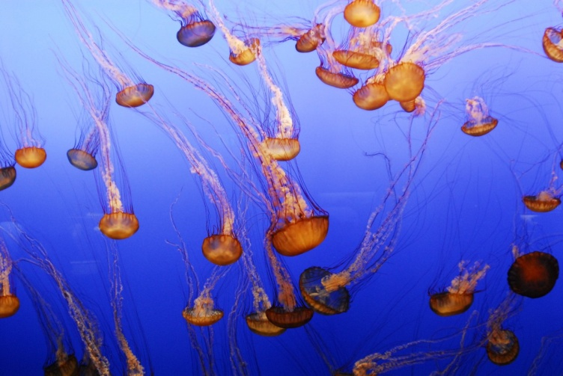
An incomplete record
Most organisms do not form fossils when they die. This is especially true for organisms which have soft bodies, these type of organisms usually leave traces for scientists to analyse.
The majority of any fossils that were formed in the earliest days will also have been destroyed by geological activity, including the formation of mountain ranges, volcanoes and earthquakes.
Many organisms that died did not become fossilised as the right conditions were rare. Finally, there are many fossils that are still yet to be found.

Slide 7
Quick Check – Silent 5
Task: Answer the following questions in your book:
Q1. What is a fossil? (1 mark)
Q2. Why would it be much more likely for a scientist to discover fossils of dinosaurs than jellyfish fossils? (2 marks)
Q3. Explain why fossils do not provide us with a complete record of evolution (3 marks)

Slide 8
Self-assessment:
Q1. A fossil is the dead remains of an animal or plant that lived millions of years ago.
Q2. It would be more likely for a scientist to discover the dead remains of a dinosaur over a jellyfish as the dinosaur contains hard bones, whereas a jellyfish is made up of soft tissue. Over millions of years the bones of the dinosaur would be resistant to decay whereas the soft tissues of the jellyfish would be very easily broken down, and so be less likely to leave a trace.
Q3. Fossils do not provide us with complete record of evolution for a number of reasons. One reason being that many early life forms were soft bodied organisms which would have decayed and left no fossil trace. Another reason is that many fossils would have disrupted by geological activity over the years, examples include earthquakes, formations of volcanoes and mountains. Furthermore, some organisms that died would not have been kept in the right conditions for fossil formation. And lastly, some fossils may still not be found yet.

Slide 9
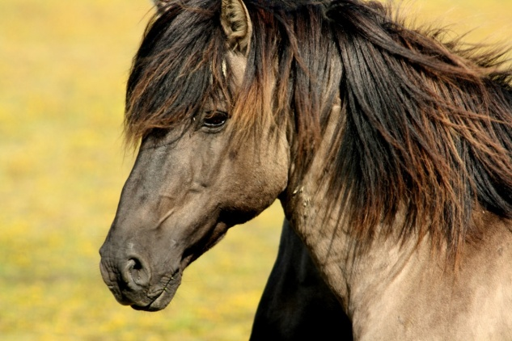
Task: Look at the cards, they contain information about horse evolution. Arrange them into the following table in order of time.
Time (mya) | Appearance (overall) | Appearance (skull) | Height (m) | Bones in front leg & how it lived
Extension: Describe changes in the size & shape of the horse’s feet over time and try to relate this to how the horse may have lived

Slide 10
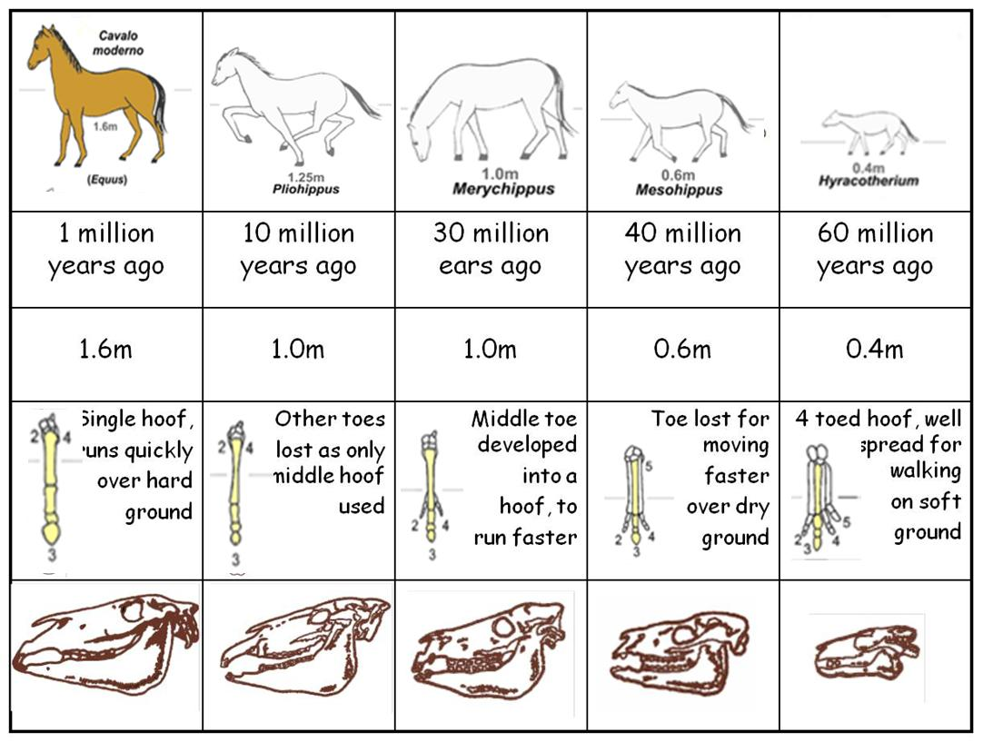
Self-assessment:

Slide 11
Exam-style question
What is a fossil? (2)
Describe three ways in which fossils can form (3)
How do fossils provide evidence for the theory of evolution? (2)
Sshh… silence!
7 marks = 7 minutes

Slide 12
Mark scheme:
Remains of an organism or bone / shell / hard part / impression of an organism
further detail – e.g. found in a rock, from a long time/mya
2. Any three from: parts of an organism which haven’t decayed, conditions needed for decay are absent, parts of the organism are replaced by other materials (mineralisation), preserved traces of organisms e.g. footprints, burrows.
3. Shows types of animals / plants that no longer exist / named ref e.g. dinosaur show changes in types (of animals / plants) similar fossils found in rocks of similar age reference to sequence of change or example e.g. horse / limb

Slide 13
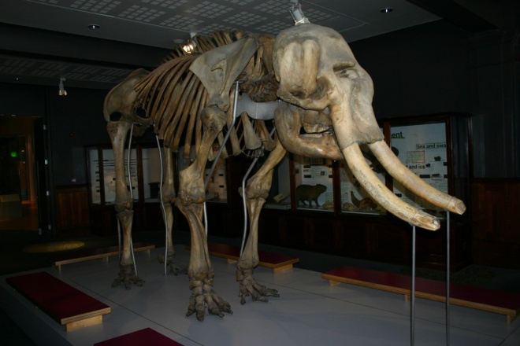
Plenary ~ Summarise what you have learn about fossils with:
Three facts
Three key words
1 question – to test your peers

Slide 14
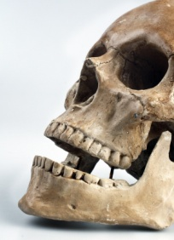
Hard parts of animals may not decay easily. Parts of the animals
such as teeth and bones may be resistant to decay, whereas softer
parts of an organisms – the flesh- will decay quite rapidly in certain
conditions, not leaving behind a trace.
Some parts may not decay because conditions are not suitable. For example, if there is no oxygen present or because poisonous gases kill off the bacteria present. Sometimes the temperature is too low for decay to occur and at times the whole organism can be preserved almost in tact – e.g. in ice or peat.
Many fossils can be formed when harder parts of the animal or plant are replaced by minerals as they decay and become part of the rock.
Traces of an organism may be preserved in rocks. For example, mould fossils are formed when an impression of an organism is made in the mud and then becomes fossilised. Cast fossils are made when the mould is filled in. Fossil footprints, burrows and droppings are examples of trace fossils.
Notes:
Card sort – how fossils can be preserved

Slide 15
Notes:
Card sort – evidence for evolution, cut into strips and give one strip to each student
Images: By André Koehne [GFDL (http://www.gnu.org/copyleft/fdl.html), CC-BY-SA-3.0 (http://creativecommons.org/licenses/by-sa/3.0/) or CC BY-SA 2.5-2.0-1.0 (https://creativecommons.org/licenses/by-sa/2.5-2.0-1.0)], via Wikimedia Commons

