Slide 1
Welcome to Science!
On the front of your book you need…
Your Name . Science . Your Teachers Name .
Notes:
Lower Ability

Slide 2
Every Lesson Expectations
Your planners must be on your desk open to the right week.
You must have the CW underlined in the top left hand corner of your book.
You must have the date and title underlined.
You start your DNA activity straight away.
Mr Sullivan
CW
9th September 2020
Plant and Animal Cells
DNA:
Notes:
Lower Ability

Slide 3
Plant & Animal Cells
Do now activity:
Draw what you think an animal and plant cell looks like I think an animal cell looks like…. I think a plant cell looks like…

Slide 4
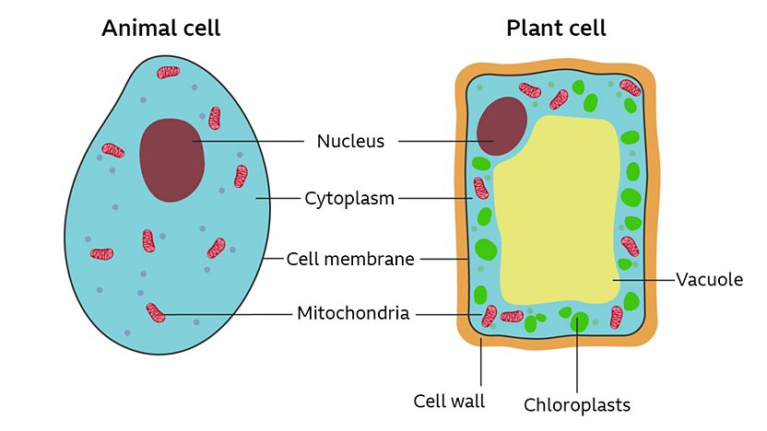
Plant & Animal Cells

Slide 5
Progress indicators
GOOD PROGRESS: Label and Describe the functions of the components of cells
OUTSTANDING PROGRESS: Compare the similarities and differences between animal and plant cells.

Slide 6
Word Consciousness
You should write down the title and make a note of the key word below. Over the course of the year you’ll have created a bank of key words and definitions.
Organelles: Small components that make up cells.

Slide 7
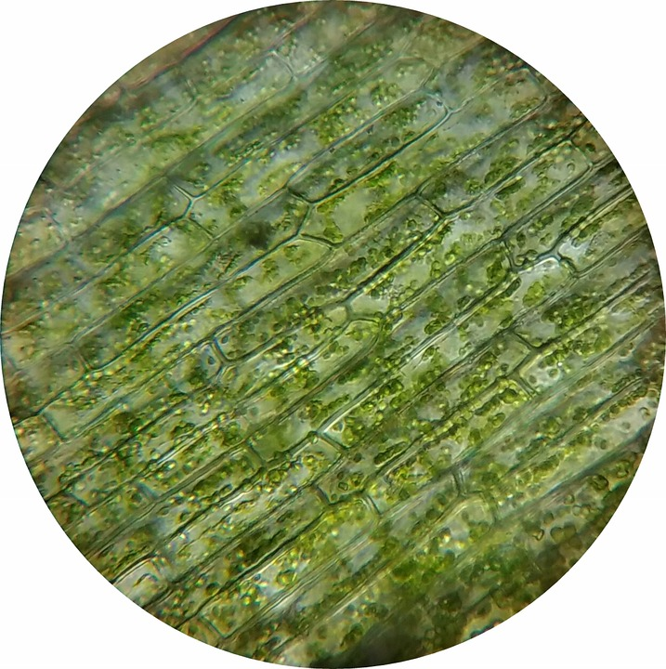
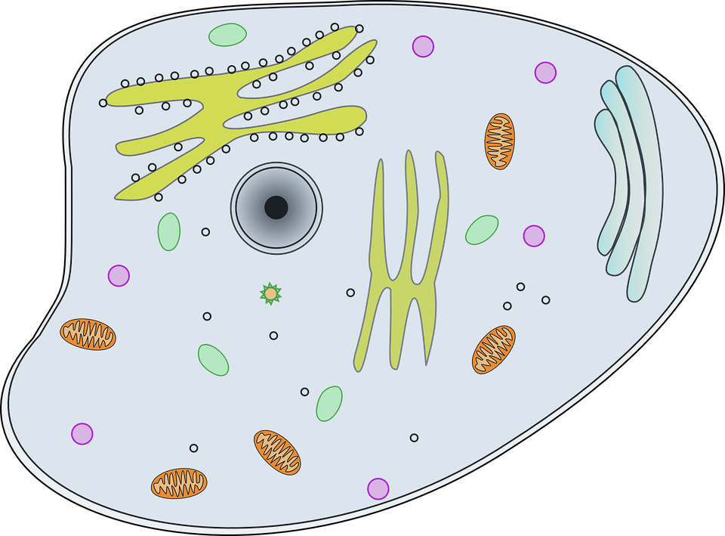
If you look at cells down a microscope you will see that they are made up of lots of smaller components – these smaller structures are called organelles.
Task: Watch the ‘Cells Rap’ and try to name as many organelles as you can!
https://www.youtube.com/watch?v=-zafJKbMPA8

Slide 8
Self-assessment:
Mitochondria
Nucleus
Organelles
Vacuole
Cell Wall
Cytoplasm
Cell membrane
Chloroplast

Slide 9
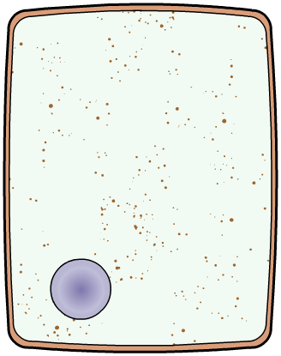
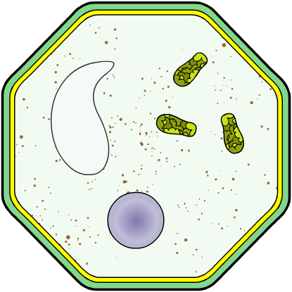
What is a cell?
Animal and plant cells come in different shapes and sizes, but they all have these basic features:
cell membrane
vacuole
mitochondria
chloroplast
cytoplasm
nucleus
Cell wall
animal cell
plant cell
Task: Animal and Plant Cells both have…
Plant Cells have these extra organelles…

Slide 10
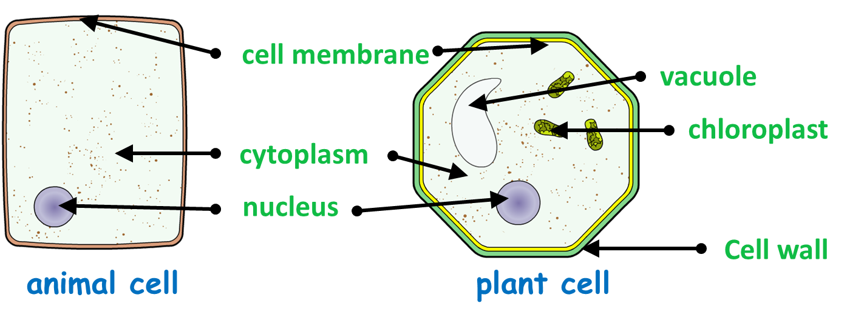
Self-assessment:
Similarities: Both animal and plant cells have a nucleus, cell membrane, cytoplasm and mitochondria.
Differences: Plant cells contain chloroplasts, a cell wall and a vacuole, whereas animal cells do not.

Slide 11
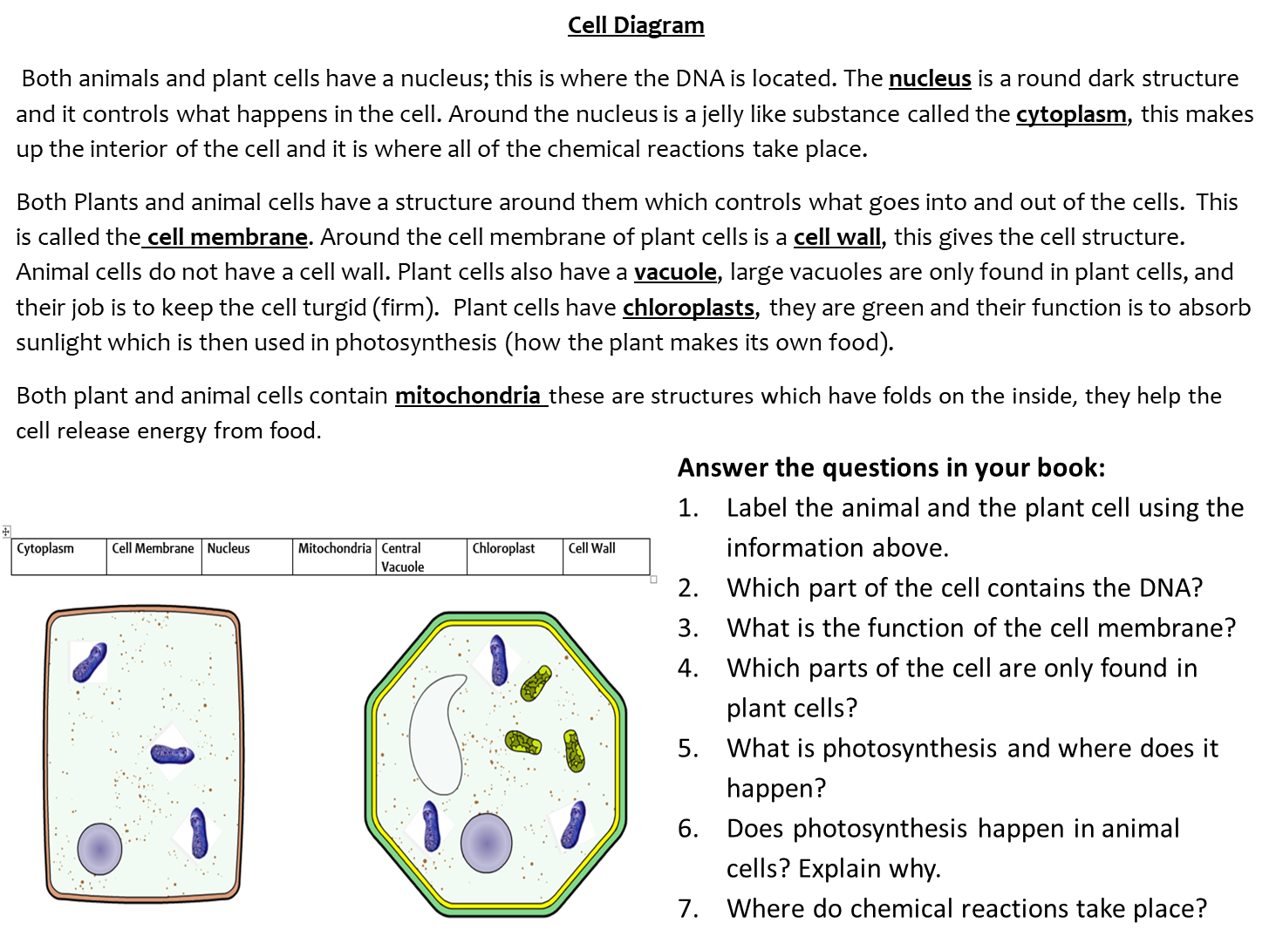
Comprehension Task: Animal & Plant Cells
Task: In pairs, read the information sheet on animal and plant cell structures. Complete the questions in your books.

Slide 12
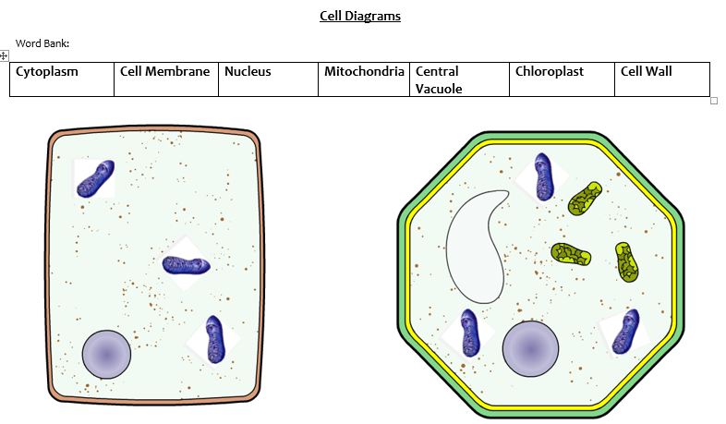
Cell Diagram
Both animals and plant cells have a nucleus; this is where the DNA is located. The nucleus is a round dark structure and it controls what happens in the cell. Around the nucleus is a jelly like substance called the cytoplasm, this makes up the interior of the cell and it is where all of the chemical reactions take place.
Both Plants and animal cells have a structure around them which controls what goes into and out of the cells. This is called the cell membrane. Around the cell membrane of plant cells is a cell wall, this gives the cell structure. Animal cells do not have a cell wall. Plant cells also have a vacuole, large vacuoles are only found in plant cells, and their job is to keep the cell turgid (firm). Plant cells have chloroplasts, they are green and their function is to absorb sunlight which is then used in photosynthesis (how the plant makes its own food).
Both plant and animal cells contain mitochondria these are structures which have folds on the inside, they help the cell release energy from food.
Answer the questions in your book:
Label the animal and the plant cell using the information above.
Which part of the cell contains the DNA?
What is the function of the cell membrane?
Which parts of the cell are only found in plant cells?
What is photosynthesis and where does it happen?
Does photosynthesis happen in animal cells? Explain why.
Where do chemical reactions take place?

Slide 13
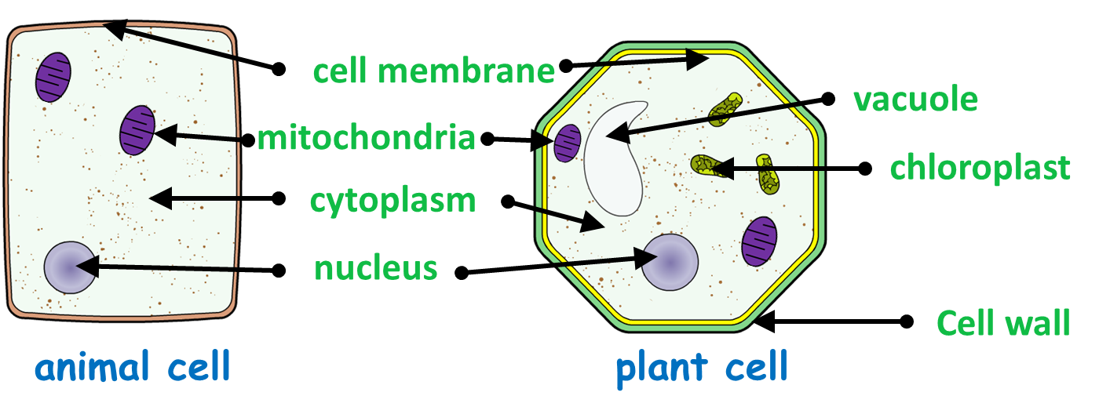
Self-assessment:
1.
2. DNA is found within the nucleus.
3. The cell membrane controls what enters and leaves the cell.
4. Chloroplasts, cell walls and vacuoles are only found in plant cells.
5. Photosynthesis is a process by which plant cells utilize sunlight to synthesis glucose (food), this process occurs in the chloroplasts.
6. Animal cells cannot carry out photosynthesis as these cells do not contain chloroplasts.
7. Chemical reactions take place in the cytoplasm of both animal and plant cells.

Slide 14
Organelle Function
Task: Draw this table in your books, you will each be given a piece of information about one of these cell structures and it’s your job in the cell, walk around the classroom to find out the rest!!
Part name | Function
cell surface membrane
cell wall
chloroplast
cytoplasm
nucleus
vacuole
Mitochondria

Slide 15
Self-assessment:
Part name | Function
cell surface membrane | Controls what enters and leaves the cell.
cell wall | Supports the cell, made of a tough fibre called cellulose which provides rigidity.
chloroplast | Contains chlorophyll which trap energy from the sun, this is used to make food via photosynthesis.
cytoplasm | Where the chemical reactions of the cells take place.
nucleus | This controls the cell and contains genetic material; genetic information is needed to make new cells.
vacuole | This contains cell sap and is used to store substances and keep the cell firm.
Mitochondria | Where respiration takes place, respiration is a reaction that transfers energy for the organism.

Slide 16
Plenary:
One thing I now know that I didn’t know before this lesson is ….
One question I still have is ….

