Slide 1
DNA
Ask a question, make a statement
Radius = 10cm
Notes:
Option 1

Slide 2
Connect
Write a definition for these words and make a sketch in your book
Circumference – Diameter -
Radius - Tangent -
Chord – Segment -
Notes:
Reliant on knowledge of types of number on a dice. Green introduces idea of “or” to stretch students understanding.

Slide 3
Circumference of a Circle
Unit 9 Objective A

Slide 4
Progress Indicators

Slide 5
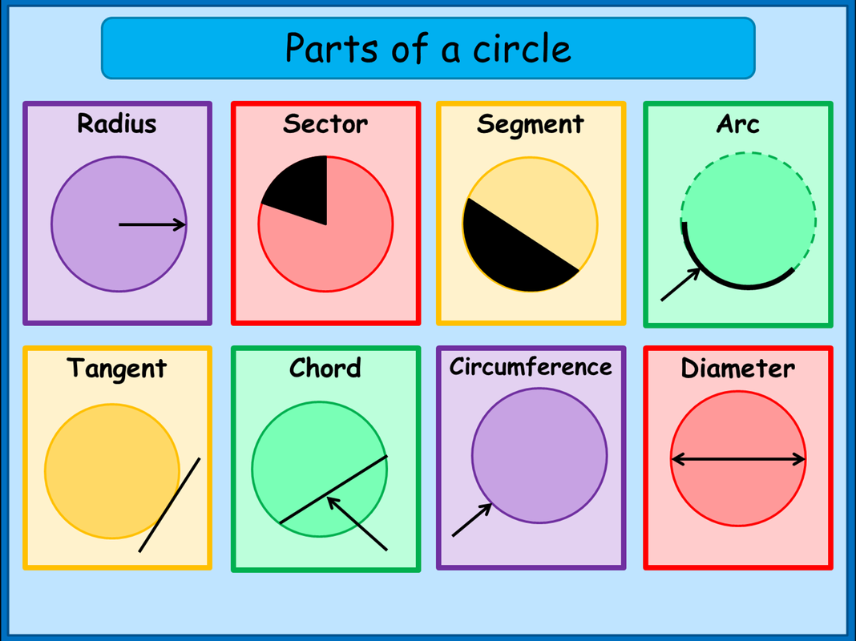
Recap

Slide 6
Formula
Circumference = π x diameter

Slide 7
Calculate the circumference of the circle
I do
We do

Slide 8
Intelligent Practice

Slide 9
Formula
Circumference = π x diameter
What other formula is there?

Slide 10
Formula
Circumference = π x diameter
Circumference = 2 x π x radius

Slide 11
Calculate the circumference of the circle
I do
We do

Slide 12
Intelligent Practice

Slide 13
Stretch Questions

Slide 14
Key Elements (must be included)
DNA
Connect to previous lesson
Main body – including worked examples, intelligent practice and collaborative learning.
Demonstrate

Slide 15
Variation Theory
Google variation theory – you will recognise it from lessons on blackboard you’ve taught previously.
This should be your first port of call for resources for these lessons.
They usually included worked examples, intelligent practice, and sometimes whiteboard activities.

Slide 16
Demonstrate
FIND THE CIRCUMFERENCE

