Slide 1
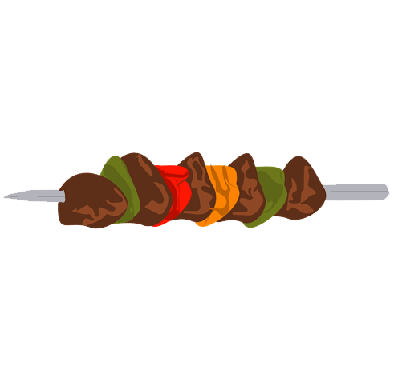
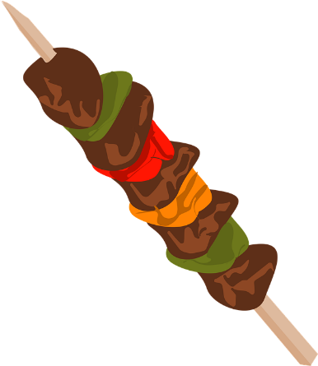
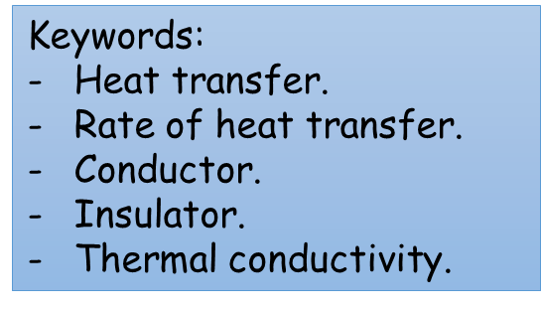
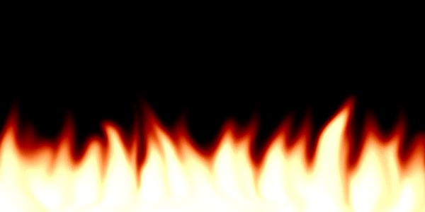
Energy transfer by conduction
Do now activity:
Draw an energy transfer diagram to show what happens when we cook the meat.
Which meat skewer do you think will be cooked first?
Explain your answer.
Notes:
Fire gif - http://www.teachertube.com/photo/14251
Skewer - https://pixabay.com/en/photos/bbq/

Slide 2
Progress indicators
GOOD PROGRESS:
Provide definitions for conductors and insulators.
Relate thermal conductivity to rate of energy transfer.
OUTSTANDING PROGRESS:
Explain ways in which rate of heat transfer can be reduced.

Slide 3
Demo: Observe and explain what you see
THINK – PAIR - SHARE
‘VIDEO LINK’
Notes:
SIMPLE DEMO FOR STARTER
CAN EITHER HAVE SET-UP WHERE IS CLEARLY VISIBLE FOR ALL, USE A VISUALISAR IF POSSIBLE OR USE VIDEO LINK.
PUPILS CAN DICUSS IDEAS OF WHY THE ICE MELTS QUICKLY ON THE METAL OBJECT.
THIS CAN THEN LINK TO WHY METAL FEELS COLD TO TOUCH LATER
ICE CUBE IMAGE - https://pixabay.com/en/ice-cube-transparent-water-cold-576352/

Slide 4
HOT, WARM OR COLD?
It feels warm because it is very slow to conduct the heat from the pan to the wooden handle
HOW WILL THE WOODEN SPOON FEEL TO TOUCH?
WHY?

Slide 5
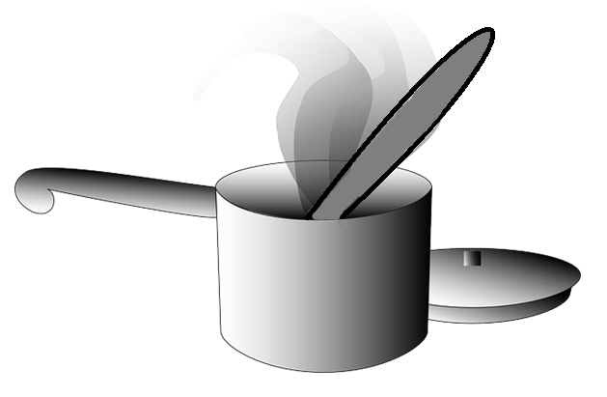
HOT, WARM OR COLD?
It feels hot because it conducts the heat from the hob to the metal handle very quickly.
HOW WILL THE METAL SPOON FEEL TO TOUCH?
WHY?
Notes:
PAN IMAGE - https://pixabay.com/en/photos/cooking%20pot/

Slide 6
HOT, WARM OR COLD?
It feels cold because it conducts the heat from your hand which makes it feel cooler.
WHAT DOES THE METAL LEG OF YOUR CHAIR OR BENCH FEEL LIKE?
WHY?
Notes:
It feels cold because it conducts the heat from your hand which makes it feel cooler.

Slide 7
What do the words ‘thermal’ and ‘conduct’ mean?
Thermal – a term relating to heat/heat energy.
Conduct – means to lead, guide or transmit.
What does the ‘thermal conductivity’ of materials mean?
Thermal conductivity of a material refers to the rate at which it transfers heat energy.
‘The more thermally conductive a material is, the greater the rate at which it will transfer heat energy’

Slide 8
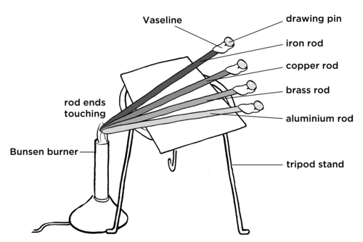
TASK: Which material conducts heat the quickest?
Prediction and theory: Predict what order the pins are going to drop and explain why.
Material | Time taken for pin to drop (s) | Order of conductivity
Glass
Copper
Aluminium
Iron
What was your independent variable?
What was your dependent variable?
What were you control variables for this experiment?
What conclusion can you make from your results?
Provide a scientific explanation for your results.
Notes:
Can be an experiment or a bench demonstration.
Experiment image - http://www.mstworkbooks.co.za/natural-sciences/gr7/gr7-ec-03.html

Slide 9
Self-assessment:
Material | Time taken for pin to drop (s) | Order of conductivity
Glass
Copper
Aluminium
Iron
Different materials/rods
Time taken for pin to drop in seconds
Length of rod, thickness of rod, amount of Vaseline used, size of pin
The…rod is the best conductor, the…rod is the worst conductor.
The…rod is the best conductor because…

Slide 10
TASK: Put in order of thermal conductivity
Glass
Copper
Aluminium
Iron
Air
Gold
Concrete
Brick
Wood
Silver
Material
Silver
Copper
Gold
Aluminium
Iron
Glass
Concrete
Brick
Wood
Air
Thermal Conductivity (W/mK)
406
385
314
205
80
0.81
0.8
0.6
0.12
0.024
MOST
LEAST
Notes:
Pupils do not need to know values for thermal conductivity of different materials or the units for this property but it can help further clarify how varied materials are in thermal conductance. Also can present the opportunity for more detail for interested pupils and explanation of units for very able pupils.

Slide 11
THINK – PAIR - SHARE
What is insulation? Where have you heard this word before?
Insulation means to reduce the amount of energy transfer across a material. Therefore thermal insulation is to reduce the rate of heat energy transfer.
Use your list to identify materials that would make good thermal insulators.
Wood, Brick, air, glass, concrete……………
What do these materials have in common?
They are poor thermal conductors, therefore insulators.
The rate of energy transfer across the material is low.

Slide 12
What factors effect the rate of heat transfer across a material?
HOT
COLD
The rate of energy transfer across a material depends on:
The temperature difference across the material.
The thickness of the material.
The thermal conductivity of the material.

Slide 13
Plenary: Review questions
1) Will an ice cube wrapped in a wool blanket remain frozen for
A – less time than not wrapped
B – same amount of time if not wrapped
C – longer than if wrapped.
2) A tiled floor feels quite cold on bare feet, but carpeted floor at the same temperature feels quite warm – Why?
3) Name a few materials that make good conductors. What type of materials are all of these?
4) Explain what type of material the handle to a pan should be made of.
Tile is better conductor and so conducts heat away from the feet quicker than carpet making them feel cooler.
Copper, Aluminium, Silver, Iron etc…Metals are commonly the best conductors.
A thermal insulator, a material which is a poor thermal conductor – plastics or wood.

