Slide 1
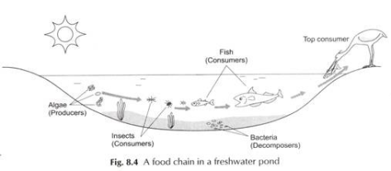
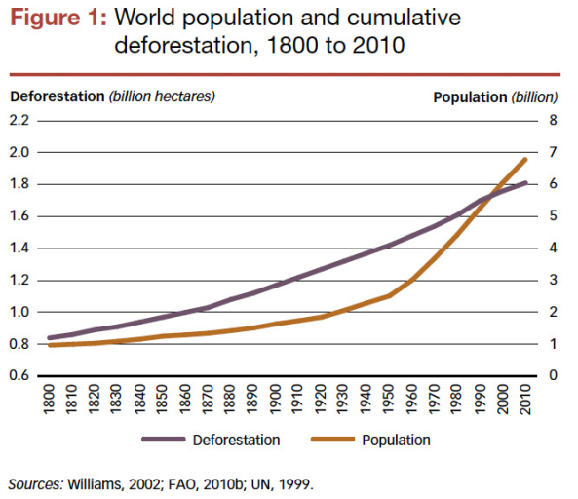
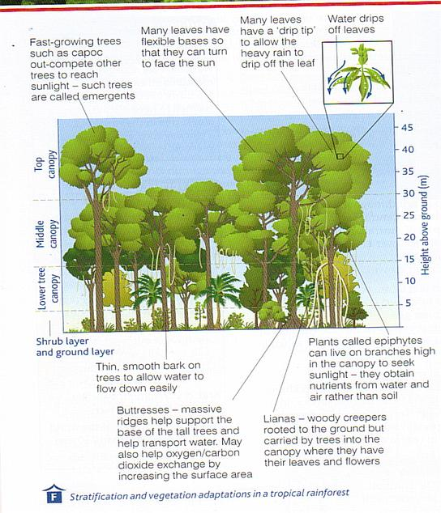
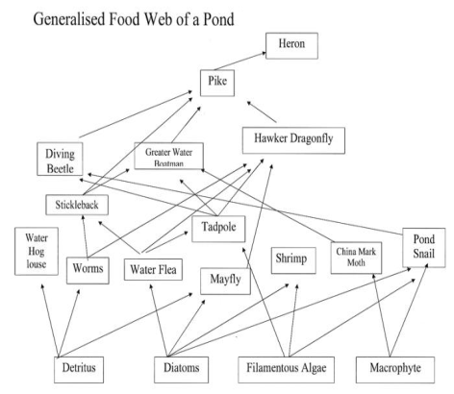
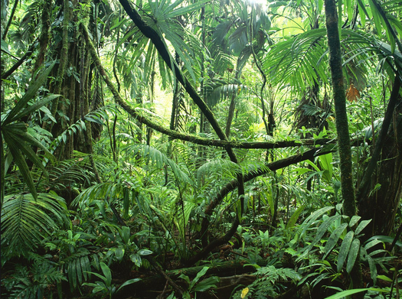
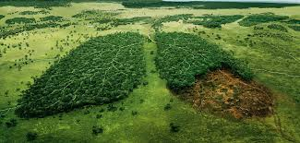
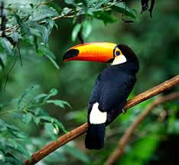
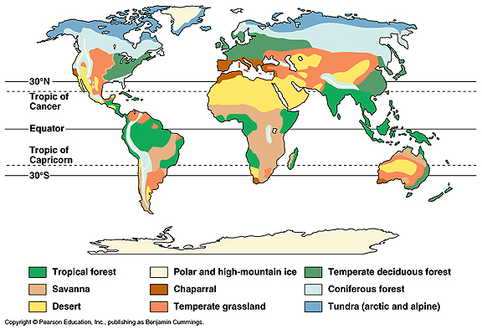
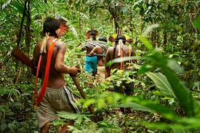
Ecosystems exist at a range of scales and involve the interaction between biotic and abiotic components.
 | Consumer – Creature that eats herbivores and/or plant matter. Decomposer – An organism such as a bacterium or fungus, that breaks down dead tissue, which is then recycled to the environment. Food chain – The connections between different organisms (plants and animals) that rely upon one another as their source of food. Food web – A complex hierarchy of plants and animals relying on each other for food. Nutrient cycling – A set of processes whereby organisms extract minerals necessary for growth from soil or water, before passing them on through the food chain − and ultimately back to the soil and water. Producer – An organism or plant that is able to absorb energy from the sun through photosynthesis.
The balance between components. The impact on the ecosystem of changing one component. Ecosystems are incredibly VULNERABLE to change. Invasive species can out-compete natives, as we have seen with Grey squirrels competing with native British red squirrels. Diseases can be introduced and spread which can cause untold damage, as we are seeing with Ash die back in UK ash trees. Within our pond, an increase in the number of water lilies could starve the bottom of the pond of both light and oxygen; this would impact on bottom feeders which would impact upon fish. Similarly, if someone added predatory fish they would eat smaller fish such as Sticklebacks and even small frogs, which would increase the numbers of slugs and flies normally eaten by the frogs.
Topical Rainforests
Changing rates of deforestation. | The physical characteristics of a tropical rainforest.
Unit 1
Living World
Managing Rainforests - Strategies used to manage the rainforest sustainably
Selective logging and replanting The cutting out of trees that are mature or inferior to encourage the growth of the remaining trees in a forest or wood and replanting any felled trees. | Ecotourism Responsible travel to natural areas that conserves the environment, sustains the well-being of the local people, and may involve education. It is usually carried out in small groups and has minimal impact on the local ecosystem.
There are also international agreements on the uses of tropical hardwoods and logging. The International Tropical Timber Agreement was set up in 2006 to "promote the expansion and diversification of international trade in tropical timber from sustainably managed and legally harvested forests and to promote the sustainable management of tropical timber producing forests". 71 countries have signed up to the agreement sponsored by the United Nations. | Conservation is all about the protection, preservation, management, or restoration of tropical forests and the ecological communities that inhabit them. In this case conservation would seek to manage human use of natural resources in tropical rainforests for sustainable social and economic uses. This includes the Amazon Region Protected Areas Program (ARPA), where the WWF work with the Brazilian government to protect parks covering 150million acres of forest.
Education Ensuring those involved in exploitation and management of the forest understand the consequences behind their actions. | Debt reduction. Countries are relieved of some of their debt in return for protecting their rainforests.

Slide 2
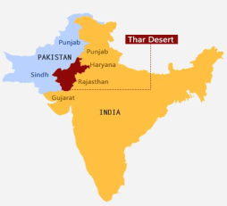
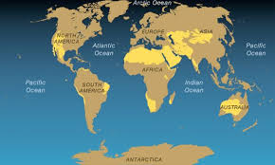
Thar Desert Case study
Background Information: Found in NW India 200,000km2 Population density of 83 per km2
Opportunities Minerals such as Gypsum and limestone for manufacturing – primary and secondary employment – tax base – investment Phosphorene used in fertilizers Tourism – Rajasthan desert festival – attracts tourism – tertiary employment etc… Agriculture – kharif crops such as sorghum and groundnuts – cash crop – trade etc Energy – 75* 800KW turbines in Rajasthan – used to pump water – clean water for 3000 villagers – less cholera. ALSO PUMP WATER FOR IRIGATION DIRECTLY PROVIDES 35 FULL TIME JOBS TO Desert Power India 2050 – 455GW through solar – provide energy – attract industry – shift from primary to sec – tax etc… | Challenges Most densely populated desert 83 per km2 – large water consumption – aquifers drained – drought – less water – dehydration ONLY GETS 100-200MM PER YEAR Gandhi canal used for irrigation – 53 degree heat – evaporates water – leaves salt in soil – soil barren – less crops – desalination. 53 degrees – laying tarmac – likely to melt – in accessible – pressure on public services – likely to collapse. DESERTIFICATION DUE TO WATER ABSTRACTION AND USE OF FUELWOOD
Management of desertification in the Thar Tai Rangeland rehabilitation project – stone walls built – slows surface runoff – causes soil to be deposited – less soil erosion. Water trapped by stone walls is used for irrigation of Atriplex shrubs which reduces water abstraction. National parks – 1992 saw 3000km2 protected under national law – reduces deforestation – less bare soil – less soil erosion Afforestation in Thar desert – sees more Prosopis cineraria trees – binds soil together – less soil erosion – more interception – more infiltration – fills the level of ground water Sand dams – stops the flow of seasonal rivers – causes sediment to build up – water infiltrates – water easily accessible – irrigation – crops etc.. ALSO LINK TO WALKING TO GET WATER IS REDUCED – YOUNG PEOPLE GO TO SCHOOL. Magic stones in– 1m high structures – at base of slope – slows runoff – allows for deposition – less soil erosion – provides 50% more water to crops
Amazon Rainforest Case study
Causes of deforestation Logging – this accounts for 3%. Timber companies are interested in trees such as mahogany and teak and sell them to other countries to make furniture (selective logging). Smaller trees are often used as wood for fuel or made into charcoal. Vast areas of rainforest are cleared in one go (clear felling). Mineral extraction – Some of the minerals that richer countries need are found beneath rainforest. In the Amazon, mining is mainly about gold. In 1999, there were 10, 0000 hectares of land being used for gold mining. Today, the area is over 50,000 hectares. The rainforest suffers badly from this. Energy development – An unlimited supply of water and ideal river conditions have encourage dams to be built to generate hydroelectric power. This involves flooding large areas of rainforest. Commercial Farming: cattle. This accounts for 80% of tropical rainforest destruction in Brazil. However, the land cannot be used for long. Commercial Farming: crops. The forest is being cleared to make way for vast plantations, where crops such as bananas, palm oil, pineapple, sugar cane, tea and coffee are grown. The cultivation of soy bean has also caused a lot of clearance in the Amazon. The amount of rainforest cleared for this crop doubled between 1990 and 2010. Growing sugar cane is a bio fuel beginning to become a major crop. Road building: Roads are needed to bring in equipment and transport products to markets, but road building means cutting great swathes of rainforest. The Trans-Amazonian highway began construction in 1972 and is 4000km long. It has played a major part in opening up remote areas of the Amazon. | Impacts of deforestation Global warming: When trees are felled, more carbon dioxide remains in the air. Also, fire is often used in clearing rainforests, which means that the carbon stored in the wood returns to the atmosphere. Loss of biodiversity Biodiversity will be reduced and individual species will become endangered or extinct. It is estimated that 137 plant, animal and insect species are being lost every day. This amounts to 50,000 species a year. As the species disappear, so do many cures for life threatening diseases. New research shows that parts of the Amazon could lose between 30 and 45% of their species by 2030. Local Impacts Climate change – Deforestation disrupts the water cycle. With the felling of trees, evapotranspiration is reducing so there is less moisture in the atmosphere. The local climate becomes drier. Once the recycling of water is reduced, the local climate becomes warmer. This is bad for farming. Soil erosion and fertility – As soon as any part of the forest cover is cleared, the thin topsoil is quickly removed by heavy rainfall. Bare slopes are particularly prone to soil erosion. Once the top soil has been removed, there is little hope of anything growing again. River pollution – Gold mining not only causes deforestation but the mercury used to separate the gold from the ground is allowed to enter the rivers. Fish are poisoned as well as people living in nearby towns. Decline of indigenous (native) tribes – There are now only around 240 tribes left compared with over 330 in 1900. Many have been forced out due to the construction of roads, logging, and the creation of ranches and the opening of mines.
A desert is an area that receives less than 250mm of rainfall per year. Day to night temperatures can fluctuate dramatically from 50ºC in the day to below 0ºC at night due to the lack of cloud cover Dryness and aridity is the main factor controlling life in the desert. Soils tend to be sandy or stony There is little organic matter (no vegetation to decay) Soils tend to be dry Soils are salty as salts are drawn to the surface as water evaporates The soils are not very fertile, but can be used if they are irrigated
Desertification is a serious issue that affects over 1 billion people around the world. It can have a damaging impact on both people and the natural environment. In 2014 the UN stated that 20million people in the Sahel region of Africa faced huger and required $2 billion in food aid due to desertification. The loss of vegetation can cause severe soil erosion. The nutrients in the soil get washed or leached away leaving soil infertile. The loss of vegetation also means that there has been damage to animal’s habitats. In addition, loss of species affects the availability of local medicines. Population pressure has also stopped people moving animals moving from place to place as they traditionally did and using settled agriculture. This settled agriculture means that people farm too intensively which also drains the soil of its nutrients. This leaves the soil of poor quality where nothing can grow. This leads to regular crop failure. People also draw more water out of the soil for irrigation. Together with the drying of the soil this leaves deposits of salt (Salinisation) and means crops can’t be planted. Lack of food and water can also mean farmed species such as cattle can die of starvation. People have to migrate out of these desertified areas and often end up in shanty towns at the edge of big cities or in refugee camps. Food aid can be flown in but people can become reliant upon this. However, famines do happen and 250,000 people died in the Sahel drought of 1968 to 73. Desertification also means there are less tree cover and more grasses, which protect the soil less.
Causes of desertification – climate change, population growth, removal of fuel wood, overgrazing, over-cultivation and soil erosion

