Slide 1
ENTRANCE DOOR
GCSE PE – YEAR 9

Slide 2
Classification and characteristics of muscle types:
Do Now Activity
Forming the heart
Of the skeletal system
In blood vessels
this is involuntary
striated muscles due to their appearance
we can't make them contract when we think about it.
this is voluntary
It is under the control of the autonomic nervous system
highly resistant to fatigue due to the presence of a large number of mitochondria
not under our conscious control
found in the internal organs
are under our conscious control
found in the walls of hollow organs such as the Stomach
we can move these muscles when we want to
Sometimes known as smooth muscle

Slide 3
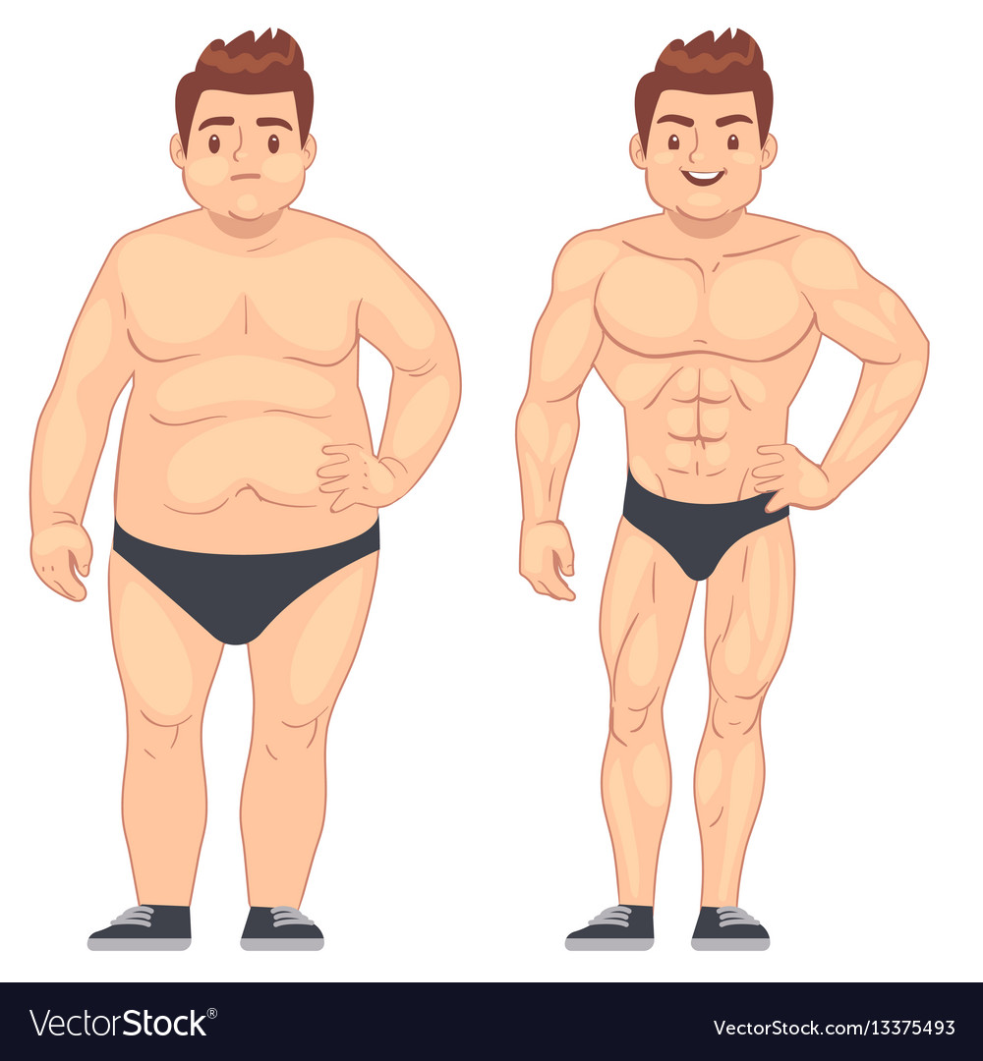
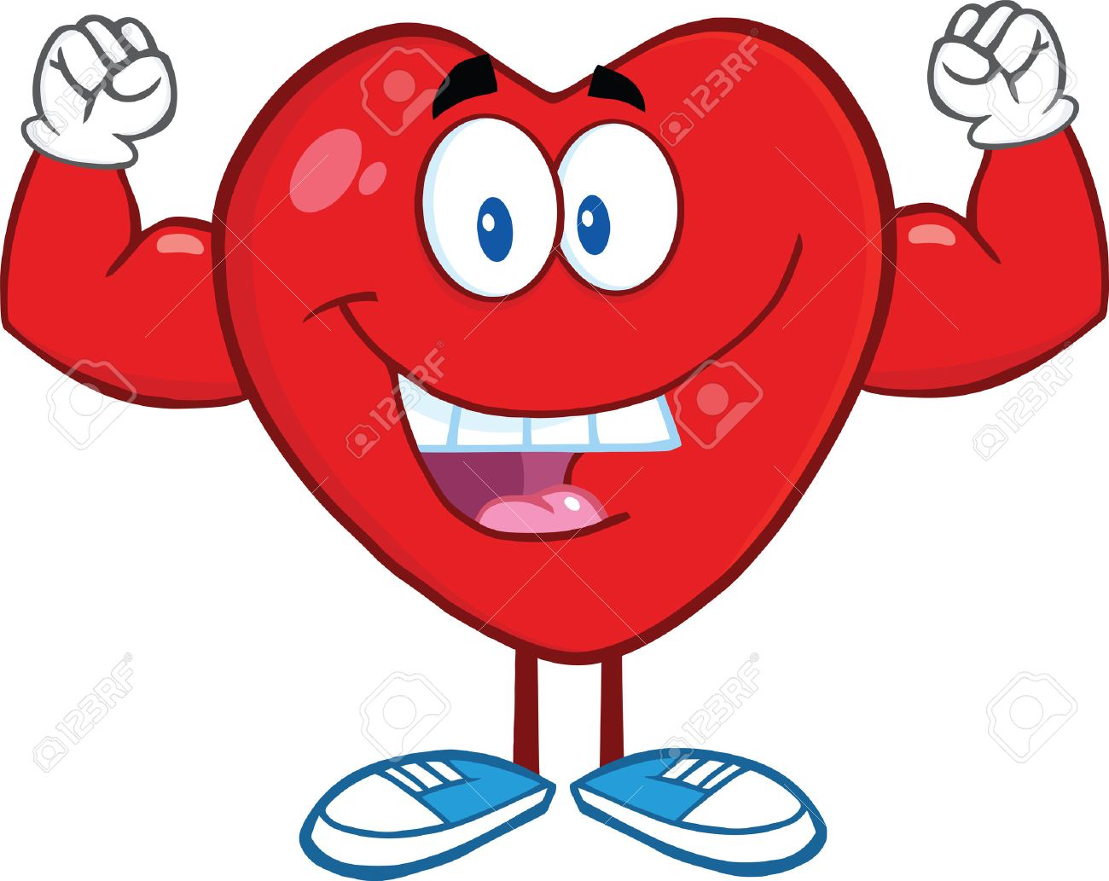
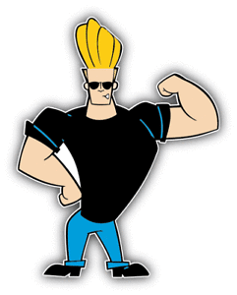
Progress Indicators:
Muscle Classification and Type
Target | Good | Outstanding
3-4 | To know there are 3 classifications of muscles (AO1) | To state the 3 classifications of muscles with some functions (AO1)
5+ | To begin to explain the 3 classifications, structure and functions (AO2) | To explain and describe the 3 classifications, structure and functions and how they help performance (AO3)

Slide 4
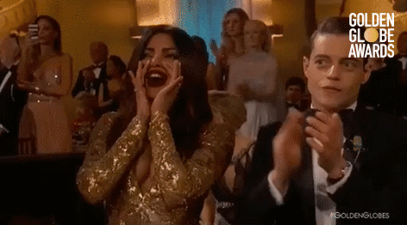
Nyela McDonald– Fab Effort in last weeks GfG lesson

Slide 5
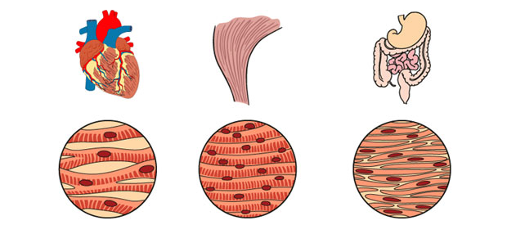
Classifiaction of Muscles and Fibres
 | Good Progress | Outstanding Progress
3-5 | To know the 3 classifications of muscles and begin to know the muscle fibres. | To be able to explain the muscle classifications and state the different types of fibres.
6-9 | To be able to explain with examples the muscle classifications and fibres. | To be able to describe with clear sports examples the different classifications of muscles and fibres.

Slide 6
Classification and characteristics of muscle types:
Do Now Activity
Forming the heart
Of the skeletal system
In blood vessels
this is involuntary
striated muscles due to their appearance
we can't make them contract when we think about it.
this is voluntary
It is under the control of the autonomic nervous system
highly resistant to fatigue due to the presence of a large number of mitochondria
not under our conscious control
found in the internal organs
are under our conscious control
found in the walls of hollow organs such as the Stomach
we can move these muscles when we want to
Sometimes known as smooth muscle

Slide 7
Classification and characteristics of muscle types:
Problem: There are 3 types of muscles make a list of the characteristics of each type using the
1) Voluntary muscles
2) Cardiac muscle
3) Involuntary muscles
In blood vessels
Of the skeletal system
Forming the heart
found in the internal organs
this is voluntary
This is involuntary
It is under the control of the autonomic nervous system
not under our conscious control
are under our conscious control
we can't make them contract when we think about it.
we can move these muscles when we want to
highly resistant to fatigue due to the presence of a large number of mitochondria
Sometimes known as smooth muscle
striated muscles due to their appearance
found in the walls of hollow organs such as the Stomach
FIX IT WITH GREEN PEN!!!

Slide 8
https://www.youtube.com/watch?v=Uxwh2IIg_Z0

Slide 9
Types of Fibres (draw the table ☺)
Use whole page
Slow Twitch | Fast Twitch
Type: ________ | Type: ________ | Type: ________
Characteristics: | Characteristics: | Characteristics:

Slide 10
Types of Fibres
Slow Twitch
Fast Twitch
Type I
Type IIA
Type IIX
Suited to LOW intensity aerobic work.
Marathon running
Long distance running / swimming (they go slow = slow twitch)
Good supply of oxygen.
Darker in colour as contain myoglobin
Can be used for a long period of time without fatiguing
Used ANAEROBIC work
Dynamic and relatively fast paced 30-2min e. 800m & games players who use both
Can be improved through endurance training to increase their resistance to fatigue,
Lighter in colour as not much oxygen
Used ANAEROBIC work
Can generate a much greater force then other Fibre type but fatigue quickly.
Useful in short bursts of exercise e.g. 100 m sprint, shot put, long jump….explosive sports
Speed
Slowest
Quickest
Time
Longest
Shortest

Slide 11
Sports of the Types of Fibres
1) In silence – Name as many sports / Sports skills (e.g. jump shot in basketball) in the correct area below
2) With your FACE PARTNER swap answers – you have 2 min to read what they have done, tick if you think the e.gs are correct.
3) Have your work back – add any more ideas in green pen
Slow
_______Twitch fibre
Marathon running
_______Twitch fibre
Type I
Type IIa
This is because it is a LOW intensity aerobic work which needs a good supply of oxygen to complete the sport
Type IIX
_______Twitch fibre
 | Good Progress | Outstanding Progress
3-5 | To know the 3 classifications of muscles and begin to know the muscle fibres. | To be able to explain the muscle classifications and state the different types of fibres.
6-9 | To be able to explain with examples the muscle classifications and fibres. | To be able to describe with clear sports examples the different classifications of muscles and fibres.

Slide 12
Sports of the Types of Fibres
_______Twitch fibre
_______Twitch fibre
Type I
Type IIa
Type IIX
_______Twitch fibre

Slide 13
Types of Muscles and Fibres
 | Good Progress | Outstanding Progress
3-5 | To know the 3 classifications of muscles and begin to know the muscle fibres. | To be able to explain the muscle classifications and state the different types of fibres.
6-9 | To be able to explain with examples the muscle classifications and fibres. | To be able to describe with clear sports examples the different classifications of muscles and fibres.
I am able to …..

Slide 14
15 minutes
Write this in BIG across your page
Demonstrate:
How does the skeletal and muscular system work together to allow participation in physical activity and sport (9)
(Use your books to help you)
AO1
Appropriate technical language (key words)
Impact on performance
Complete
Define
Select
Identify
Label
State
AO2
Which – using an example
Application of knowledge on how it effects performance
Clarify
Describe
Give
Linked
Applied
AO3
Analyse how it effects performance
Detailed E.G justifying
Discuss
Assess
Analyse
Examine
Explain
Justify

Slide 15
Question: How does the skeleton and muscular system work together to allow participation in physical activity and sport

Slide 16
Success criteria:
Answer shows some ways in how the skeletal system and muscular system work together. The answer identifies links, however, examples may be limited or non specific.
Example would be..
The muscles are attached to bone this causes movement…..
The answer shows greater description and gives many examples to how is helps performance in physical activity.
Example would be….
One of the functions of the skeletal system is to help movement, movement occurs by muscles being attached to bones by tendons, when the muscle contracts it pulls the bone…..
The answer shows detailed answer discussing many ways that both systems work together.
Example would be….
Another way we can examine how both systems work together, is to look at movement. The skeletal systems has many functions, movement is one. Bones are connected together by ligaments theses keep joints stable. Bones can only moved if they are pulled, this occurs from muscles contracting. Muscle are connected to bone through tendons, then muscles contract or relax to help movement; an example is a bicep curl, when the bicep contracts it pulls the lower arm upwards, to do this the triceps must relax these are called antagonistic pairs….
This would be 2 marks alone.
This alone would get no marks
This alone would get 1 mark

Slide 17
Question: How does the skeleton and muscular system work together to allow participation in physical activity and sport (9)
Use your notes from task one now to make a long 9 mark answer
You have 15 min to do this in silence – use you book for help too
How we assess you!
AO1
Appropriate technical language (key words)
Impact on performance
Complete
Define
Select
Identify
Label
State
AO2
Which – using an example
Application of knowledge on how it effects performance
Clarify
Describe
Give
Linked
Applied
AO3
Analyse how it effects performance
Detailed E.G justifying
Discuss
Assess
Analyse
Examine
Explain
Justify
Good Progress | Outstanding Progress
To state and identify key components that help the skeleton and muscles work together (AO1) | To begin to explain why they have an impact on performance (AO1)
To be able to explain with examples how the skeleton and muscles help effect performance | To be able to discus and analyse with clear sports examples how the skeleton and muscles help effect performance justifying the need for it

Slide 18
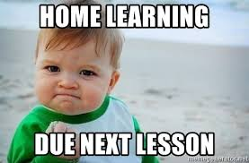
Home learning:
Complete the movement analysis worksheet..

Slide 19
To Print…

Slide 20
Classification and characteristics of muscle types:
Problem:
There are 3 types of muscles make a list of the characteristics of each type using the
1) Voluntary muscles
2) Cardiac muscle
3) Involuntary muscles

Slide 21
Sports of the Types of Fibres
_______Twitch fibre
_______Twitch fibre
Type I
Type IIa
Type IIX
_______Twitch fibre

Slide 22
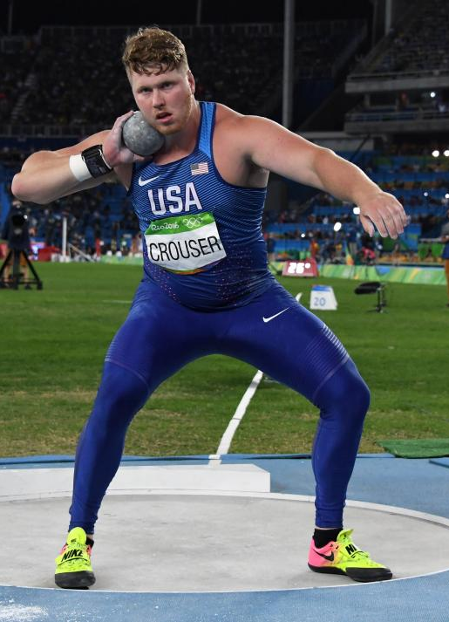
Name: …………………………………. In pairs explain this movement using ALL the information we have done on muscles so far
Home Learning
These muscles are needed because
1) Voluntary muscles
This athlete would have mainly _________ twitch fibres because
2) Cardiac muscle
3) Involuntary muscles
Today:
Type of muscle
Type of muscle fibres
Previous learning:
Location of muscles
Muscle jobs
Antagonistic pairs
Extension –add previous learning too

Slide 23
Name: …………………………………. In pairs explain this movement using ALL the information we have done on muscles so far
Home Learning
These muscles are needed because
1) Voluntary muscles
This athlete would have mainly _________ twitch fibres because
2) Cardiac muscle
3) Involuntary muscles
Today:
Type of muscle
Type of muscle fibres
Previous learning:
Location of muscles
Muscle jobs
Antagonistic pairs
Extension –add previous learning too

