Slide 1
Forces
Wednesday, 01 July 2020
Do Now Activity:
Calculate the pressure of a piston with an area of 0.08m² exerting a force of 200N.
Calculate the pressure due to sea water with a density of 1,025kg/m³ At a depth of 15m. Use g as 10N/kg.
Calculate the depth a fish was at in the sea experiencing 65,500Pa.

Slide 2
Self Assess
p = F/A 3. h = p / ρ x g
p = 200 / 0.08 h = 65,500 / (1,025 x 10)
p = 2,500Pa h = 6.4m
2. p = h x ρ x g
p = 15 x 1,025 x 10
p = 153,750Pa

Slide 3
Progress Indicators
Good Progress
Describe a simple model of the Earth's atmosphere
Outstanding Progress
Explain why atmospheric pressure varies with height above a surface

Slide 4
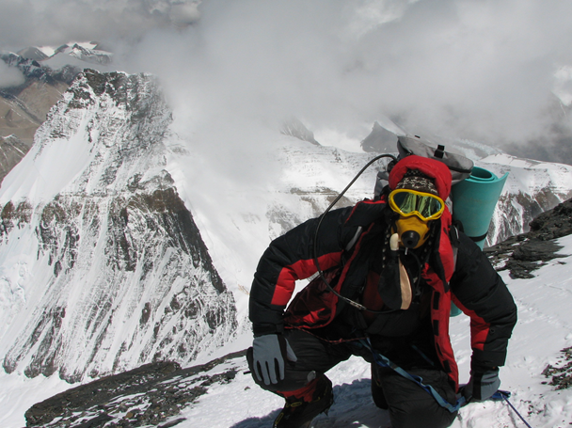
Climbing Everest
75 people have died trying to reach the top of Mount Everest. What difficulties do they face apart from the cold?

Slide 5
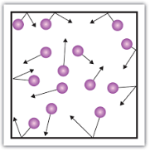
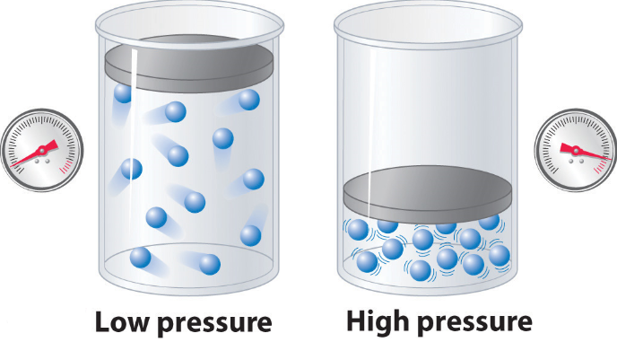
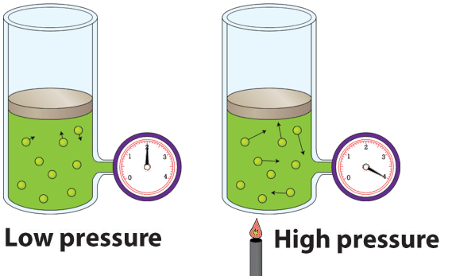
What we need to remember
Gas pressure is the force of the gas particles colliding with the walls of the container.
The pressure will increase if you decrease the volume.
The pressure will increase if you increase the temperature.

Slide 6
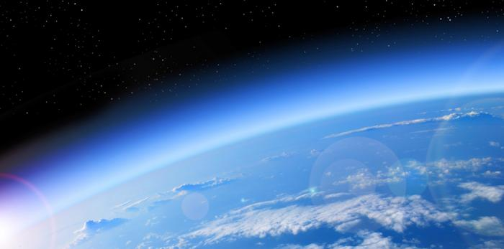
The Earth’s Atmosphere
The Earth’s atmosphere is a thin layer of air round the Earth.
It exerts a pressure of 100kPa at sea level. This means the force on each square meter of ground is about 100,000N.
Don’t forget unit
conversions…
1kPa = 1000Pa
kPa is kilopascal

Slide 7
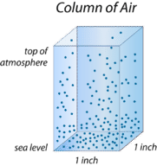
Atmospheric pressure is due to air molecules colliding with a surface.
The earth’s atmosphere rises more than 100km from the surface. The pressure decreases the further into space you go.

Slide 8
Gravity pulls the atmosphere toward Earth, creating air pressure.
The higher you go in the atmosphere, the less dense the air and the lower the pressure.

Slide 9
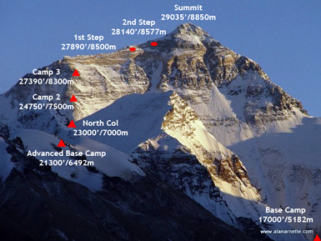
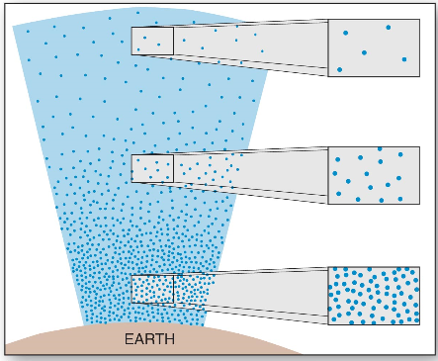

Slide 10
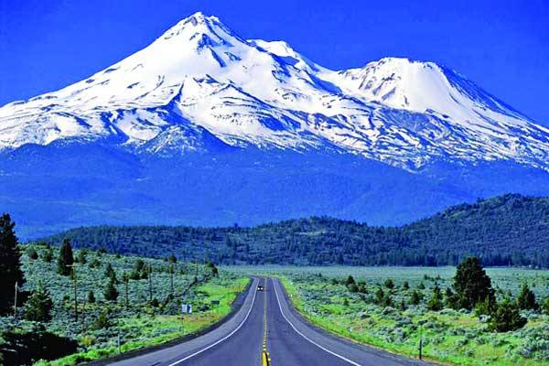
Atmospheric Vs Altitude
As height increases the atmospheric pressure decreases.
Top of
Mount Everest
8848m
30kPa
Sea Level
0m
100kPa

Slide 11
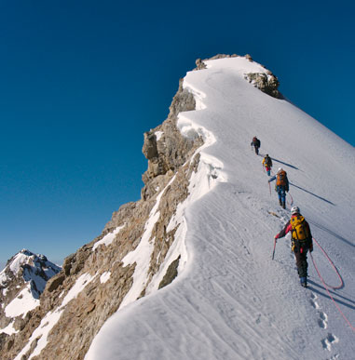
As gas is a fluid, like liquid, we can use the same equation on the Physics equation sheet to calculate air pressure.

Slide 12
Plenary
1. What is the atmosphere and how does it change with altitude?
2. What causes atmospheric pressure? Calculate the density of the atmosphere at an altitude of 10km with a pressure of 25kPa. Use g as 9.81N/kg.
3. Each window of an aeroplane has an area of 0.05m². The cabin pressure is 80kPa, but the air pressure outside is 30kPa. Calculate the force on each window due to this pressure difference.

