Slide 1

AQA English Language Paper 1 Section B/Question 5
In Section B or Question 5 you’re asking to create a piece of fiction writing.
You’ll be given a choice of two writing tasks (only answer one!)
You might be asked to write narrative fiction (a story) or descriptive fiction (a detailed description).
However, you might only be given a choice of two narrative tasks or two descriptive tasks, so it is best to be prepared for both!
Here are the kinds of questions you’ll get:
Write a description of something as suggested by a picture
Write a story about something
Write a story that begins with the sentence…
Describe something...
Write a story about… as suggested by this picture.

Slide 2

A magazine has asked for new contributors to their fiction writing section.
Either
Write a description of a holiday as suggested by this picture:
or
Write a story about a time when something changed dramatically.
(24 marks for content and organisation 16 marks for technical accuracy) [40 marks]

Slide 3

Write a description of a holiday as suggested by this picture:
Step 1: Identify what type of writing you’re being asked to make
When you read this task, a few alarms should be going off in your head. Firstly, it’s asking for a description, not a story (narrative writing).
Secondly, it asks you to focus on a holiday, so that’s what you’ll be describing.
Finally, it mentions about creating a description suggested by this picture. This means you can use the picture for inspiration or ideas.
Step 2: Zoom in on the picture and select at least five key areas to describe
You could literally draw circles on your exam picture to help you remember!

Slide 4
These clouds seem dark, sinister, almost shaped like razors
The colours of the cloud here seem to be reflecting or hinting at the sun hidden away
Palm trees that seem to be moving in the wind
Is that someone standing on the beach? They appear to be totally alone.
Huts for holidaymakers seem abandoned
A tiny dot in the distance could be a boat or a rock in the water
The sea looks relatively calm at the moment, but could this change?
Footprints on the sand

Slide 5





Step 3: Think about the tone or sound of writing you want to create
Is this going to be a happy holiday? Is this going to be a terrible experience? Will it start off fantastic but end miserably?
If you look at the original picture the colours seem to suggest a mixture of a calm and relaxing holiday (palm trees, huts, beautiful sands), but the clouds and the hidden sun suggest a storm is on the way, so there is an undercurrent of tension. A combination of these two tones would make for a brilliant description!

Slide 6



Vocabulary
Really impressive vocabulary choices chosen for effect
The choice of vocabulary makes the writing interesting and engaging for the reader.
Ideas
Structure
Complex, detailed ideas with specific examples used to develop them and make them relevant for the reader.
Wide-ranging ideas that cover multiple areas within an idea and avoids repetition.
Step 4: Planning
Every teacher will tell you to plan your answer to Section B/Question 5. Even though examiners don’t actually ‘mark’ your plans, they’ll notice them and they’ll see your plans coming through in the organisation and structure of your work.
You can plan in any way you like:
Mind maps
Paragraph plans
Diagrams, graphs, charts, etc
Lists of ideas
Flows from one idea or argument to the next
Engaging opening to the writing.
Powerful finish to the writing.
A carefully chosen and crafted order of ideas including within paragraphs and sentences.
Use of discourse markers/connectives to link complex ideas.
Communication
Paragraphs
Your ideas clear and makes sense to the reader.
You sound confident in the way you write
The writing is engaging and genuinely interesting for the reader.
The writing has a distinctive voice that flows and feels natural not robotic.
Paragraphs are linked together and in an order that engages the reader and makes their argument easy to follow.
Paragraphs allow the structure of the piece to come through to the reader easily.
Tone, style, register
The tone (sound of writing) is confident and changes dependent on the point being made.
The writing is appropriately formal or informal (register).
The pace (speed) of the writing changes depending on the point being made.

Slide 7

Here’s an example plan. Master planning and you master writing!
Introduction: Describe how the holiday has been so far: peaceful, calm, relaxed.
Topic 2: Zoom in on sand and footprints. Zoom in on palm trees and colours.
Topic 3: Zoom in on huts and describe memories of holiday.
Topic 4: Zoom in on person on beach – that’s me. Switch to sinister tone – zoom in on the darker clouds.
Topic 5: Zoom in on choppy waters, switch to empty huts, palm trees moving more wildly.
Topic 6/Conclusion: Zoom back to man on beach – zoom in on eyes on face. End with description of a tear on face.

Slide 8
















Beginnings
Step 5: Beginnings and Endings
Imagine you’re an examiner. You’re marking hundreds and hundreds of exam papers and answers. A student needs something different, something catchy and something engaging at the very beginning at a piece of writing, whether it’s descriptive or narrative.
Plan your first sentence and your last sentence as part of your overall plan.
A puzzle! Hook your reader in with something that isn’t clear at the beginning, perhaps something unusual has happened?
Direct address. Talk directly to your readers as a way of engaging them.
Visual hook. Use a powerful image or description to engage the reader at the start.
Amusing hook. Use a joke to establish a comedic tone at the beginning of your text.
Dialogue. Have characters talking to each other right from the beginning to establish characters and relationships.
Endings
Subtle hook. Hint at what is going to happen in the rest of the text/chapter.
Cyclical ending: where the ending returns back to the beginning of the narrative.
Atmospheric hook. Use your descriptive language to build up a particular tone and atmosphere right at the very beginning.
Plot twist: a complete change in direction from where the narrative was going.
Uncertain ending: an end which is unclear to the reader – they have to think about it what it means
Converging storylines: where two or more different storylines combine together at the end
Deus ex machina (Latin for ‘God within the machine’): where a seemingly unsolvable problem is resolved thanks to the introduction of a new character, place or object.
Tying up loose ends: where all the different strands of a plot are brought together and completed
Happy ending: a joyful celebration at the end
Sad ending: a very negative and possibly tragic finish
Epiphany: a sudden moment of realisation or a sudden idea or emotional change.

Slide 9

First sentence
It was as if the world was encompassed in glass.
Final sentences
I feel the cold sting of a lone tear roll down my aching cheek. What have I done?

Slide 10
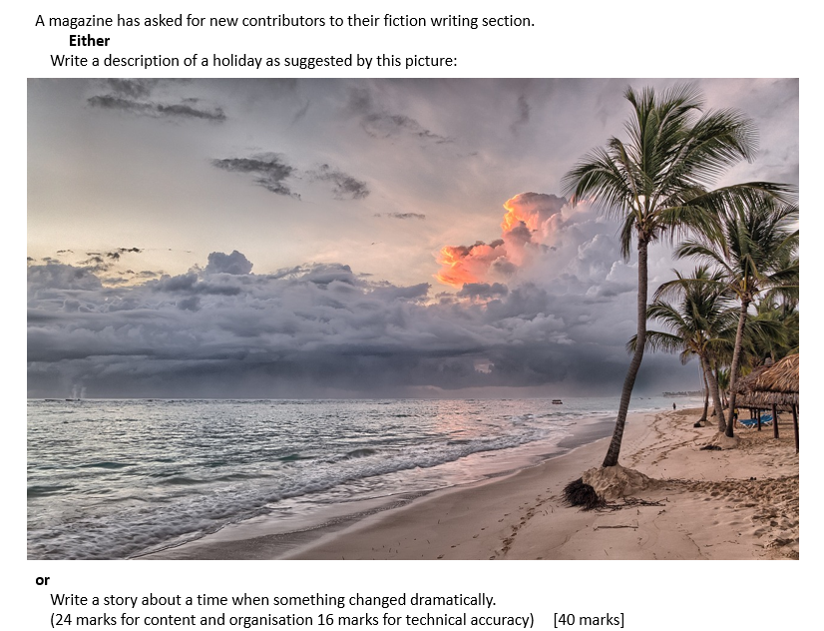
Now, give this a go yourself.
Go through all the steps we’ve looked at and plan out your answer carefully.
If you want to really make it like the exam, time yourself for 45 minutes (allow for any extra time if you are given it).
Remember to think about all the different requirements of the mark scheme.

