Slide 1
Human Lifespan Development
Lesson Objectives
To identify self image and self esteem.
To explain the difference between self image and self esteem.
To identify peer pressure and connect moral development with peer pressure.
Watch an episode of The Simpsons and given an example of where you noticed peer pressure occurring.

Slide 2
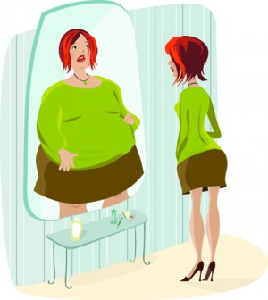
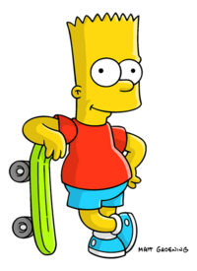
Do Now Activity
What do you see?

Slide 3
Progress Indicators
GOOD OUTSTANDING
You have been able to explain the difference between self image and self esteem.
You have shown a detailed understanding of peer pressure and how this affects your intellectual development.

Slide 4
Emotional Development
I’m fat
Self Image
This is how you see yourself OR how they think others see them.
Self Esteem
This is how much a person values their skills and abilities.
I’m unattractive

Slide 5
Main Task
Class discussion….. This is the image you will see and the REAL image is…

Slide 6
Main Task
What is peer pressure?
Peer pressure is when you are influenced from members of one's peer group… this can be a positive or a negative thing…
https://www.youtube.com/watch?v=a6_8zBcm7xk
https://www.youtube.com/watch?v=R3LV5oZPof4

Slide 7
Intellectual Development
Mini Task:
Sometimes a teenager may find it difficult to understand the consequences of their actions. … Read the scenario you have been given and write down:
What the person has been peer pressured to do…
What the consequences are…
Is this a positive or a negative scenario?

Slide 8
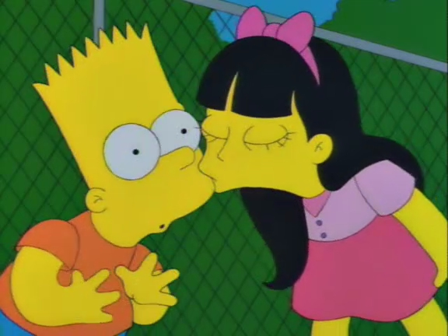
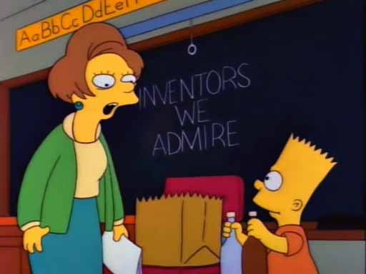
Plenary Task
2.
Identify different
types of relationships.
Match Bart’s relationships
to their titles…
Informal relationship
Friendships
Formal relationships
Intimate relationships
1.
3.
4.

Slide 9
Plenary Task
2.
(answers)
2. Informal
relationship
1. Friendships
4. Formal relationships
3. Intimate
relationships
1.
3.
4.

