Slide 1
1. What do you need in small amounts to keep healthy? | 2. Which food group helps with normal digestion and excretion?
3. Describe the role of protein in the body. | 4. Describe the role of lipids in the body.
Vitamins and minerals
Fibre
Repair body tissues and growth of new cells.
Energy source, provide insulation and protect organs from damage.

Slide 2
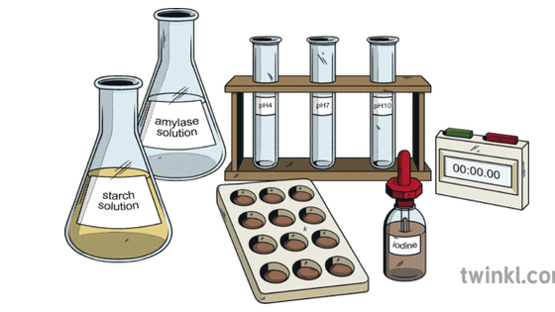
FOOD TESTS
GOOD PROGRESS
Name each food test, what they test for and their colour changes.
OUTSTANDING PROGRESS
Describe the errors and risks of the practical
Interpret a set of results to identify the nutrients present in a food
WORD CONSCIOUSNESS
Starch – A carbohydrate occurring widely in plant tissue such as in cereals and potatoes
Lipid – Compounds of fatty acids including butter and oil
Protein – Long chain of amino acids. Meat, cheese, fish and eggs contain a lot of protein
Sugar – Sweet-tasting carbohydrates found in living tissues such as sugar cane

Slide 3
context
LAST LESSON
NUTRIENTS
THIS LESSON
FOOD TESTS
NEXT LESSON
UNHEALTHY DIET
WHY ARE WE STUDYING FOOD TESTS REQUIRED PRACTICAL?
In the Foundation Combined Science (Trilogy) course this is 1 out of 12 required practicals you are expected to be familiar with for Paper 1.

Slide 4
CARRY OUT FOOD TESTS RP
Food Tests - GCSE Science Required Practical

Slide 5
Colourless → Cloudy (Milky)
Test for starch
Benedict’s solution
Test for lipids
Iodine solution.
Brown → Blue / black
Test for protein
Biuret solution
Blue → Brick red
Test for sugars
Ethanol
Blue → Purple
Notes:
Print

Slide 6
Colourless → Cloudy (Milky)
Test for starch
Benedict’s solution
Test for lipids
Iodine solution.
Brown → Blue / black
Test for protein
Biuret solution
Blue → Brick red
Test for sugars
Ethanol
Blue → Purple
Notes:
Print – Draw lines or colour code to match the component being tested to the method and colour change

Slide 7
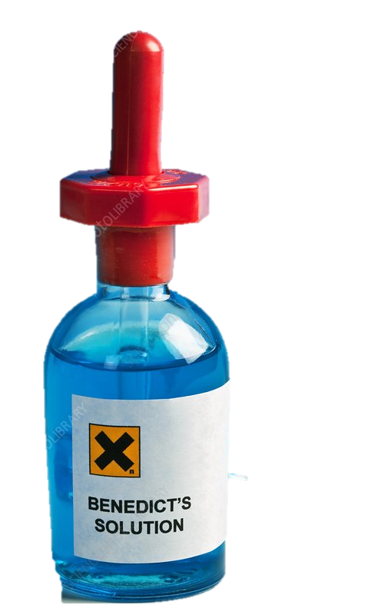
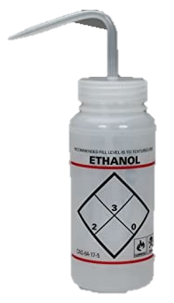
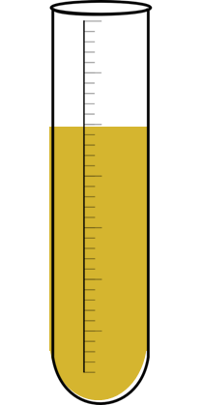
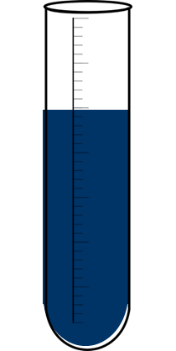
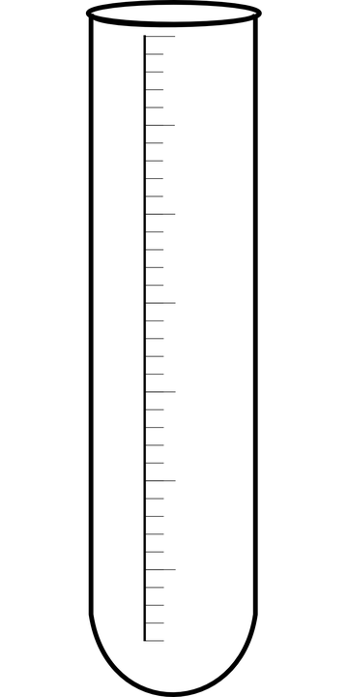
BENEDICT’S SOLUTION = Brick-red precipitate: Positive result showing the presence of glucose (sugar)
BIURET REAGENT = Purple/violet colour: Positive result showing the presence of protein
IODINE SOLUTION = Blue/black colour: Positive result showing the presence of starch
ETHANOL = Milky emulsion: Positive result showing the presence of lipids (fats)

Slide 8
ACTIVITY
Put the information you have into a table.
Test for… | Reagent | Colour change

Slide 9
ANSWERS
Test for… | Reagent | Colour change
Starch | Iodine solution | Brown → Blue / Black
Lipids | Ethanol | Colourless → Milky
Protein | Biuret solution | Blue → Purple
Sugars | Benedict’s solution | Blue → Brick red

Slide 10
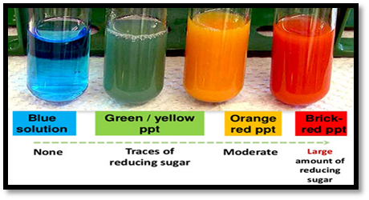
QUESTION
Explain what each colour indicates about the food
Blue = No glucose
Green = Small amount of glucose
Orange = Moderate/median amount of glucose
Brick red = Large amount of glucose

Slide 11
QUESTION
Provide 3 possible errors which may have caused anomalous results. E.g. The water bath may not have been at 80°C therefore the colour change may not have occurred
Examples of possible errors:
- incorrect volume/amount of sample used
incorrect volume/amount of reagent used
incorrect length of time left in water bath
human error when interpreting colour change
food colourings in food mask colour changes

Slide 12
EXAM STYLE QUESTIONS
List two risks associated with this investigation. [2]
This experiment required you to measure very small volumes of reagents. Suggest an appropriate piece of equipment you can use to measure very small volumes precisely. [1]
A student tested three foods using qualitative food tests. The results are shown in the table.
For each of the food samples, list all the nutrients that are present.
Food sample A. [1]
Food sample B. [1]
Food sample C. [1]
Food sample | Observations
 | Starch test | Glucose test | Protein test | Lipid test
A | Brown | Blue | Purple | Milky white
B | Black | Tomato red | Blue | Colourless
C | Brown | Tomato red | Purple | Colourless

Slide 13
ANSWERS
List two risks associated with this investigation. [2]
Any two of the following:
Ethanol is flammable and could catch fire
Reagents could get into eyes or skin
Boiling water could cause burns
People could have food allergies
2. This experiment required you to measure very small volumes of reagents. Suggest an appropriate piece of equipment you can use to measure very small volumes precisely. [1]
Pipette or syringe
3. A student tested three foods using qualitative food tests. The results are shown in the table….
For each of the food samples, list all the nutrients that are present.
Food sample A. [1] Protein and lipid
Food sample B. [1] Starch and glucose
Food sample C. [1] Glucose and protein

Slide 14
Plenary: Who want to be a millionaire

Slide 15
£100
1. Which of these is a nutrient in our food?
A:
Carbohydrate
B:
Fertiliser
C:
Indicator
D:
Alkali

Slide 16
£300
2. Which of these tests for starch?
A:
Ethanol
B:
Benedict’s
C:
Iodine
D:
Biuret

Slide 17
£1000
3. What colour change would you expect
to see if a food contained protein?
A:
Blue
B:
Purple
C:
Red
D:
Black

Slide 18
£4000
4. How would you test for fats?
A:
Using ethanol
B:
Using biuret
C:
Using iodine
D:
Using Benedict’s

Slide 19
£16,000
5. What colour would you see if a substance
didn’t contain sugar?
A:
Red
B:
Blue
C:
Orange
D:
Green

Slide 20
£64,000
6. What does Biuret test for?
A:
Proteins
B:
Fats
C:
Carbohydrates
D:
Glucose (sugar)

Slide 21
£250,000
7. What does iodine test for?
A:
Glucose (sugar)
B:
Fats
C:
Carbohydrates
D:
Starch

Slide 22
£1 million
8. How do you test for glucose (sugar)?
A:
Add Benedicts’
B:
Add biuret
C:
Add Benedict's and heat
D:
Add Proteins

Slide 23
HOMEWORK

