Slide 1
Lesson Twenty Four
C/W Date
Lesson Title: I am the Hound
Lesson Focus: - Make a personal response to text and provide some textual reference in support

Slide 2
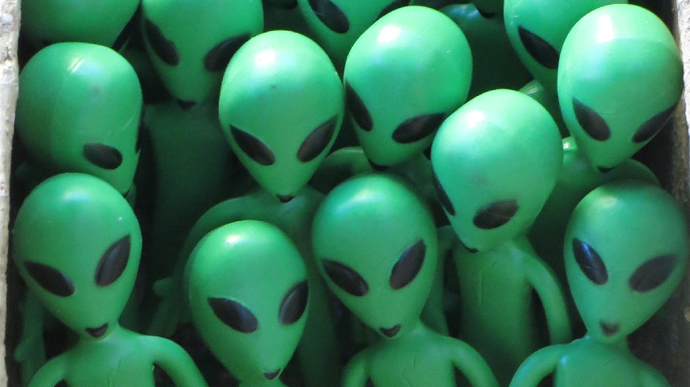
DNA – imagine the person next to you is an alien, you must explain to them what a kenning is. ​

Slide 3
Task - Word Consciousness
1) Please copy this out. If you are using your exercise book, this should be in the back.
2) Please complete this column by putting the definitions into your own words AND coming up with synonyms*. You saw and copied an example of how to do this in lesson 1.
*synonym means alternative words
Word and definition | Your definition or synonyms
Evaluate (verb). To form an idea of the value of or performance of something or someone; assess.
Coherence - (noun) Being logical and consistent.
Cohesion - (noun) the action or fact of being a united whole.

Slide 4
Learning Journey
You now understand the differences between the narrative voices.
. You can apply the correct narrative to your writing about the Hound.
You will be able to discuss this in your GCSE responses and use the correct voice in your creative writing.

Slide 5
Continuing…
LAST LESSON YOU STARTED TO WRITE USING 1ST, 2ND, OR 3RD NARRATIVE FOR THE HOUND OF THE BASKERVILLES.
TODAY YOU WILL FINISH THIS.
THINGS TO INCLUDE WHEN WRITING A NARRATIVE PIECE.
*Communicate clearly, effectively and imaginatively, selecting and adapting tone, style and register for different forms, purposes and audiences.​
*Organise information and ideas, using structural and grammatical features to support coherence and cohesion of texts.​
*You must use a range of vocabulary and sentence structures for clarity, purpose and effect, with accurate spelling and punctuation.​

Slide 6
Self assess
Mark yourself out of 5 for A05 and another 5 for A06 – a total of 10 marks. How creative have you been and have you managed to stay in your narrative?
1-3 – There is some basic ideas and limited imaginative work. There are lots of spellings and punctuation errors.
4-6 – You have really tried to write in the correct style and be creative. You have few errors in your spellings and punctuation.
7-10 – You have nailed it! You are sophisticated. You have written creatively and produce an effective narrative with no spelling errors or missing punctuation.

Slide 7
You have now completed the unit!
You have enrolled in the Link Detective Agency.
Learnt about context, poetry, produced Kennings, analysed language, learnt about inference and deductions, produced your own narrative piece and so much more!
Now you have to evaluate your performance for this topic.

Slide 8
The Hound of the Baskervilles
Current topic: The Hound of the Baskervilles – reading and analysis
Why do you think we are studying this topic?
Why is this unit important for us?
How might this impact me? Think future!
Previous topic: Previous topic title
Why do you think we have studied other topics before this one?
How will the knowledge learnt in other topics help us understand this one?
What skills might help us understand?
Assessment:
What did you have to do in this assessment?
Explain the content of the assessment and what form of assessment it was.
What went well?
Even better if…
Why now? Becoming excellent in English
Write down 3 connections that this topic might have to the previous topics that we have studied. Could you link to other subjects?

