Slide 1



5.3 - The Importance of a Business Plan
Forward button

Slide 2













Business Plan
What is a business plan?
What is included in a business plan?
“A formal document outlining what a business wants to achieve, and how it intends to do be successful”

Slide 3


Business Idea
What question should a business be able to answer about its business idea?
The business plan should answer a number of key questions about the products and services to be offered:
Who will the main suppliers be?
What other related products and/or services could be sold?
How much stock will be needed?
What are the main products and/or services being sold?
Are there alternative suppliers available?
BUSINESS
PLAN
Excellent - Why is answering these questions vital for a business?
Progress Indicators
Good – Describe each section of the business plan. | Excellent – Explain why each section of the business plan is important.

Slide 4

Aims and Objectives
What are aims and objectives?
The business plan should outline what the aims and objectives of the business are over different time periods:
Year:
1
2
3
4
5+
Short-Term
E.g. To survive, or to establish a reputation
Excellent – How do Aims and Objective help a business?
Medium-Term
E.g. to achieve growth, perhaps by opening other branches
Long-Term
E.g. to be an ethical business, or make a contribution to society
Progress Indicators
Good – Describe each section of the business plan. | Excellent – Explain why each section of the business plan is important.

Slide 5




Market Research
What do businesses need to research?
The business plan should highlight the results of market research that has been carried out.
Competitors
The Target Market
The Market
Who are they?
Where are they located?
How many of them could there be?
Who are they?
Where are they located?
What are their strengths?
What are their weaknesses?
Is it growing or shrinking?
What is causing this?
Is the market seasonal?
Excellent – Why is Market research vital for a business?
Progress Indicators
Good – Describe each section of the business plan. | Excellent – Explain why each section of the business plan is important.

Slide 6
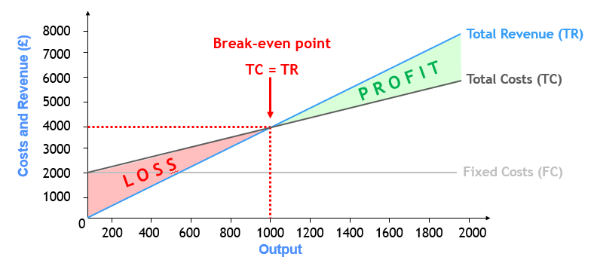
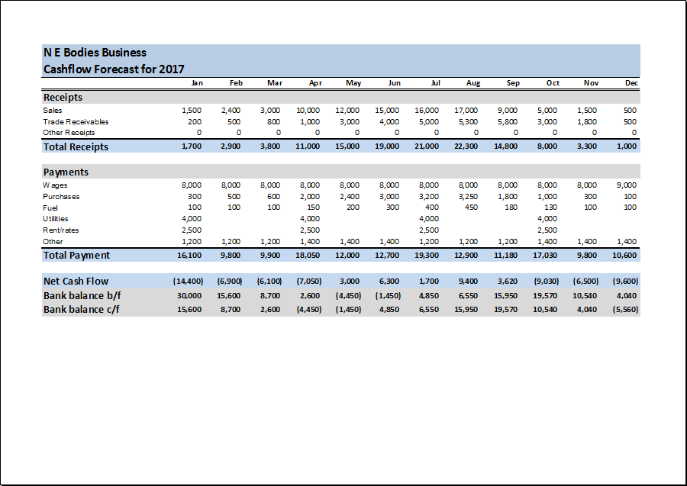
Financial Forecasts
What information is included in a financial forecast?
Break-even Calculations Showing:
A Cash Flow Forecast Showing:
Forecasted revenue
Forecasted costs
Forecasted profit (or loss!)
Expected cash coming in
Expected cash spending
Difference between cash in and out
Excellent – Why is predicting how financially successful your business is important?
Progress Indicators
Good – Describe each section of the business plan. | Excellent – Explain why each section of the business plan is important.

Slide 7

Sources of Finance
What different sources of are available to small businesses?
This section will outline how the business
intends to fund it’s plan.
Excellent – Why does a business need to show how they are financing the business?
Progress Indicators
Good – Describe each section of the business plan. | Excellent – Explain why each section of the business plan is important.

Slide 8

Sales Plan
What does a sales plan show?
A sales plan should set out the sales targets for the business
  Targets should be based on ensuring that the financial forecasts can be met
It should be used alongside the
“Marketing Plan” in order to:
  Choose sales methods that are suited to
  the target market
  Identify sales tactics
  Motivate and focus sales staff
Sales plans should be monitored to
ensure sufficient cash is coming in
Excellent – Why is a sales plan important?
Progress Indicators
Good – Describe each section of the business plan. | Excellent – Explain why each section of the business plan is important.

Slide 9




Marketing Plan
What does a marketing plan include?
Excellent – Why is Market research vital for a business?
The marketing plan should be used with the sales plan to show how the target market will be reached through the marketing mix:
PRODUCT
PRICE
PLACE
PROMOTION
Details of the products sold by the business
What price(s) customers will be charged
Where customers will be able to purchase products
How customers will be made aware of products
Progress Indicators
Good – Describe each section of the business plan. | Excellent – Explain why each section of the business plan is important.

Slide 10

What is the Purpose of a Business Plan?
It effectively outlines the road ahead, and can help a business:
  Be more confident that their plan is realistic
  Make business decisions
    Since it will contain most of the information needed
  Use it to gain support from
    Banks and other potential finance providers
    Others interested in the business
“A formal document outlining what a business wants to achieve, and how it intends to do be successful”

Slide 11

Why do Businesses Plan?
It is important for businesses to plan for a number of reasons:
REASONS
TO
PLAN!
Survival
Finance
Risks
Objectives

Slide 12
Clarify Business Idea
Explain why businesses need to clarify a business idea?
The business plan should answer a number of key questions about the products and services to be offered:
Who will the main suppliers be?
What other related products and/or services could be sold?
How much stock will be needed?
What are the main products and/or services being sold?
Are there alternative suppliers available?
BUSINESS
PLAN
Notes:
Back returns to slide 8

Slide 13


Measure Progress towards Goals
When planning, businesses will think about what it wants to achieve
  These targets are called objectives
So the planning process will help to:
Explain why businesses need to measure progress.
Keep the business on track to meet it’s aims
Set targets for
managers and staff
Identify issues and problems before they occur
Notes:
Back returns to slide 3

Slide 14

Potential Problems
Explain what are the potential problems with starting a small business
There are a number of reasons why businesses fail:
Not Knowing The Market
Surprisingly many businesses fail to understand their customers or their competitors
Poor Business Plans
Poor Financial Control
Many businesses fail due to a flawed business idea, or badly implemented plan
The most common reason for business failure is poor cash management
Notes:
Back returns to slide 3

Slide 15

Potential Problems
Risk is everywhere in business
  But good planning can help businesses to avoid unnecessary risks
This involves balancing potential rewards against possible risks:
The Risk
The Reward
What if things don’t go as planned - can the business afford it?
What gains might be obtained if things go as planned…or better!
Notes:
Back returns to slide 3

Slide 16

Manage Cash Flow
Explain why managing cash flow is vital for business.
Running out of cash is the most common cause of business failure
  Many businesses don’t manage cash very well as it comes in or leaves
    The movement of money in and out of a business is called “cash flow”
  This can be easily avoided through careful planning:
Financial forecasts should highlight if and when extra cash will be needed
This will give the business time to make arrangements with lenders before they run out of cash
Notes:
Back returns to slide 3

