Slide 1
Chromosomes
Do now activity:
1. What is contained within the nucleus?
2. What is the job of the nucleus?
3. What does our DNA control?
4. What may happen if the DNA within a cell is disrupted?
Key Words
Nucleus
DNA
Chromosomes
Cells
Characteristics

Slide 2
Progress indicators
GOOD PROGRESS:
Describe where chromosomes are located Explain the function of chromosomes.
OUTSTANDING PROGRESS: Link chromosomes to cell reproduction.

Slide 3
Task: Watch the video and have a go at answering the questions
What are some examples of cells?
What does the nucleus contain?
What does a chromosome look like? Draw a diagram!
Where are the chromosomes found?
What are chromosomes made out of?
https://www.youtube.com/watch?v=xUrlreMaUrs

Slide 4
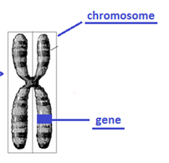
Self-assessment:
Types of cells include skin cells, muscle cells & nerve cells
The nucleus contains the genetic information
Chromosome:
The chromosomes are found within the nucleus
Chromosomes are made out of protein & DNA

Slide 6
Memory test!!!

Slide 7
Fill in as many blanks as you can remember!

Slide 8
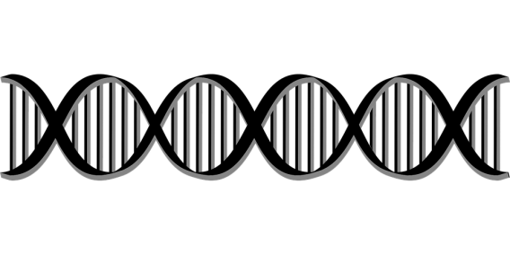
Largest Smallest
Task: Name these structure and place them in order, from the largest to smallest, in your books

Slide 9
Chromosomes
Nucleus
The Nucleus contains chromosomes
Cell
Your DNA contains Genes. Your Genes code your characteristics like eye colour and hair colour.
The Chromosomes Contain DNA
Self-assessment

Slide 10
Task: Can you draw a line to match the object to definition?
Cell |  | Contains genetic material in the form of chromosomes, which controls the activities of the cell
Nucleus |  | Small unit that makes up all living things
Chromosome |  | Unit of inheritance that are made out of DNA, they determine our physical characteristics
Gene |  | Complex chemical molecule carrying the different codes needed for different proteins to be made
DNA |  | Very small X-shaped objects carrying genes

Slide 11
Cell |  | Contains genetic material in the form of chromosomes, which controls the activities of the cell
Nucleus |  | Small unit that makes up all living things
Chromosome |  | Unit of inheritance that are made out of DNA, they determine our physical characteristics
Gene |  | Complex chemical molecule carrying the different codes needed for different proteins to be made
DNA |  | Very small X-shaped objects carrying genes
Self-assessment

Slide 12
Task: Complete the sentences:

Slide 13
We inherit information from our parents which is passed on
as genes.
Genes are linked together in long chains called chromosomes.
One set of chromosomes comes from the mothers egg cell
and the other set comes from the father’s sperm cell.
Eggs and sperms are special cells called gametes. An egg
and sperm cell join together during fertilisation.
Self-assessment

Slide 14
Plenary – 3-2-1 Reduction
3 facts
2 key words
1 question – to test your peers!

Slide 15
We inherit information from our parents which is passed on
as ________.
Genes are linked together in long chains called ___________.
One set of ___________ comes from the mothers egg cell
and the other set comes from the father’s sperm cell.
Eggs and sperms are special cells called _________. An egg
and sperm cell join together during _____________.
We inherit information from our parents which is passed on
as ________.
Genes are linked together in long chains called ___________.
One set of ___________ comes from the mothers egg cell
and the other set comes from the father’s sperm cell.
Eggs and sperms are special cells called _________. An egg
and sperm cell join together during _____________.
We inherit information from our parents which is passed on
as ________.
Genes are linked together in long chains called ___________.
One set of ___________ comes from the mothers egg cell
and the other set comes from the father’s sperm cell.
Eggs and sperms are special cells called _________. An egg
and sperm cell join together during _____________.
We inherit information from our parents which is passed on
as ________.
Genes are linked together in long chains called ___________.
One set of ___________ comes from the mothers egg cell
and the other set comes from the father’s sperm cell.
Eggs and sperms are special cells called _________. An egg
and sperm cell join together during _____________.

Slide 17
