Slide 1
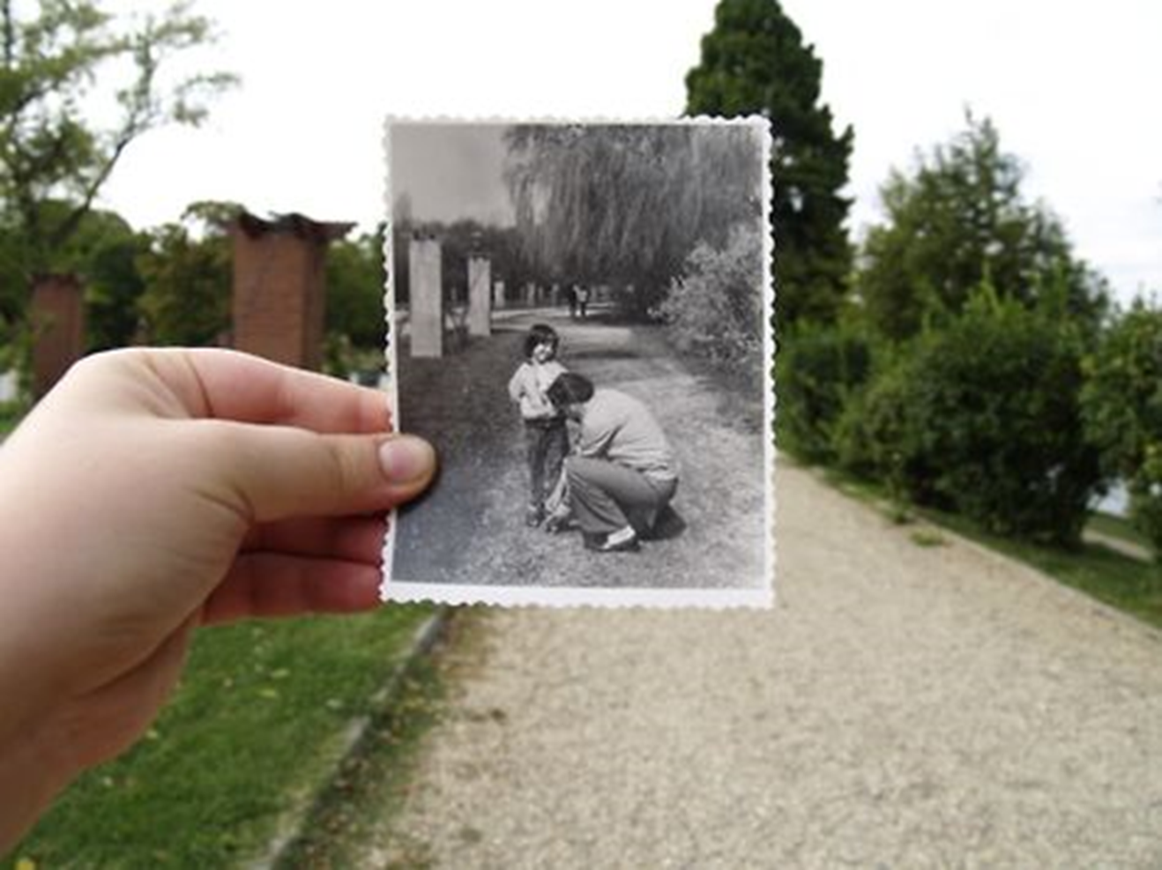
What can you tell me about the camera settings for this photo?

Slide 2
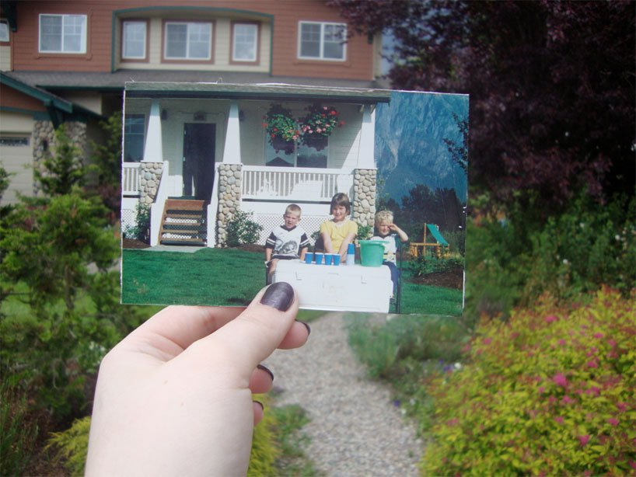
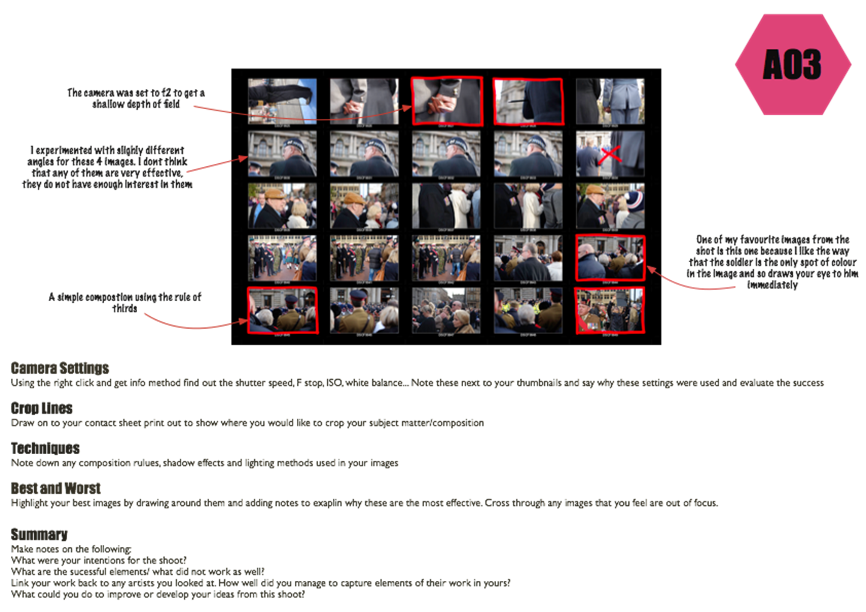
Annotating a Contact Sheet
To take a set of photographs that are inspired by the work of Taylor Jones.
GCSE photography Progress Indicators
Basic Requirements | Taken a range of photos using the mini figures as props Saved all images to your one DRIVE Printed a contact sheet
Good | Taken wide selection of images that show links to the work of Dear Photograph Camera settings/compositions have been experimented with when on the photo shoot and discussed
Outstanding | Taken a wide, varied and creative selection of photos that show strong links to the work of Dear Photograph project Camera settings/compositions have been expertly and creativity used and discussed
Title – Dear Photograph Contact Sheet
TASK 1
Take your photos in the style of Dear Photograph. You need to have printed a Slinkachu photo in black and white first
Remember that you should demonstrate your understanding of aperture, focus and composition in your photographs!
TASK 2
Save your photos to your OneDRIVE area under the file name: Contact sheet Dear Photograph
Print ALL your images and then using the ‘Annotating a contact sheet’ add notes to your sheet. Tick and cross your best and worst – label with why they are good or bad.
Extension - Print your 2 best photo’s to A4 and mount only on black paper not on to white ready for ‘Best Photo’

Slide 3
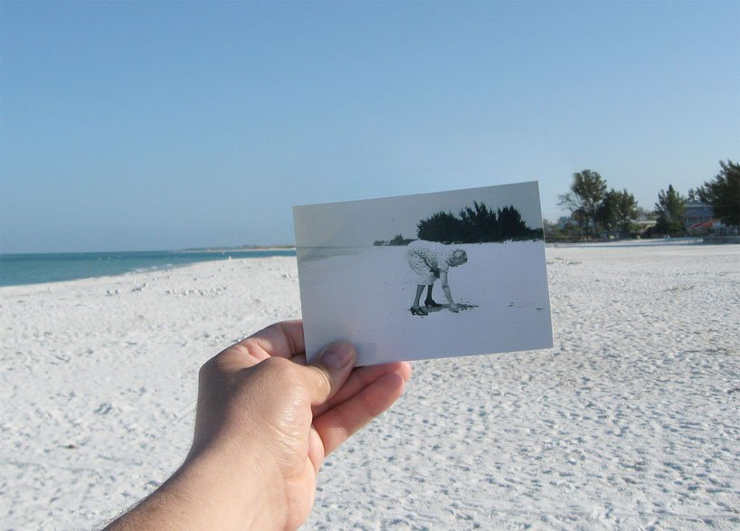
Bring up your most successful image and be ready to discuss why you feel it is your best shot

Slide 4
Annotating a Contact Sheet

