Slide 1
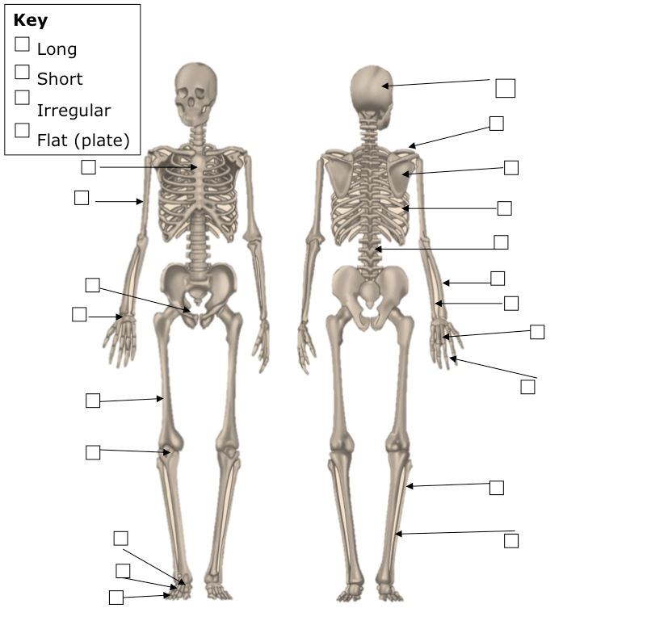
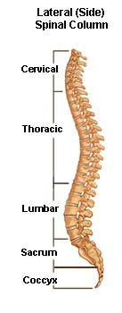
GCSE PE – RECAP of LEARNING
Good = State
Outstanding = Explain
1 | 2 | 3
8 | Functions of the Skeleton | 4
7 | 6 | 5
Types of bones
 | Short Bones | Long Bones | Flat Bones | Irregular Bones
Job
Bone E.g.
Sporting Examples

Slide 2
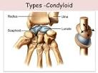
Type of Synovial Joint: | MY notes taken on each of the four synovial joints (targeted interview)
Ball and socket
Hinge
Pivot
Condyloid
Shape =
Examples =
Movement available =
Shape =
Examples =
Movement available =
Shape =
Examples =
Movement available =
Shape =
Examples =
Movement available =

