Slide 1



6.1 - The Purpose of The Main Functional Activities
Hyperlink(s)
Back button
Forward button

Slide 2
6.2 - The Main Activities of The Functional Areas
Hyperlink(s)
Back button
Forward button

Slide 3
Progress Indicators
Outstanding Progress – Identify the main activities of each functional area
Good Progress – Identify the purpose of the main functional areas.

Slide 4






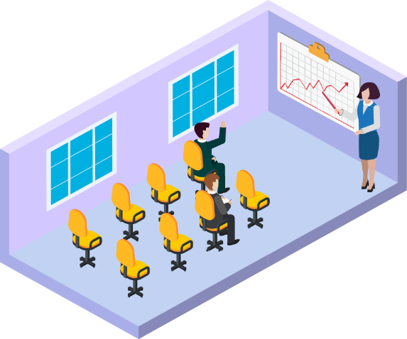
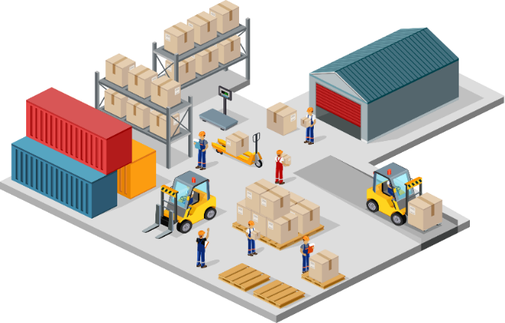
Functional Activities in a Start-up Business
Arrange the main functional activities of the main functional areas in small businesses.
FINANCE
MARKETING
Once complete, write the purpose of each functional area.
FUNCTIONAL
ACTIVITIES IN A
SMALL BUSINESS
Good Progress – Identify the purpose of the main functional areas. | Outstanding Progress – Identify the main activities of each functional area
HUMAN
RESOURCES
OPERATIONS

Slide 5





What Are Functional Activities?
Every business will need some tasks to be done on a regular basis
  These tasks, or activities, might include:
Recording Sales
Placing Orders
Arranging Meetings
Maintaining the Website
Large businesses will carry out these activities within a functional area, which can be defined as:
“The person, or team, responsible for completing specific tasks within a business, e.g. finance”

Slide 6

Human Resources (HR)
This function is responsible for co-ordinating staff within the business
It will be involved with staff in a number of ways:
- Recruitment and selection of employees
- Training and development of employees
- Performance management of employees
- Responsibility for health and safety in the workplace
- Ensuring compliance with employment legislation
In some business it is known as
“Personnel”
Induction
For New
Staff
Notes:
Back returns to slide 2.

Slide 7

Finance
This function is responsible for controlling anything involving finance within the business
Organisation and allocation of financial resources
  E.g. budgets, credit control
Financial performance reporting
  E.g. to meet statutory requirements
Monitoring of cash flow
  E.g. money coming in and going out
Notes:
Back returns to slide 2.

Slide 8

Marketing
This function is responsible for finding out what customers want, and for promoting the business
Market research to research the market and find out customer opinions
    To find out what customers want
    To know how best to communicate with them
    Using a variety of public relations activity
    and advertising media
Developing a marketing mix: Product, Price, Place, Promotion (4Ps)
Notes:
Back returns to slide 2.

Slide 9

Operations
This function is responsible for manufacturing finished goods that the business will sell
Production planning
    By identifying correct production method
Producing the product or service
    By turning inputs into outputs
Quality control
    To ensure consistency
Stock control
    By packaging and storing them
Logistics
    By ensuring the best method of getting a product from A to B
Notes:
Back returns to slide 2.

Slide 10







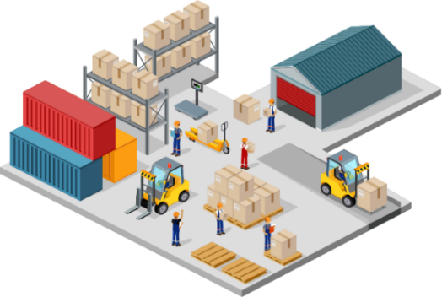
Functional Activities in a Start-up Business
A start-up business will still need to carry out these activities
  But one person may be responsible for doing a number of different activities
FINANCE ACTIVITIES
MARKETING ACTIVITIES
FINANCE
The purpose of Finance is to keep financial records and to report on financial performance
The purpose of Marketing is to identify what customers want, and then provide it
MARKETING
FUNCTIONAL
ACTIVITIES IN A
SMALL BUSINESS
HR ACTIVITIES
OPERATIONS ACTIVITIES
The purpose of Human Resources is to deal with all aspects of those who work for the business
The purpose of Operations is to organise the production of outputs using raw materials
HUMAN
RESOURCES
OPERATIONS

Slide 11
https://quizlet.com/join/CJtRyVFVc
Sign up for free access
  DOB
  Use Real Name or as close as you can
  username@hillcrest.dudley.sch.uk
  Accept terms and conditions

