Slide 1
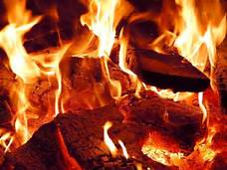
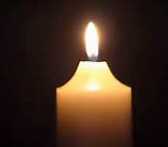
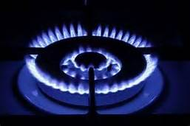
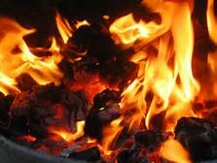
Combustion of hydrocarbons
DNA:
What type of reaction are shown in the 4 pictures?
What else is needed beside the fuel?
Answer: Combustion of fuels. Oxygen is needed as well as the fuel.
Notes:
Answer: Combustion (burning) of fuels

Slide 2
Progress indicators
Good progress:
Describe the complete combustion of a hydrocarbon
Explain how to test for a product of complete combustion
Outstanding progress:
Explain why incomplete combustion can be lethal

Slide 3
Activity 1: Describe the complete combustion of a hydrocarbon (3)
The combustion of hydrocarbon fuels release __________. During combustion, the carbon and _________ atoms are ____________. The products of complete combustion are _________ and _________ __________.
Words: oxidised, carbon dioxide, energy, hydrogen, water
Do the word equations below for complete combustion:
Methane + oxygen → ________ + ______ _____
Propane + _______ → ________ + _____ _____
Construct the combustion equation for butane
Higher- Construct balanced symbol equations for 1-3
Notes:
https://www.youtube.com/watch?v=Nl0bipxyuyk

Slide 4
Activity 1: Describe the complete combustion of a hydrocarbon (3) SELF-ASSESS
The combustion of hydrocarbon fuels release __________. During combustion, the carbon and _________ atoms are ____________. The products of complete combustion are _________ and _________ __________.
Words: oxidised, carbon dioxide, energy, hydrogen, water
energy
hydrogen
oxidised
water
carbon dioxide

Slide 5
Activity 1: Describe the complete combustion of a hydrocarbon (3) SELF-ASSESS
Complete the word equations below:
Methane + oxygen → ________ + ______ _____
Propane + _______ → ________ + _____ _____
Construct the combustion equation for butane
Higher- Construct balanced symbol equations for 1-3
water
carbon dioxide
oxygen
water
carbon dioxide
butane + oxygen → water + carbon dioxide
1. CH₄ + 2O₂ → 2H₂O + CO₂
2. C₃H₈ + 5O₂ → 4H₂O + 3CO₂
3. 2C₄H₁₀ + 13O₂ → 10H₂O + 8CO₂

Slide 6
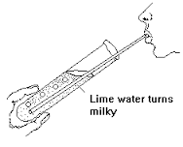
Activity 2: Explain how to test for a product of complete combustion
Practical:
Pour a small amount of limewater
in a test tube
Using a clean straw, blow into the
limewater for a couple of minutes
MAKE SURE YOU DO NOT SUCK UP THE LIMEWATER!
3. What gas have you been testing? What is a positive result?
Alternatively, watch this video: https://www.youtube.com/watch?v=xvQNaAFkE6c
Notes:
Limewater is a test for carbon dioxide. When you blow into the tube, the carbon dioxide in the exhaled air causes the limewater to turn cloudy (milky white).

Slide 7
Activity 3: Read the information and use it to explain incomplete combustion
Incomplete combustion occurs when the supply of air or oxygen is poor. Water is still produced, but carbon monoxide and carbon are produced instead of carbon dioxide.
The carbon is released as soot. Carbon monoxide is a poisonous gas, which is one reason why complete combustion is preferred to incomplete combustion. Gas fires and boilers must be serviced regularly to ensure they do not produce carbon monoxide.
Construct a word equation for the incomplete combustion of propane
Write a sentence explaining why incomplete combustion is lethal
Notes:
Propane + oxygen → carbon + carbon monoxide + water
Pupils are only expected to be able to construct or complete balanced symbol equations for complete combustion, not incomplete combustion.

Slide 8
Activity 4- Complete the exam question
Notes:
Note - c part v is only relevant to higher tier pupils (linking back to the energy changes topic in paper 1) – could just be removed for foundation pupils

Slide 9
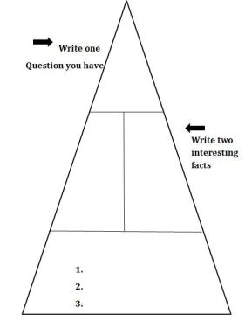
Plenary: 3, 2, 1 Pyramid
(3) Write down 3 keywords from the lesson.
(2) Write down 2 facts about combustion.
(1) Write down 1 question you have about combustion.

