Slide 1
TITLE = Retrieval DNA
Brainstorm as many things as you can remember about the context of AIC
Make a list of characters and add one word to describe what they represent about society.

Slide 2
Lesson 1: Charge of the Light Brigade
Learning Objective: To begin to explore the poem

Slide 3
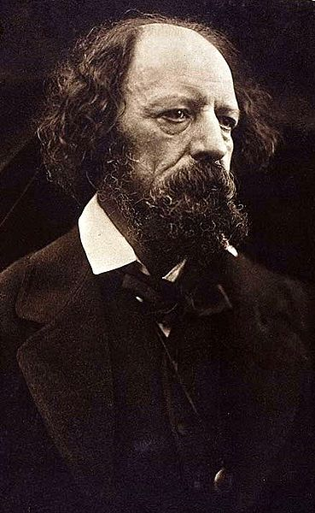
Alfred, Lord Tennyson
Today we will be studying the poem The Charge of the Light Brigade but before we read the poem we need to find out a little bit about the author. Alfred, Lord Tennyson was born in 1809 and died in 1892. He was thought of as one of the great poets of the Victorian age.
Notes:
Popular and widely read

Slide 4
Social and Historical Context
The poem is based on an actual historical event. It is set in 1854 during the Crimean War.
It describes a terrible battle, the Battle of Balaclava, in which a mistake made by the commanding officer led to the deaths of many soldiers.
Tennyson wrote the poem after reading about the battle in a newspaper.

Slide 5
“The Charge of the Light Brigade” recalls a disastrous military situation that took place during the initial phase of the Crimean War fought between Turkey and Russia (1854-56).
Under the command of Lord Raglan, British forces entered the war in September 1854 to stop the Russians.
From the beginning, the war was plagued by a series of misunderstandings and errors, one of which serves as the subject of this poem
On October 25, 1854, Lord Raglan sent desperate orders to his Light Cavalry Brigade to fend off the Russians.
The brigade began charging—but in the wrong direction! Over 650 men rushed forward, and well over 100 died within the next few minutes.
http://www.youtube.com/watch?v=uj5bilCQEDU history

Slide 6
Group of soldiers – they’re called light to separate them from the heavy brigade
Measurement of distance. About 3 miles
Feeling low and discouraged
Mistake made through carelessness
Round of cannon fire
Heavy sword with a curved blade
Smoke emerging after cannon fire
A member of the Ukraine/Southern Russia - famous for their horsemanship and military skill
Broken in two
To regard with high respect
Brigade
League
Dismayed
Blundered
Volleyed
Sabre
Battery Smoke
Cossack
Sunder’d
Honour
First impressions: What is the poem about?

Slide 7
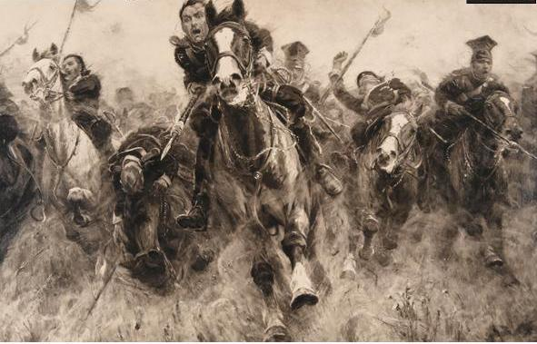
Audio Reading
Click on the image below to hear an audio reading of the poem.
Notes:
Go to http://www.bbc.co.uk/schools/gcsebitesize/english_literature/poetrytennyson/1tennyson_chargesubjectact.shtml

Slide 8
What is it about?
The poem is made up of six stanzas. Can you work out what is happening in each? Complete the table below:
Stanza | What is happening?
Stanza 1 | The poem begins in the middle of the action as six hundred soldiers charge onwards into the ‘valley of Death’
Stanza 2
Stanza 3
Stanza 4
Stanza 5
Stanza 6

Slide 9
Stanza | What is happening?
Stanza 1 | The poem begins in the middle of the action as six hundred soldiers charge onwards into the ‘valley of Death’
Stanza 2 | Soldiers are commanded to move towards doom. They realise this is a mistake but do as they are told because it is their duty.
Stanza 3 | Sensory description of the sounds of battle. Highlights the bravery of the soldiers as they face certain death.
Stanza 4 | Calvary only had swords against the Russian guns making them even more vulnerable yet they do have some luck – images of brutal warfare. However they have gone as far as they can and must turn back.
Stanza 5 | The return trip is just as deadly. Image of soldiers and horses collapsing under the rain of gunfire. Emphasises how many have died.
Stanza 6 | Reminded that we should be in awe of these noble men. They are now legendary.

Slide 10
Imagery
Tennyson uses imagery to describe the violence, drama, sorrow and glory of the battle. Pick out images from the poem which convey these emotions.
Violence | Drama | Sorrow | Glory
The valley of death | Charge for the guns

Slide 11
Lesson 2: Charge of the Light Brigade
Learning Objective: To explore the finer details of the poem

Slide 12
DNA - Mood and atmosphere
How would you describe the mood or tone
of this poem? Choose words from the list
below:
angry romantic sad exciting reflective sorrowful dramatic regretful proud fearful
Write three sentences explaining how the speaker feels about what happened during the battle.

Slide 13
Group Work
You have 5 mins only to analyse your stanza. Use the guided questions to support your annotations.
You will then present your findings to the rest of the class who will annotate their own copy of the poem.

Slide 14
Why does Tennyson tell us the exact number?
What measurement is this? Why is it repeated? What does it sound like?
What does this phrase make you think of?
What image does this paint? Why?
Half a league, half a league,
Half a league onward,
All in the valley of Death
Rode the six hundred.
‘Forward, the Light Brigade!
Charge for the guns!’ he said:
Into the valley of Death
Rode the six hundred.
What happens here? What has changed?
Why is this important? Consider the context.
Why is this word important? Why is it capitalised?
Where have you heard this phrase before? Why is it important?
Why is this repeated?

Slide 15
This is a command. What is the effect?
What does this question mean?
Why can’t the soldiers reply?
‘Forward, the Light Brigade!’
Was there a man dismay’d?
Not tho’ the soldier knew
Some one had blunder’d:
Theirs not to make reply,
Theirs not to reason why,
Theirs but to do and die:
Into the valley of Death
Rode the six hundred.
What is Tennyson doing here? Who is the ‘someone’?
A refrain is a repeated part of a poem, particularly when it comes either at the end of a stanza or between two stanzas. Why is this used here?
Why are these three lines repeated? What is the effect of the rhyme?
Who is the ‘theirs’?

Slide 16
Why does the poet include the directions?
Why is this word repeated?
Who is the enemy?
Cannon to right of them,
Cannon to left of them,
Cannon in front of them
Volley’d and thunder’d;
Storm’d at with shot and shell,
Boldly they rode and well,
Into the jaws of Death,
Into the mouth of Hell
Rode the six hundred.
Why is onomatopoeia used here?
What is the effect of this adverb?
What is the effect of personification here? How does it make the valley sound?
Why is repetition used here?

Slide 17
What does this show about the weaponry?
What does this word connotate?
How does this make the battle sound?
Flash’d all their sabres bare,
Flash’d as they turn’d in air
Sabring the gunners there,
Charging an army, while
All the world wonder’d:
Plunged in the battery-smoke
Right thro’ the line they broke;
Cossack and Russian
Reel’d from the sabre-stroke
Shatter’d and sunder’d.
Then they rode back, but not
Not the six hundred.
What is revealed about the battle here?
What technique is used here? What is the poet’s intention here?
Why is this word important? How does it make the soldiers sound?
How does this make the soldiers sound?
What has changed here?
How does the reader feel?
What does it hint at?
What technique is used here? Why?

Slide 18
What has happened here?
What does this show about the battle?
Cannon to right of them,
Cannon to left of them,
Cannon behind them
Volley’d and thunder’d;
Storm’d at with shot and shell,
While horse and hero fell,
They that had fought so well
Came thro’ the jaws of Death
Back from the mouth of Hell,
All that was left of them
Left of six hundred.
How does the battle sound here?
What technique is used here? What word reveals the poet’s viewpoint?
What has changed here? Why?
Why is this word important?
What stanza is mirrored here?

Slide 19
What is the effect of the Rhetorical Question?
Why is this repeated at the end?
When can their glory fade?
O the wild charge they made!
All the world wonder’d.
Honour the charge they made!
Honour the Light Brigade,
Noble six hundred!
What is the effect of this exclamation mark?
Why does the poet use a command here? Why is it repeated?
Why is this adjective important?

Slide 20
Retrieval Starter
Write a one sentence explanation of the following techniques:
Metaphor
Simile
Adjective
Verbs
Personification
Ceasura
Enjambment
Repetitions
Rule of 3
Challenge:
Write an example of each

Slide 21
How has Tennyson presented war?

