Slide 1
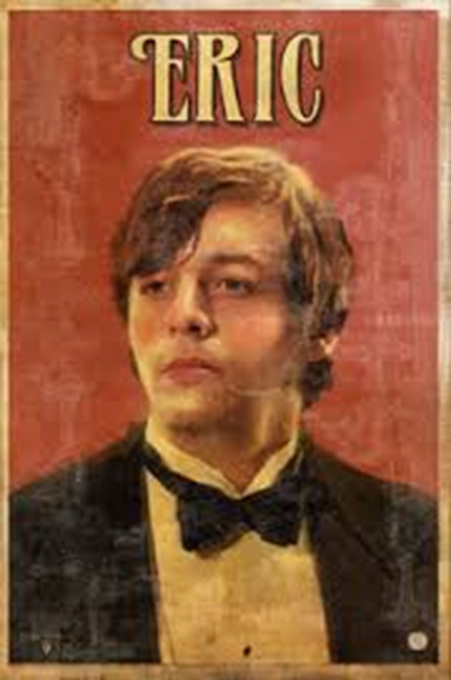
Week 4 / Lesson Two: DNA
Mr Birling | Gerald | Eric
How did he treat Eva Smith? (Actions/ Reasons)
Consequence for Eva Smith
Challenge: Once you have completed the table – write a brief argument on which man is most to blame for Eva’s death…

Slide 2
C/W Date
Lesson Title: Priestley’s Portrayal of Eric
Lesson Focus: Use a repertoire of strategies to analyse and respond to layers of meaning, subtlety and allusion.

Slide 3
Week focus: Priestley’s intentions
Word Consciousness – Please record on the back page of your exercise books
Word and definition | Your definition or synonyms
Juvenile – being childish or immature
Compassionate – feeling or showing sympathy and concern for others
Dissenting - expressing opinions that go against the majority view

Slide 4
Learning Journey
Week focus: Priestley’s intentions
Last lesson we explored Eric’s presentation at the start of the play and discovered his side of things in Act 3
Today we are going to analyse Eric’s quotes from Act 3 to gain a deeper understanding of his character and purpose in the play.
Then we will demonstrate our understanding of Eric’s role in Act 3 by also linking to theme, context and Priestley’s intentions.

Slide 5
Key quotes from Act 3
Task: Sort these quotes into the four headings of how they present Eric. You can put them into more than one. Be prepared to justify your choices.
Challenge:
Are there any better words you can think of that could be used to describe Eric from these quotations?
Juvenile | Selfish | Volatile | Compassionate/ Responsible
“She told me she didn’t want to go in but - well I was in the state when a chap easily turns nasty”
“Because you’re not the kind of father a chap could go to when he’s in trouble.”
“You killed her – and the child she’d have had too – my child – your own grandchild – damn you”
“Oh for God’s sake – what does it matter now whether they give you a knighthood”
“She treated me as if I were a kid. Though I was nearly as old as she was.”
“Yes. I wasn’t in love with her or anything – but I liked her – she was pretty and a good sport”
“I insisted on giving her money to keep her going”
“I was a bit squiffy”
Week focus: Priestley’s intentions

Slide 6
TEXT DEPENDENT QUESTIONS
Remember that Priestley is trying to convey a message or idea through the characters’ speech, so word choices are very deliberate – think about what he's trying to show about people and society.
“She told me she didn’t want to go in but - well I was in the state when a chap easily turns nasty”
1. How does this quote show the power Eric has in this situation? – What is the power than he has over Eva? – Why is he able to ignore her wishes? 2. Why do you think Eric stresses that he ‘wasn’t in love’ with Eva?
4. The adjective ‘pretty’ echoes Gerald’s words from earlier in the play – what does the use of this word show here? 5. ‘A good sport’ – what does this noun phrase suggest about the way Eric views Eva Smith? - in particular the word ‘sport’… 6. Why do you think Eva treats Eric like ‘a kid’, despite them being the same age? – What does this simile show about both Eva and Eric as characters?
“Yes. I wasn’t in love with her or anything – but I liked her – she was pretty and a good sport”
“She treated me as if I were a kid. Though I was nearly as old as she was.”
Week focus: Priestley’s intentions

Slide 7
Demonstrate - How does Priestley present the role of Eric throughout ‘An Inspector Calls’?
Challenge: Can you use any of the word consciousness vocabulary in your paragraph
Independent writing:
Priestley presents Eric as… when he says…
This shows he is because…
The use of the word/device (label) shows he is … because
At that time …
Priestley wanted to show…
Success Criteria:
Quotes
Zooming in on quotes
Identifying techniques used
Discussing the effect/intention behind character words/actions
Discussing the effect on the audience
Linking to context
The writer’s message

Slide 8
Review: Self Assessment
Week focus: Priestley’s intentions
Success Criteria:
I can write confidently expressing my own views informed by the play.
I can include a range of references, zooming in on their connotations and linking these.
I can link quotations to deepen my analysis and expand ideas.
I can consider the writer’s intended effect on the audience, taking into consideration the context of the time.

