Slide 1
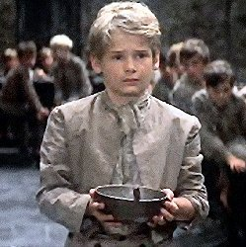
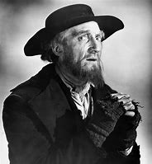
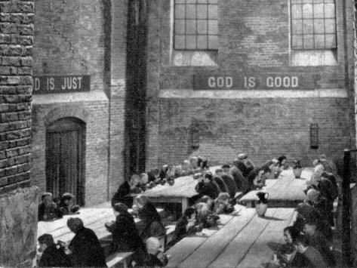
Lesson 7 Oliver
Title: Criticising the rich
Lesson focus -analyse in depth and detail writers’ use of literary, rhetorical and grammatical features on different readers
Notes:
Learners respond independently

Slide 2
DNA
A pupil said “Being rich would be the best thing in the world. You would be so happy and everyone would look up to you.”
To what extent do you agree?
Challenge: Can you think of any examples to support your response?

Slide 3
New word and DD Sojourning – Staying somewhere temporarily | Your definition | Synonym
Interment- the burial of a corpse in a grave or tomb, typically with funeral rites
Malicious - intending or intended to do harm
Bureaucracies -The structure and set of rules that control the activities of people that work for large organisations and governments

Slide 4
Learning Journey
Last lesson we looked at Gothic writing and its effect on the reader.
We selected and synthesized evidence from the text.
Today we are going to use a Contiguous read to learn more about Oliver and the way he is treated.
Notes:
Learners respond independently

Slide 5
Contiguous read
We will now read chapter 6
This is available on pages 37-40 of the copy of the text your teacher has uploaded for you
Notes:
Learners respond independently

Slide 6
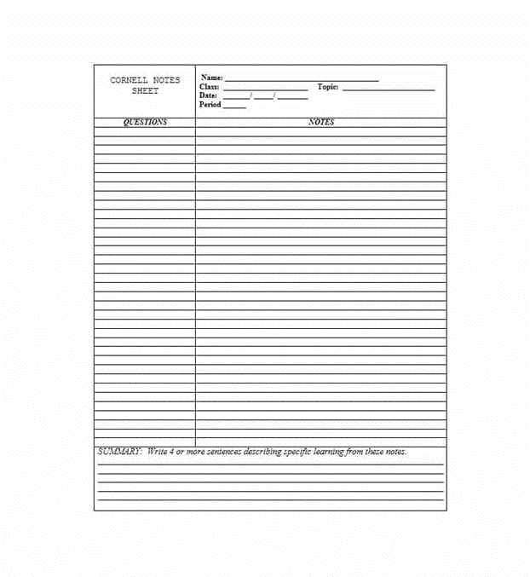
Cornell Notes
Complete the notes summary for Chapter 6

Slide 7
In this chapter Dickens is strongly emphasizing one of his key messages. Think back to our previous lessons and look at today’s title.
What can you remember about the poor law?
What do you think this message might be?
Notes:
Learners respond independently

Slide 8
The cruelty of institutions and bureaucracies toward the unfortunate is perhaps the leading theme of Oliver Twist, and essentially what makes it a social novel. Dickens wrote the book largely in response to the Poor Law Amendment Act of 1834, which represented the government's both passive and active cruelty to the poor and helpless.
Can you find any examples from the text?
Notes:
Learners respond independently

Slide 9
“who had been perfectly inconsolable during the previous illness…conversing together with as much freedom and gaiety”
Each quote helps to show us the intention of the writer
Dickens describes rich as greedy because they all cry whilst person alive, but happy on death.

Slide 10
“for many months he continues to submit to the domination and ill-treatment of Noah Claypole.”
Still being bullied.
Because Noah is jealous.
Not Oliver’s fault.

Slide 11
“Charlotte treated him ill, because Noah did and Mrs Sowerberry was his decided enemy because Mr Sowerberry was disposed to be his friend.”
People don’t like him because other people don’t.
Mrs S jealous of the relationship.
1 friend now and everybody hates it.

Slide 12
“And it’s a great deal better… that she died when she did, or else she’d be hard labouring in Bridewell, or transported, or hung”
Presumptions of The State about Oliver’s heritage.

Slide 13
“the cruel insult to his dead mother had set his blood on fire”
Fighting back
Metaphor for Oliver fighting back against all of his ill treatment
Catalyst is in defence of his mother.

Slide 14
“Oh you little un-grateful, mur-derous, hor-rid villain!”
Presume that it’s Oliver’s fault.
Not bothered about the fact that it isn’t.

Slide 15
“I only hope this’ll teach the master not to have any more of these dreadful creaturs, that are born to be murderers and robbers from their very cradle”
Again – presumptions that he will be a bad character because he was an orphan!

Slide 16
Write down which numbers you think are TRUE
Dickens wrote the poor law to show his readers how bad it was
Dickens wrote Oliver Twist in response to the poor law
This chapter shows the way the poor were little of by the rich
“Set his blood on fire” is a metaphor
Notes:
Learners respond independently

Slide 17
On your whiteboard write down which numbers you think are TRUE
Dickens wrote the poor law to show his readers how bad it was
Dickens wrote Oliver Twist in response to the poor law
This chapter shows the way the poor were little of by the rich
“Set his blood on fire” is a metaphor
Notes:
Learners respond independently

