Slide 1
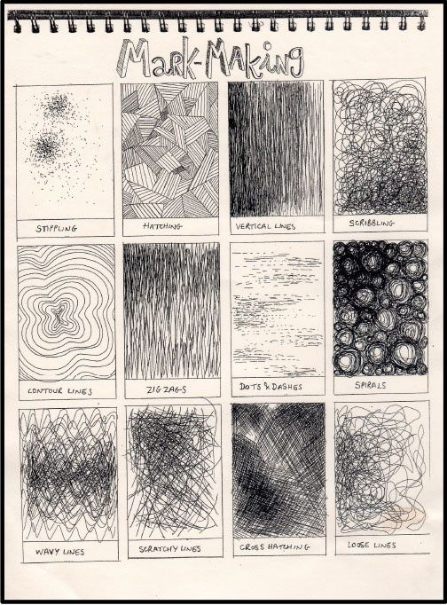
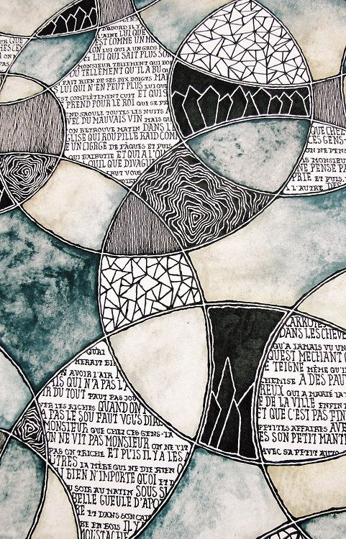
Good Progress – Explore mark making and tone using pencil and pen with some creative presentation
Outstanding Progress – Explore with various pencil and pens to creatively present varied mark making skills. Demonstrate and adapt smooth tonal values.
Try using different grades of pencil (B, 2B, 4B, 6B,) and different pens

Slide 2
Tone Practise
Good Progress – Explore mark making and tone using pencil and pen with some creative presentation
Outstanding Progress – Explore with various pencil and pens to creatively present varied mark making skills. Demonstrate and adapt smooth tonal values.

Slide 3
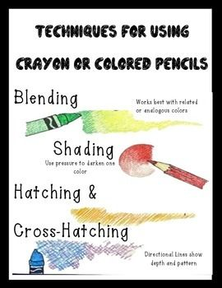
Crayon Blending Practise
Good Progress – Explore crayon blending skills with some creative presentation
Outstanding Progress – Explore crayon blending skills with creative presentation. Demonstrate and adapt smooth tonal values / blended colours.

Slide 6
