Slide 1
More about Waves
DNA
Name some equipment needed for the waves required practical
What is the wave speed equation?
What does amplitude tell us?

Slide 2
Progress indicators
GOOD PROGRESS:
State that sound waves require a medium to travel in.
Describe how sound waves travel more quickly in solid than they do in gases.
OUTSTANDING PROGRESS:
Calculate the speed of waves using the wave speed equation.

Slide 3
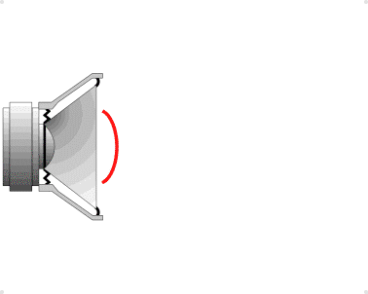
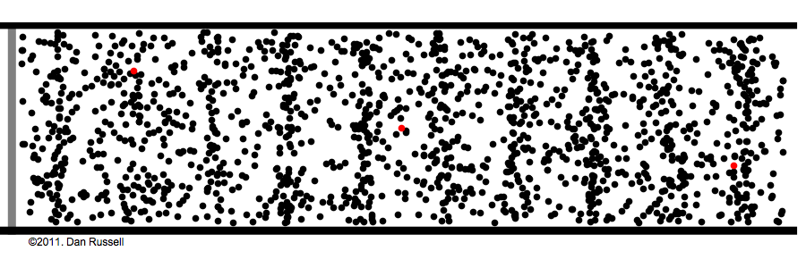
What type of wave is this?
The movement of Sound
As a speaker vibrates a diaphragm moves backward and forward
slow motion
Consider a Tube of Air
The diaphragm of the speaker pushes and pulls the air particles in front of it
A Particle
A Particle we are tracking the movement of

Slide 4
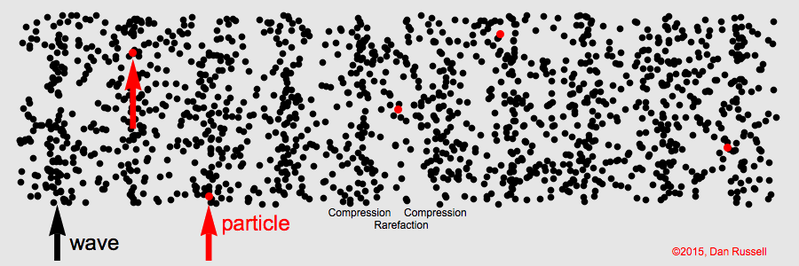
Longitudinal Wave Propagation
Direction of the Wave
Direction of Energy Transfer
A Particle
A Particle we are tracking the movement of

Slide 5
Waves
If a tree falls in the woods and there is no one around to hear it, does it still make a sound?
So how do we hear sound?

Slide 6
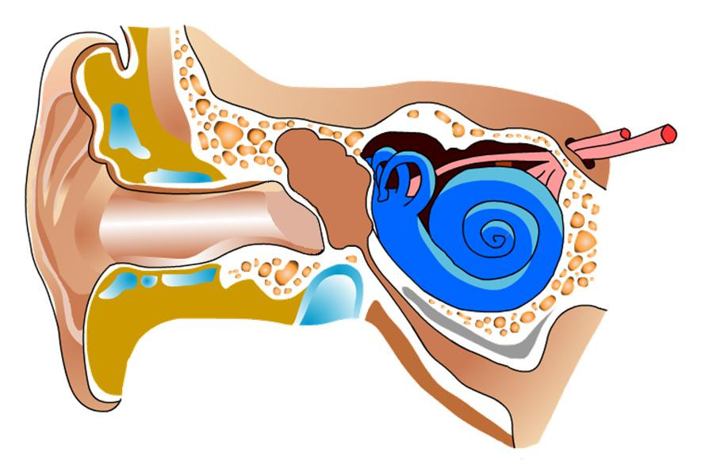
Hearing Sound
3.The waves reach the eardrum and make it vibrate.
6.The auditory nerve
takes the signals
to the brain.
2.The waves travel along the ear canal.
5.The cochlea turns these into electrical signals.
4.The small bones (ossicles) amplify the vibrations.
1.Sound waves are collected by the ear lobe (or pinna).
Notes:
Students to label their diagram

Slide 7
Sound is a Mechanical Wave
A Mechanical Wave is a wave that travels as a displacement of matter, and therefore transfers energy through a medium.
Mechanical Waves cannot travel through a vacuum.
A Medium is any material substance though which a wave or energy can travel e.g. solid, liquid or gas

Slide 8
Self Assess Red/Green
Task – 1
Describe how sound waves are produced and how we hear them.
Mechanical Wave
Vibration or Oscillation of Particles
Vibration is Parallel to the direction of energy transfer of the wave
Transmission by Particles

Slide 9
Measuring the speed of sound.
Measuring the Speed of Sound
002.9
000.0
milliseconds
1m
Speed = Distance ÷ Time
= 1 ÷ 0.0029
= 345m/s
Speed of Sound in QMGS Lab Air = 345m/s
Speed of Sound in QMGS Lab Water = 1405m/s
Speed of Sound in QMGS Steel Pole = 4980m/s
Notes:
Ask students what pattern they can see in the resulting data, and question them as to why in relation to particles and structure. Solids can be linked to newtons cradle.

Slide 10
Sound Traveling through a Solid
The particles in a solid are very close together so can pass on the vibration quickly to the next particle

Slide 11
Sound Traveling through a Gas
The particles in a gas are spread out so cannot pass on the vibration to the next particle.

Slide 12
Self Assess Red/Green
Task – 2
Explain why the speed of sound changes with material type?
Solid particles are close together
Vibration is passed on quickly in a solid
Gas particles are far apart
Vibration passed on less quickly in a gas
Average Speed of sound in Air = 330 m/s

Slide 13
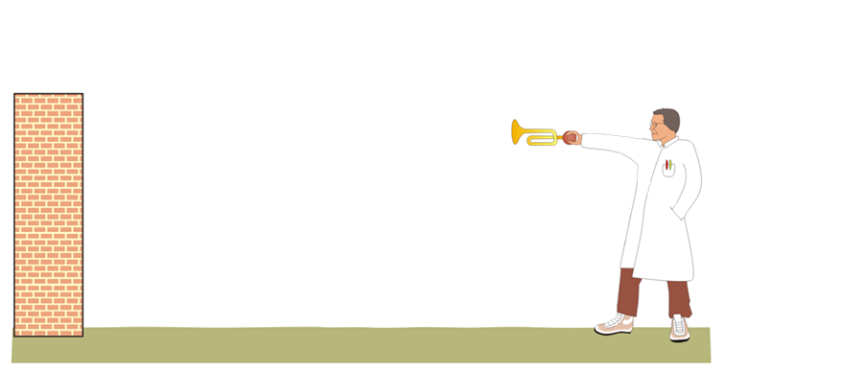
What is an Echo?
A reflection of sound is known as an echo.
Sound waves from the horn travel towards both the wall and the man
Sound waves reflected by wall
Horn heard first
Echo heard after
Reflected waves travel back to the man
Hard surfaces produce good echo's, soft surfaces produce poor echo's

Slide 14
Calculating the Speed of Sound from an Echo.
You hear a delay between the original sound and the reflected sound because the reflected sound waves have to travel further, taking longer to reach your ears.
It’s known as an echo.
$$\text{Speed}\text{ = }\frac{\text{Distance} \text{travelled}\text{ (}\text{m}\text{)}}{\text{time} \text{taken}\text{ (}\text{s}\text{)}}$$

Slide 15
Self Assess Red/Green
Task – 3
Can we hear you SCREAM in space? Explain your answer?
No as sound waves are mechanical waves which require matter for them to transfer sound energy.
Space is a Vacuum therefore there are no particles for the sound energy to transfer to and pass on.
However transverse waves do not require a medium for the waves to transfer energy, an example of which would be light.

