Slide 1
Connect
The mean of 4 numbers is 7. Four of the numbers are 3, 8 and 9. What’s the fifth number? | Don delivers pint bottles of milk to two streets. For the first street of 10 houses, the mean number of bottles of milk he delivers is 3.1. For the second street of six houses, the mean number of bottles he delivers is 2.5. Find the mean number of bottles of milk he delivers per household for the two streets altogether. | Nigel has scored a mean of 18 runs in the last five cricket matches. His mean score must be 20 or more for him to be chosen for the school team. Find the number of runs that he must make in the next match if he is to be chosen for the school team.

Slide 2
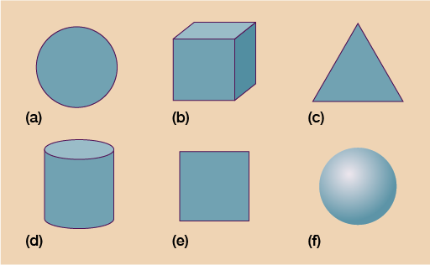
DNA
Ask a question or make a statement

Slide 3
Names and Properties of Shapes
Unit 9 – Objective 9a

Slide 4
Number Bonds
Where are you now? | Emerging | Developing | Proficient | Advanced

Slide 5
2d Shapes
What is a 2d shape?

Slide 6

How do you know it is a
2d Shape?
It has only 2 dimensions height
and width.
You can draw it easily on a piece of paper.
height
width

Slide 7
2d means a shape is
‘2 dimensional’

Slide 8
What shape is this?
How many angles and sides does this shape have?

Slide 9
A circle
It has only 1 curved side.
It has no measurable angles on its’ sides.

Slide 10
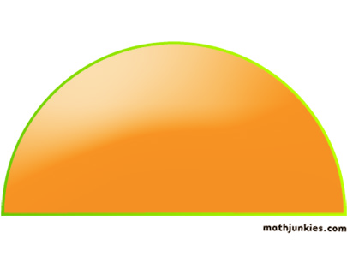
What shape is this?
How many corners and sides does this shape have?

Slide 11
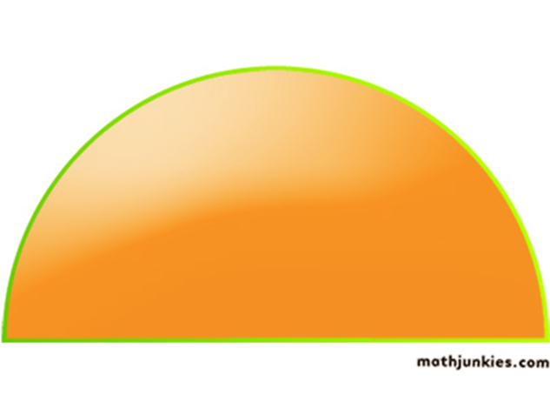
A Semi - circle
It has only 1 curved side and 1 straight side.
It has 2 corners.
A semi-circle is half of a circle.

Slide 12
There are lots of circular
2d shapes in our everyday life
Look around the classroom can you spot any circular shapes?
List as many as you can in your book.

Slide 13


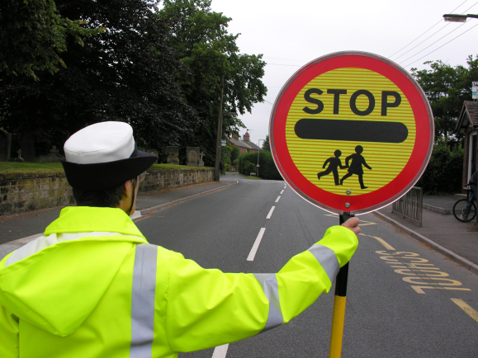
Everyday life circular shapes.
A cd.
A clock face
The lollipop persons sign

Slide 14
What is a polygon?

Slide 15
Polygon
A polygon is a 2D shape with 3 or more straight sides.
Can you think of any polygon shape names ?

Slide 16
What shape is this?
How many angles and sides does this shape have?

Slide 17
A triangle
Equilateral
3 straight sides.
3 angles.
Isosceles
Right angled
Scalene

Slide 18

Everyday life
3 sided, triangle shape.
A road works sign

Slide 19
What shape is this?
How many angles and sides does this shape have?

Slide 20
A Square
4 straight sides, all of equal length.
4 angles.

Slide 21
What shape is this?
How many angles and sides does this have?

Slide 22
Is it a square?

Slide 23
A rectangle
4 straight sides.
2 sides are longer, have a look.
4 angles.
A Square is a special type of rectangle!

Slide 24
Everyday life
4 sided, rectangle shapes.
The interactive white board.
Your work book.
Shape of the top of your desk

Slide 25
What shape is this?
How many angles and sides does this have?

Slide 26
A Pentagon
5 angles
5 flat sides.

Slide 27

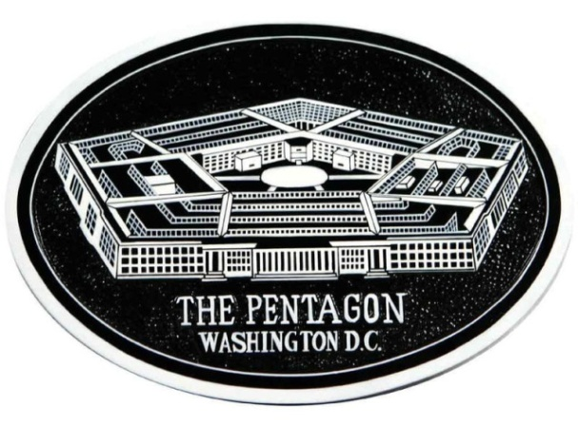
Everyday life
5 sided, Hexagonal shapes.
A football is made up lots of pentagons.
The Pentagon in America is a pentagon.

Slide 28
What shape is this?
How many angles and sides this shape have?

Slide 29
It is a Hexagon
6 straight sides.
6 corners.

Slide 30
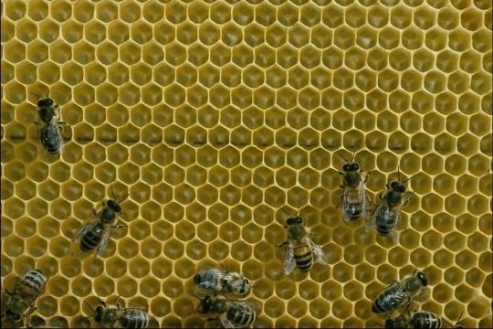
Everyday life
6 sided Hexagonal shapes.
Bee hive cells are hexagonal.

Slide 31
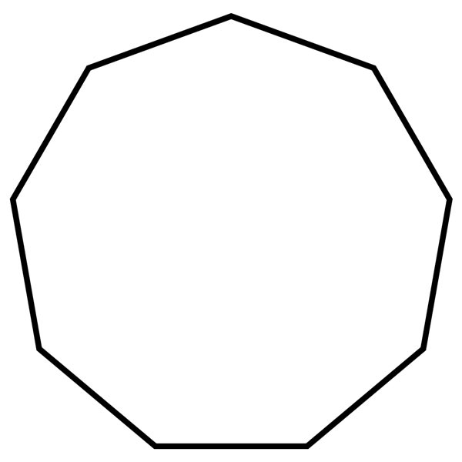
What shape is this?
How many angles and sides does this shape have?

Slide 32
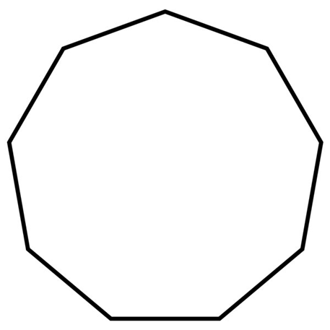
It is a Heptagon
7 sides.
7 corners.

Slide 33
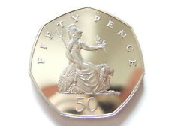
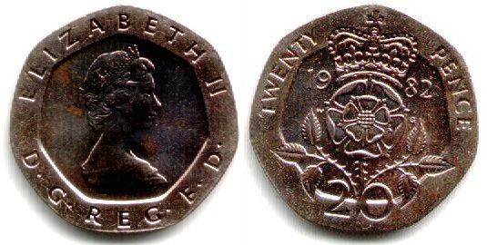
Everyday life
7 sided Heptagonal shapes.
50p and 20p coins we use today are curved heptagonal shapes.

Slide 34

What shape is this?
How many angles and sides does this shape have?

Slide 35
It is a Octagon
8 sides.
8 corners.

Slide 36
Can you think of any words that start with ‘Oct…..’ that will help remind you that an octagon has
8 sides?

Slide 37
Octopus
An Octopus has ‘8’ legs.

Slide 38

Everyday life
6 sided Octagonal shapes.
The ‘STOP’ road sign has 8 sides and is a hexagon shape.

Slide 39

What shape is this?
How many angles and sides does this shape have?

Slide 40
It is a Nonagon
9 sides.
9 corners.

Slide 41

What shape is this?
How many angles and sides does this shape have?

Slide 42

It is a decagon
10 sides.
10 corners.

Slide 43
What is a
Quadrilateral shape?

Slide 44
A quadrilateral shape has 4 sides.

Slide 45


Examples of some quadrilateral shapes.
Parallelogram
Quadrilateral shapes
Rhombus
Kite

Slide 46
Summary of shapes
Circle 1 side
Semi-circle 2 sides - 1 flat side and 1 curved side
Triangle 3 straight sides
Square 4 equal sides and 4 angles
Rectangle 4 sides two longer and 2 angles
Pentagon 5 sides
Hexagon 6 sides
Heptagon 7 sides
Octagon 8 sides
Nonagon 9 sides
Decagon 10 side

Slide 47
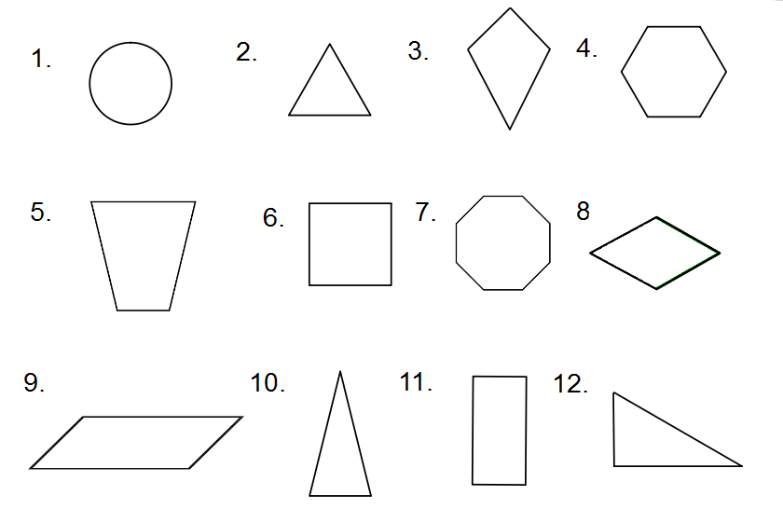
Equilateral
Triangle
Circle
Kite
Hexagon
Square
Octagon
Rhombus
Trapezium
Parallelogram
Right-angled
Triangle
Isosceles
Triangle
Rectangle

Slide 48
What is the difference between a 2D shape and 3D shape?
Which 3D shapes can you name?

Slide 49
CUBE
Can you think of any objects which are the shape of a cube?

Slide 50
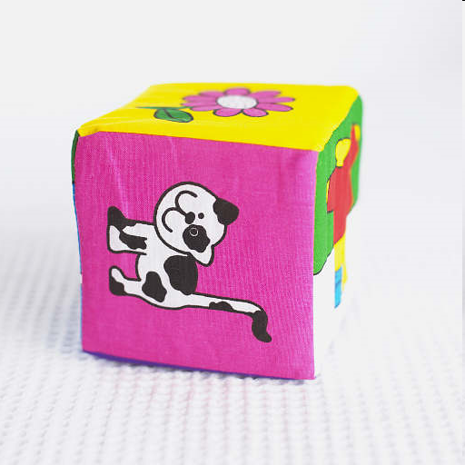
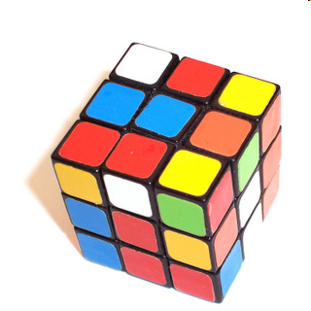

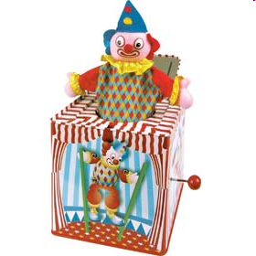
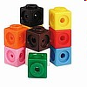
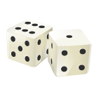

Slide 51
CUBOID
Can you think of any objects which are the shape of a cuboid?

Slide 52
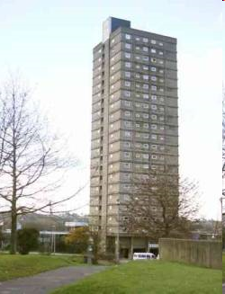
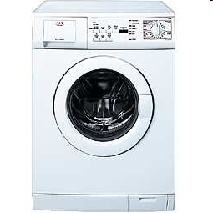




Slide 53
SPHERE
Can you think of any objects which are shape of a sphere?

Slide 54





Slide 55
CONE
Can you think of any objects which are the shape of a cone?

Slide 56


Slide 57
CYLINDER
Can you think of any objects which are the shape of a cylinder?

Slide 58
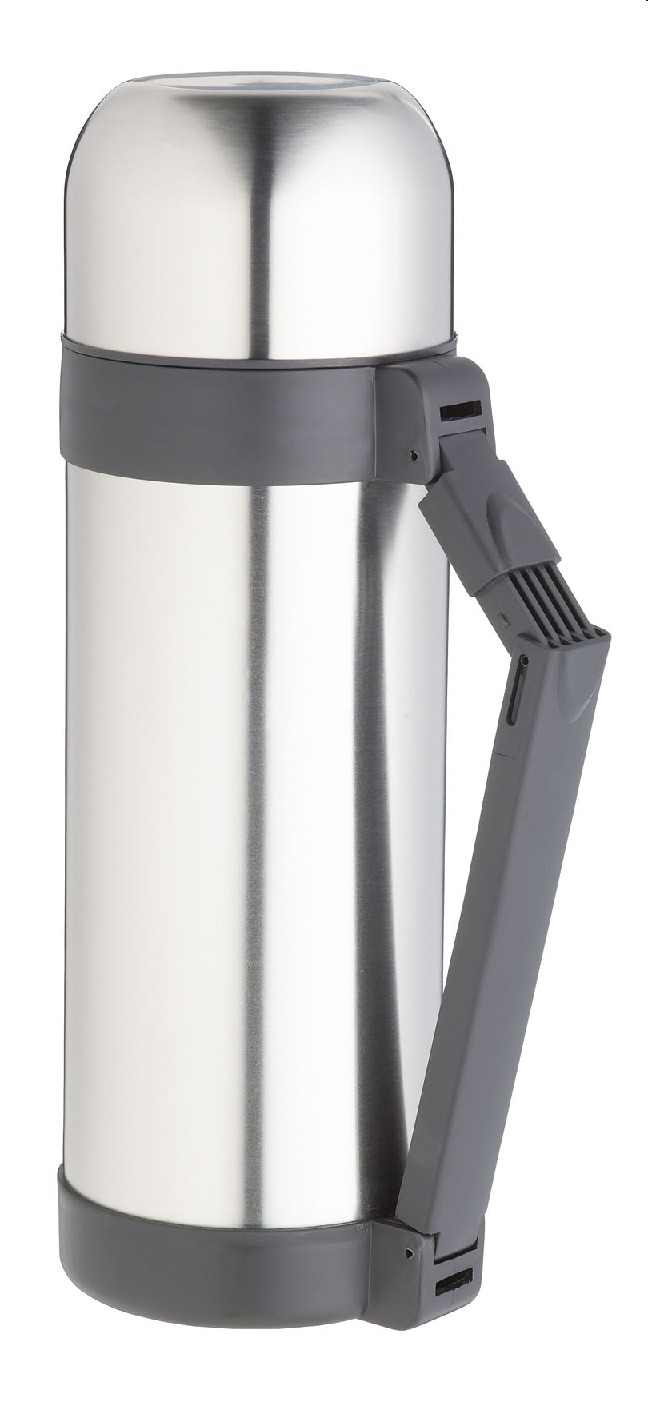


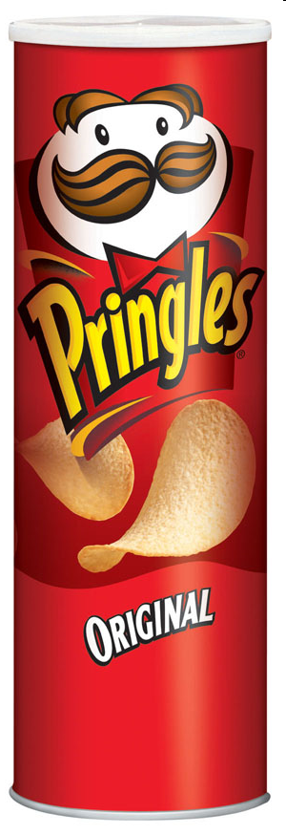
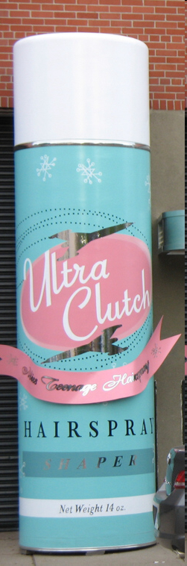

Slide 59
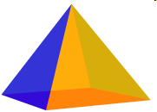
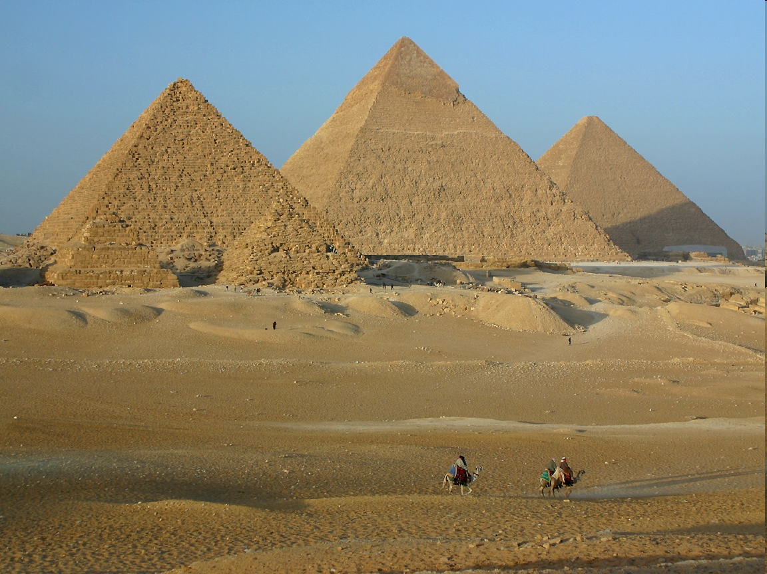
SQUARE BASED PYRAMID

Slide 60
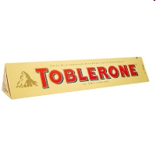
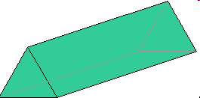
TRIANGULAR PRISM

Slide 61
How can we describe these shapes?

Slide 62
We can use words like…
FACES
EDGES
CORNERS

Slide 63
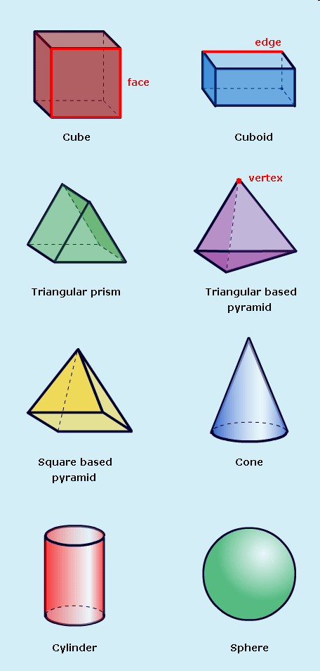
FACES or SIDES
All 3D shapes have faces.

Slide 64
EDGES
All 3D shapes have edges apart from a sphere.

Slide 65
CORNERS OR VERTICES
All 3D shapes have vertices apart from a sphere.

Slide 66
We can also say what shape the face is.
The face is the shape of a square.

Slide 67
Using these words, how could we describe a cube?
It has…
6 faces that are square shaped
12 edges
8 vertices

Slide 68
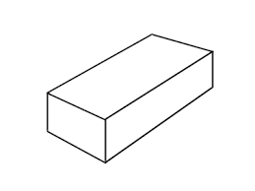
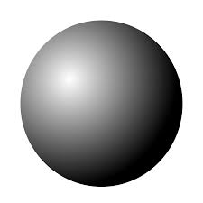
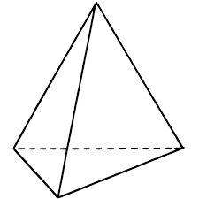
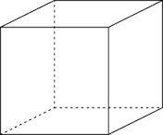
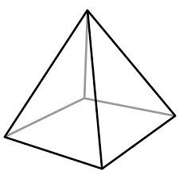
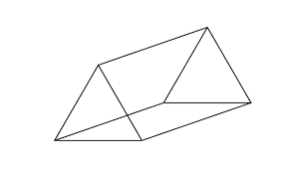
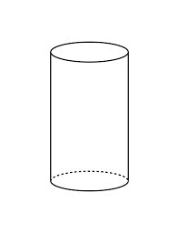
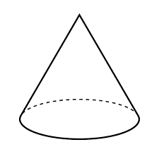
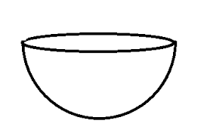
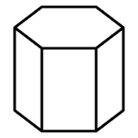
1.
2.
3.
4.
Cuboid
Cube
Sphere
Tetrahedron
5.
7.
6.
Cylinder
Square-based Pyramid
Triangular Prism
8.
9.
10.
Hemisphere
Hexagonal Prism
Cone

Slide 69
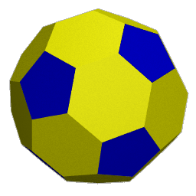
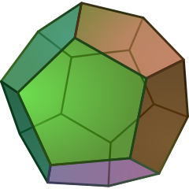
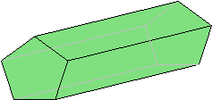
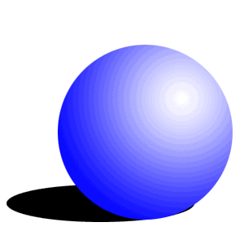
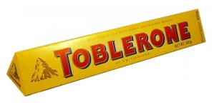
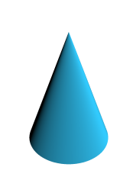
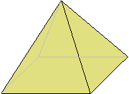
Which of the following shapes are:
Polygons?
Prisms?
Polyhedra?
None of these?
→ A 2D shape with only straight sides
→ A 3D shape with a consistent cross-section (Some prisms are also polyhedra!)
→ A 3D shape with flat faces and straight edges
B
M
G
A
H
K
C
K
N
E
D
F
I
J
L
E
H

Slide 70
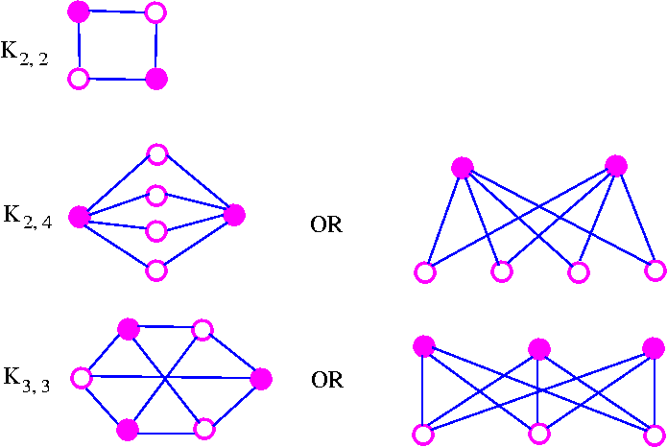
Faces, Edges and Vertices
Face:
→ The faces of a shape are its ‘sides’. They are areas
VERTEX
EDGE
VERTEX
EDGE
FACE
EDGE
EDGE
VERTEX
VERTEX
Edge:
→ The edges of a shape are the lines that make it’s ‘skeleton’
EDGE
FACE
EDGE
FACE
EDGE
EDGE
VERTEX
EDGE
Vertex/Vertices:
→ The vertices of a shape are its ‘corners’
VERTEX
VERTEX

Slide 71
Faces, Edges and Vertices
So how many Faces, Edges and Vertices does this cube have?
Faces:
Edges:
Vertices:
6
12
8

Slide 72
Faces, Edges and Vertices
So how many Faces, Edges and Vertices does this Square-based Pyramid have?
Faces:
Edges:
Vertices:
5
8
5

Slide 73
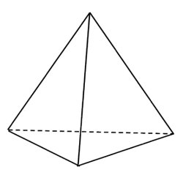


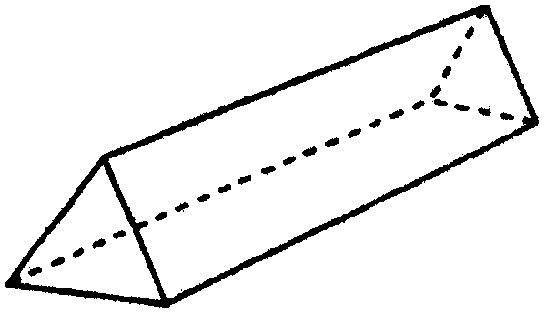
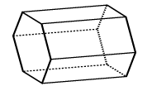
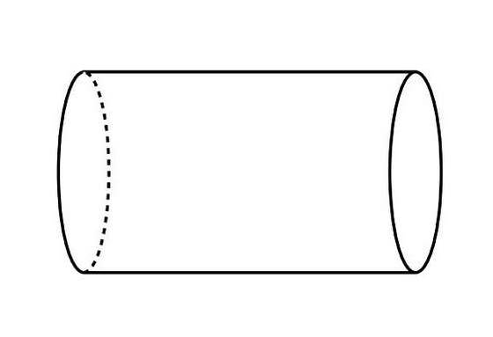

Faces, Edges and Vertices
Complete the following table:
Shape
Sketch
Faces
Edges
Vertices
Cube
Cuboid
Tetrahedron
Square-based Pyramid
Pentagonal-based Pyramid
Triangular Prism
Hexagonal Prism
Cylinder
Cone
Sphere
Frustum

Slide 74
Faces, Edges and Vertices
Complete the following table:
Shape
Sketch
Faces
Edges
Vertices
Cube
6
12
8
Cuboid
6
12
8
Tetrahedron
4
6
4
Square-based Pyramid
5
8
5
Pentagonal-based Pyramid
6
10
6
Triangular Prism
5
9
6
Hexagonal Prism
8
18
12
Cylinder
3
2
0
Cone
2
1
1
Sphere
1
0
0
Frustum
6
12
8

Slide 75
Plenary
What is the link between Faces , Edges and Vertices in the Polyhedra?
Shape | Faces | Edges | Vertices
Cube | 6 | 12 | 8
Cuboid | 6 | 12 | 8
Tetrahedron | 4 | 6 | 4
Square-based Pyramid | 5 | 8 | 5
Pentagonal-based Pyramid | 6 | 10 | 6
Triangular Prism | 5 | 9 | 6
Hexagonal Prism | 8 | 18 | 12
Frustum | 6 | 12 | 8
Cube
Square-based Pyramid
Hexagonal Prism

Slide 76
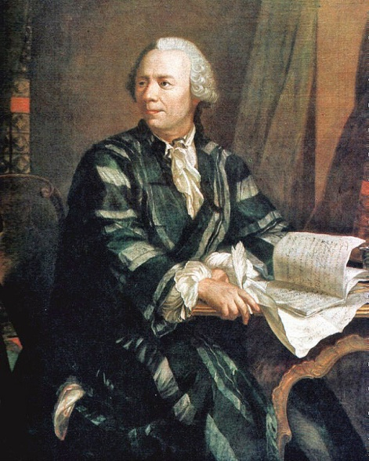
Plenary
or
This formula was discovered by Leonhard Euler, a Swiss mathematician considered to be one of the most prolific of all time…
Knowing this formula allowed mathematicians to further investigate the properties of 3D objects.
You can also set people impossible ‘trick’ tasks!
Leonhard Euler (1707-1783)
“Draw a polyhedron with 5 faces, 8 vertices and 10 edges”
This is impossible as the numbers do not fit the formula!

Slide 77
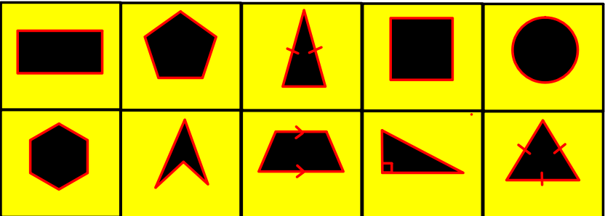

Demonstrate
Name the Shapes
Name the shapes and state the number of edges, vertices and faces for each

