Slide 1
Diffusion
Do now activity:
What types of substances might need to move in and out of a cell?
Which organelles might be involved with the movement of substances in an out of a cell?
What factors might affect how quickly substances move in and out of a cell?

Slide 2
Progress indicators
GOOD PROGRESS:
To understand how diffusion takes place and why it is important to a living organism
OUTSTANDING PROGRESS:
To explain the factors that affect the rate of diffusion

Slide 3
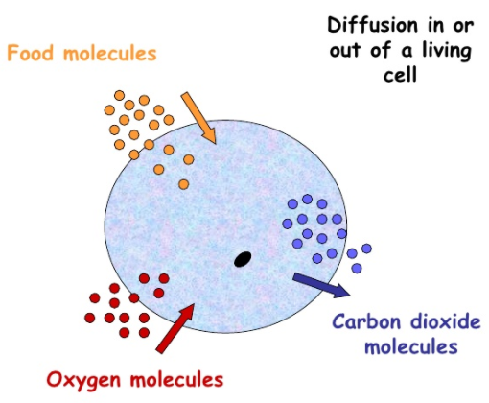
Your cells need to take in substances such as glucose and oxygen for respiration.
They also need to get rid of waste products and chemicals that are needed elsewhere in your body.
Dissolved substances and gases can move in and out of cells, across the cell membrane, by diffusion.

Slide 4
When you have just sprayed perfume, the concentration of perfume particles in that area is very high.
Diffusion is the movement of the ‘smelly’ particles, through particles of air, to an area where they are at a LOWER concentration.
Air particle
Perfume particle

Slide 5
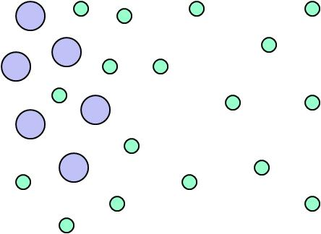
Definition of diffusion:
The spreading out of particles of a gas, or any substance in solution, resulting in the net movement of particles from an area of high concentration to an area of low concentration.

Slide 6
1
2
3
4
Task: Draw the diagrams above and match the correct statements to the correct diagram to demonstrate the sequence of diffusion
The particles are now nearly diffuse
The particles are separate when first put together
The particles are fully diffuse
They slowly start to mix due to their random motion

Slide 7
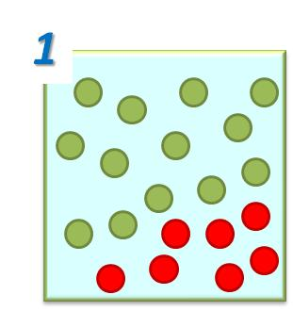
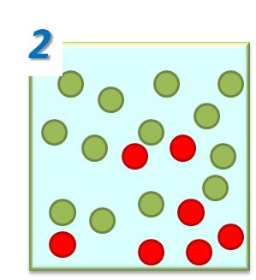
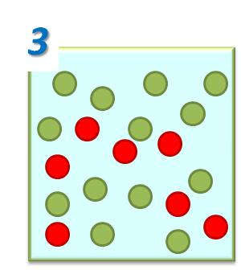
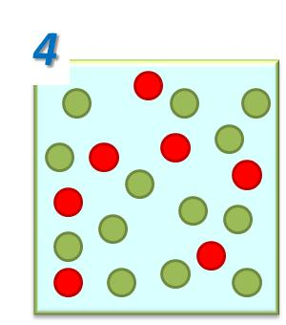
The particles are separate when first put together
They slowly start to mix due to their random motion
The particles are now nearly diffuse
The particles are fully diffuse

Slide 8
Think > Pair > Share!
Size of particles
What factors might affect the rate of diffusion?
Concentration of particles
Temperature

Slide 9
Another factor which affects the rate of diffusion is the concentration.
In general, the greater the difference in concentration, the faster the rate of diffusion. The difference between the two areas is called the concentration gradient.
The bigger the difference, the steeper the concentration gradient and the faster the rate of diffusion.
1. Which diagram – A, B or C – shows the steepest concentration gradient?
2. In which diagram would diffusion occur the slowest? Explain why?
A
B
C

Slide 10
Temperature also affects the rate of diffusion, how do you think temperature might affect the rate of diffusion?
http://lab.concord.org/embeddable.html#interactives/sam/diffusion/2-temperature.json
Key Words: thermal, collide, higher, diffusion, move
In summary, the _________ the temperature the quicker the rate of _________.
This is due to the fact the an increase temperature means the particles are supplied with more _______ energy. The more energy the particles have, the more they _______ around and will _______ more often.
This means diffusion will happen much more rapidly.

Slide 11
higher
In summary, the _________ the temperature the quicker the rate of _________.
This is due to the fact the an increase temperature means the particles are supplied with more _______ energy. The more energy the particles have, the more they _______ around and will _______ more often.
This means diffusion will happen much more rapidly.
diffusion
thermal
move
collide
Self-assessment

Slide 12
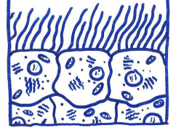
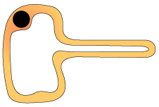
Diffusion in living organisms
Lots of dissolved substances move in and out of your cells, across your cell membrane. These include: oxygen, glucose, carbon dioxide, waste products such as urea.
Individual cells may be adapted to make diffusion easier and more rapid. Look at the two cells below, how are they adapted for diffusion?
The increased surface area of the cell membrane means the area over which diffusion can take place is increased.
Therefore, the rate of diffusion is increased!
Notes:
Ciliated cell: By Esaah6 (Own work) [CC BY-SA 3.0 (https://creativecommons.org/licenses/by-sa/3.0)], via Wikimedia Commons

Slide 13
Plenary: Create 3 quiz questions to test your peers knowledge of diffusion
Notes:
Ciliated cell: By Esaah6 (Own work) [CC BY-SA 3.0 (https://creativecommons.org/licenses/by-sa/3.0)], via Wikimedia Commons

