Slide 1
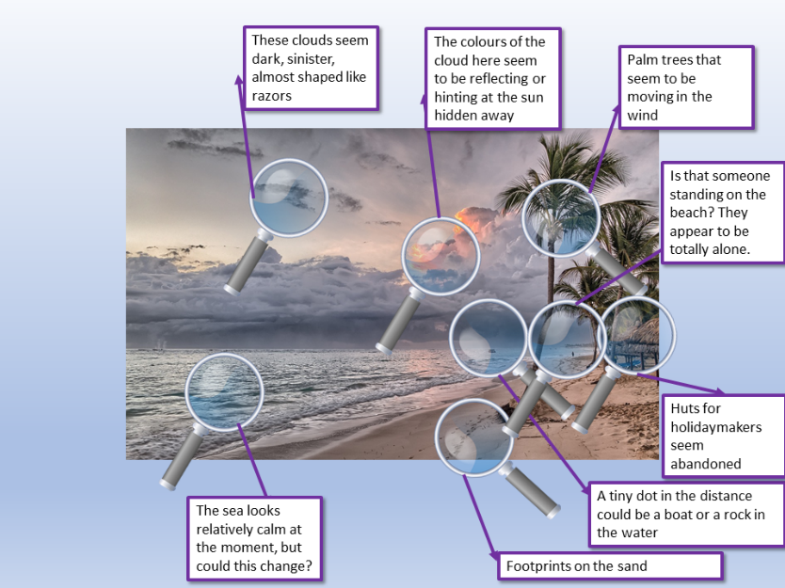
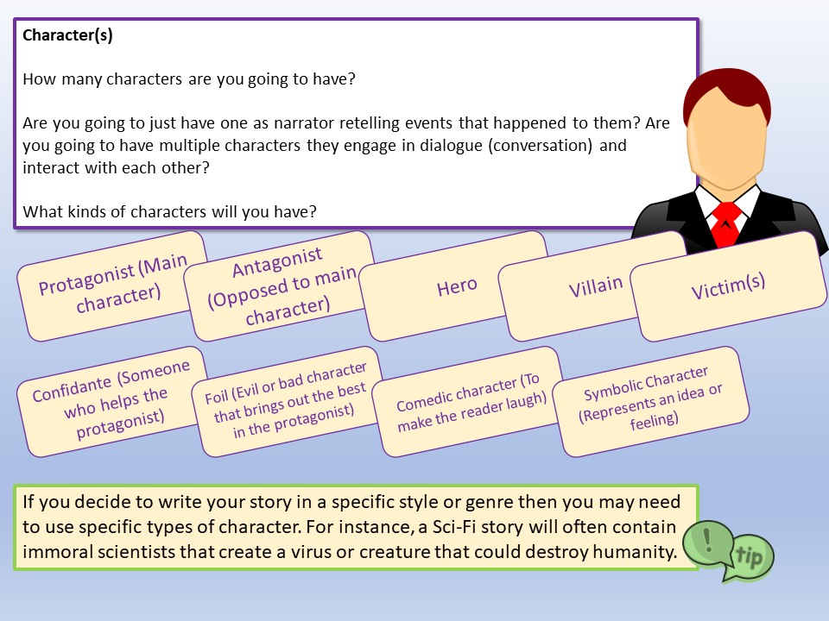
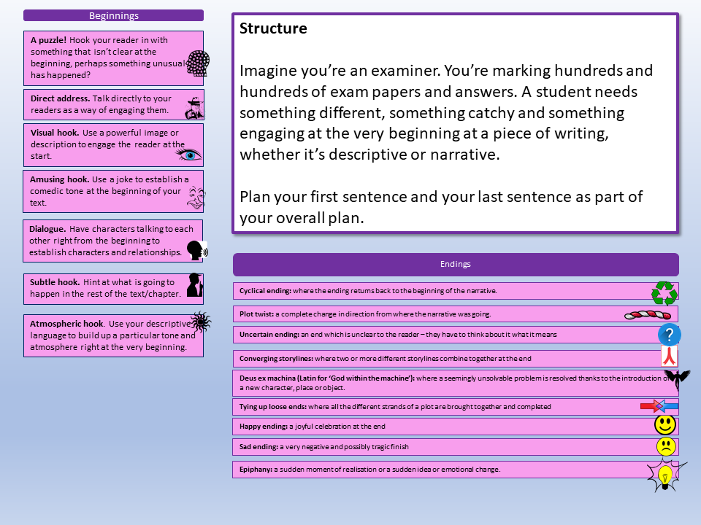
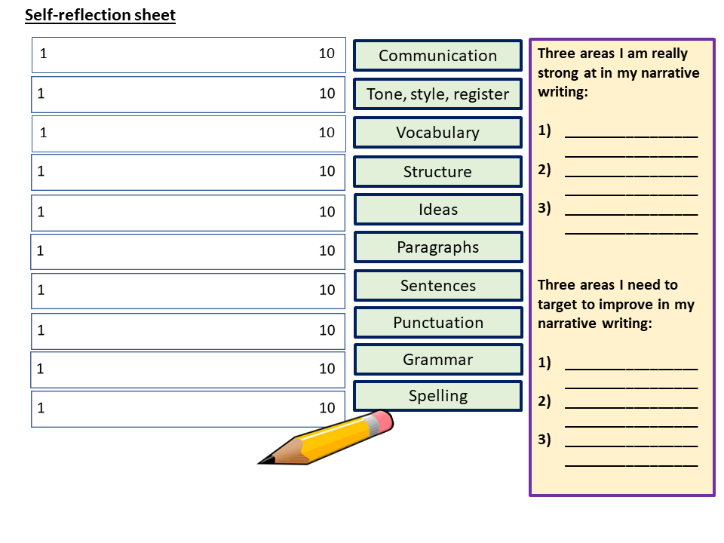
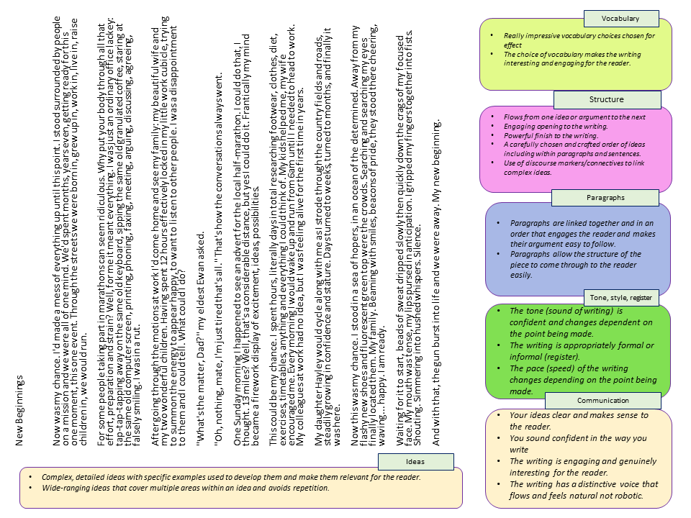
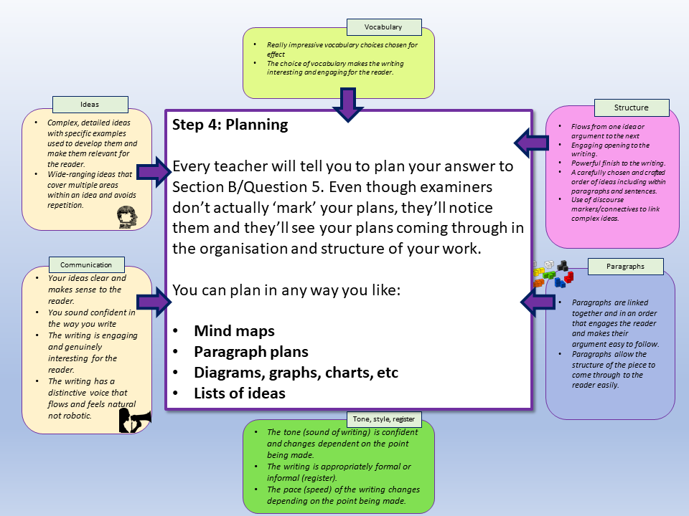
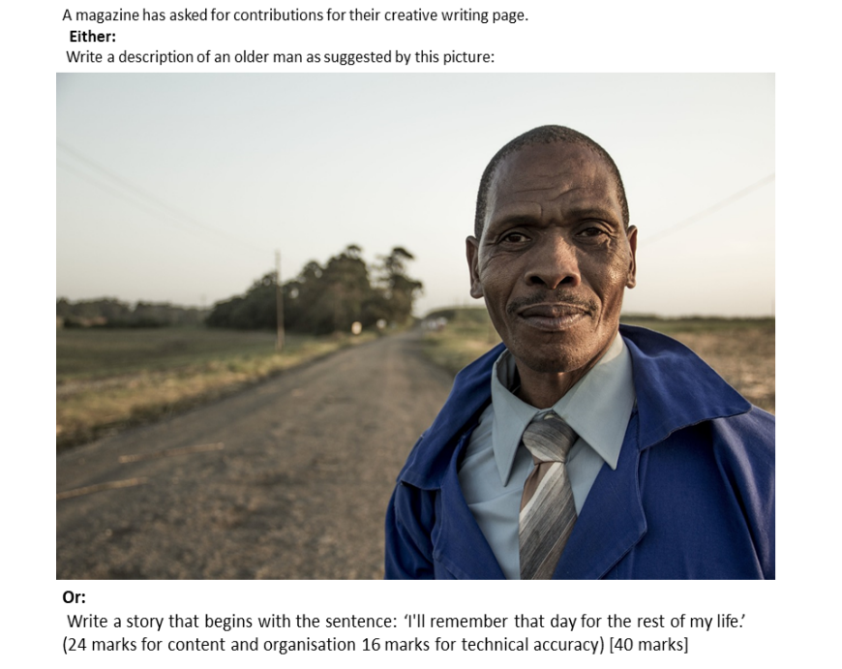
AQA English Language Paper 1 Question 5
Exam Practice Pack
Ten exam-style questions for narrative and descriptive writing
Step-by-step guides for narrative and descriptive writing
Modelled examples of narrative writing and descriptive writing
Self-reflection sheets
Revision guide for students
Revision lessons for teachers
Exam practice questions for teachers and students to use
34 slides of exam revision goodness!

Slide 2
AQA English Language Paper 1 Section B/Question 5
In Section B or Question 5 you’re asking to create a piece of fiction writing.
You’ll be given a choice of two writing tasks (only answer one!)
You might be asked to write narrative fiction (a story) or descriptive fiction (a detailed description).
However, you might only be given a choice of two narrative tasks or two descriptive tasks, so it is best to be prepared for both!
Here are the kinds of questions you’ll get:
Write a description of something as suggested by a picture
Write a story about something
Write a story that begins with the sentence…
Describe something...
Write a story about… as suggested by this picture.

Slide 3
A magazine has asked for new contributors to their fiction writing section.
Either
Write a description of a holiday as suggested by this picture:
or
Write a story about a time when something changed dramatically.
(24 marks for content and organisation 16 marks for technical accuracy) [40 marks]

Slide 4
Write a description of a holiday as suggested by this picture:
Step 1: Identify what type of writing you’re being asked to make
When you read this task, a few alarms should be going off in your head. Firstly, it’s asking for a description, not a story (narrative writing).
Secondly, it asks you to focus on a holiday, so that’s what you’ll be describing.
Finally, it mentions about creating a description suggested by this picture. This means you can use the picture for inspiration or ideas.
Step 2: Zoom in on the picture and select at least five key areas to describe
You could literally draw circles on your exam picture to help you remember!

Slide 5
These clouds seem dark, sinister, almost shaped like razors
The colours of the cloud here seem to be reflecting or hinting at the sun hidden away
Palm trees that seem to be moving in the wind
Is that someone standing on the beach? They appear to be totally alone.
Huts for holidaymakers seem abandoned
A tiny dot in the distance could be a boat or a rock in the water
The sea looks relatively calm at the moment, but could this change?
Footprints on the sand

Slide 6
Step 3: Think about the tone or sound of writing you want to create
Is this going to be a happy holiday? Is this going to be a terrible experience? Will it start off fantastic but end miserably?
If you look at the original picture the colours seem to suggest a mixture of a calm and relaxing holiday (palm trees, huts, beautiful sands), but the clouds and the hidden sun suggest a storm is on the way, so there is an undercurrent of tension. A combination of these two tones would make for a brilliant description!

Slide 7
Vocabulary
Really impressive vocabulary choices chosen for effect
The choice of vocabulary makes the writing interesting and engaging for the reader.
Ideas
Structure
Complex, detailed ideas with specific examples used to develop them and make them relevant for the reader.
Wide-ranging ideas that cover multiple areas within an idea and avoids repetition.
Step 4: Planning
Every teacher will tell you to plan your answer to Section B/Question 5. Even though examiners don’t actually ‘mark’ your plans, they’ll notice them and they’ll see your plans coming through in the organisation and structure of your work.
You can plan in any way you like:
Mind maps
Paragraph plans
Diagrams, graphs, charts, etc
Lists of ideas
Flows from one idea or argument to the next
Engaging opening to the writing.
Powerful finish to the writing.
A carefully chosen and crafted order of ideas including within paragraphs and sentences.
Use of discourse markers/connectives to link complex ideas.
Communication
Paragraphs
Your ideas clear and makes sense to the reader.
You sound confident in the way you write
The writing is engaging and genuinely interesting for the reader.
The writing has a distinctive voice that flows and feels natural not robotic.
Paragraphs are linked together and in an order that engages the reader and makes their argument easy to follow.
Paragraphs allow the structure of the piece to come through to the reader easily.
Tone, style, register
The tone (sound of writing) is confident and changes dependent on the point being made.
The writing is appropriately formal or informal (register).
The pace (speed) of the writing changes depending on the point being made.

Slide 8
Here’s an example plan. Master planning and you master writing!
Introduction: Describe how the holiday has been so far: peaceful, calm, relaxed.
Topic 2: Zoom in on sand and footprints. Zoom in on palm trees and colours.
Topic 3: Zoom in on huts and describe memories of holiday.
Topic 4: Zoom in on person on beach – that’s me. Switch to sinister tone – zoom in on the darker clouds.
Topic 5: Zoom in on choppy waters, switch to empty huts, palm trees moving more wildly.
Topic 6/Conclusion: Zoom back to man on beach – zoom in on eyes on face. End with description of a tear on face.

Slide 9
Beginnings
Step 5: Beginnings and Endings
Imagine you’re an examiner. You’re marking hundreds and hundreds of exam papers and answers. A student needs something different, something catchy and something engaging at the very beginning at a piece of writing, whether it’s descriptive or narrative.
Plan your first sentence and your last sentence as part of your overall plan.
A puzzle! Hook your reader in with something that isn’t clear at the beginning, perhaps something unusual has happened?
Direct address. Talk directly to your readers as a way of engaging them.
Visual hook. Use a powerful image or description to engage the reader at the start.
Amusing hook. Use a joke to establish a comedic tone at the beginning of your text.
Dialogue. Have characters talking to each other right from the beginning to establish characters and relationships.
Endings
Subtle hook. Hint at what is going to happen in the rest of the text/chapter.
Cyclical ending: where the ending returns back to the beginning of the narrative.
Atmospheric hook. Use your descriptive language to build up a particular tone and atmosphere right at the very beginning.
Plot twist: a complete change in direction from where the narrative was going.
Uncertain ending: an end which is unclear to the reader – they have to think about it what it means
Converging storylines: where two or more different storylines combine together at the end
Deus ex machina (Latin for ‘God within the machine’): where a seemingly unsolvable problem is resolved thanks to the introduction of a new character, place or object.
Tying up loose ends: where all the different strands of a plot are brought together and completed
Happy ending: a joyful celebration at the end
Sad ending: a very negative and possibly tragic finish
Epiphany: a sudden moment of realisation or a sudden idea or emotional change.

Slide 10
First sentence
It was as if the world was encompassed in glass.
Final sentences
I feel the cold sting of a lone tear roll down my aching cheek. What have I done?

Slide 11
Now, give this a go yourself.
Go through all the steps we’ve looked at and plan out your answer carefully.
If you want to really make it like the exam, time yourself for 45 minutes (allow for any extra time if you are given it).
Remember to think about all the different requirements of the mark scheme.

Slide 12
Look at the example answer to the question provided to you
Using the mark scheme boxes and ideas given to you, think about what really works well in this answer in terms of:
Vocabulary
Structure
Paragraphs
Tone, style, register
Communication
Ideas
Go through the answer and highlight sections that work well in your opinion.
Make notes on how this answer works well and meets the requirements of the mark scheme.
Having reflected on this example, what might you add or change to your own version and why?

Slide 13
It was as if the world was encompassed in glass. Beautiful memories had been suspended in my mind’s eye, crystallised images of repetitive footsteps on golden sands, colossal palm trees gently swaying in the cooling breeze and soothing blurs of calming greens, joyous yellows and bountiful blues surrounded my thoughts. My holiday so far.
Standing stoically next to the ocean’s searching waves, bamboo huts with thatched hair waited for occupants. Normally they would be teeming with tourists, overflowing with boisterous conversation – laughing, shouts, happiness. Only a few days ago I had waited with my wife as we held multi-coloured and garish drinks and smiled at some much-told joke a friend had repeated, waiting to enter the inviting and calming azure blanket ahead of us.
That was the past, those crystallised images. Now you can see me standing in the distance. Isolated. Detached. Alone.
Looking up to the once cerulean skies, I see the omnipotent sun is flanked by imposing soldiers of grey, huge clouds of disappointment and frustration begin to cover the light. Below the horizon, the once enticing waters thrash and struggle, crashing towards the coast in ever-increasing motions of anger. A rattle of thunder from the upper echelons snatches my attention. Above my head inky snipers point themselves in my direction, waiting to strike. Ready for action.
My thoughts wander back to the beach and to the same huts that now shudder in solitariness. Next to them the previously peaceful palm trees judder and pulsate as the air grows aggressive. I think back to what has happened. I feel the cold sting of a lone tear roll down my aching cheek. What have I done?
Vocabulary
Really impressive vocabulary choices chosen for effect
The choice of vocabulary makes the writing interesting and engaging for the reader.
Structure
Flows from one idea or argument to the next
Engaging opening to the writing.
Powerful finish to the writing.
A carefully chosen and crafted order of ideas including within paragraphs and sentences.
Use of discourse markers/connectives to link complex ideas.
Paragraphs
Paragraphs are linked together and in an order that engages the reader and makes their argument easy to follow.
Paragraphs allow the structure of the piece to come through to the reader easily.
Tone, style, register
The tone (sound of writing) is confident and changes dependent on the point being made.
The writing is appropriately formal or informal (register).
The pace (speed) of the writing changes depending on the point being made.
Ideas
Communication
Complex, detailed ideas with specific examples used to develop them and make them relevant for the reader.
Wide-ranging ideas that cover multiple areas within an idea and avoids repetition.
Your ideas clear and makes sense to the reader.
You sound confident in the way you write
The writing is engaging and genuinely interesting for the reader.
The writing has a distinctive voice that flows and feels natural not robotic.
Notes:
Can be printed off. Word document version also included.

Slide 14
Complete your self-reflection sheet and make changes or additions to your own answer in red pen.
Communication
Tone, style, register
Vocabulary
Structure
Ideas
Paragraphs
Sentences
Punctuation
Grammar
Spelling

Slide 15
Self-reflection sheet
1 10
Communication
Three areas I am really strong at in my descriptive writing:
__________________________________
__________________________________
__________________________________
Three areas I need to target to improve in my descriptive writing:
__________________________________
__________________________________
__________________________________
Tone, style, register
1 10
Vocabulary
Structure
Ideas
Paragraphs
Sentences
Punctuation
Grammar
Spelling
Notes:
To print off

Slide 16
An online competition for creative writing is under way, and you have decided to enter.
Either
Write a story about a journey, as suggested by this picture:
or Write a story with the title ‘New Beginning’.
(24 marks for content and organisation 16 marks for technical accuracy) [40 marks]

Slide 17
Let’s look at a narrative (story) question now
In the next set of exam questions you’ll see that both of them start with ‘write a story’! That’s very naughty from the examiners, they want you to write a narrative piece – not a descriptive piece.
The first one wants you to use the picture for inspiration, but let’s look at the second one:
This time they’ve given you a title (a topic) but you don’t have to use the picture in any way.
Even when it says ‘suggested by this picture’ it means you can still make substantial changes.
or Write a story with the title ‘New Beginning’.
(24 marks for content and organisation 16 marks for technical accuracy) [40 marks

Slide 18
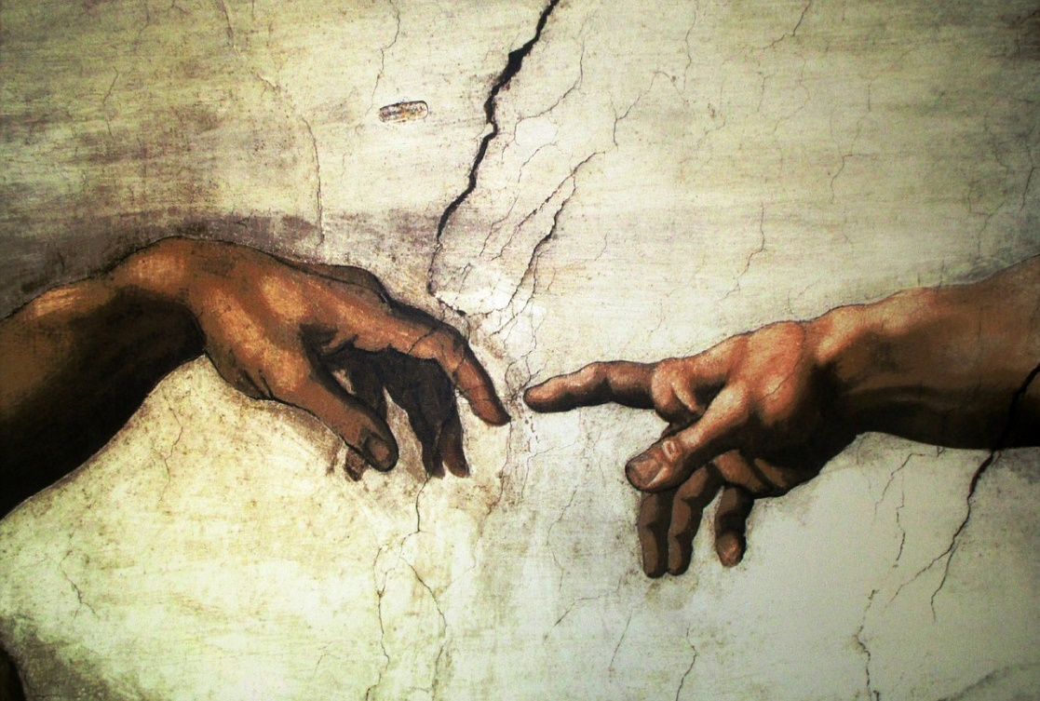
‘New Beginnings’ is a brilliant title to work with!
Beginning a race or sporting event
New day
New life
New planet
New home
New job
New way of life
New position
Creating a new universe
Beginning from the beginning!
New relationship
New situation or circumstances
War is over
Time to begin again
You don’t have to write about a journey or a railway station – you can choose any ‘new beginning’ you want! Like Sci-Fi? Write a Sci-Fi story. Like romance stories? Write about someone falling in love!

Slide 19
Remember to plan your story before you write it. There is so much you can think about before writing the piece!
Perspective or Viewpoint:
1st/2nd/3rd person? A mixture?
Character(s): How many? What type of characters?
Setting(s): Where does the story take place? Why?
Tone: What will it sound like? Serious? Light-hearted? Angry? Tense?
Plot: What will happen in your story?
Structure: How will it start? How will it end? Will it be tense in parts? When? Why?
Genre: What style of story is this? Sci-Fi? Western? Action? Romance? Crime?
Themes or messages: Is this story trying to ‘say’ something to its readers? What? How? Why?

Slide 20
Perspectives
Who is telling the story? Who is your narrator?
1st Person (“I”, “Me”)
Told from the viewpoint of a character in the actual story or from a narrator who gets involved in the story. Really useful for getting across the main characters’ thoughts and feelings and making a story more personal and emotive.
2nd Person (“You”)
Told from the viewpoint of a narrator talking to you.
Example: You see the iron door in front of you, imposing. Hesitating, you slowly move your hand to towards the handle.
It can help to bring a reader into a story, but it’s quite a hard perspective to use well and powerfully.
3rd Person (“They”)
Told from the viewpoint of a narrator talking about other people.
Example: Michael saw the door in front of him, imposing. Hesitating, he slowly moved his hand to towards the handle.
This is a really common perspective in creative writing as it allows the narrator to be neutral or detached from the story, allowing you to make up your own mind about the events taking place.

Slide 21
Character(s)
How many characters are you going to have?
Are you going to just have one as narrator retelling events that happened to them? Are you going to have multiple characters they engage in dialogue (conversation) and interact with each other?
What kinds of characters will you have?
Protagonist (Main character)
Antagonist (Opposed to main character)
Hero
Villain
Victim(s)
Confidante (Someone who helps the protagonist)
Foil (Evil or bad character that brings out the best in the protagonist)
Comedic character (To make the reader laugh)
Symbolic Character (Represents an idea or feeling)
If you decide to write your story in a specific style or genre then you may need to use specific types of character. For instance, a Sci-Fi story will often contain immoral scientists that create a virus or creature that could destroy humanity.

Slide 22
Settings
Where will your story be set? Are you going to have more than one setting?
What would be the best setting(s) for your style, genre and type of story?
Think carefully about your setting – they help to establish a tone, can impact on a narrative and really help to engage the reader with your whole story.

Slide 23
Tone
Remember how we thought about tone before? Well, it’s really important to get the sound of your writing consistent. Will it be angry? Will it be disappointed? Will it be joyful? Will it be a combination of different tones?

Slide 24
Plot
So you’ve got an idea of the characters, the settings, the tone and the perspectives of your story so far.
However, what exactly is going to happen in your story? It’s really important that you plan this out and decide where you’re going with your story.
Here’s an example plan. Master planning and you master writing!
Introduction: Protagonist talks about the race and introduces it.
Topic 2: Focus moves on to the reasons for wanting to run the race and how he wanted a change to his life.
Topic 3: Focus is on what the man’s life used to be like and how he was lazy, sad, unhappy and so on. Introduces his children and his wife and he feels they are disappointed with him.
Topic 4: Focus switches to the preparations the man has gone through to get ready for his race and the sacrifices he made.
Topic 5: Protagonist describes the race start, the emotions he feels and the thoughts that go through his head.
Topic 6: The protagonist spies his family watching in the crowd and their beaming faces. He feels ready.
Topic 7: The protagonist makes his final preparations and the gun goes off. This is his new beginning.

Slide 25
Beginnings
Structure
Imagine you’re an examiner. You’re marking hundreds and hundreds of exam papers and answers. A student needs something different, something catchy and something engaging at the very beginning at a piece of writing, whether it’s descriptive or narrative.
Plan your first sentence and your last sentence as part of your overall plan.
A puzzle! Hook your reader in with something that isn’t clear at the beginning, perhaps something unusual has happened?
Direct address. Talk directly to your readers as a way of engaging them.
Visual hook. Use a powerful image or description to engage the reader at the start.
Amusing hook. Use a joke to establish a comedic tone at the beginning of your text.
Dialogue. Have characters talking to each other right from the beginning to establish characters and relationships.
Endings
Subtle hook. Hint at what is going to happen in the rest of the text/chapter.
Cyclical ending: where the ending returns back to the beginning of the narrative.
Atmospheric hook. Use your descriptive language to build up a particular tone and atmosphere right at the very beginning.
Plot twist: a complete change in direction from where the narrative was going.
Uncertain ending: an end which is unclear to the reader – they have to think about it what it means
Converging storylines: where two or more different storylines combine together at the end
Deus ex machina (Latin for ‘God within the machine’): where a seemingly unsolvable problem is resolved thanks to the introduction of a new character, place or object.
Tying up loose ends: where all the different strands of a plot are brought together and completed
Happy ending: a joyful celebration at the end
Sad ending: a very negative and possibly tragic finish
Epiphany: a sudden moment of realisation or a sudden idea or emotional change.

Slide 26
First sentence
Now was my chance.
Final sentences
And with that, the gun burst into life and we were away. My new beginning.

Slide 27
Genre
You might have a favourite type of story that you’re most familiar with. When I was a kid I read loads and loads of science fiction stories, and so I could write a pretty decent one.
Even if you don’t read that much (you should!) you could use movies and TV programmes you’ve seen as a source of inspiration.
For the example narrative I’ve created about the runner, it’s a kind of self-redemption narrative where the protagonist feels he needs to change his life for the better and does. This is a classic type of story: the anti-hero that becomes a hero for the sake of his or her family or friends.
When you think about genre, think about:
Types of character
Types of setting
Types of tone
Types of objects or items you’d expect to see

Slide 28
Themes or messages
Many narratives try to get across a particular message or theme to their readers.
For instance, war stories are often anti-war and try to get across ideas of peace and ending conflict.
Love stories are often about people making bad choices and finding ways of changing those decisions for the better.
Love
Peace
Friendship
Honour
Trust
Respect
Abusing power
Ending conflict
Fighting for what is right

Slide 29
New Beginnings
Now was my chance. I'd made a mess of everything up until this point. I stood surrounded by people on a mission and we were all of one mind. We'd spent months, years even, getting ready for this one moment, this one event. Through the streets we were born in, grew up in, work in, live in, raise children in, we would run.
For some people taking part in marathons can seem ridiculous. Why put your body through all that effort, preparation and strain? Well, for me it meant everything. I was just an ordinary office lackey: tap-tap-tapping away on the same old keyboard, sipping the same old granulated coffee, staring at the same old computer screen, printing, phoning, faxing, meeting, arguing, discussing, agreeing, falsely smiling. I was in a rut.
After going through the motions at work I'd come home and see my family: my beautiful wife and my two wonderful children. Having spent 12 hours effectively locked in my little work cubicle, trying to summon the energy to appear happy, to want to listen to other people. I was a disappointment to them and I could tell. What could I do?
"What's the matter, Dad?" my eldest Ewan asked.
"Oh, nothing, mate, I'm just tired that's all." That's how the conversations always went.
One Sunday morning I happened to see an advert for the local half-marathon. I could do that, I thought. 13 miles? Well, that's a considerable distance, but yes I could do it. Frantically my mind became a firework display of excitement, ideas, possibilities.
This could be my chance. I spent hours, literally days in total researching footwear, clothes, diet, exercises, timetables, anything and everything I could think of. My kids helped me, my wife encouraged me. Every morning I would wake up and run from 6am until I needed to head to work. My colleagues at work had no idea, but I was feeling alive for the first time in years.
My daughter Hayley would cycle along with me as I strode through the country fields and roads, steadily growing in confidence and stature. Days turned to weeks, turned to months, and finally it was here.
Now this was my chance. I stood in a sea of hopers, in an ocean of the determined. Away from my flashy new shoes and fluorescent green top were the crowds. Searching and searching my eyes finally located them. My family. Beaming with smiles, beacons of pride, they stood there cheering, waving... happy. I am ready.
Waiting for it to start, beads of sweat dripped slowly then quickly down the crags of my focused face. My mouth was tense, my lips pursed in anticipation. I gripped my fingers together into fists. Shouting. Simmering into hushed whispers. Silence.
And with that, the gun burst into life and we were away. My new beginning.
Vocabulary
Really impressive vocabulary choices chosen for effect
The choice of vocabulary makes the writing interesting and engaging for the reader.
Structure
Flows from one idea or argument to the next
Engaging opening to the writing.
Powerful finish to the writing.
A carefully chosen and crafted order of ideas including within paragraphs and sentences.
Use of discourse markers/connectives to link complex ideas.
Paragraphs
Paragraphs are linked together and in an order that engages the reader and makes their argument easy to follow.
Paragraphs allow the structure of the piece to come through to the reader easily.
Tone, style, register
The tone (sound of writing) is confident and changes dependent on the point being made.
The writing is appropriately formal or informal (register).
The pace (speed) of the writing changes depending on the point being made.
Communication
Your ideas clear and makes sense to the reader.
You sound confident in the way you write
The writing is engaging and genuinely interesting for the reader.
The writing has a distinctive voice that flows and feels natural not robotic.
Ideas
Complex, detailed ideas with specific examples used to develop them and make them relevant for the reader.
Wide-ranging ideas that cover multiple areas within an idea and avoids repetition.
Notes:
Can be printed off. Word document version also included.

Slide 30
Complete your self-reflection sheet and make changes or additions to your own answer in red pen.
Communication
Tone, style, register
Vocabulary
Structure
Ideas
Paragraphs
Sentences
Punctuation
Grammar
Spelling

Slide 31
Self-reflection sheet
1 10
Communication
Three areas I am really strong at in my narrative writing:
__________________________________
__________________________________
__________________________________
Three areas I need to target to improve in my narrative writing:
__________________________________
__________________________________
__________________________________
Tone, style, register
1 10
Vocabulary
Structure
Ideas
Paragraphs
Sentences
Punctuation
Grammar
Spelling
Notes:
To print off

Slide 32
You’ve now practised both narrative and descriptive tasks!
Below are another six exam-style questions that you could use to create more plans and answers. The only way you’ll really get better at writing is by becoming a regular writer!
Try them yourself and get someone at home or your teacher to give you some feedback, but most important reflect on your own work and look to always improve as a writer.
Best of luck!

Slide 33
A local newspaper is running a creative writing competition and the best entries will be published. Either
Write a story about a crime as suggested by this picture:
or
Describe witnessing a crime taking place.
(24 marks for content and organisation 16 marks for technical accuracy)
[40 marks]

Slide 34
Your local newspaper is running a creative writing competition and they want to publish the winning entries.
Either Describe a day out as suggested by this picture:
Or Write a story about being disappointed. (24 marks for content and organisation 16 marks for technical accuracy) [40 marks]

Slide 35
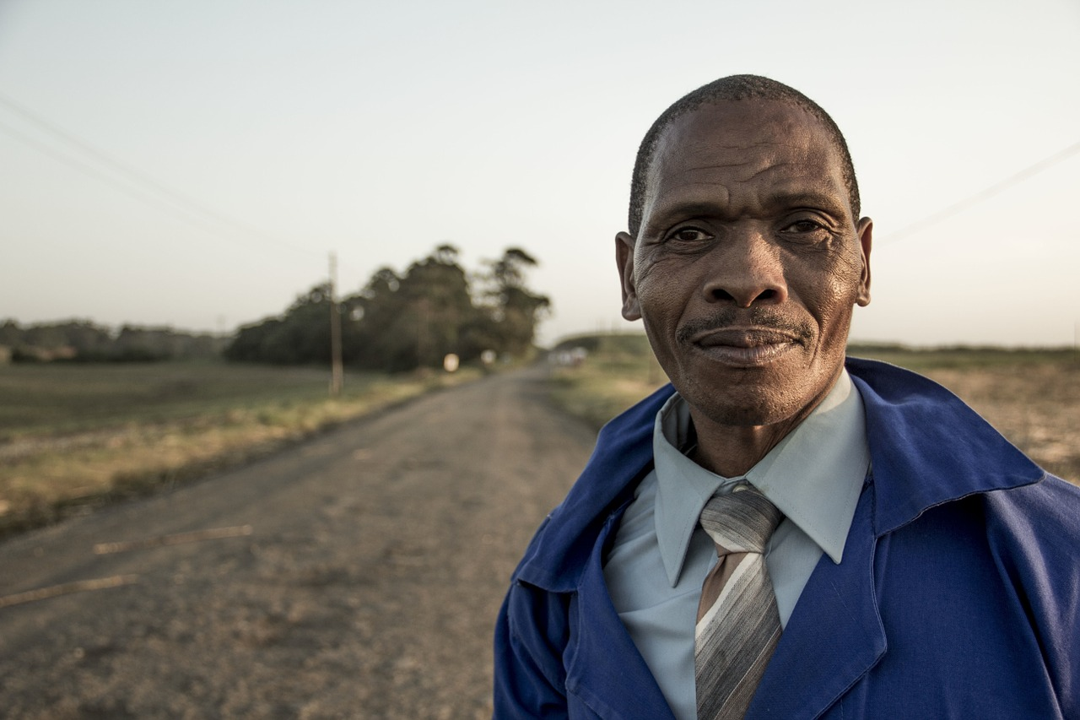
A magazine has asked for contributions for their creative writing page.
Either:
Write a description of an older man as suggested by this picture:
Or:
Write a story that begins with the sentence: ‘I'll remember that day for the rest of my life.’ (24 marks for content and organisation 16 marks for technical accuracy) [40 marks]

