Slide 1
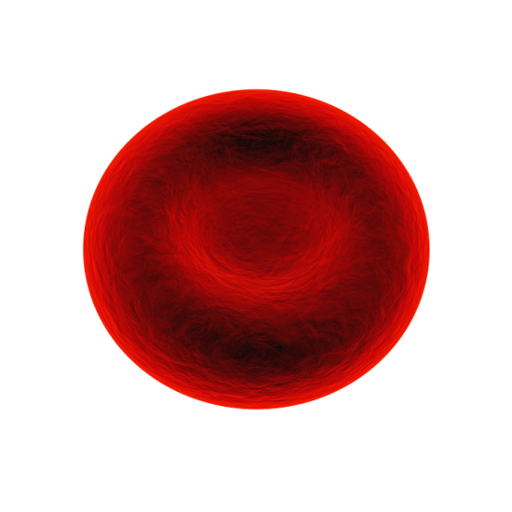
The blood
Do Now activity:
How is a red blood cell adapted to carry out its function?
Apart from red blood cells, can you name any other examples of cells found in the blood?
How are substances transported around the body?

Slide 2
Progress indicators
GOOD PROGRESS:
- Identify pictures representing the different types of blood cells
- Describe the four main components of blood
OUTSTANDING PROGRESS:
- Explain how each component is adapted to it’s function

Slide 3
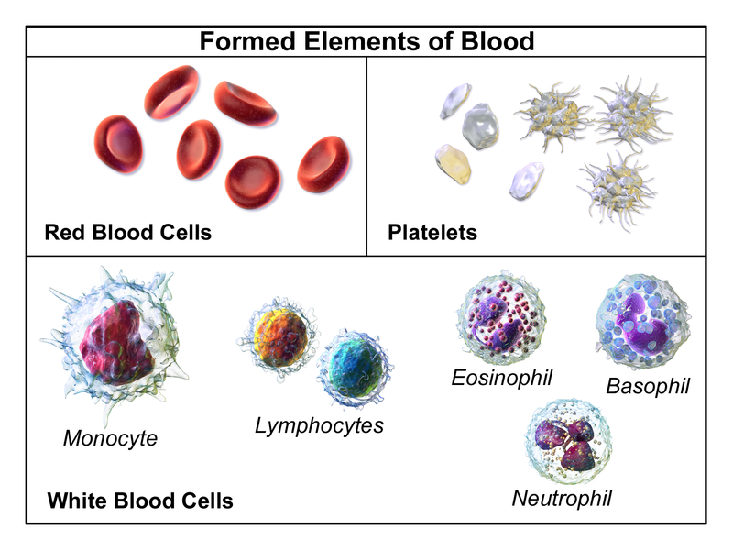
Your blood is a unique tissue, based on a liquid called plasma.
Plasma carries red blood cells, white blood cells and platelets suspended in it.
It also carries many dissolved substances around your body.
Notes:
By BruceBlaus. When using this image in external sources it can be cited as: Blausen.com staff (2014). "Medical gallery of Blausen Medical 2014". WikiJournal of Medicine 1 (2). DOI:10.15347/wjm/2014.010. ISSN 2002-4436. (Own work) [CC BY 3.0 (http://creativecommons.org/licenses/by/3.0)], via Wikimedia Commons

Slide 4
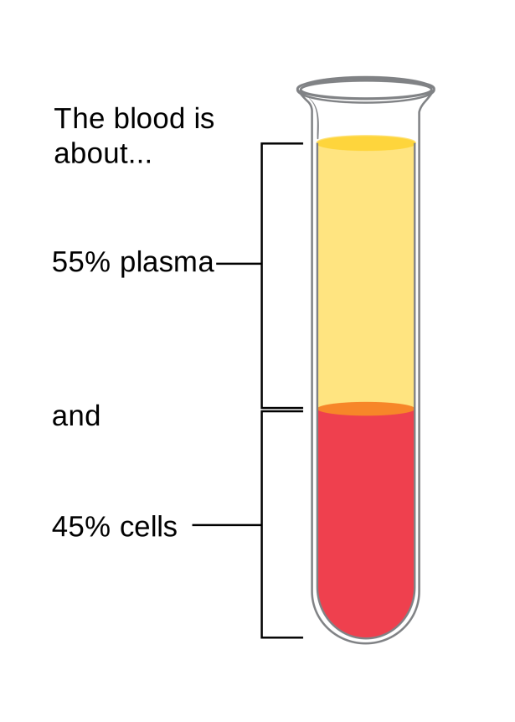
Task: You are going to given a placemat of questions, you will need to fill this in using the slips of information you will get.
Make sure you try and use as many of the key words as you can in your answers ☺.
Write in full sentences.
Notes:
Image by Cancer Research UK (Original email from CRUK) [CC BY-SA 4.0 (https://creativecommons.org/licenses/by-sa/4.0)], via Wikimedia Commons

Slide 5
Blood plasma
List the substances that are carried around the body in the blood plasma.
Where is urea formed and where does it exit the body?
EXTRA CHALLENGE: Why do you think that urea needs to be removed from the body?
Red blood cells
What is the job of the red blood cell?
List three adaptations of a red blood cell and explain how this helps a red blood cell to do it’s job
EXTRA CHALLENGE: Why do is it important that red blood cells have adaptations to do their job properly? What would happen if red blood cells couldn’t carry oxygen around the body?
To carry oxygen from the lungs to respiring cells
Carbon dioxide, urea, substances from digestion. E.g. glucose, amino acids, lipids
Forms in the liver and is removed from the body by the kidneys
Biconcave shape – higher SA:Vol ratio = faster diffusion
Lots of haemoglobin – to bind to more oxygen
No nucleus – more space for haemoglobin to carry more oxygen
White blood cells
State one difference of a red blood cell to a white blood cell?
How do white blood cells help to control microorganisms in the body?
EXTRA CHALLENGE: Why is it important that your white blood cells have different ways of killing microorganisms?
Platelets
Describe the structure of a platelet
Describe how clotting helps to prevent blood loss
EXTRA CHALLENGE: If a scab did not form and bacteria entered into your blood stream, explain what might happen to the microorganism
Small fragments of cells which do not have a nucleus
A white blood cell is bigger and also has a nucleus
Protein fibres will form a network with additional platelets to form a clot
Produce antibodies – kills microorganisms
Produces antitoxins – stops poisons from microorganisms
Phagocytes – engulf and break down microorganisms
Self-assessment

Slide 6
Transporting oxygen
Red blood cells carry oxygen. When a red blood cell passes through a capillary close to the alveolus in the lungs oxygen diffuses into the red blood cell.
The oxygen combines with the haemoglobin to produce a bright red substance called oxyhaemoglobin.

Slide 7
Transporting oxygen
When oxygenated blood flows through a capillary close to respiring cells, the oxygen leaves the oxyhaemoglobin and diffuses out of the blood and into the cells.
The oxyhaemoglobin is split up into haemoglobin and oxygen and the blood becomes less bright red – this is deoxygenated blood.

Slide 8
Task: Using the sentences below to complete the flow diagram to show how red blood cells transport oxygen around the body:
The red blood cells return to the lungs to collect more oxygen.
The blood is now oxygenated – rich in oxygen.
When oxygenated blood flows through a capillary close to respiring cells oxyhaemoglobin splits back into oxygen and haemoglobin.
Oxygen combines with haemoglobin, forming oxyhaemoglobin.
The blood is now deoxygenated.
When a red blood cell passes through a capillary close to the alveolus oxygen diffuses into the red blood cell
Oxygen diffuses out of the blood and into the tissue cells.

Slide 9
Self-assessment:
When a red blood cell passes through a capillary close to the alveolus oxygen diffuses into the red blood cell
Oxygen combines with haemoglobin, forming oxyhaemoglobin.
The blood is now oxygenated – rich in oxygen.
When oxygenated blood flows through a capillary close to respiring cells oxyhaemoglobin splits back into oxygen and haemoglobin.
Oxygen diffuses out of the blood and into the tissue cells
The blood is now deoxygenated.
The red blood cells return to the lungs to collect more oxygen

Slide 10
True or False?
When oxygen binds to haemoglobin within the red blood cells the blood is said to be deoxygenated
Platelets are small fragments of cells with no nucleus
Red blood cells do not contain a nucleus, this makes space for more haemoglobin meaning more oxygen can be transported
White blood cells are needed to form scabs when you have a cut or a graze
Blood plasma carries waste products such as carbon dioxide and urea
FALSE
TRUE
TRUE
FALSE
TRUE

Slide 11
Exam-style question
Task: Answer the past-paper question on your own at the back of your books!
6 = 6 minutes!
1. Complete the following table to give either the name or function of different components of blood: (3 marks)
2. Explain how haemoglobin helps a red blood cell to pick up oxygen from the alveoli and release it to cells where it is needed in the body. (4 marks)
Blood component | Function
Red blood cell
 | Help to clot the blood
White blood cell

Slide 12
Self-assessment:
a) Function of red blood cell: to pick up oxygen from the lungs and carry it around the body in blood vessels, delivering it respiring cells.
b) Blood component: Platelets
c) Function of white blood cells: make antibodies/antitoxins, engulf or destroy bacteria
- Oxygen diffuses from the alveoli and into the bloodstream
- Oxygen has an affinity for haemoglobin/forms oxy-haemoglobin
- In areas of high oxygen concentration
- Where there is a low oxygen concentration oxy-haemoglobin breaks down and release oxygen (e.g. to respiring tissues)

Slide 13
Plenary:
Produce a brain storm of all the key words we have learnt so far that are associated with the blood!
Blood – Key Words

Slide 14
Resources

Slide 15
Blood plasma
List the substances that are carried around the body in the blood plasma.
Where is urea formed and where does it exit the body?
EXTRA CHALLENGE: Why do you think that urea needs to be removed from the body?
Red blood cells
What is the job of the red blood cell?
List three adaptations of a red blood cell and explain how this helps a red blood cell to do it’s job
EXTRA CHALLENGE: Why do is it important that red blood cells have adaptations to do their job properly? What would happen if red blood cells couldn’t carry oxygen around the body?
White blood cells
State one difference of a red blood cell to a white blood cell?
How do white blood cells help to control microorganisms in the body?
EXTRA CHALLENGE: Why is it important that your white blood cells have different ways of killing microorganisms?
Platelets
Describe the structure of a platelet
Describe how clotting helps to prevent blood loss
EXTRA CHALLENGE: If a scab did not form and bacteria entered into your blood stream, explain what might happen to the microorganism

Slide 16
Blood plasma
Blood plasma is a transport medium, it transports your blood cells and other substances around your body.
Waste carbon dioxide produced by cells is carried to the lungs
Urea formed in your liver from the breakdown of proteins is carried to your kidneys where it is removed as urine
The small, insoluble products of digestion pass into the plasma and are carried to individual cells
Red Blood Cells
There are more red blood cells than any other cell in your body. The job of a red blood cell is to pick up oxygen from the air in your lungs and carry it to cells.
Red blood cells have adaptations which make them efficient at their job:
Biconcave shape means a high surface area to volume ratio, this increases diffusion
Packed full of haemoglobin that binds to oxygen
No nucleus = this means there is more space for haemoglobin
Notes:
Cut these four slips of information – blood plasma, red blood cells, white blood cells and platelets – into four strips. Each pupil can have one slip, they will need to trade information in order to complete their placemat

Slide 17
White blood cell
White blood cells are much bigger than red blood cells and there are fewer of them. They have a nucleus and form part of the body’s defence system. Different types of white blood cells do different things:
Some produce antibodies to fight against microorganisms
Some produce antitoxins to fight poisons made by microorganisms
Phagocytes engulf and digest microorganisms
Platelets
These are small fragments of cells which have no nucleus. Their main job is to clot the blood.
Clotting involves producing a network of protein fibres that capture red blood cells and more platelets to form a clot, so you don’t bleed to death!
The clot dries and hardens to form a scab, this stops bacteria entering the wound.

Slide 18
