Slide 1
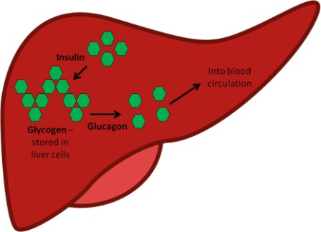
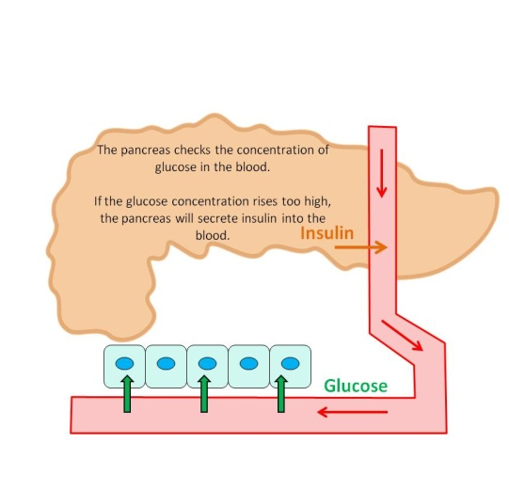
The control of blood glucose levels
Do now activity:
Name three hormones and the glands which produce them in the human body
What do you already know about the function of the pancreas?
Why might it be important to control blood glucose levels? What might happen if it rises to high/falls too low?

Slide 2
Progress indicators
GOOD PROGRESS:
Describe how blood glucose concentration is monitored and controlled.
Explain when insulin is produced and how it helps to control blood glucose levels
OUTSTANDING PROGRESS:
Explain how insulin and glucagon work together to control blood glucose levels.
HT: Explain when glucagon is produced by the pancreas and its effect on blood glucose levels.

Slide 3
Glucose is transported around the body dissolved in blood plasma. Cells take in the glucose and combine it with oxygen in respiration, this releases energy.
What might happen if blood glucose levels drop too low?
What might happen if blood glucose levels drop rise too high?
If blood glucose levels drop too low then cells may not get enough energy.
Brain cells are the first to be affected.
Task: In pairs, discuss how you think a rise in blood glucose or a fall in blood glucose levels might affect somebody
If blood glucose levels rise too high, then water is drawn out of the body cells by osmosis and this can do permanent harm.

Slide 4
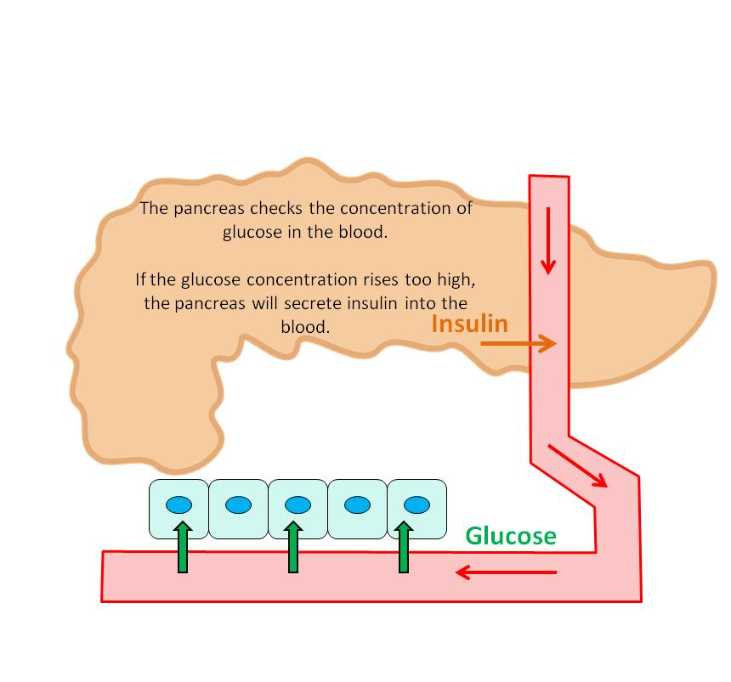
So how does your body keep your glucose levels at a constant?
Your pancreas monitors and controls the level of glucose in your blood using two hormones, the best known is insulin.
If blood glucose concentration rises…
The soluble glucose is moved into cells and either used by your cells or stored as insoluble glycogen.

Slide 5

So … what if the blood glucose concentration is too low?
The other important hormone needed to control blood glucose concentration is glucagon.
Glucagon makes your liver break down glycogen, turning it back into soluble glucose which then diffuses back into the blood.

Slide 6


Regulation of blood glucose levels
https://www.youtube.com/watch?v=y9Bdi4dnSlg
________ monitors blood glucose concentration
Blood glucose too low
Blood glucose too high
__________ is released by the __________ and _________ stops being released
__________ is released by the ____________.
Glucagon tells the liver to break __________ in to glucose and release this into the _________
Insulin tells the ________ to take ___________ out of the blood and turn it into glycogen and store it.
Blood glucose back to normal
Blood glucose back to normal
Task: Complete the flow diagram in your books
Notes:
Cheat Sheet: Write a list of key words on the board for students to use to fill these blanks in. Key Words are: Insulin, pancreas, glucagon, glucose, glycogen, blood, cells

Slide 7
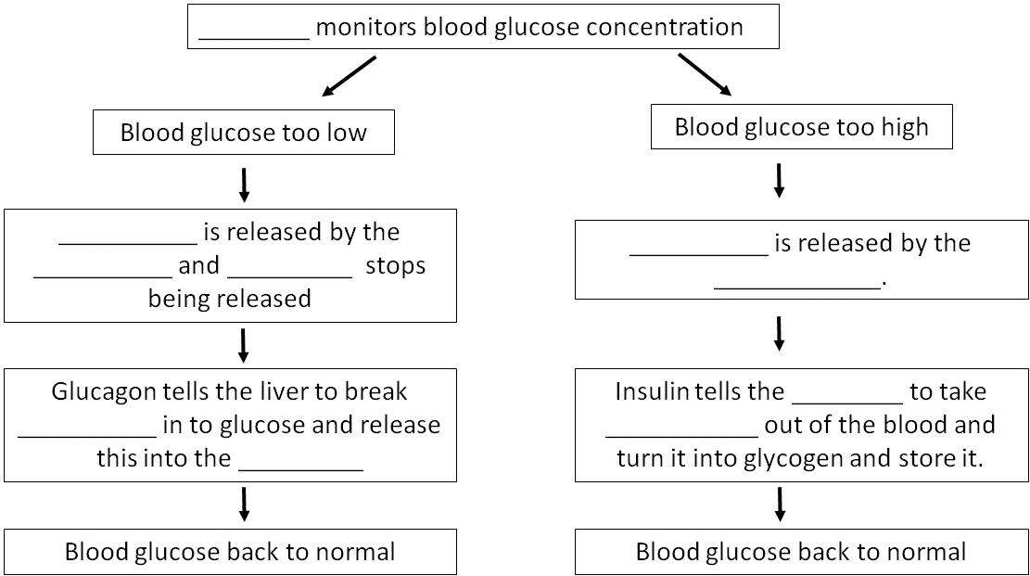

Self-assessment:
Pancreas
Glucagon
Insulin
pancreas
insulin
pancreas
liver
glucose
glucose
blood

Slide 8
Monitoring blood glucose – Key Words
Task: Copy the table below into your books, in groups you will be given a set of cards which can be used to fill in the missing the boxes:
Key Word | Role
Insulin
 | A hormone released by the pancreas to help increase the blood glucose concentration
 | Insoluble form of glucose that is stored together in long chains. It is stored in the liver.
Liver
Pancreas

Slide 9

Self-assessment:
Key Word | Definition
Insulin | A hormone released by the pancreas to help decrease the blood glucose concentration
Glucagon | A hormone released by the pancreas to help increase the blood glucose concentration
Glycogen | Insoluble form of glucose that is stored together in long chains. It is stored in the liver.
Liver | This is the site of many metabolic reactions, it stores glucose as glycogen.
Pancreas | The gland that monitors the blood glucose levels in your body, it will secrete insulin or glucagon as appropriate.

Slide 10
Quick Check: Silent 5
Task: ON YOUR OWN, answer the following questions in your book in silence…
Name the organs involved in regulating blood glucose
How do these organs regulate blood glucose levels?
How can blood glucose levels increase?
How can blood glucose levels decrease?
5. Name the 2 hormones released by the pancreas
6. What is glucose stored as in the liver?
7. How is this form of glucose released when blood glucose levels are too low?
8. What is the response when blood glucose levels are too high?

Slide 11

Self-assessment:
Brain, liver and pancreas
By releasing hormones
Eating or drinking food/drink that contains sugar
Exercising - respiring
Insulin and glucagon
Glycogen
Glucagon
Insulin released from the pancreas

Slide 12
What causes diabetes?
Task: Watch the video and try to answer the following questions:
What is the difference between type 1 and type 2 diabetes?
What are the main symptoms of both types of diabtes?
What are the risk factors of Type 2 diabetes?
How could you reduce the risk of developing type 2 diabetes?
https://www.youtube.com/watch?v=aq4Mv0qqWe0

Slide 13

Self-assessment:
Type 1 diabetes is when no insulin is produced by your pancreas and Type 2 diabetes is either there is not enough insulin produced by your pancreas or it is being produced but not working properly.
Symptoms of Type 1 and Type 2 diabetes are thirst, needing to urinate frequently, tiredness and weight loss.
The risk factors for Type 2 diabetes are being overweight, a family history of the disease, high blood pressure, poor diet and lack of exercise, age and ethnicity – South-Asians have a greater risk.
You can reduce your risk of Type 2 diabetes by maintaining a healthy body weight, exercising for 30 minutes each day can also reduce your risk by 40%

Slide 14
Task: Exam-style question
What is the name of an organ which released hormones? (1)
How do hormones travel around the body?
                (1)
Explain the cause of diabetes and how it is controlled. (3)

Slide 15

Self-assessment:
In the blood / bloodstream / circulatory system
Released by glands (endocrine gland)
The pancreas
Does not produce enough insulin / cannot control the blood sugar levels properly
One medical treatment – insulin injections / inhaler
Balanced diet / exercise

Slide 16
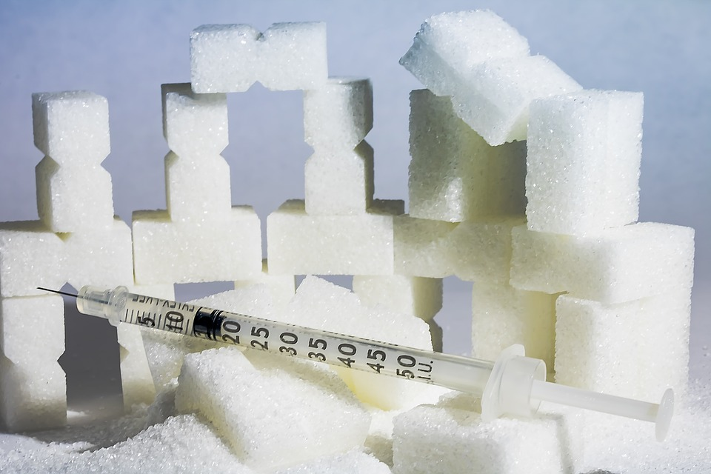
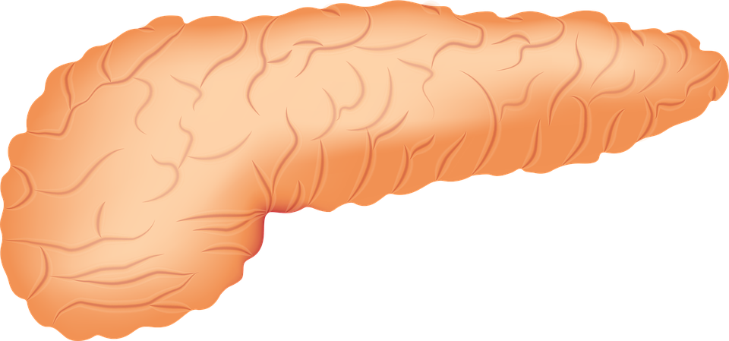
Plenary – Summarise what you have learnt this lesson in 3 sentences ☺

Slide 18
Glycogen
Glycogen
Glucagon
Glucagon
A hormone released by the pancreas to help decrease the blood glucose concentration
A hormone released by the pancreas to help decrease the blood glucose concentration
This is the site of many metabolic reactions, it stores glucose as glycogen.
This is the site of many metabolic reactions, it stores glucose as glycogen.
The gland that monitors the blood glucose levels in your body, it will secrete insulin or glucagon as appropriate.
The gland that monitors the blood glucose levels in your body, it will secrete insulin or glucagon as appropriate.

