Slide 1
Task – 8 Research of Still life Artists
Find names of artists who drew or painted still life works of art.
Find out information about them:-
Full name
Date of birth
Where they were born
What materials do they use to complete the still life drawings/paintings
What are their still life art works about
3. Collect some images and if you are able to print add them to your power point slide if not have a go at drawing to add to your research.
Put all this information together to make a creative leaflet about Still Life Art Works (or a reference page as we call it in Art)

Slide 2
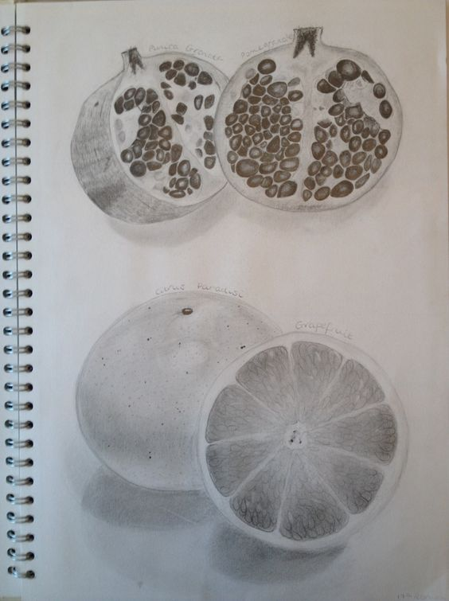
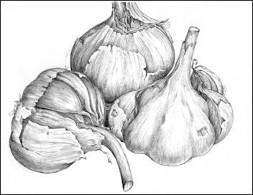
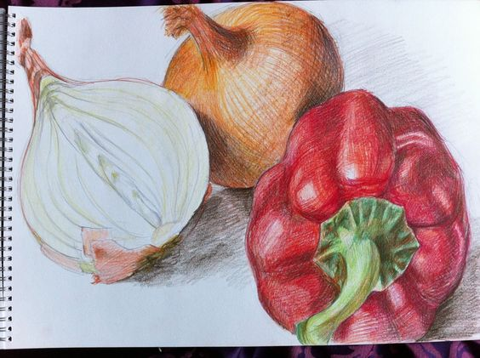
Task 9 - Observational drawing of a piece of fruit or vegetable cut in half
With the fruit or vegetable in front of you– observe the inside and the outside, then and draw and shade them in.
Once you have completed the outline add shading to give the drawing a more realistic look and 3D
Make sure your drawing is large (A4) to be able to add finer details

Slide 3
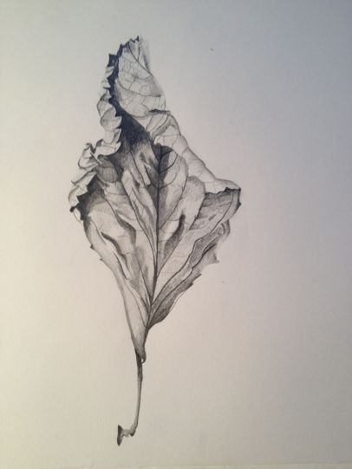
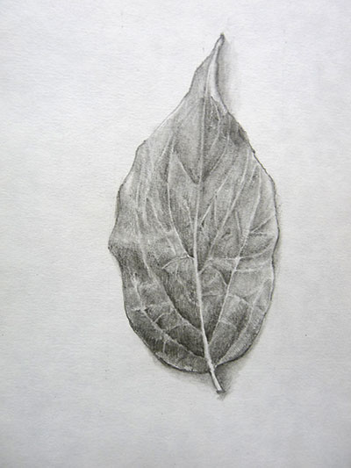
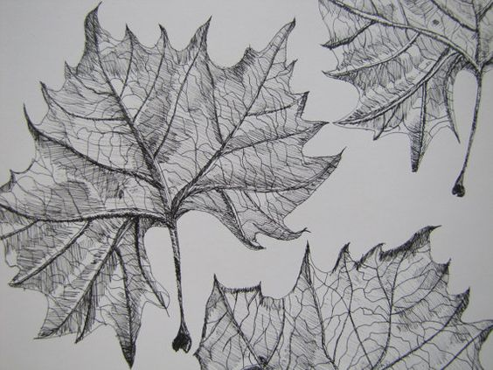
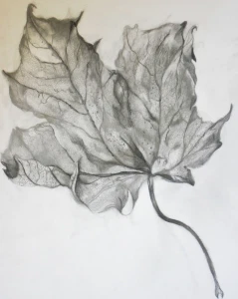
Task 10 - Observational drawing of a leaf in detail (close up)
With the leaf in front of you – observe and draw and shade it in(or colour if you have)
Once you have completed the outline add shading to give the drawing a more realistic look and 3D
Make sure your drawing is large (A4) to be able to add finer details

