Slide 1



1.4 - Market Research
Hyperlink(s)
Back button
Forward button
Notes:
Please note that the symbols and buttons behave as follows:
HYPERLINKS – where there is a hyperlink this symbol will be shown in the margin. More information about the hyperlink is given in the notes for each slide
BACK BUTTON – used where hyperlinks have been used to move to a given slide. This button will take you back to the slide the link was from
FORWARD BUTTON – this allows you to move forward to the next section (if there is one) of the presentation. This may skip a number of slides that are linked to from the slide the button appears on.

Slide 2
Progress Indicators
Outstanding Progress – Describe the purpose of market research
Good – Identify the purpose of market research

Slide 3



Market Research
Define Market Research?
“Market research” can be defined as:
“The organised gathering, recording and analysis
of data in order to better understand
the behaviour of customers”
Good – Identify the purpose of market research | Outstanding – Describe the purpose of market research

Slide 4


The Purpose of Market Research
Write the purpose to the description?
To understand customer needs | To reduce the business risks | To understand the market | To inform product development | To promote the organisation | To aid decision making
STRATEGIC REASONS:
TO REDUCE THE
BUSINESS RISKS
TO AID DECISION MAKING
TO PROMOTE THE ORGANISATION
  Research will
  help to indicate the likely success of a product or idea in advance
  Research findings can be
  used to help make decisions about what the a business should do
  Carrying out research can increase the awareness of the business and their products
MARKETING REASONS:
TO UNDERSTAND
THE MARKET
TO UNDERSTAND
CUSTOMER NEEDS
TO INFORM PRODUCT DEVELOPMENT
  To identify the competition, and understand their strengths and weaknesses
  To know what customers are looking for, so the business can try to provide it
  By gaining customer views, research findings can be used to help develop new and improved products
Good – Identify the purpose of market research | Outstanding – Describe the purpose of market research

Slide 5
1.5, 1.6 - Market Research Methods
Hyperlink(s)
Back button
Forward button
Notes:
Please note that the symbols and buttons behave as follows:
HYPERLINKS – where there is a hyperlink this symbol will be shown in the margin. More information about the hyperlink is given in the notes for each slide
BACK BUTTON – used where hyperlinks have been used to move to a given slide. This button will take you back to the slide the link was from
FORWARD BUTTON – this allows you to move forward to the next section (if there is one) of the presentation. This may skip a number of slides that are linked to from the slide the button appears on.

Slide 6
Progress Indicators
Outstanding – Describe the advantages and disadvantages of each market research method
Good – Describe how each market research methods is carried out

Slide 7

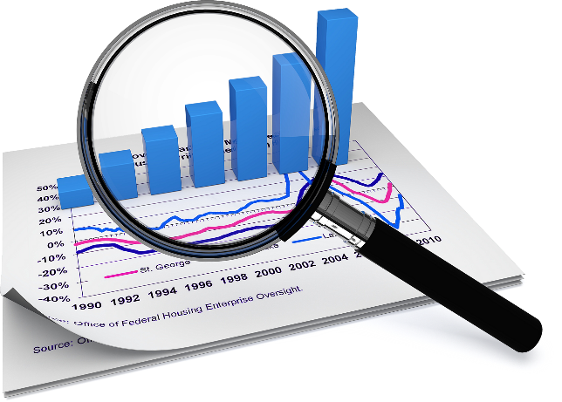
Methods of Market Research
Write a definition for primary and secondary research?
Methods of Market Research
Primary Research
Secondary Research
New information collected
first-hand
It might be collected by:
  The business itself
  Specialist
  research
  companies
Existing information collected
by someone else
It would include:
  Information within
  the business
  Information
  from outside
  the business

Slide 8





Primary Research
What are the 5 primary research methods?
Surveys
Focus Groups
Questionnaires
Observations
Consumer Trials
Investigate all 5 primary research methods.
Description of how they are conducted
2 x Positives and negatives
Good – Describe how each market research methods is carried out | Outstanding – Describe the advantages and disadvantages of each market research method
Notes:
“Surveys” takes you to slide 3
“Questionnaires” takes you to slide 4
“Consumer Trials” takes you to slide 5
“Focus Groups” takes you to slide 6
“Observation” takes you to slide 7
Forward takes you to slide 8 (End Slide)

Slide 9



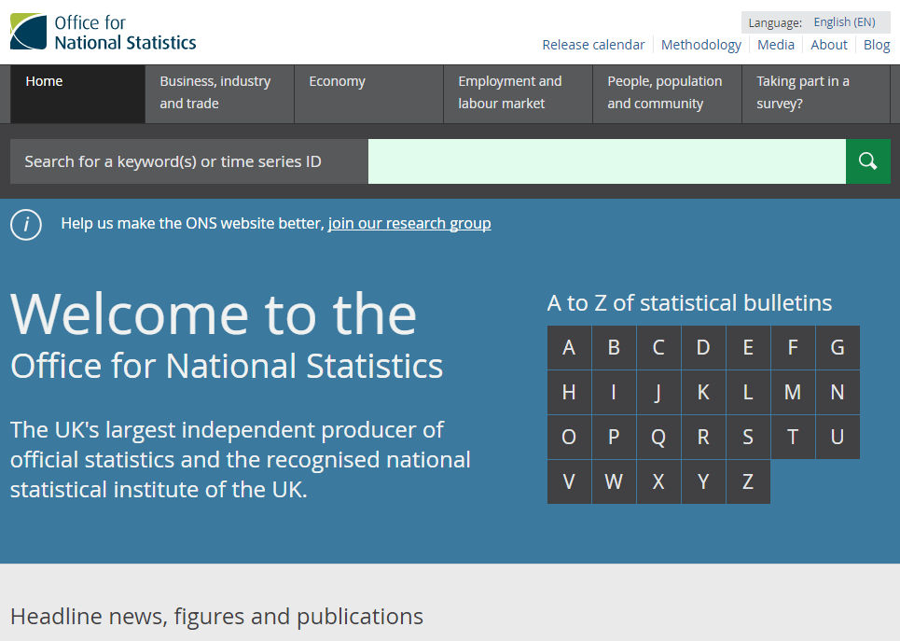
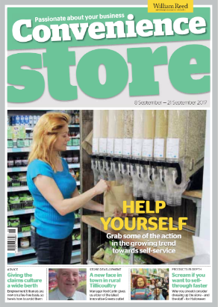


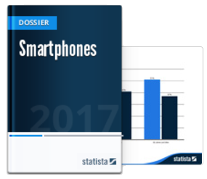




Secondary Research
What are the 5 secondary research methods?
Sometimes called “desk research”, this can be obtained from:
Competitor’s
Data
Books, Newspapers,
and Trade Magazines
Government Statistics and Publications
J Bloggs PLC
Annual Report
and Accounts
to Shareholders
Internal
Data
Investigate all 5 secondary research methods.
Description of how they are conducted
Positives and negatives
Purchased Research Material
Good – Describe how each market research methods is carried out | Outstanding – Describe the advantages and disadvantages of each market research method
Notes:
Click on the relevant text to find out more about each method of secondary research:
“Internal Data” takes you to slide 3
“Competitor’s Data” takes you to slide 4
“Books, Newspapers and Trade Magazines” takes you to slide 5
“Government Statistics and Reports” takes you to slide 6
“Market Reports” takes you to slide 7
Forward takes you to slide 8 (End Slide)

Slide 10
Primary
Market Research
Hyperlink(s)
Back button
Forward button

Slide 11



Surveys
“A detailed study that involves gathering
and analysing information.”
`
REASONS FOR
THINGS TO CONSIDER
  Tools can be tailored to the target market.
  Uses a range of tools so results are accurate
  Inappropriate tools = poor data gathered.
Notes:
Back returns you to slide 2

Slide 12

Questionnaires
“A list of questions designed to gather
information from people.”
`
REASONS FOR
THINGS TO CONSIDER
  Tailor questions for your need
  Collate results quickly
  Accurate analysis
  Need to be carefully planned to get the right information
  Dishonesty
Notes:
Back returns you to slide 2

Slide 13

Consumer Trials
`
“A temporary or restricted offer of a product to gain information from consumers who have the chance to examine, use or test it.”
REASONS FOR
THINGS TO CONSIDER
  Helps assess how good the product is.
  Provides a sense of urgency as the free trial will expire at a certain date.
c
  Limited to a geographical area
  Costly to carry out
  Some prospects will keep asking for free trial extensions.
Notes:
Back returns you to slide 2

Slide 14

Focus Groups
`
“A small group of people brought together to give their views and discuss a given product or topic.”
REASONS FOR
THINGS TO CONSIDER
  Suggest potential solutions to problems
  Help finalise a product
  Only small numbers of people are involved
  Difficult to manage
Notes:
Back returns you to slide 2

Slide 15


Observation
`
“Physically or electronically watching how people behave in a natural environment.”
REASONS FOR
THINGS TO CONSIDER
  ‘Real world’ behaviour of customers
  Observation could affect the natural behaviour of people
Notes:
Back returns you to slide 2

Slide 16
Secondary
Market Research
Hyperlink(s)
Back button
Forward button

Slide 17

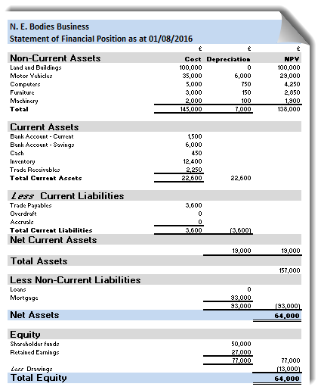
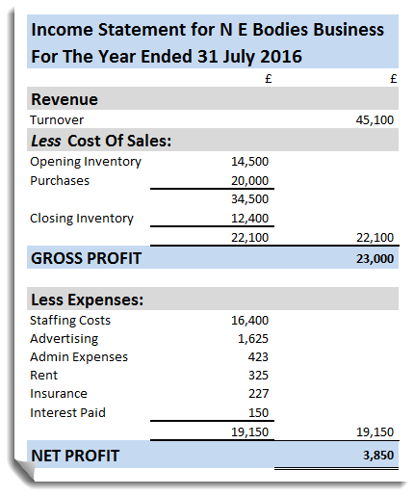
Internal Data
Internal data refers to information that a business already holds
Sources of internal data include:
Sales Data
Customer Profiles
Financial Records
REASONS FOR
THINGS TO CONSIDER
  Cheap and easy to obtain
  Exclusive to the organisation, so that rival firms will not have access to it.
  Information is not out of date
  If a project is new, there may be no relevant data at all.
Notes:
Back returns you to slide 2

Slide 18


Competitor’s Data
Competitors may also publish useful information:
J Bloggs PLC
Annual Report
and Accounts
to Shareholders
in company literature…
and in published accounts
On their website…
REASONS FOR
THINGS TO CONSIDER
  Easy to access information
  Cheap source of information
  Only provide limited information
Notes:
Back returns you to slide 2

Slide 19


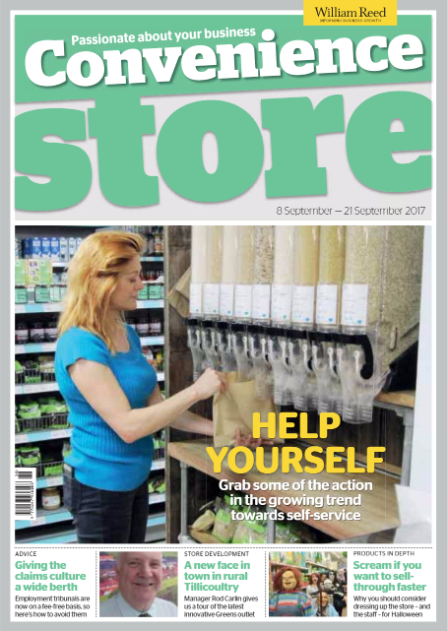
Books, Newspapers and Magazines
REASONS FOR
THINGS TO CONSIDER
  Provides and overview of key issues in the industry
  May lack detailed information
Notes:
Back returns you to slide 2

Slide 20


Government Publications and Statistics
  Huge amounts of data through the Office of National Statistics
  Detailed reports prepared as part of government action plans
REASONS FOR
THINGS TO CONSIDER
  Updated on a regular basis.
  Huge amount of data
  Detailed Reports
  May not provide detailed information on a specific area of interest
Notes:
Back returns you to slide 2

Slide 21
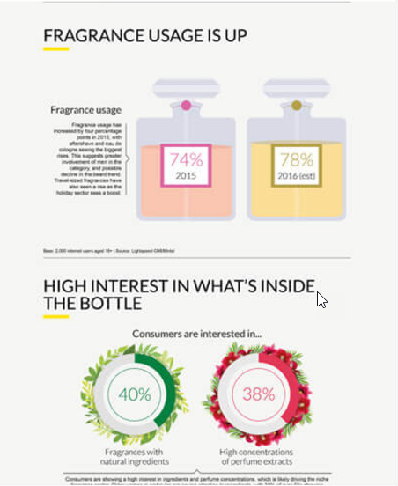
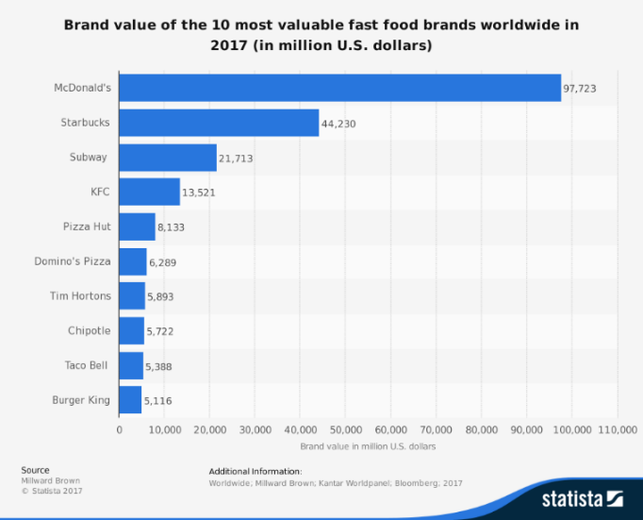

Purchased Research Material
This refers to reports that contain detailed and specific information about a market or industry
  They can be purchased from specialist companies, such as Mintel and Statista
REASONS FOR
THINGS TO CONSIDER
  Good source of market information
  Find industry/product specification reports
  Can be very expensive
  Reports may not be specifically relevant to your business
  Consumer trends may have changed
Notes:
Back returns you to slide 2

Slide 22
1.7 - Customer Feedback Techniques
Hyperlink(s)
Back button
Forward button
Notes:
Please note that the symbols and buttons behave as follows:
HYPERLINKS – where there is a hyperlink this symbol will be shown in the margin. More information about the hyperlink is given in the notes for each slide
BACK BUTTON – used where hyperlinks have been used to move to a given slide. This button will take you back to the slide the link was from
FORWARD BUTTON – this allows you to move forward to the next section (if there is one) of the presentation. This may skip a number of slides that are linked to from the slide the button appears on.

Slide 23
Progress Indicators
Outstanding – Describe how each customer feedback method works
Good – Identify different customer feedback methods

Slide 24
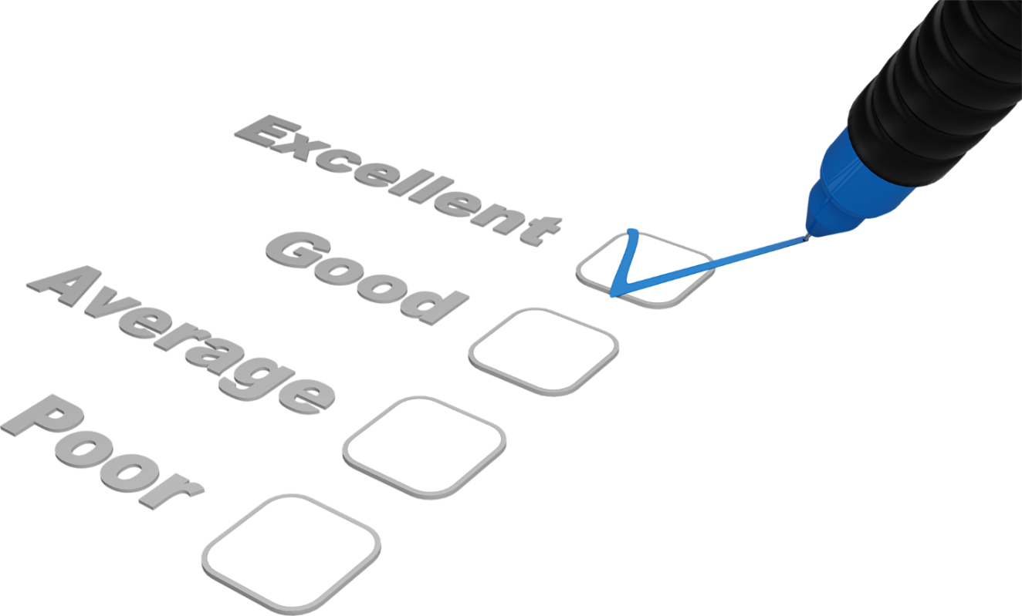
Customer Feedback
What is customer feedback?
“Opinions obtained directly from customers regarding their level of satisfaction for a given product, service or experience.”
`
Why is both positive and negative feedback important for business?
Good – Identify different customer feedback methods. | Outstanding – Describe how each customer feedback method works

Slide 25
Obtaining Customer Feedback
What are the different methods of feedback?
Online Surveys | Comments made to staff | Online/Email contact forms | Social media | Telephone & email surveys | comment cards
Customer
comment cards
Comments
made to staff
Online
surveys
Telephone &
email surveys
Social media
& online
communities
Online/Email contact forms
Good – Describe the different types of market segmentation. | Outstanding – Explain the benefits of market segmentation
Notes:
There are numerous case studies that may be useful here. For example, Richer Sounds make very effective use of customer comment cards, and the launch of Innocent Drinks followed an activity asking festival goers to try a sample, and then place their empty cup in one of 2 dustbins – 1 was for those who liked it, whilst the other was for those who didn’t like it.

Slide 26
Obtaining Customer Feedback
Customer
comment cards
Comments
made to staff
Online
surveys
Telephone &
email surveys
Social media
& online
communities
Online/Email contact forms
Investigate each method of gathering feedback
Good – Describe the different types of market segmentation. | Outstanding – Explain the benefits of market segmentation
Notes:
There are numerous case studies that may be useful here. For example, Richer Sounds make very effective use of customer comment cards, and the launch of Innocent Drinks followed an activity asking festival goers to try a sample, and then place their empty cup in one of 2 dustbins – 1 was for those who liked it, whilst the other was for those who didn’t like it.

Slide 27
Importance Customer Feedback
Why is Customer Feedback Important?
Help improve products
and services
Show customers that they
are valued
Provide information for future business decisions
Encourage customers to return, and build loyalty

