Slide 1
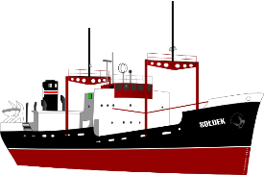
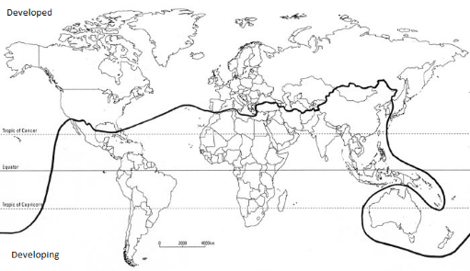
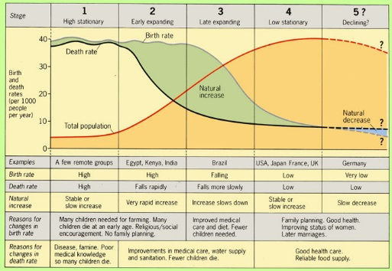
Measuring Development
Development measures how economically, socially, culturally or technologically advanced a country is. It suggests: advancement, evolution, expansion, growth, improvement, increase, maturity, progress, changes for the better.
Development Indicators
GNI | Gross National Income (Money earned by residents of a country including money earned abroad).
HDI | Human Development Index. Calculated using life expectancy, education, and per capita income.
Infant mortality | How many children per 1000 die before they are 1.
Literacy rate | The % of adults that read and write acceptably.
You must know advantages and disadvantages of each of these measures.
Factors Causing Uneven Development
Physical Environment | Health
Soil erosion, desertification, climate (and climate change), overgrazing and infertile soils affect farming. Areas without fertile land, natural resources, water and energy suffer. Natural hazards make little progress with development e.g. Haiti. | Diseases can make people too weak to work or go to school. 80% of all developing world disease is water-related. 2 million die a year. LIC’s are unable to invest in good quality health care
Trade | History
Trade blocs favour member states. Primary products sold by LICs are sold for cheap prices that can fluctuate. HICs make more expensive products so earn more. Poor infrastructure or conflict means some people cannot sell their goods at all. | Colonialism: Many countries in Asia, South America and Africa have spent a lot of time and money on civil wars and political struggles for power since being made separate from European superpowers. Many LICs haven’t had time to develop fully.
UK Links
Ports | Air | Roads
The UK’s port industry is the biggest in Europe due to our large coastline. There are 120 ports in the UK. Dover is the largest and Teesport is the 3rd biggest. 12 million people and 700,000 freight lorries travel from Dover a year. | Heathrow is the UK’s busiest airport with 1 plane taking off every 45 seconds. 300,000 people are employed in UK aviation. As well as large international airports small centres e.g. Cambridge airfield allow internal flights. | The first motorway the UK was opened in 1958. By 2008 there were 2,200 miles of motorways allowing rapid movement around the country. The A1 is the longest road in the UK and connects London and the north-east.
Classifying the World’s Development
 | An HIC has an GNI per capita of over $12,000. A NEE has an economy that is rapidly progressing. A LIC has a GNI per capita of below $800.
In the 1980’s, Dr Brandt classified the world into the rich north and the poor south. He drew this line called the Brandt Line or the North-South Divide. However, over time countries in the south began to develop e.g. Singapore and China, and the line became outdated.
UK Global Links
Political | Commonwealth - In 1922 Britain ruled over an empire of 458 million people (about 20% of the world’s population and 53 countries). - Many expats (Brits who live abroad) live in these ex-colonies. - Many of these ex colonies are part of the Commonwealth, choosing to keep close ties. EU - The UK joined the EU in 1973 with the aim of becoming part of the common market and improving trade between countries. - The UK opted to leave in 2016. Brexit negotiations are ongoing and outcomes are unsure. - About 50% of exports and imports are to the EU. Other links - The UK is a member of the G8, a group of 8 countries whose leaders meet to discuss important issues. - The UK is a member of NATO (North Atlantic Treaty Organisation) a group of European countries and the USA. Leaders meet to keep peace. - The UK is a member of the UN Security Council in which 15 countries meet to keep peace.
Trade | 50% of the UK’s exports go to EU countries, and 50% went to non-EU countries such as the USA and China. The USA takes the most. A lot of trade is now finance and communications following deindustrialisation.
Transport | More than 750,000 international flights depart from the UK annually to 400 airports in 114 countries. Heathrow is the 4th busiest airport in the world. Eurotunnel links Britain to Europe.
Culture | Spoken English has helped create strong links with countries. British exams can be sat abroad; recognised for their quality. UK TV productions have a global audience. We are a culture of immigration leading to a unique and multicultural society.
Technology | The UK is a centre for submarine internet cables connecting the whole world. 18 million British businesses run from home.
Unit 2b
The Changing Economic World
Solutions to Uneven Development
TNC investment | Aid
Industrial Development | Intermediate Technology
Fair Trade | Debt Relief
Microfinance loans | Tourism
Key terms
Standard of living refers to the economic level of a person’s daily life. Quality of life is a social measure of well being.
Tourism in Jamaica
Background: Jamaica is in the Carribbean. A fairly poor country that now relies heavily on its tourism in order to sustain the current quality of life. | Attractions: - Warm, tropical climate. Sandy beaches. Cultural experiences and the paradise holiday.
Positive Impacts | Negative Impacts
Economic - Many jobs including hotel workers, restaurants and entertainment Social – Increased GDP has been spent on improving the healthcare, education and infrastructure for Jamaicans Environmental – Some sites are now protected areas to encourage tourism, resulting in protected habitats. | Economic – Leakage. Much of the profits go abroad to companies that have invested from other countries. Social – Seasonal work. Employment only lasts during the summer months. Environmental – mass tourism has caused excess waste and damage to coral and beach ecosystems
Measuring Population
The demographic transition model shows how a country’s population changes as it becomes more developed, from subsistence farming cultures (LICs) to HICs.
Population pyramids change over time too – from having a lot of babies (a wide base), to good healthcare and more elderly people (a wide top).
Sustainable Tourism
Sustainable tourism aims to support local communities socially and economically whilst causing no harm to the environment e.g. small scale lodge developments employing local people and using local foods in Kenya.

Slide 2
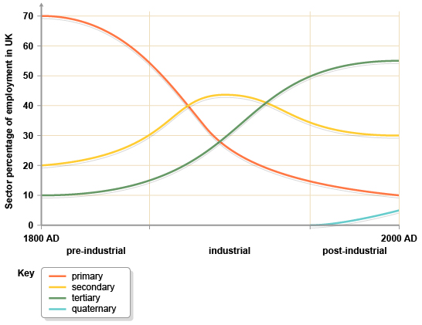
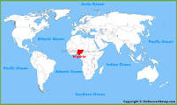
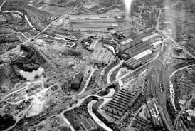
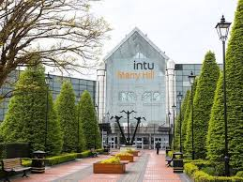
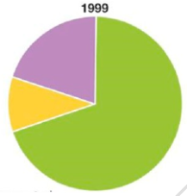
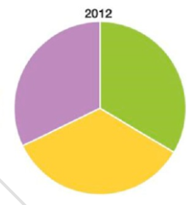
Economic and Industrial Change in Nigeria
History and Landscape
West Africa, North of the Equator Largest population of Africa – 184 million NEE – 3rd largest manufacturing economy in Africa Youthful educated population – skilled workforce for manufacturing and services 1960 Gained independence from the UK 1967 – 1970 Civil war followed by 28 years of military government. 1998 - Now stable democratic government 500 ethnic groups – South is Christian, North is Muslim. Some ethnic boundaries broken by rapid urbanisation South is Tropical Rainforest (Cocoa and oil palm crops) and North is Savanna (Peanuts grown) Issues in the north with extremist group Boko Haram – want Sharia law and own government. 17,000 dead.
Changes in Employment Structure |  | Industry
 |  | Oil found in 1950s. 14% GDP, 95% export earnings Produces 2.7% of world’s oil which is higher quality than oil from the Middle East Overdependence on oil -- prices fell in 2015 Oil processing led to chemical by products leading to growth in chemical industries such as soaps, detergents and plastics Dangote Cement (Nigerian company) has expanded into 13 countries in Africa All led to increased standard of living, FDI, jobs, taxes, multiplier effect, manufactured goods. Less imports needed and Nigerian TNCs have more influence in the region
60% live on less than US$1.25 a day. Growing inequality GDP 2006 – US$110 billion, GDP 2015 US$560 billion Money earned from Services 52%, Manufacturing 7%, Oil and gas 14%, Agriculture 22%, Other 5% Nollywood – 3rd largest film industry in the world 70% employed in agriculture in 1999 Rapid increase in telecommunications and retail Manufacturing increasing – processed food, leather, textiles, soap, detergents
TNCs in Nigeria: Shell
TNC – Trans-National Corporation – A company with headquarters in one country and operations across many other countries Huge investment 65000 directly employed and 250,000 indirectly employed 91% of contracts with Nigerian companies Issues – oil spills, oil flares (toxic fumes), militant groups disrupting supplies, oil theft and sabotage
Social issues: Employ male workforce Shell investing in the wider development of the country; schools, education and healthcare | Economic issues: - Investment mainly in south of Nigeria resulting in development disparities between north and south |  | Environmental issues: - Waste disposal and oil spills. Damage to wetland ecosystems
Aid to Nigeria
2009 – 2013 : 60 million mosquito nets distributed UK gives US$300 million year of aid Most successful projects are community based Problems include government corruption, government diverting money, donors have political influence, promoting commercial self interest
Impacts of Development in Nigeria
Rated 152/187 countries in terms of HDI. Improving and is increasing quickly New jobs mean more income and increased quality of life Large differences between north and south; rural and urban; educated and uneducated Lack of access to safe water, sanitation and reliable electricity supply Overdependence on oil may become an issue. If oil runs out, Shell leaves, what is the income? Key challenges include continuing stable government, pollution of the Niger delta, tsetse fly affecting commercial livestock, desertification, religious conflict between north and south, Boko Harem extremist group
Economic and Industrial Change in the UK
Industrialisation took place in the UK during the 1800s. Most early manufacturing industry took place in areas with coal fields which provided energy. This was a break of bulk location, reducing transport costs. |  | De-industrialisation is the decline in secondary (manufacturing) industries, and the subsequent growth in tertiary and quaternary employment. The UK has experienced de-industrialisation changing into a post-industrial economy; with more tertiary & quaternary industries. Secondary industries has moved to cheaper countries e.g. China. | De-industrialisation is the decline in secondary (manufacturing) industries, and the subsequent growth in tertiary and quaternary employment. The UK has experienced de-industrialisation changing into a post-industrial economy; with more tertiary & quaternary industries. Secondary industries has moved to cheaper countries e.g. China.
Industry in the Black Country was characterised by mining and heavy industry, including coal mines, iron and steel industry. As raw materials were used up, and it became cheaper to import coal as well as manufacture abroad, industry fell into decline. Round Oak Steel Works closed in the 80s. The Merry Hill Centre is now situated on the site of this steel works.
De-industrialisation has many socio-economic impacts. High unemployment leads to the decline of services in affected areas. Reliance on benefits leads to a decline in housing quality. Life expectancy in de-industrialised areas is lower than the national average. Average GCSE grades are also lower in these areas.
Modern industrial developments in the UK
For years the UK thrived due to its secondary industries. However it is now a post industrial economy; one where most manufacturing jobs have been replaced by jobs in the service industries. A new sector that is growing rapidly is the quaternary industry. Quaternary jobs are those that involve highly skilled people who carry out research, provide information and give advice e.g. financial advisers, research scientists.
Located to the north-east of Cambridge the site is home to over 1,500 IT and bio-technology (quaternary) companies. Location factors include closeness to a major junction of the A14 which provides rapid access to the M11, and thereafter Heathrow and London. It is on cheaper land at the edge of the city. This land is flat and there is room for expansion. The proximity to Cambridge University promotes strong working relationships and access to the best University graduates. |  | Toyota, Burnaston 1.5 million cars are manufactured in the UK by 7 large TNCs. Toyota are attempting to become more sustainable in a number of ways. - They have installed 17,000 solar panels and introduced more efficient practices. They aim to reach zero carbon emissions at the plant by 2050. - They are reducing water use, using rainwater harvesting methods and ensuring that all water used is purified before being returned to the environment.
The North-South Divide
Most areas affected by de-industrialisation are in the north and west of the UK. The areas of industrial growth tend to be in the south and west. The divide has led to social and economic differences. Unemployment in the north east is 5.5% higher than the south east. Average pay is £4,000 higher in the south and life expectancy is 2.5 years longer. In attempt to reduce the differences between the north and south governments have supported a number of schemes.
HS2 / HS3 HS2 and 3 are High Speed rail links that will run from London to Birmingham, and then on to Manchester and Leeds. Benefits - reduced travel times to the north will encourage the location of industry in the north. 100,000 jobs will be created. Problems - The scheme will cost over £50 billion, lead to 600 homes being demolished, and 150 nature sites being affected. |  | Roads £6 billion will be invested in northern roads to reduce congestion. Benefit - This will encourage industrial location as it will reduce the cost associated with longer transport times. Problem - We should be discouraging road use.
Other UK Transport Improvements
London Gateway Only 30 miles from Central London. It should handle 3.5 million containers per year. Benefit: It will reduce the need for over 2,000 lorries to collect and deliver from Southampton port. |  | Heathrow Expansion Heathrow is operating at full capacity with 480,000 flights each year. A third runway, costing £20 billion will allow more flights. Benefit - Encourage more industry to locate in the UK. Problems - Cost, noise pollution and one village demolished.

