Slide 1
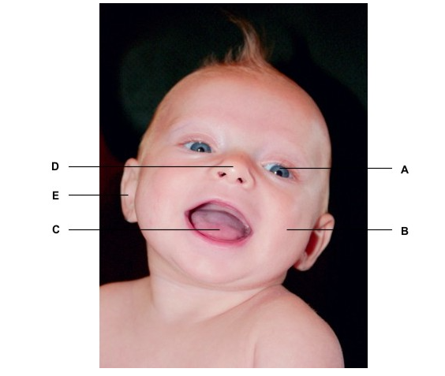
CwK
Thursday, 20 February 2020
The Nervous System
Do Now Activity
Labels A-E show the sense
Organs
Name the sense organs and what they detect

Slide 2
Self Assess
eye-light
skin-touch and temperature
tongue-chemicals (in food and drink)
nose-chemicals (in the air)
Ear-sound

Slide 3
Progress Indicators
Good Progress
State the pathway in a nervous response
Explain how structures in a reflex arc are related to their function
Outstanding Progress
Understand why reflex actions are important
Last Lesson: Homeostasis
This Lesson: The Nervous System
Next Lesson: Required Practical

Slide 4
Word Consciousness
Neurone-nerve cell

Slide 5
The Nervous System
Made up of the
Brain
Spinal cord
Which make up the central nervous system
neurones

Slide 6
The Nervous System
This enables humans to react to their surroundings and to coordinate their behaviour
cells called receptors, which detect stimuli (changes in the environment)
Neurones which transfer information
coordination centres (such as the brain and spinal cord) that receive and process information from receptors
effectors, muscles or glands, which bring about responses which restore optimum levels.

Slide 7
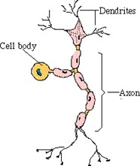
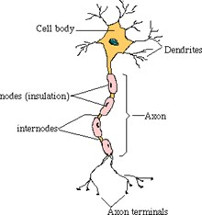
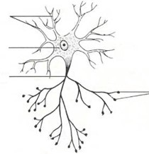
Neurones
Sensory
Relay
Motor
Receptors to the spinal cord/brain
carry messages from one part of the CNS to another.
Spinal cord/brain to effectors

Slide 8
Common Features of Neurones
A long fibre (axon) which is insulated by a fatty (myelin) sheath.
They are long so they can carry messages up and down the body.
Tiny branches (dendrons) which branch further as dendrites at each end.
These receive incoming impulses from other neurones.

Slide 9
Stimuli
Receptor
Sensory neurone
Brain or spinal cord
CNS
Motor neurone
Muscle contracts or gland releases hormones
effector
response

Slide 10
Stimuli
Picking up a hot pan
Receptor
Temperature receptors
Sensory neurone
Sensory neurone
CNS
CNS
Motor neurone
Motor neurone
effector
Muscle contracts
response
Drop the pan

Slide 11
Reflex Arc
A reflex arc is the nerve pathway which makes such a fast, automatic response as possible.
They do not involve the conscious part of the brain

Slide 12
Synapse
Sensory neurone
Stimulus
Receptor
Motor neurone
Relay neurone
Effector-Muscle

Slide 13
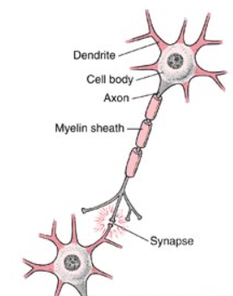
Synapse
Gap between two neurones
Chemical neurotransmitters pass on the message

Slide 14
Plenary
What are the two main advantages of a reflex action and why are they important?
Describe the parts of a reflex arc except for synapses
Describe and explain what happens at a synapse and suggest why they are important

