Slide 1
MOOD BOARDS

Slide 2
Objectives
Understand what is meant by the term ‘mood board’
Know where we use mood boards
Create a mood board for a specific situation to meet a client brief.

Slide 3
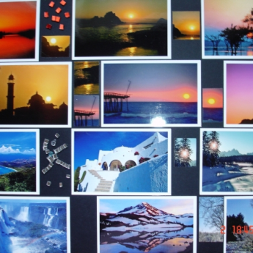
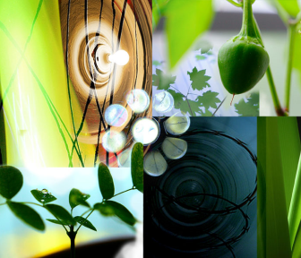
Mood Board
A mood board is a collage (digital or on paper), of objects (images, colours, screenshots, patterns, text etc), which try to capture a feeling, theme or design.
They are mostly used in interior design and advertising.
Often used to generate ideas for a client, to meet their approval before making the final product.

Slide 4
Why We Use Mood Boards
Can be a central focus of ideas in one place.
2. Can bring together a lot of different objects (images, materials, text, fabrics, text, shapes etc).
3. Intended to inspire and generate more ideas. A starting point.
4. Easy to show to client to demonstrate ideas.
5. Can make sure everyone in a design team share the same vision.

Slide 5
However….
Some people argue that mood boards are too time consuming.
Others argue that creating a mood board is more entertaining than actually thinking about a solution to a client problem.

Slide 6
EXAM PRACTICE
To draw/create a moodboard in the exam:
T – Title
I – Images (suitable ones) – spread them out across the board and in neat squares
L – Label the images to justify exactly why they have been chosen to suit the brief (write outside the box)
E – Extras – add suitable finishing touches such as text/keywords, colours, fonts, textures
It needs to be tidy and neat

Slide 7
The Creation Process
Collect a range of materials (images, text, material etc).
Arrange them together on a page.
Remove any items which do not fit in with the theme.
Use the mood board throughout production to ensure the theme is being adhered to.

Slide 8
Plenary
Let’s review our mood boards.
Look at someone else's mood board. Can you guess what they are trying to convey? What would you suggest they add?
Q&A:
What is a mood board?
Why are they used?
What are the steps in mood board production?
How can a mood board help you in your coursework?

Slide 9
Exam practice

Slide 10
