Slide 1
Upthrust and Flotation
Wednesday, 01 July 2020
Do Now Activity
State the units for density, volume, height, gravity.
State the units for force, area, pressure.
What two equations have we used so far in this topic to calculate pressure.
How does atmospheric pressure change with height and why?

Slide 2
Self Assess
Density (kg/m³), volume (m³), height (m), gravity (N/kg).
Pressure (Pa), Force (N), area (m²)
P = mgh, P=F/A
Atmospheric pressure decreases the higher you go as there is less air.

Slide 3
Progress Indicators
Good Progress
Describe upthrust and how it is caused
Outstanding Progress
Describe the factors which influence floating and sinking

Slide 4
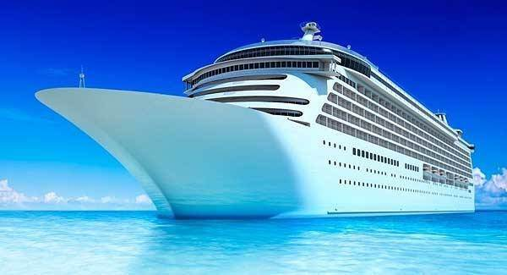
An object floats when its weight is equal to its Upthrust, but what is Upthrust?
Notes:
We can use the idea of pressure to explain why objects float or sink. We are going to look at the idea of Upthrust. (show an object immersed in a liquid). The pressure of a liquid depends on the depth. The bottom of the object is at a greater depth than the top of the object. This means that the bottom of the object experiences a larger pressure than the top. Because of this there is a larger force acting on the bottom of the object than there is acting on the top of the object. There is a resultant force acting upwards. We call this Upthrust. For an object to float, the Upthrust must equal the object’s weight. If the Upthrust is less than the objects weight, then the object sinks.

Slide 5
A submerged object experiences a greater pressure on the bottom surface than on the top surface.
This creates a resultant force upwards (as all forces have an equal and opposite reaction).
This force is called the upthrust.

Slide 6
Upthrust is an upwards force which acts on an object in a fluid. Objects in air experience an upthrust, but upthrust in water is much larger and more noticeable.

Slide 7
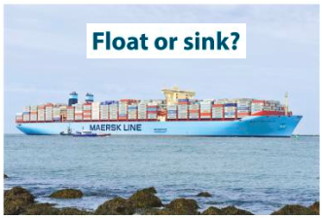
An empty cargo ship will float in water as it is displacing its own weight with water.
As it is loaded it will float lower and lower.
It keeps displacing more water which means the upthurst will increase to match the increase in weight.

Slide 8
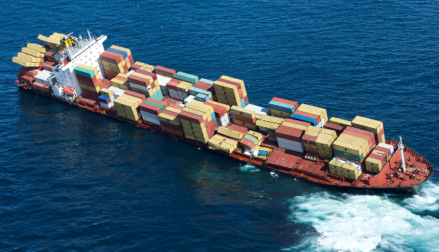
Sink or float?
If it is loaded with too much weight it will no longer float.
This is because it has already displaced as much water as it can so it cannot increase the upthrust force.
If the weight force is greater than upthrust the ship will sink.
Notes:
When we lower an object into water the level of the water rises, this is because the object displaces the water. The size of the Upthrust acting on the object is the same as the weight of the water displaced by the object. If an object can displace its own weight of water, then the Upthrust will equal the objects weight and the object will float. An object less dense than water only has to displace a small volume of water before the weight of the water displaced equals the weight of the object. So now Upthrust equals weight and the object floats.
An object more dense than water cannot displace a volume of water equal to its own weight. Therefore, the weight of the object is greater than Upthrust so it will sink.

Slide 9
Plenary
What us Upthrust and how is it caused?
Explain why a ship will sink if too much cargo is loaded onto it.
How can you tell if an object’s density is greater than 1g/cm³?

