Slide 1
Demonstrate
The speed of an object is a measure of how: (1 mark) a) far it is travelling b) fast it is travelling c) long it is travelling d) high it is travelling
A train travelled a distance of 80km in 2 hours. Its speed was: (1 mark) a) 0.1km/h b) 40km/h c) 20km/h d) 10km/h
The average speed of something is: (1 mark) a) its fastest speed b)the total distance it travels divided by the time taken c) its slowest speed d) its speed limit
If a car travels at 50mph for 4 hours, what distance has it travelled? (1 mark) a) 50 miles b) 100 miles c)40 miles d) 200 miles
Two cars are travelling in the same direction. The blue car is travelling at 25m/s in front of the red car which is travelling at 30m/s. What is their relative speed? (1 mark)
Notes:
Give 15 minutes to complete the allocated task independently. Move onto the next one if complete and then the extension.
The main tasks can all be completed using book notes. Provide text books with page references if it is appropriate.
Collect in quiz scores to record in the mastery tracker.
Max 15 min

Slide 2
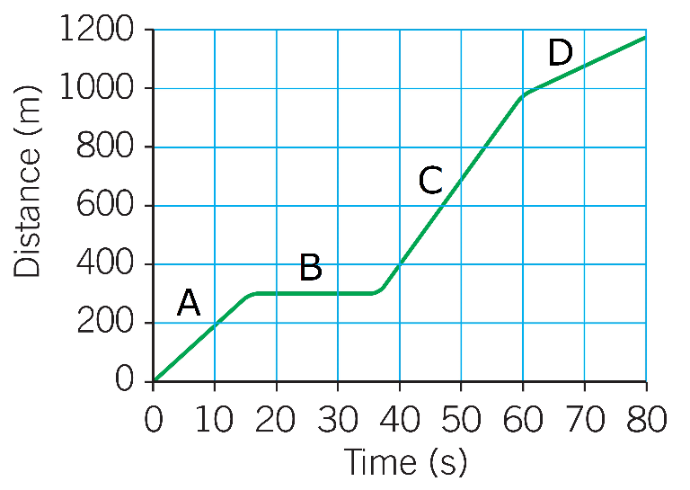
Demonstrate
6. The graph shown is a distance-time graph for a remote controlled car A) State the section of the graph (A, B, C or D) where the car is stationary (1 mark) B) State the section of the graph (A, B, C or D) where the car is moving the slowest (1 mark) C) Explain your answer to Q6B (1 mark) D) Calculate the average speed of the car over the whole journey (3 marks)
Notes:
Give 15 minutes to complete the allocated task independently. Move onto the next one if complete and then the extension.
The main tasks can all be completed using book notes. Provide text books with page references if it is appropriate.
Collect in quiz scores to record in the mastery tracker.
Max 15 min

Slide 3
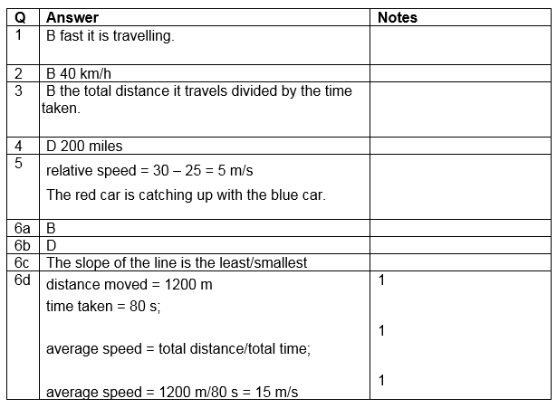
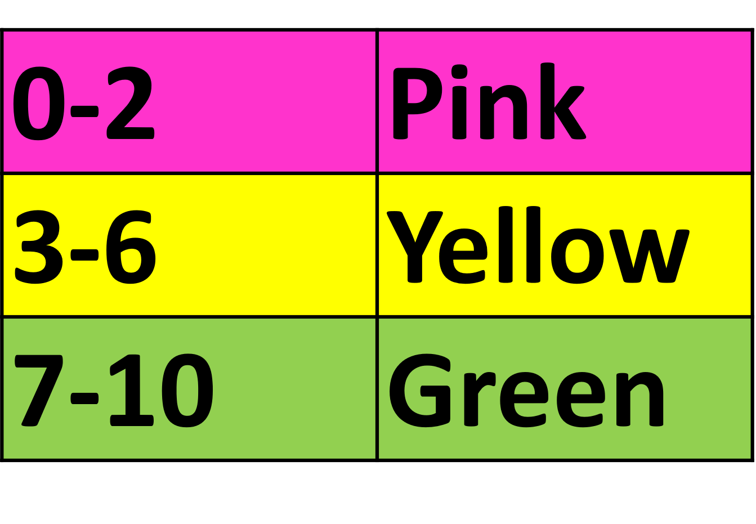
Demonstrate – Mark Scheme
RED pens please!
Notes:
Give 15 minutes to complete the allocated task independently. Move onto the next one if complete and then the extension.
The main tasks can all be completed using book notes. Provide text books with page references if it is appropriate.
Collect in quiz scores to record in the mastery tracker.
Max 15 min

Slide 4
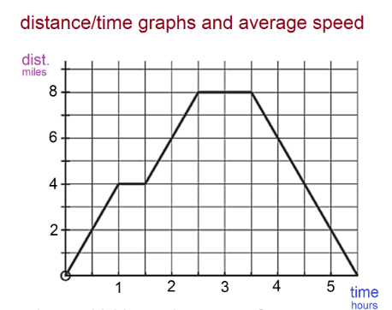
Connect Task - Green Pens Please!
If you got Q1 wrong… State the equation that links speed, distance and time. Include the standard units used for each.
If you got Q2 or Q4 wrong… After a meal an earth worm moves 45cm in 90seconds. Calculate the speed of the earthworm
If you got Q3 wrong… A car leaves Dover at 8:00AM and arrives in London at 10:30AM. If the distance covered was 120miles calculate the average speed for the journey.
If you got Q6 wrong… (Using the graph) 1. At what time(s) is the car stationary? 2. Complete the sentence: The steeper the gradient of the line the _____ the car is travelling 3. Calculate the average speed of the car over the whole journey
Extension – Write a description of your journey to school this morning. Then turn it into a distance-time graph. Draw the graph and annotate it with key information about your journey.
Notes:
Give 15 minutes to complete the allocated task independently. Move onto the next one if complete and then the extension.
The main tasks can all be completed using book notes. Provide text books with page references if it is appropriate.
Collect in quiz scores to record in the mastery tracker.
Max 15 min

