Slide 1
Do Now Activity - Whiteboards
Hex Binary Denary
4316
6A16
ASCII Challenge
Can you remember what characters these numbers represent?
00100000

Slide 2
Do Now Activity - Whiteboards
Hex Binary Denary
4316
6A16
ASCII Challenge
Can you remember what characters these numbers represent?
01000011
67
= C
01101010
106
= j
2016
00100000
32
= space

Slide 3
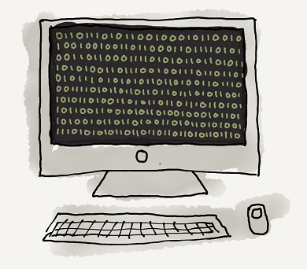
Unit 12 Data Representation
Lesson 6
Good – Describe how bitmap images are created and the effect of colour depth and resolution on the size of an image file.
Outstanding – Calculate the file size of an image
Key Terms: Bitmap / Pixels / Colour Depth / Resolution / Metadata

Slide 4
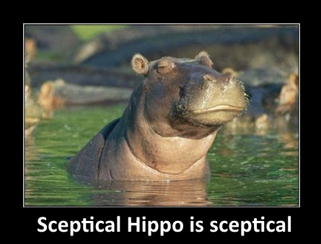
How are images made?

Slide 5
Bitmap images
Binary can be used to create bitmap images.
Bitmap images are made up of a grid (or map) of pixels.
Each pixel is assigned a binary code to represent it’s colour.
Here 1 means black and 0 means white.
0 | 0 | 1 | 1 | 1 | 1 | 0 | 0
0 | 1 | 0 | 0 | 0 | 0 | 1 | 0
1 | 0 | 0 | 0 | 0 | 0 | 0 | 1
1 | 0 | 1 | 0 | 0 | 1 | 0 | 1
1 | 0 | 1 | 0 | 0 | 1 | 0 | 1
1 | 0 | 0 | 0 | 0 | 0 | 0 | 1
1 | 0 | 1 | 0 | 0 | 1 | 0 | 1
1 | 0 | 0 | 1 | 1 | 0 | 0 | 1
0 | 1 | 0 | 0 | 0 | 0 | 1 | 0
0 | 0 | 1 | 1 | 1 | 1 | 0 | 0

Slide 6
Bitmap images
How can we add more colours to our image?
Binary can be used to create bitmap images.
Bitmap images are made up of a grid (or map) of pixels.
Each pixel is assigned a binary code to represent it’s colour.
Here 1 means black and 0 means white.
0 | 0 | 1 | 1 | 1 | 1 | 0 | 0
0 | 1 | 0 | 0 | 0 | 0 | 1 | 0
1 | 0 | 0 | 0 | 0 | 0 | 0 | 1
1 | 0 | 1 | 0 | 0 | 1 | 0 | 1
1 | 0 | 1 | 0 | 0 | 1 | 0 | 1
1 | 0 | 0 | 0 | 0 | 0 | 0 | 1
1 | 0 | 1 | 0 | 0 | 1 | 0 | 1
1 | 0 | 0 | 1 | 1 | 0 | 0 | 1
0 | 1 | 0 | 0 | 0 | 0 | 1 | 0
0 | 0 | 1 | 1 | 1 | 1 | 0 | 0

Slide 7
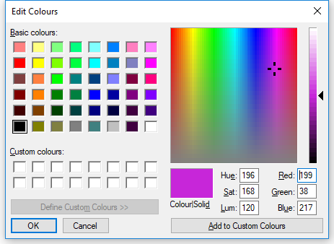
Colour Depth
COMPLETE PAGE 16 + 17
The number of colours an image can contain depends on the number of bits used to represent each pixel.
If 2 bits are used to represent each pixel (2²) then 4 colours can be stored. (00 01 10 11)
If 3 bits are used for each pixel (2³)(000) then ……..
Most images use a 24 bit colour depth which allows up to 16,777,216 different colours

Slide 9
Resolution
The concentration of pixels in a bitmap is called its resolution.
The higher the resolution (the more pixels it has) the more detailed an image is.
What happens to the file size if the colour depth or resolution increase?
75ppi 100ppi 200ppi 300ppi
COMPLETE PAGE 18

Slide 10
Bitmap file Size
We can calculate the size of an image file using the following information:
- The height of the image in pixels
- The width of the image in pixels
- The number of bits used for each pixel
Calculate 100 x 100 pixel image with a 4 bit colour depth
100 x 100 image = 10,000 bits
4 bits per pixel = 10,000 x 4 = 40,000 bits
40,000 bits / 8 = 5,000 bytes
5,000 bytes / 1000 = 5KB

Slide 11
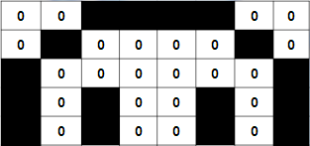
Bitmap file - Metadata
0011110001000010100000011010010110100101
Means nothing but if we know that height = 5 and width = 8 and the number of bits per pixel = 1 then we can rearrange them to get:
What else could be stored in Metadata?
Complete Page 19
0 | 0 | 1 | 1 | 1 | 1 | 0 | 0
0 | 1 | 0 | 0 | 0 | 0 | 1 | 0
1 | 0 | 0 | 0 | 0 | 0 | 0 | 1
1 | 0 | 1 | 0 | 0 | 1 | 0 | 1
1 | 0 | 1 | 0 | 0 | 1 | 0 | 1

Slide 12
Computer Task
K:\Drive
Computing
Computer Science 9-1
Unit 12 - Data Representation
Bitmap Images

Slide 13
Do Now Activity
What is a pixel?
What do we mean by Resolution?
If an image has a 4 bit colour depth, how many colours can it use?
How many bits are used for True Colour?
What is the file size of a 20 x 200 pixel image with a 2 bit colour depth in kbs?

