Slide 1
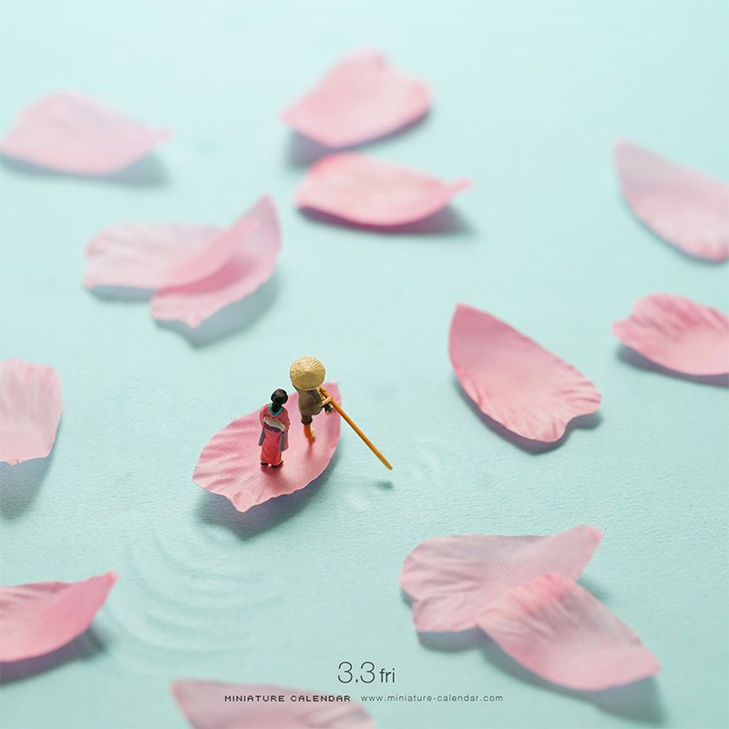
Give your most successful image to your shoulder partner for them to discuss improvements

Slide 2
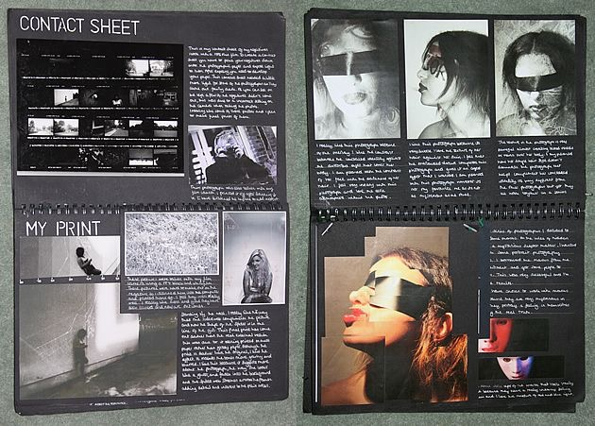
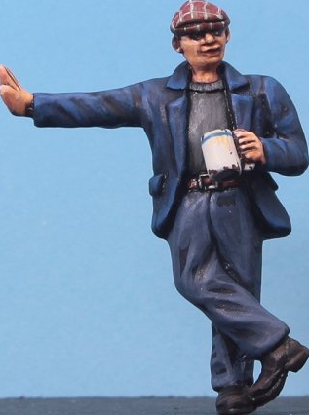
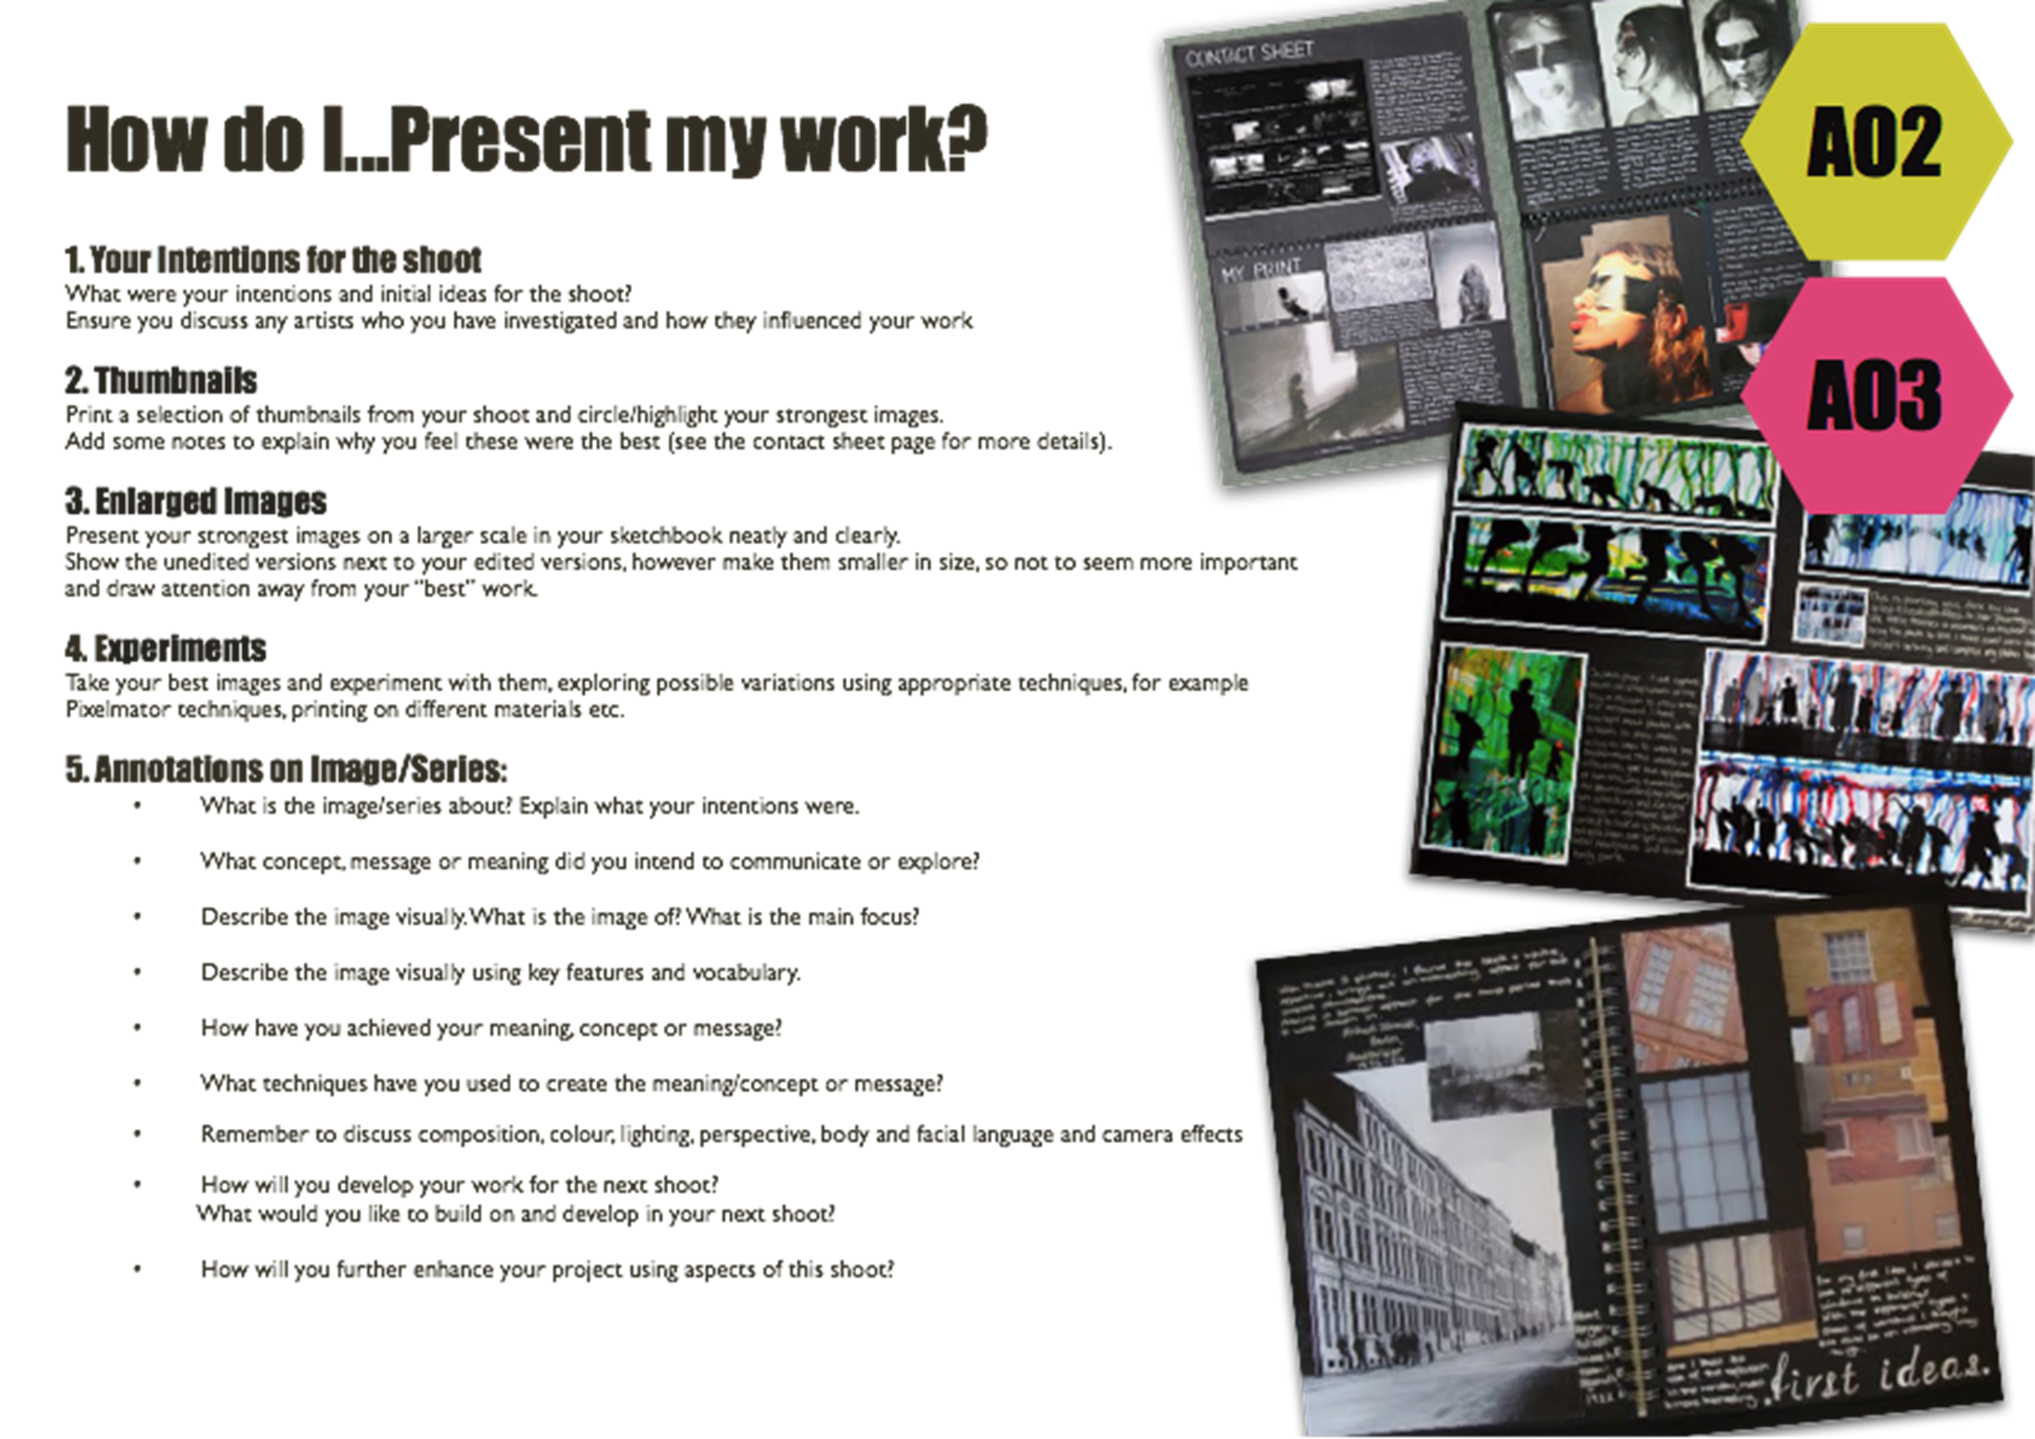
To present the results of the Little People style photo shoot.
To be able to identify the most successful images from a photo shoot.
GCSE photography Success Criteria
Basic Requirements | A contact sheet is stuck in and annotations are present Best images printed and presented Notes evident to explain the images presented Edited and Final images are saved to the DRIVE
Good | A contact sheet present that has been fully annotated, answering most of the ‘How to Annotate a Contact Sheet’ questions Images have been cropped and scaled to improve the final prints - smaller unedited images presented alongside
Outstanding | Most question prompts have been answered for point number 5 on the ‘How to Annotate a Contact Sheet’ and How to present my work Sheet? Creative and neat presentation of the images and notes used
Title – Best Photos
TASK 1
Complete the thumbnail contact sheet annotations from the previous lesson.
TASK 2
Using the ‘How do I... Present my work?’ sheet and your A4/2x A5 best photo’s - present the results of your photo shoot on A3 paper (you may hand write or type up any written work).
TASK 3
Save any edited (cropped/resized) images and final images to your DRIVE in a folder called: Little People project Edits and Finals.

Slide 3
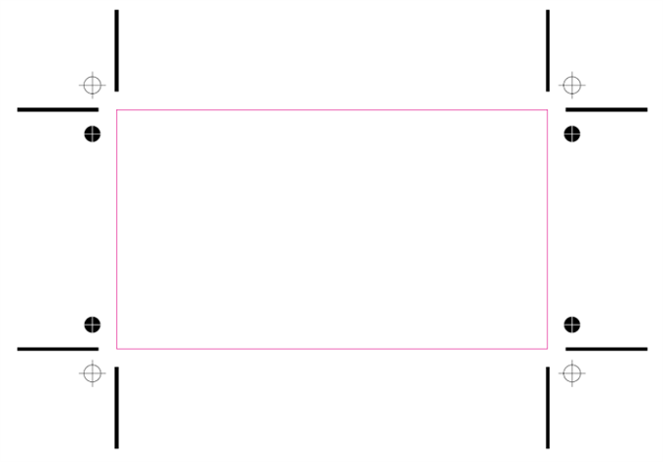
Cropping
What does this word mean?
Why might you crop an image?

Slide 4
