Slide 1
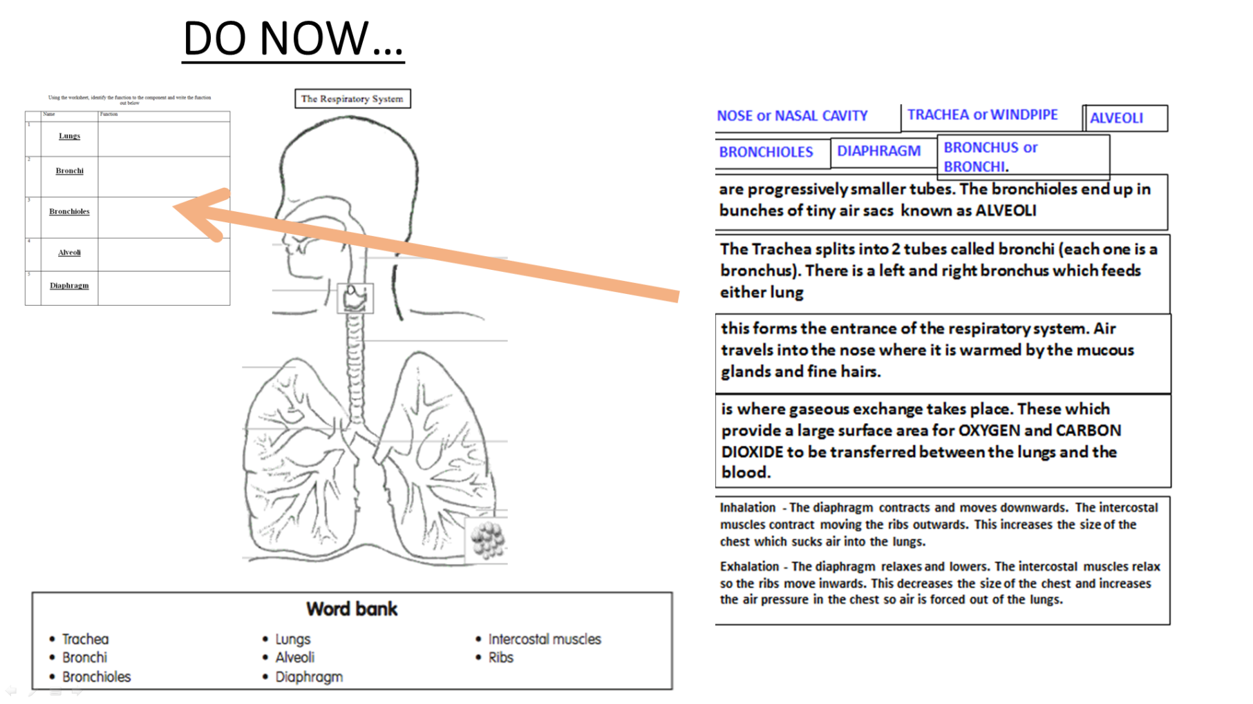
Title: Respiratory system
LO: To recap the different role of Respiratory system in the body
Progress Indicators
Good Progress | Outstanding Progress
To identify and explain the role of key functions of the respiratory system | To be able to explain how a range of aspects of the respiratory system contribute to performance

Slide 2
Answers using next slide

Slide 3
BRONCHIOLES
BRONCHUS or
BRONCHI.
NOSE or
NASAL CAVITY
Trachea
Lungs
ALVEOLI
Bronchi
Ribs
Intercostal Muscles
DIAPHRAGM
Bronchioles
Diaphragm
Alveoli

Slide 4
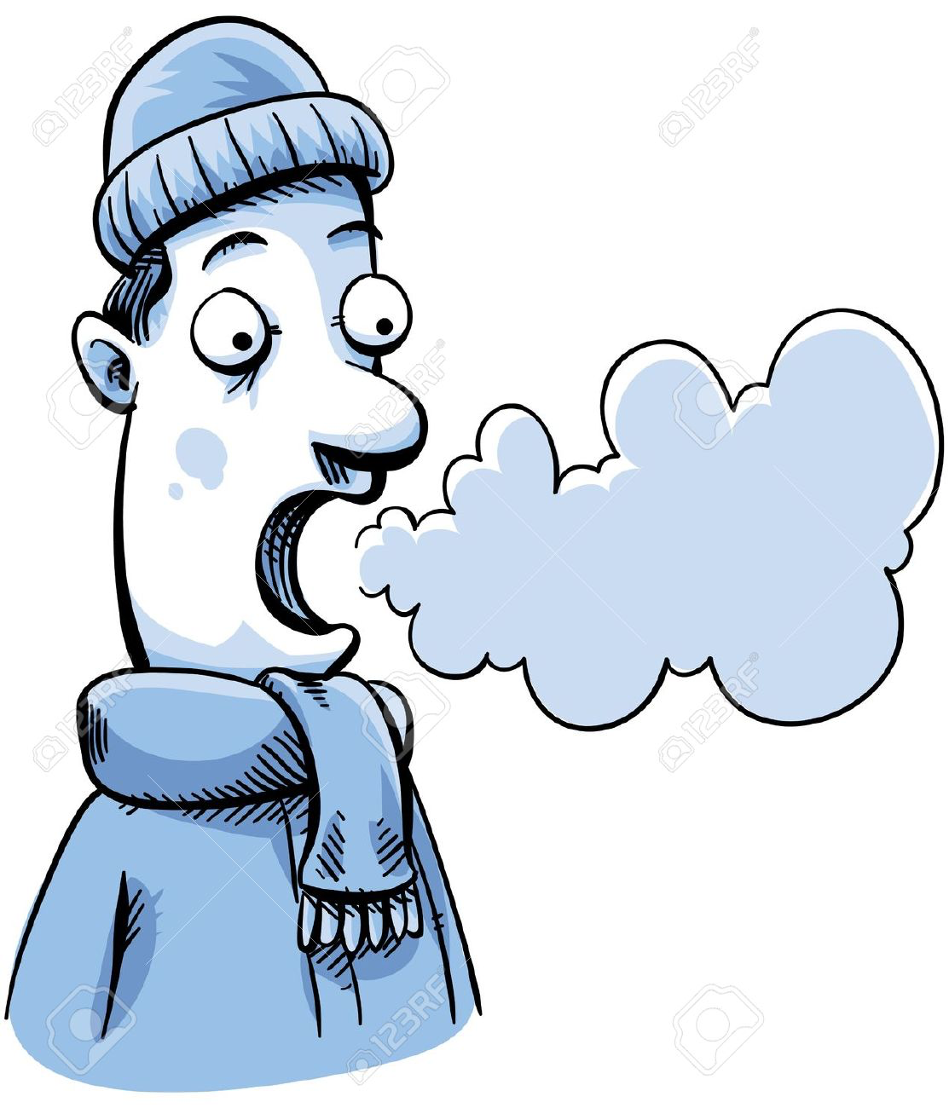
Composition of breathing
Inspire
Expire
79% Nitrogen
20 (21) % Oxygen
0.4% (Trace) - Carbon Dioxide
79% Nitrogen
16% Oxygen
4% Carbon Dioxide

Slide 5
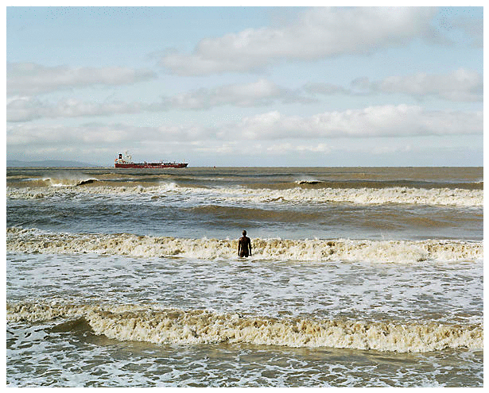
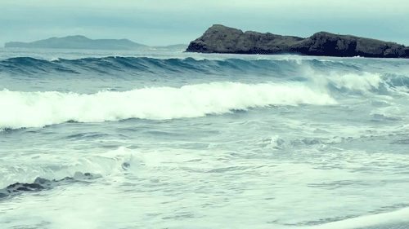
Tidal Volume
How much are you breath in & out when breathing normally!
This increases when exercising

Slide 6
Vital Capacity
Is the most air you could possibly breathe in after breathing the largest volume of air you can
Vital capacity = biggest breath possible!

Slide 7
KEY WORDS
Use the internet or your revision guide to research what each of these mean and explain them in your own words!
=
RESPIRATORY RATE =
TIDAL VOLUME =
=
Vital Capacity =
=
=
RESIDUAL VOLUME=

Slide 8
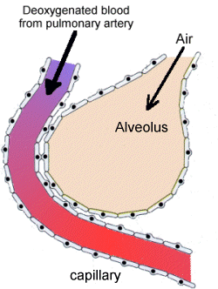
The Gaseous Exchange
https://www.youtube.com/watch?v=57byXpOUpSU
https://www.youtube.com/watch?v=mZvzl8KH6iI

Slide 9
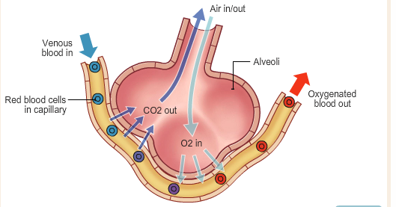
Structure of the alveoli to enable Gaseous exchange…
The Cardiovascular and respiratory system work together to get oxygen to the muscles, can carbon dioxide away = Exchanging gases between alveoli and the capillaries
In Alveolus
In Capillary
Diffusion of O2
High Concentration of 02
Low Concentration of CO2
Low Concentration of 02
High Concentration of CO2
Diffusion of CO2

Slide 10
Task 1
Use half a page to draw this and label on paper!
Task 2
Once drawn as accurately as possible, annotate the gaseous exchange identifying where it occurs
Once complete take a photo and send it to your teacher with your work!

Slide 11
Gaseous Exchange….what do I need to remember?
Exchange of O2 & Co2 into blood stream
Through alveoli (1 cell thick)
More efficient the exchange = more O2 for working muscles…..?????

Slide 12
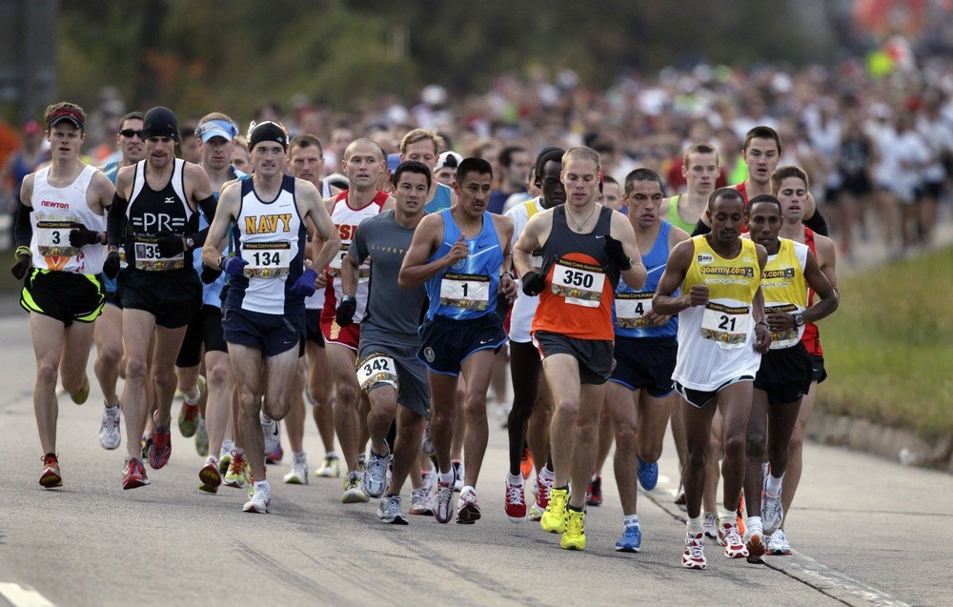
For example=
Explain how the gaseous exchange works, and how it will be important for a long distance runner:

Slide 13
Aerobic exercise
Anaerobic exercise
No oxygen is used in its initial release, energy is produced from the supplies already in the body.
Maximum bursts of energy
Time it takes to do is very short
Aerobic exercise need a sufficient supply of oxygen to the tissues.
Work for a long time
Moderate – hard work
Periods of more then 60s
Extension task Explain how a games player would use both aerobic and anaerobic systems
(4 marks)
Glucose
Glucose + Oxygen
CO2 + water + Energy
Energy + Lactic acid

Slide 14
Aerobic exercise
Anaerobic exercise
AIR
N
With O2
NO oxygen!

Slide 15
Energy
The muscles and liver store glucose (main source of energy from food)
Aerobic Respiration -
Glucose + oxygen -----Energy + CO2 + water
Is toxic!, causes muscle ache, cramps eventually stopping them from working!
Anaerobic Respiration -
Glucose -----Energy + lactic acid
The muscles and liver store glucose (main source of energy from food)
Fats:
Fuel source for aerobic activity
Carbohydrates:
Fuel source for anaerobic and aerobic activity

Slide 16
Oxygen debt
Oxygen debt is….
Oxygen debt is…
The amount of oxygen needed at the end of a physical activity to break down lactic acid. Often after a 400m race lactic acid is build up as oxygen is not being used. Oxygen is repaid through deep gasping breaths at the end of exercise
Anaerobic Respiration -
Glucose -----Energy + lactic acid

Slide 17
Homework due in
Wednesday 23rd Jan
Add text boxes or create this mind map at home, research using the internet of your revision guide this information from paper 2 and make small notes around the page!
SOME……….…
key topics from
Paper 2

