Slide 1
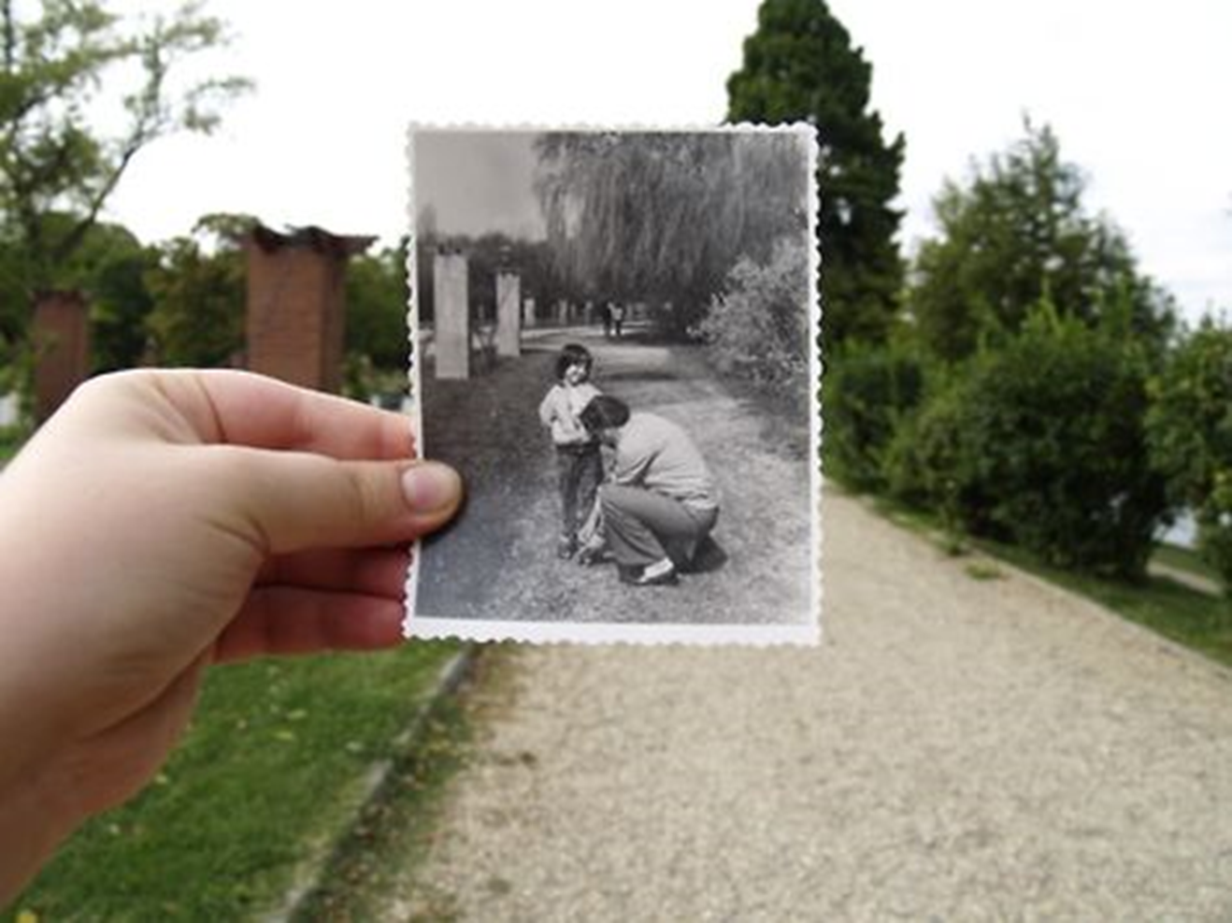
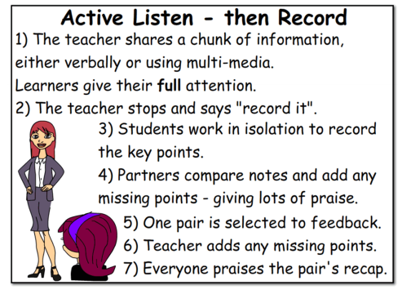

Slide 2
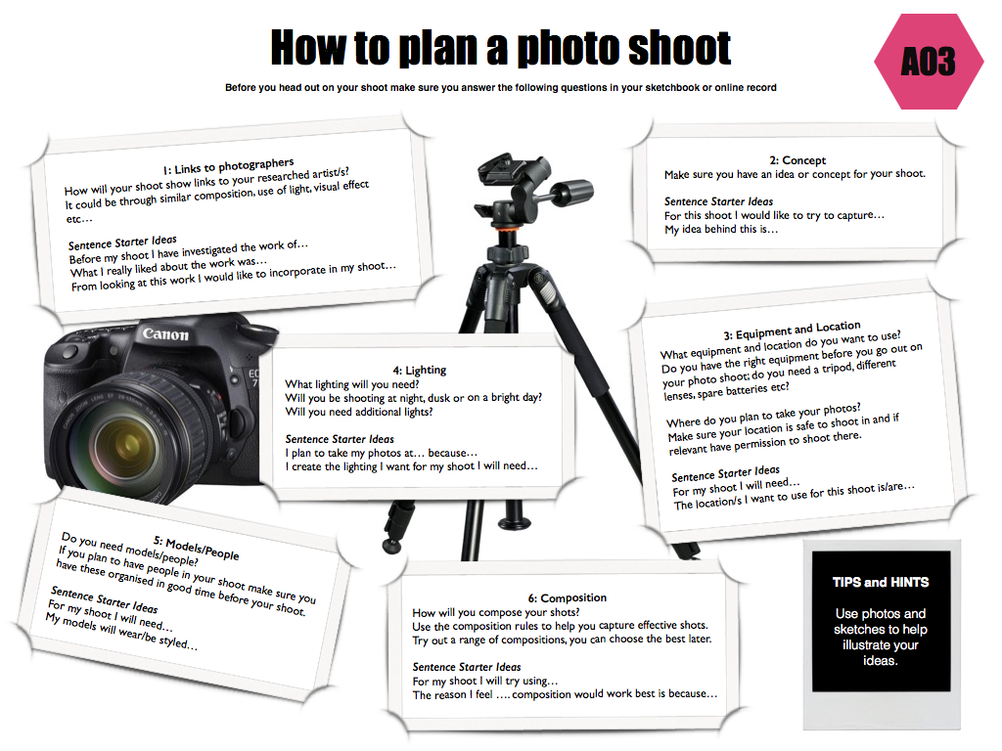

Slide 3
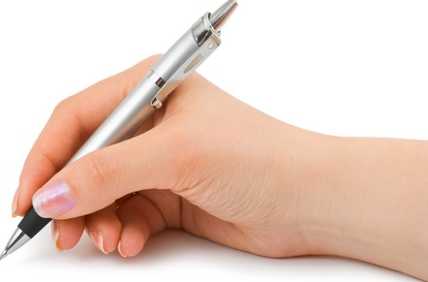

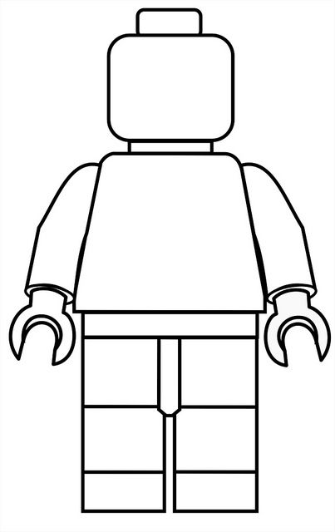
To plan out a photo shoot using a set of given headings
GCSE photography Progress Indicators
Basic Requirements | Have an idea of the photos you wish to take next lesson Answered some questions on the ‘How do I…plan a photo shoot?’ sheet Notes are presented in a clear manner
Good | Answered most questions from some of the headings on the ‘How do I…plan a photo shoot?’ sheet Notes are presented in a clear and organised manner
Outstanding | Answered all questions from all the headings on the ‘How do I…Analyse a Photographers work?’ sheet Writing uses detailed and in-depth sentences Creative layout/design for the page used Thumbnail sketches used to illustrate composition ideas
Title – Dear Photograph Plan
TASK 1
Using the handout plan your Dear Photograph photo shoot on A3 paper. (How to Plan Your Photo Shoot)
Remember you need to have a photograph printed out in black and white with your lego man in – then you need to return holding your photo of your lego man in the same position – black and white verses colour
Use mini sub heading (to ensure your have covered each area from help sheet) and mount writing on black paper
- Lighting/location/equipment/links to photographer style/composition of photos(framing)/ actual ideas in detail
Task 2
Sketch out ideas for your photoshoot and add labels to these. (show where the camera will be, your miniature figure and what they will be doing).You can trace

Slide 4

Link to photographers work
Concept behind the shoot
Equipment and Location
Lighting
Models and People
Compositions used

