Slide 1
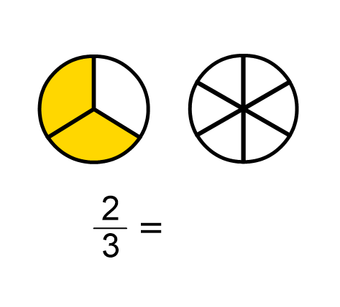
DNA:
Ask a Question/Make a Statement

Slide 2
Equivalent Fractions with Shaded Diagrams
Unit 4A

Slide 3
Prior learning:
Place value.
Percentage as an amount out of 100.
Multiplication and division.
Ordering integers on a number line.
Unit 5 - Fractions, Decimals
and Percentages
Shading fractions of diagrams, equivalence and simplification of fractions.
57-59,61
Convert between improper fractions and mixed numbers.
63-64
65-66,
67-70
Four operations with mixed and improper fractions.
60
Order fractions.
Calculate a percentage of an amount and percentage change.
84-90
Find fractions of an amount.
77
73-76,
82-83
Convert between fractions, decimals and percentages and compare them.
Calculate simple and compound interest.
93-94
Next steps:
Calculating proportions of pie charts.
Using multipliers.
Reverse percentages.
Reverse fractions.

Slide 4
Progress Indicators:

Slide 5
What does “Equivalent” mean?

Slide 6
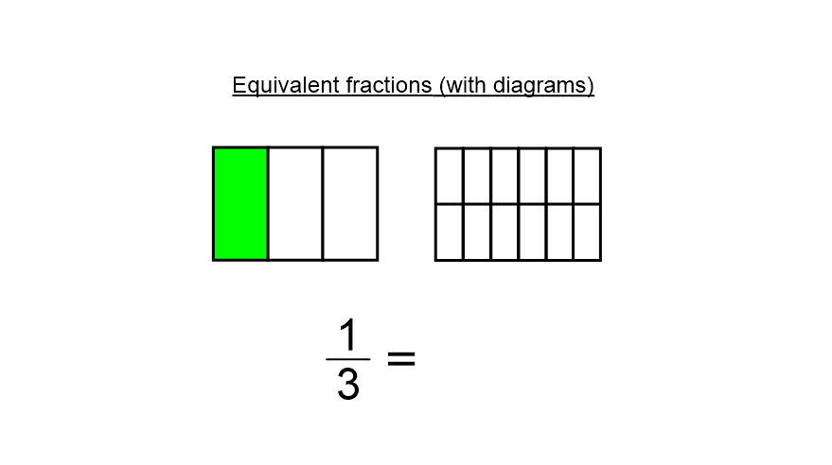

Slide 7
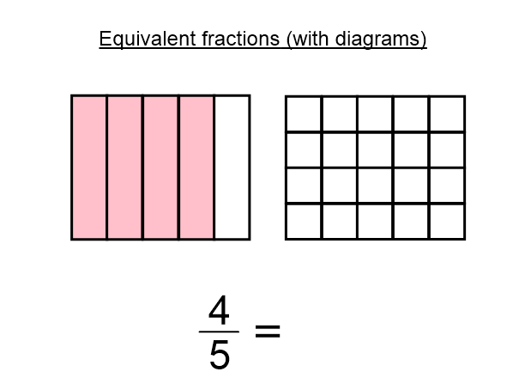

Slide 8
We Do

Slide 9
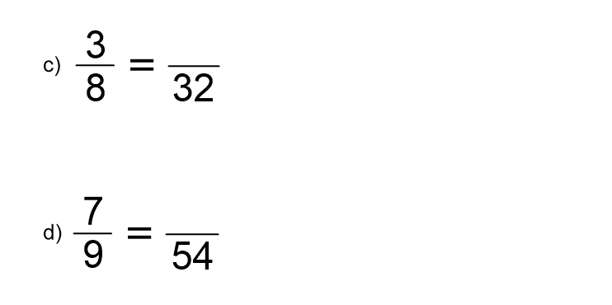
Whiteboard Activity:

Slide 10
We Do
You Do
What have we multiplied by to make this equivalent fraction?
What have we multiplied by to make this equivalent fraction
$$\frac{1}{2}$$
$$\frac{2}{4}$$
$$×\frac{2}{2}$$
$$×\frac{2}{2}$$
$$\frac{2}{4}$$
$$\frac{4}{8}$$
$$\frac{2}{4}$$
$$\frac{3}{8}$$
$$×\frac{6}{6}$$
$$×\frac{8}{8}$$
$$\frac{12}{24}$$
$$\frac{24}{64}$$
$$×\frac{11}{11}$$
$$×\frac{12}{12}$$
$$\frac{3}{6}$$
$$\frac{33}{66}$$
$$\frac{4}{7}$$
$$\frac{48}{84}$$
=
=

Slide 11
1)
$$\frac{1}{2}$$
4)
$$\frac{1}{5}$$
$$\frac{2}{8}$$
$$\frac{2}{10}$$
2)
$$\frac{1}{2}$$
5)
$$\frac{1}{5}$$
$$\frac{8}{16}$$
$$\frac{4}{20}$$
3)
$$\frac{1}{2}$$
6)
$$\frac{1}{5}$$
$$\frac{9}{18}$$
$$\frac{10}{50}$$

Slide 12
Answers
1)
$$\frac{1}{2}$$
4)
$$\frac{1}{5}$$
$$×\frac{4}{4}$$
$$×\frac{2}{2}$$
$$\frac{2}{8}$$
$$\frac{2}{10}$$
2)
$$\frac{1}{2}$$
5)
$$\frac{1}{5}$$
$$×\frac{8}{8}$$
$$×\frac{4}{4}$$
$$\frac{8}{16}$$
$$\frac{4}{20}$$
3)
$$\frac{1}{2}$$
6)
$$\frac{1}{5}$$
$$×\frac{9}{9}$$
$$×\frac{10}{10}$$
$$\frac{9}{18}$$
$$\frac{10}{50}$$

Slide 13
7)
$$\frac{2}{3}$$
10)
$$\frac{2}{6}$$
$$\frac{16}{24}$$
$$\frac{18}{54}$$
8)
$$\frac{2}{3}$$
11)
$$\frac{6}{7}$$
$$\frac{18}{27}$$
$$\frac{30}{35}$$
9)
$$\frac{2}{6}$$
12)
$$\frac{6}{7}$$
$$\frac{16}{48}$$
$$\frac{48}{56}$$

Slide 14
Answers
7)
$$\frac{2}{3}$$
10)
$$\frac{2}{6}$$
$$×\frac{8}{8}$$
$$×\frac{9}{9}$$
$$\frac{16}{24}$$
$$\frac{18}{54}$$
8)
$$\frac{2}{3}$$
11)
$$\frac{6}{7}$$
$$×\frac{9}{9}$$
$$×\frac{5}{5}$$
$$\frac{18}{27}$$
$$\frac{30}{35}$$
9)
$$\frac{2}{6}$$
12)
$$\frac{6}{7}$$
$$×\frac{8}{8}$$
$$×\frac{8}{8}$$
$$\frac{16}{48}$$
$$\frac{48}{56}$$

Slide 16
Answers

Slide 17
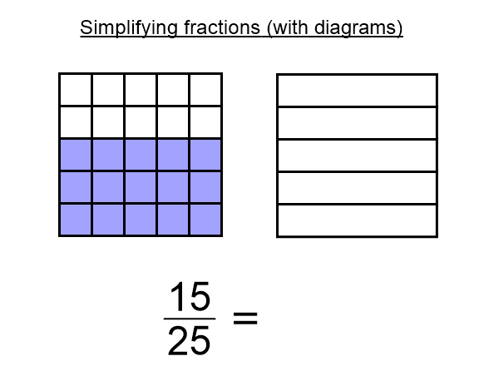

Slide 19
Give an equivalent fraction which is as simple as possible.
?
?
$$\frac{2}{4}=\frac{1}{2}$$
$$\frac{6}{9}=\frac{2}{3}$$
?
?
$$\frac{4}{10}=\frac{2}{5}$$
$$\frac{45}{54}=\frac{5}{6}$$
Lots of lines here

Slide 20
Practice: Worksheet

Slide 21
Answers:

Slide 22
Demonstrate:
2) Write the shaded area of each shape as a fraction. In its simplest form and with 3 more equivalent fractions.

Slide 23
Connect
Write down the fraction of the shape that is shaded | Shade $\frac{7}{8}$ of this shape and give 2 more equivalent fractions | Use these shapes to decide which is larger $\frac{3}{4}$ or $\frac{5}{8}$

