Slide 1
CwK
Monday, 28 September 2020
Scalar and Vector Quantities
Do Now Activity
What are the units for
Speed
Mass
Weight
Force
Distance

Slide 2
Progress Indicators
Good Progress
Identify quantities as either scalar or vector
Define scalar and vector quantities
Outstanding Progress
Draw scale diagrams to represent a vector quantity

Slide 3
Word Consciousness
Scalar-size but no direction
Vector- size and direction
Magnitude- size

Slide 4
Scalar
A scalar quantity has size but no direction
We also use the word magnitude for size
Examples include
Speed
Distance
Time
Mass
energy
power

Slide 5
Vector
A vector quantity has both magnitude and direction
Example include
Acceleration
Force
Weight
Velocity
displacement

Slide 6
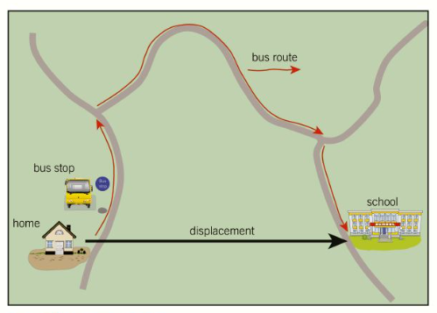
Representing Vector Quantities
Using arrows
Arrow direction shows direction
Length of arrow shows the magnitude

Slide 7
Scale diagrams
When more than one force acts on an object, the forces sometimes need to be shown on a scale diagram.
For example: two forces of 3.0N and 4.0 N act at right angles to each other
We need to show the forces on a scale diagram

Slide 8
Scale diagrams
We can use the scale 10mm=1N
Draw the scale diagram
Object
3.0N
4.0N

Slide 9
Task
Draw the following to scale
Two forces of 8.5N and 13N act at right angles to each other
A parachutist with air resistance of 20N and weight of 9.8N
A car has forward force of 5N, drag of 3N, gravity of 9.8N and upthrust of 9.8N
Describe scalar and vector quantities, you must include some examples of both and use the word magnitude in your description.

Slide 10
Plenary
What is a scalar quantity?
What is a vector quantity?
Which of the following are scalar quantities?
power, velocity, force, mass, distance

