Slide 1
Food Preparation and Nutrition GCSE Revision 2019
Name:
Target Grade:
Examination (1 ¾ hours)
Section A Multiple choice questions (20 marks) | Section B Five questions each with a number of sub questions (80 marks)

Slide 2
Revision check list
Macro Nutrients
Micro Nutrients
Nutritional Groups
Cooking methods
Chemical & Functional properties
Food spoilage & contamination
Food safety
Food choices
British & International cuisines
Sensory Evaluations
Environment
Sustainability
Food production
Food processes

Slide 3
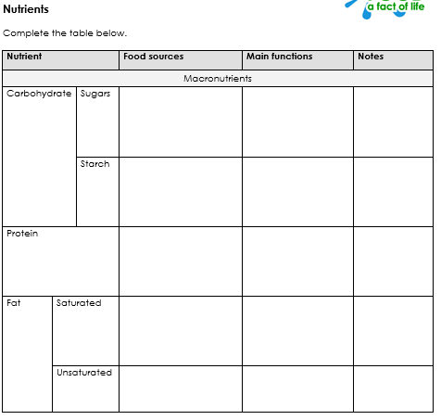
Macro Nutrients

Slide 4
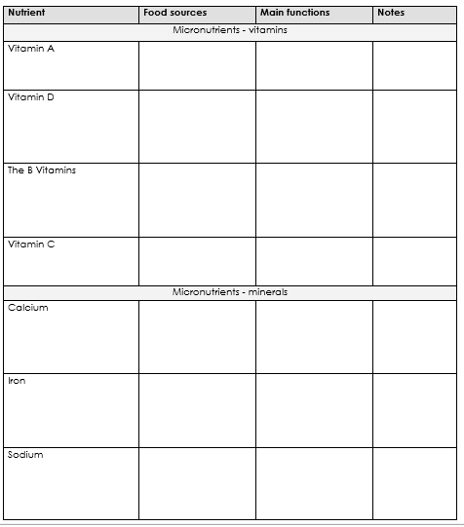
Micro Nutrients

Slide 5
Nutrition
Nutrient | Function in the body | Deficiency | Food source
Carbohydrate (Starch, sugar & dietary fibre)
Fat Saturated & Unsaturated
Protein HBV& LBV
Vitamin A
Vitamin D
Vitamin E
Vitamin K
B group B1 (thiamin), B2 (riboflavin), B3 (niacin), folic acid, B12
Vitamin C

Slide 6
Nutrition
Nutrient | Function in the body | Deficiency | Food source
Minerals
Calcium
Iron
Sodium (salt)
Flouride
Iodine
Phosophorus
Important Non-nutrients
Water

Slide 7
Eat well guide
Explain what the Eat well guide is and why is helps towards a balanced diet.
Fill in the Eatwell guide with the name, nutrients and food examples:
List the 8 tips to healthy eating?
1.
2.
3.
4.
5.
6.
7.
8.

Slide 8
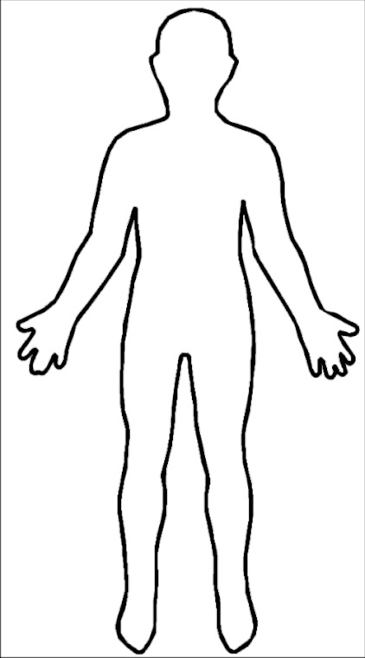
Eat well guide
Food contains essential nutrients for your body to live on.
Label the body with what nutrients give to your body.

Slide 9
nutrition
An unbalanced diet can cause various health problems. Match the problem with what nutrients you would need to eat more of and the food that you find it in.
Anaemia Calcium Wholewheat bread
Split nails Iron Fruit and Vegetables
Constipation Vitamin C Red meat
Regular colds Fibre Dairy products
______________________________________________
Some people have to follow a special diet for health reasons. What are the reasons that the following groups of people cant eat the named food?
Pregnant women cant eat shellfish and raw eggs.
Celiac can’t eat gluten.
Lactose intolerance cant have dairy.
Diabetics have to control their sugar.
Children under five can’t have nuts

Slide 10
Dietary need | Description | Key points | Nutritional needs | Foods to eat | Foods to avoid
Babies | Age 0-2 | Breast milk or formula provides most nutrients until 6 months. Avoid food high in salt, fat and sugar.
Young children | Age 2-12 | Meals should not just be smaller versions of adult meals.
Teenagers | Age 13-19 | Girls, more weight conscious than boys, usually consume fewer calories, therefore are more prone to nutritional deficiencies.
Adults | Age 20-65 | Balanced diet following eatwell guide.
Elderly people | Age 65 + | They should be careful not to over eat as they may become fat if they are not very active.
Invalids | Often recovering from illness, an operation, accident or injury. | People may be bedridden so foods must take this into account.
Dietary need | Description | Key points | Nutritional needs | Foods to eat | Foods to avoid
Vegetarians | People who do not eat a full range of meat, fish, poultry or animal products. | Lactose vegetarians who eat no animal flesh but do eat animal products Demi or semi vegetarians sometimes do eat white meat and do eat animal products Vegans eat no animal flesh or products
Religion | People whose religious beliefs prevent them from eating specific foods. | The caterer must be aware of different religions needs for preparation, cooking and serving of food e.g. halal and kosher
Medical / health related diets | People with a medical condition that affects the foods they can eat (including allergies below) | Diabetes Obesity Heart disease Low fat, salt or sugar diet High fibre diet
Allergies | People who cannot specific foods as they have an allergic reaction. People may also have an intolerance which stops people eating specific foods. | Common allergies and are nuts, fish, shellfish, eggs, soya and sesame seeds. Common intolerances are gluten and lactose. New allergen law December 2014.

Slide 11
Life stages
Peoples’ nutritional needs change throughout life. You need to be able to plan a balanced diet for different life stages.
Special Diet | An explanation of diet and changes which need to be made when following the diet
Young children (2-5 yrs)
Children (5-12 yrs)
Teenagers
Adults
Elderly

Slide 12
Special dietary needs
Some people have to follow a special diet because…
1. They may need to lose weight
2. They have an illness that needs to be controlled, by what they eat.
3. Certain foods make them ill, so they have to avoid eating them
Special Diet | An explanation of diet and changes which need to be made when following the diet
Vegetarian
Vegan
Coeliac disease
Lactose intolerant
High fibre diets.
Low calorie diets

Slide 13
Health
Explain how diet can affect health and how nutritional needs change in relation to:
Diet related health risk | Explanation
Obesity
Cardiovascular health (coronary heart disease (CHD) and high blood pressure)
Bone health (rickets and osteoporosis)
Dental health
Iron deficiency anaemia
Type 2 diabetes

Slide 14
Cooking methods
Name 4 reasons for cooking food
________________________________________________________________________________________________________________________________________________________________________________________________
Food is cooked by heat energy - Methods of heat transfer
The three ways that heat energy can be passed through food are:
convection
conduction
radiation.
Describe each method – use diagrams if necessary
The selection of appropriate preparation and cooking methods can conserve or modify nutritive value or improve palatability:
Give examples of different cooking methods for each method
Water based:
Dry methods:
Fat based:

Slide 15
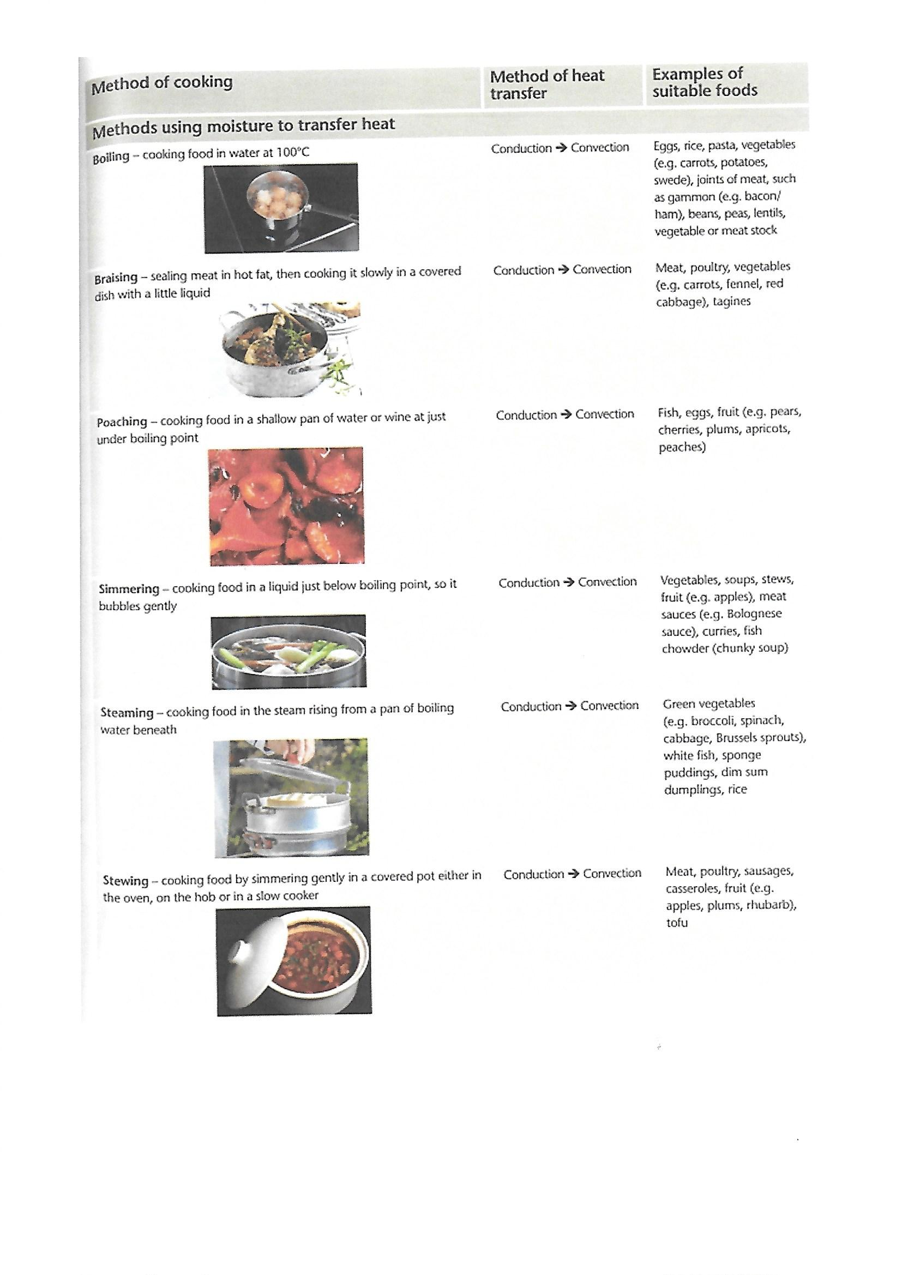

Slide 17
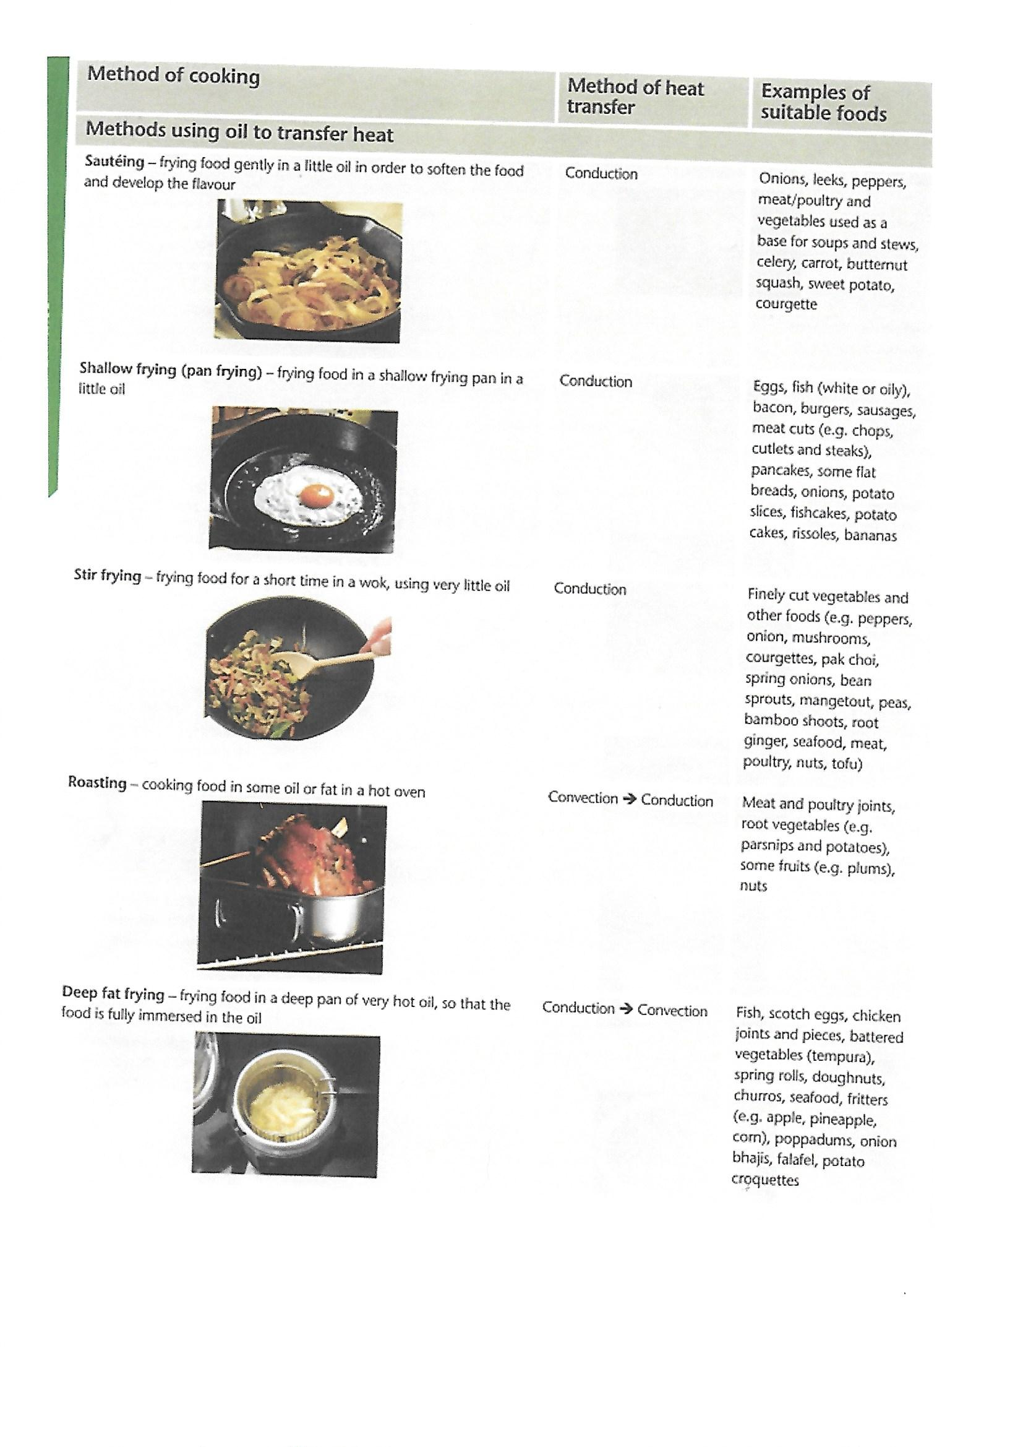

Slide 18
Heating methods | What foods ingredients can you cook with this method | What does this mean? | What are the effects on the texture, smell and flavour of the food | What are the effects on the appearance of the food
Boiling
Braising
Poaching
Simmering
Steaming
Stewing
Sautéing
BBQ
Roasting
Frying
Baking

Slide 19
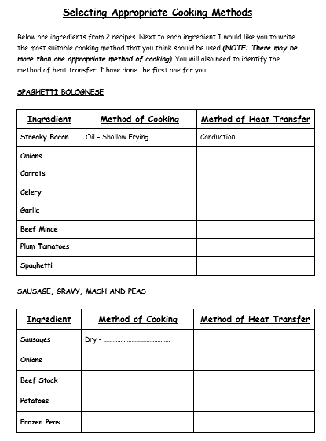

Slide 20
Protein
Garnish:
Thickening:
Coagulation:
Emulsification:
Enriching:
functions of eggs
Binding:
Aeration:
Coating:
Glazing:

Slide 21
The Functions of Protein
You need to understand the scientific principles underlying these processes when preparing and cooking food
You also need to be able to explain the working characteristics, functional and chemical properties of proteins.
Use images if appropriate
Function | Description
protein denaturation
protein coagulation
gluten formation
foam formation

Slide 22
The Functions of Fat
Function | Description
 | Fat coats the flour particles, preventing the flour absorbing the water. Preventing the water absorption stops the gluten developing. If the gluten cannot develop the mixture is shortened giving a crumbly, melt in the mouth texture.
 | Required to add air into food. Eg. When fat is creamed with sugar to helps traps air
Plasticity
Emulsification
The Functions of Carbohydrate
Function | Description
Gelatinisation
Dextrinisation
caramelisation

Slide 23
Raising Agents
How are raising agents added into food products?
Mechanical:
Chemical:
Biological:
Steam
In the table give examples how air, steam and carbon dioxide act as raising agents:
Chemical | Mechanical | Biological | Steam

Slide 24
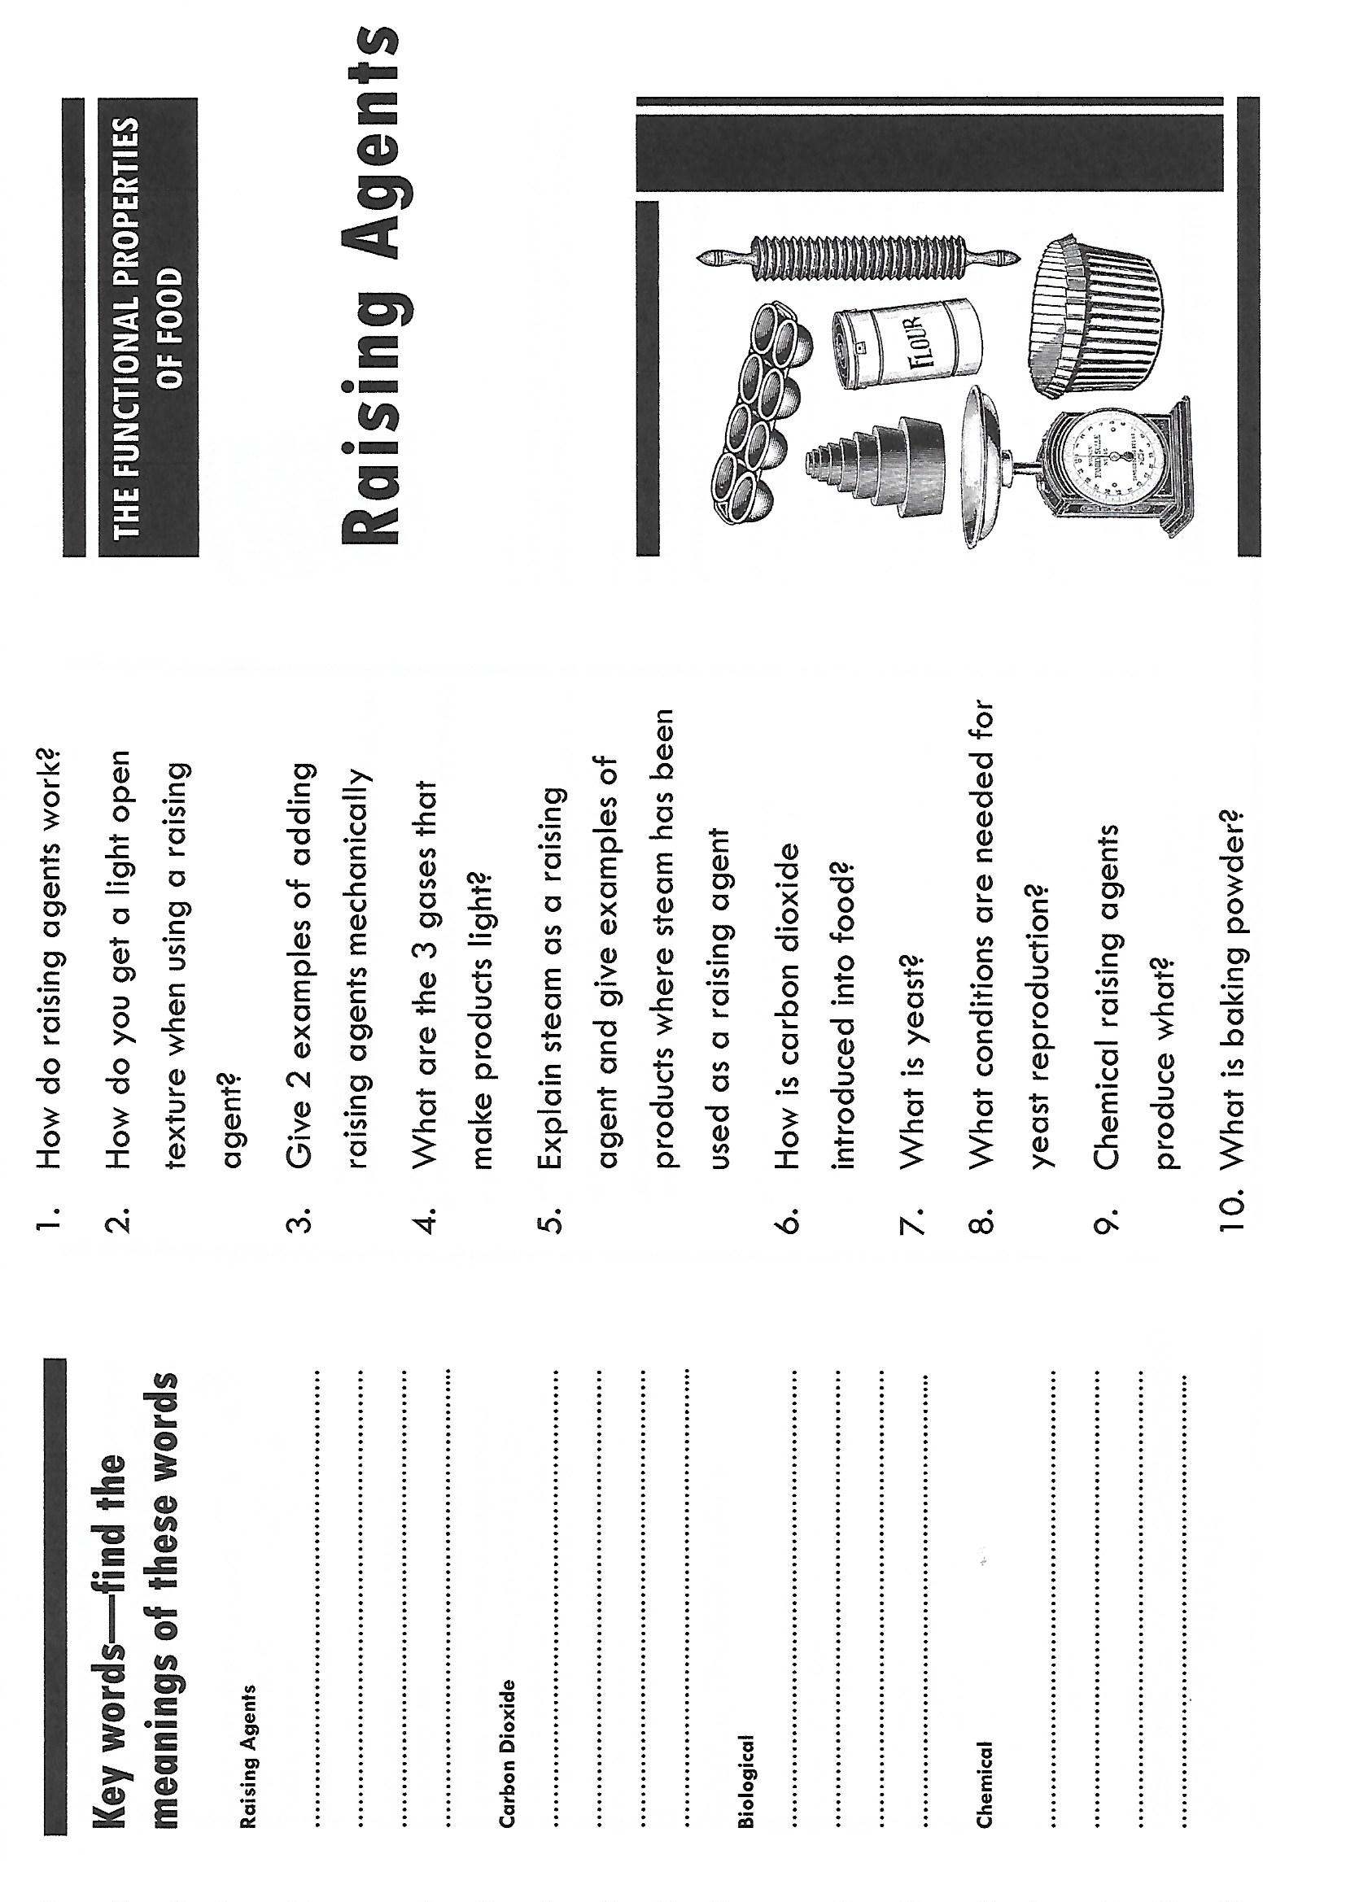

Slide 25
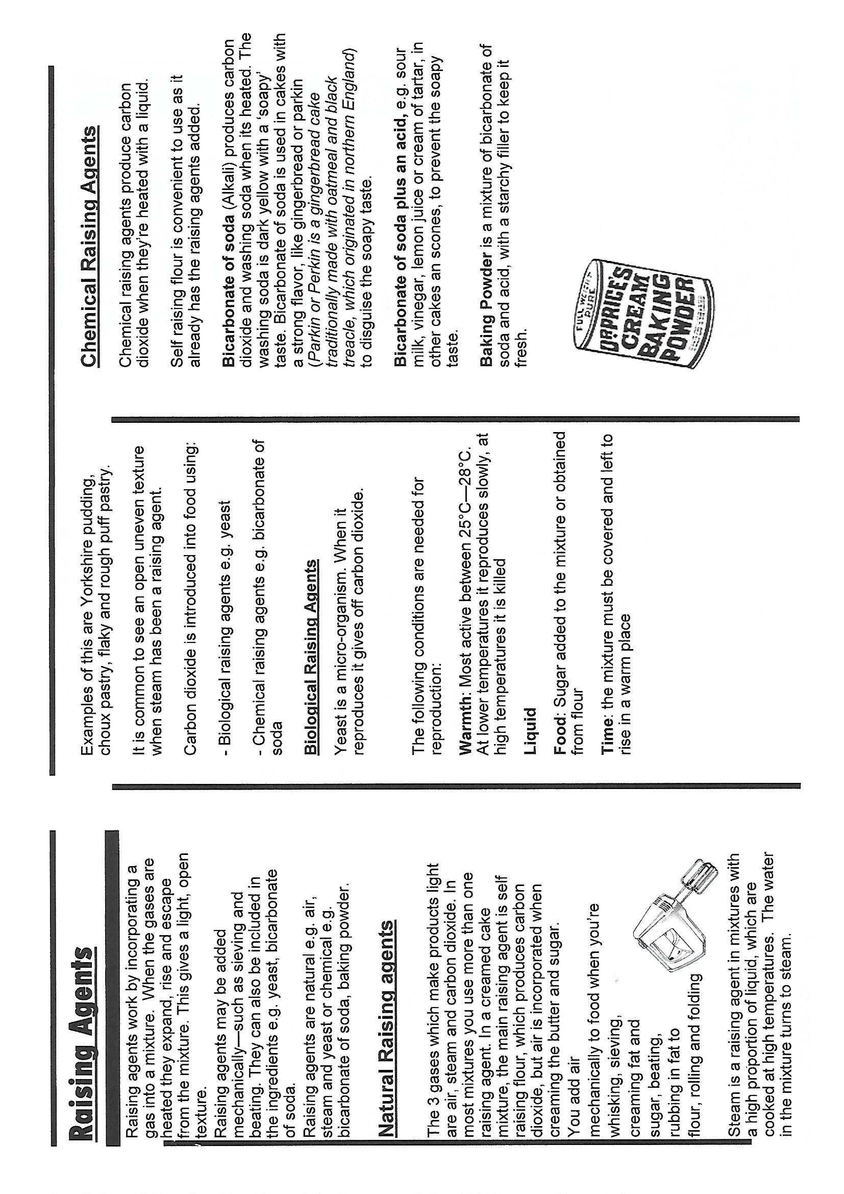

Slide 26
Food Spoilage
What 4 conditions do Bacteria like to grow in? (Give examples and explanations)
How do we stop bacteria growing in food?
T
F
T
M
The signs of food spoilage - give examples of foods for each of the below
enzymic action
mould growth
yeast action
T _ _ _ _ _ _ _ _ _ _
F _ _ _
T _ _ _
M _ _ _ _ _ _ _

Slide 27
contamination
Name of food poisoning- sources | Symptoms | Onset Time
Clostridium botulinum Source:
Campylobacter Source:
Clostridium perfringens Source:
E Coli 0157 Source:
Salmonella Source:
Staphylococcus aureus Source:
Listeria Monocytogenes Source:

Slide 28
Food Safety theory
Do now Activity
What is bacteria?________________________________________________________________________________________________________________________________________________________________________________________
What is food safety?
____________________________________________________________________________________________
____________________________________________________________________________________________
These four rules of food safety
_______________________________________________________________________________________
_______________________________________________________________________________________
_______________________________________________________________________________________
_______________________________________________________________________________________
Personal Hygiene—Identify what the chef has done to model safe personal hygiene.
High risk foods are
____________________________________________________________________________________________
Examples include _____________________________________________________________________________
Low risk foods are
____________________________________________________________________________________________
Examples include______________________________________________________________________________
A used by date is______________________________________________________________________________
A best by date is_______________________________________________________________________________

Slide 29
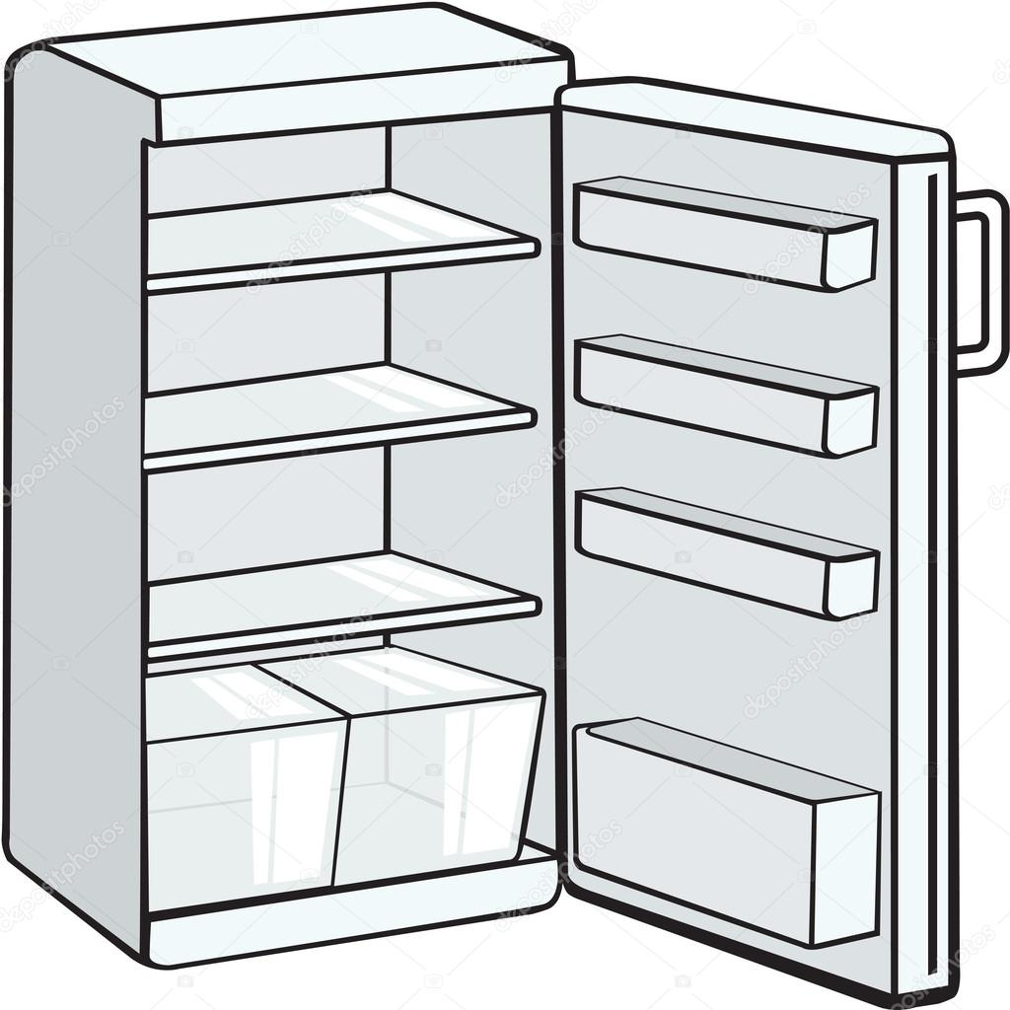
What would you look for when buying products to determine if the food is safe to eat and fresh.
Fresh fish ________________________________________________________________________________
Fresh meat_______________________________________________________________________________
Fresh vegetables___________________________________________________________________________
Fresh fruit________________________________________________________________________________
Packaged food _____________________________________________________________________________

Slide 30
Food Hygiene
How does food poisoning happen?
Define what Pathogenic bacteria is.
What are the 4 most common types of food poisoning and which foods carry them?
S
2.St
3. C
4.E.C
5. L
What is a high risk food?
Temperature | What is happening to bacteria?
-18C
0-5C
5-63C
37C
72C

Slide 31
Food Storage
Temperature of Freezer :
When food is frozen bacteria……
Temperature of Fridge:
When food is chilled bacteria….
What 4 essential rules need to be followed when reheating food?
1……………………………………………………………………………………………………
2…………………………………………………………………………………………………..
3…………………………………………………………………………………………………..
4………………………………………………………………………………………………….
How do you use a temperature food probe?
What is meant by the term Ambient?
Step 1: | Step 2:
Step 3: | Step 4:

Slide 32
Food handling & Personal Hygiene
List 7 things food handlers have to do to make sure their hygienic and safe in the kitchen.
Explain what cross-contamination is and when it could occur….
Red chopping board is for…………………………………………
Green chopping board is for…………………………………….
Yellow chopping board is for…………………………………….
Blue chopping board is for…………………………………………
White chopping board is for……………………………………..
1
2
3
4
5
6
7

Slide 33
Factors affecting food choice
Food Choice
Give detailed reasons what families need to consider when meal planning. (10 marks)

Slide 34
Factors affecting food choice
Food Choice
Food choice linked to the following religions and cultures: Buddhism, Christianity, Hinduism, Islam, Judaism, Rastafarianism and Sikhism

Slide 35
Packaging & Labelling
Why do we package & label food? | Reason | Explanation
 | P
 | P
 | P
 | P
List 10 Things that must be displayed on a food product label (according to EU Law):
1
2
3
4
5
6
7
8
9
10

Slide 36
Nutritional Labelling and Marketing
Dietary Reference Values (DRVs)
Traffic light labelling.
Nutritional Panel
Guideline Daily amount (GDAs)
Discuss how food marketing can influence food choice eg buy one get one free, special offers, meal deals, media influences, advertising, point of sales marketing.

Slide 37
Food products from British tradition and two different cuisines.
Country | distinctive features and characteristics of cooking | equipment and cooking methods used | eating patterns | presentation styles | Examples of recipes.
Britain

Slide 38
Sensory evaluation
The importance of sensory testing
The sensory analysis of food plays an important role in the food industry. Food product-development specialists carry out a range of sensory analysis tests to produce the variety of foods that are available in the shops. Food manufacturers wish to ensure consumers continue to buy existing products because they like their taste and new products because they are innovative and existing.
Sensory analysis tests are carried out to:
Evaluate new and established products
Analyse food products for improvements
Establish consumer response to a product
Ensure that a product meets its original specification
Conduct a product review, assess quality control and make improvements to the product
Maintain product quality
Assess shelf life
How to set up a sensory analysis test:
________________________________________________________________________________________________________________________________________________________________________________________________________________________________________________________________________________________________________________________________________________________________________________________________________________________________________________________________________________________________________________________

Slide 39
Name the 5 senses
Sensory analysis tests
Sensory analysis tests can be used on food products to establish their most important characteristics. There are several types of sensory analysis tests, which can be used by the industry. These are laid down by British Standard (BS5929)
They include:
Preference or acceptance tests
These tests are used to establish the acceptability of a product by finding out the opinions likes and dislikes of the consumer. They are not intended to evaluate specific characteristics, such as crunchiness or smoothness. The information gathered is subjective and large numbers of consumers are required to complete the testing. There are a number of different types of Preference tests
Paired preference test
Hedonic ranking or descriptors
Discrimination or Difference tests
These tests would be used to find out if there is a perceptible difference between two or more products. They are objective tests. They use comparative judgements to determine differences in particular sensory characteristics or small differences between products. Food manufacturers would use these tests in product development eg: reducing the fat content of a ‘healthy option’ product range.
triangle test
Grading Tests
These tests are used to produce a ranking, rating and profiling of a product. Trained testers can also assess the flavour or texture of a product to provide a sensory profile. These tests assess the intensity of specific sensory qualities. There are a number of different grading tests
Ranking test
Rating test
Star profile

Slide 40
Environmental Considerations
Food Provenance
How can manufacturers be more environmentally friendly with their packaging?
1…………………………………………………………………………………………..
2 ………………………………………………………………………………………….
3 ………………………………………………………………………………………….
4 ………………………………………………………………………………………….
5 ………………………………………………………………………………………….
Define the following key terms:
Genetically Modified
Intensive farming
Free range foods
Organic Farming/Food
Sustainable fishing
Fairtrade
Carbon footprint
Food miles

Slide 41
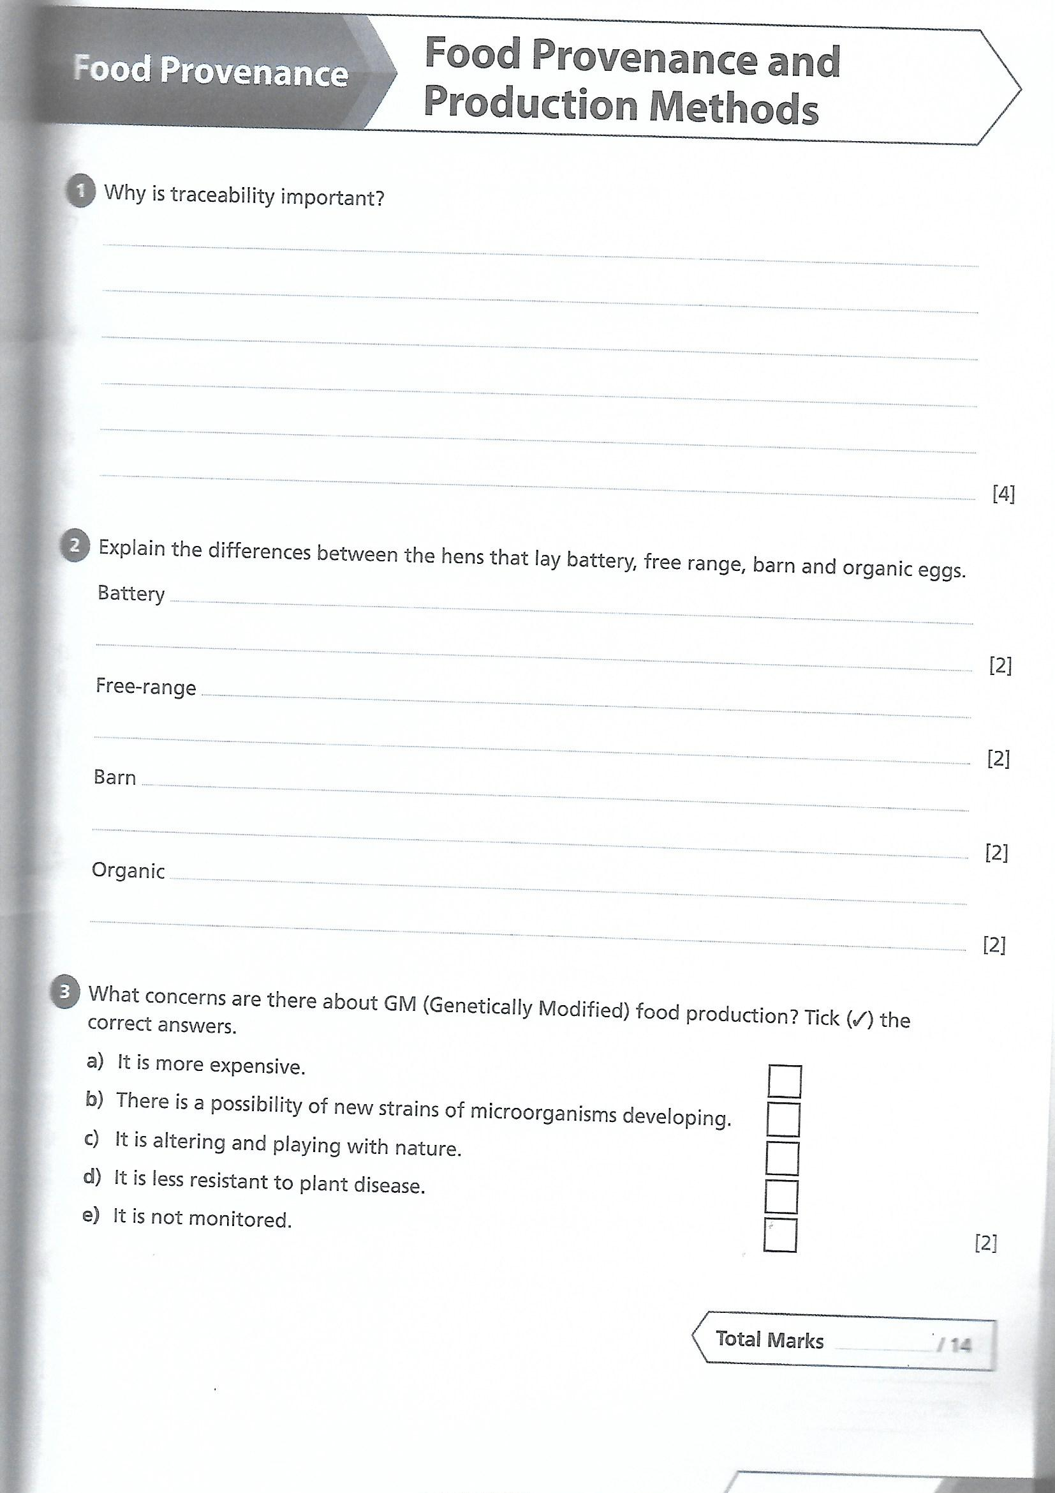

Slide 42
Waste food and packaging
Food Provenance
Food Waste
Your food does its job best when it's on a plate ready to be enjoyed. Saving food saves money and helps to slow down global warming and deforestation. Reducing the amount of food that ends up in the bin also means you can say goodbye to unnecessary packaging waste. If we all make a few small changes and start using up the food we buy, together we can make a big difference.
We throw away lots of food at home.
List 4 reasons why…
________________________________________________________________________________________________________________________________________________________________________________________________________________________________________________
Why do you think producers and retailers waste food too?
________________________________________________________________________________________________________________________________________________________________________________________________________________________________________________
Food waste
How can we reduce our food waste?
https://www.lovefoodhatewaste.com/what-to-do

Slide 43
Primary and secondary processing
Food Provenance
Milk and Milk products
Wheat

Slide 44
Additives
What is a food additive
Complete the table of additives, functions & food examples:
What are the issues in the media surrounding E numbers?
What are the 4 main roles of additives?
1
2
3
4
Additive | Function | Food Example
Preservatives
Colourings
Flavourings
Emulsifiers
Stabilisers
Anti-oxidants
Nutritional enhancers
Thickeners & Gelling agents

Slide 45
Technological developments
Technological developments to support better health and food production including fortification and modified foods with health benefits and the efficacy of these.
Write some brief notes on the following:
cholesterol lowering spreads
health benefits of fortification
fortified foods: thiamin, niacin, calcium and iron added to white flour
folic acid and iron added to breakfast cereals
vitamins A and D added to fats and low fat spreads

Slide 46
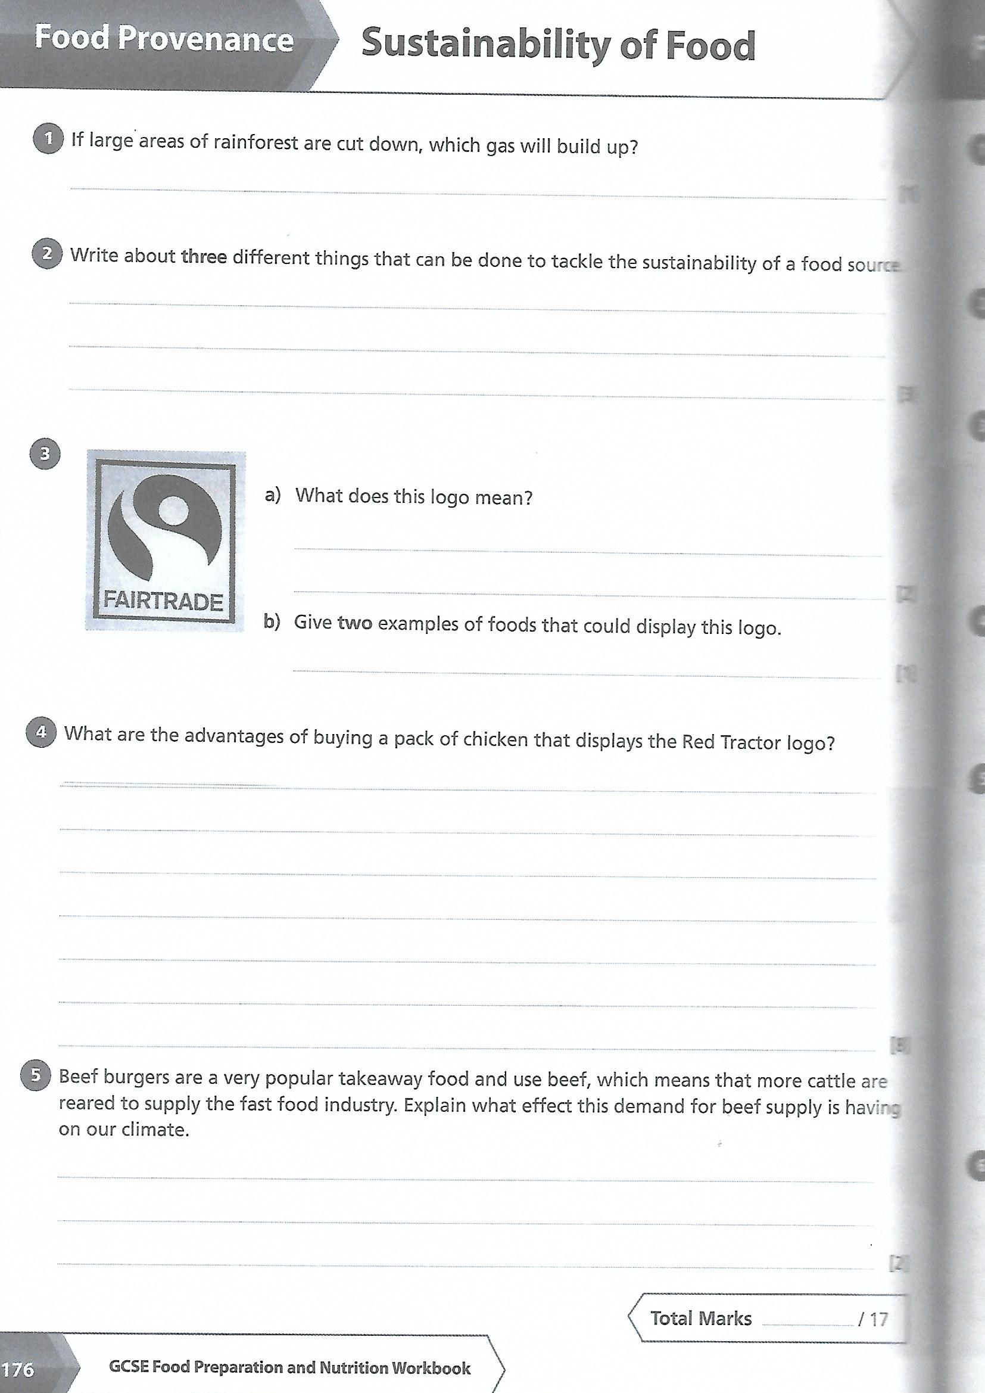

Slide 47
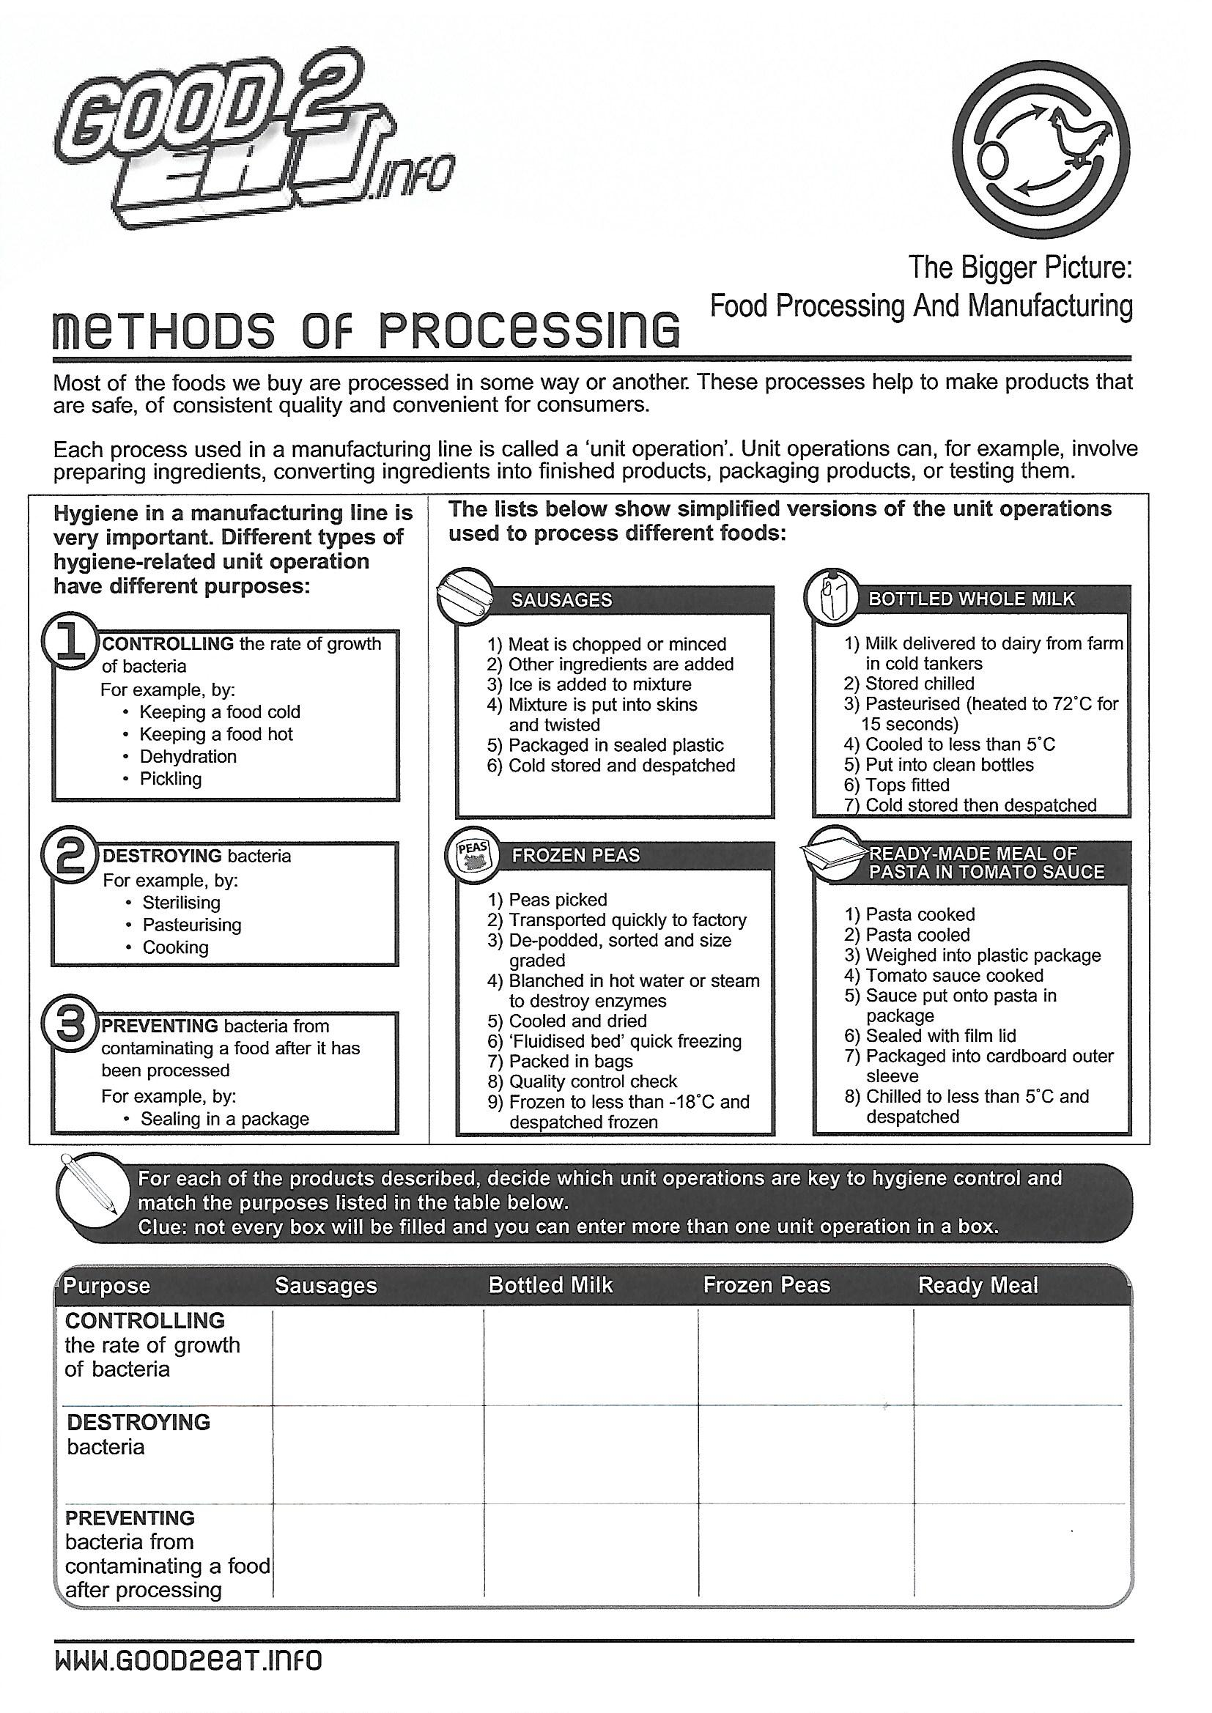

Slide 48
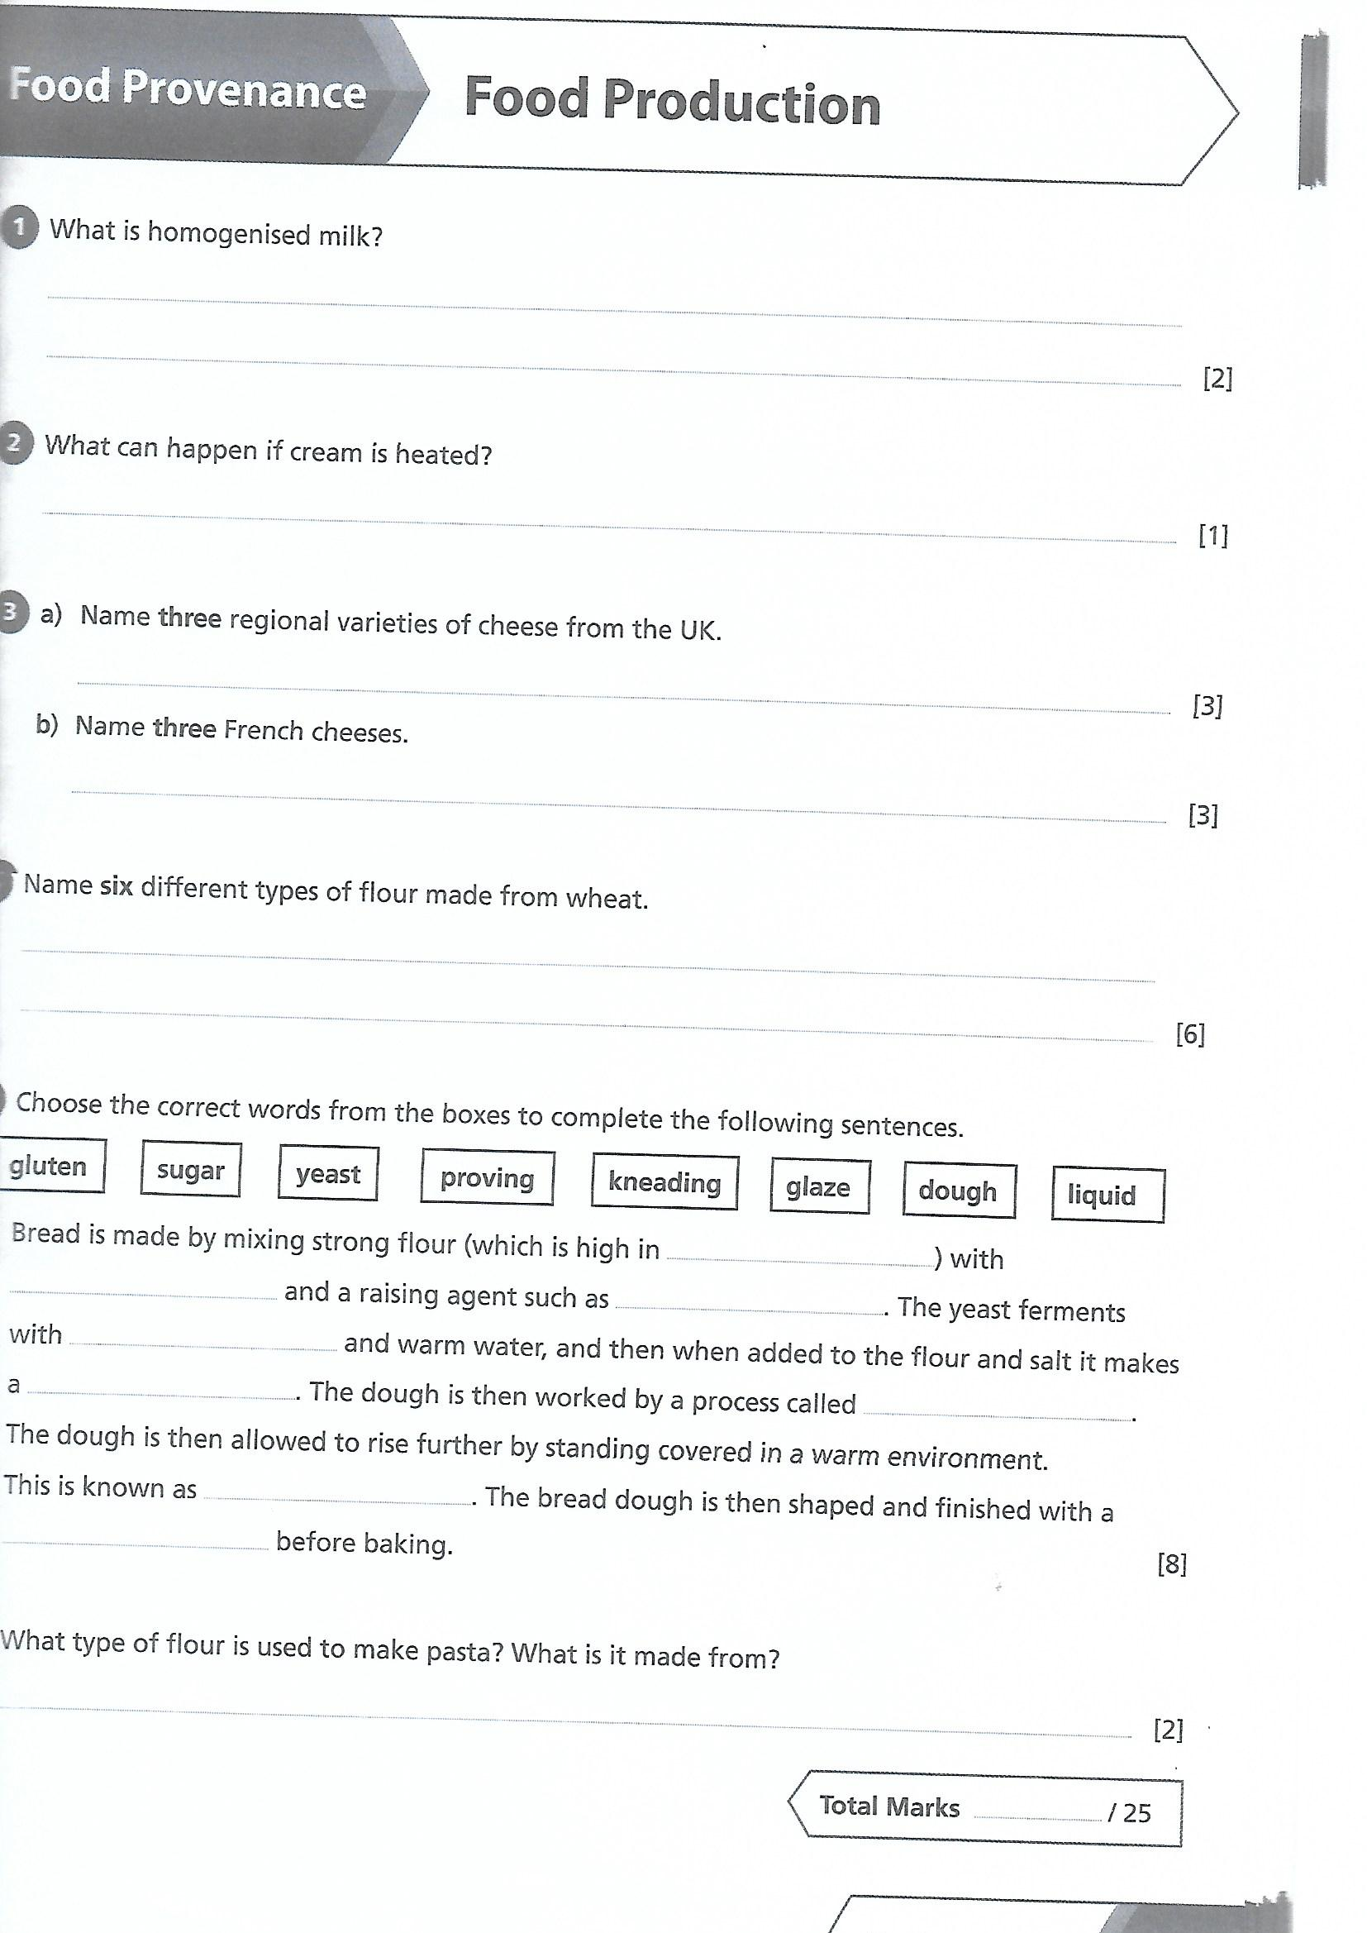

Slide 49
Key words/Terms
Additives - Substances added to food in small amounts to perform a function such as to preserve, colour or flavour a product. Aesthetics - The appreciation of good taste or good design. The product appeals to your senses. “It looks appealing, I want to eat it!” Ambient temperature - Normal room temperature. 20 - 25°C Antibacterial - Working against or prohibiting the growth of bacteria. Bacteria - Small microscopic organisms found all about us. They multiply by splitting in two every 20 mins. (Binary fission) Batch production - Producing a small quantity of identical products. For GCSE assume 50. Blast chill - To cool food quickly by blasting it with cold air. Blast freezing - Quickly freezing that makes small ice crystals which do less damage to the food than slow freezing. Brand - A particular make of product usually with a well known name e.g. Heinz baked beans. Consumer - A person who buys or uses products and services. Cook-chill - Food that has been cooked, fast chilled and then stored at low temperatures.
Cook-freeze - Food that has been cooked, fast frozen and then stored below freezing point. Cross contamination - The transfer of harmful bacteria from one area to another. Danger zone - The temperature range in which bacteria thrive (5 - 63°c). Diet - The food and drink that we eat.
Dietary Reference Values DRV’s - DRV’s show the amount of food energy or other nutrients needed by people of different ages. Due diligence - In food preparation this means that the company has set up systems to help avoid contamination of food products. E numbers - The number given to an additive to show that it has been approved by the EU. Environmental Health Officer EHO - The enforcement officer at local government level who covers public health such as the hygiene of food premises and food safety.

Slide 50
Hazard - Anything that can cause harm to the consumer. High risk area - The section in the food preparation area where food is most likely to be contaminated by bacteria. High risk foods - Those most likely to encourage bacterial growth. e.g. cooked meat, cooked poultry, fish, dairy foods. Logo - The symbol of a company used on products. Low risk area - Section in the food preparation area where food is less likely to be contaminated by bacteria. M.A.P. - Modified atmosphere packaging. Removing the air and flushing the packet with a gas. Marketable product - One that appeals to people and will sell when it reaches the shops; to succeed, all products must be marketable Organoleptic Testing - A posh term for sensory analysis. Using your sensory organs to test a product. In simple language, taste testing! Portion - A portion for one is the amount of food that satisfies the need for one person.
Preservative – Something added to food to slow down the growth of bacteria so that food lasts longer. Quality assurance - A system that is set up before a product is made and which lays down procedures for making a safe, quality product.
Quality control - The steps in the process of making a product to make sure that it meets the standards; faulty products are removed. Sensory descriptors - Words that describe taste, smell, texture and flavour. Shelf life - How long a food product can be kept, making sure it is safe to eat and good quality. Target Market / group - The person or group of people that the product is aimed at. e.g. teenagers, families. Tolerance level - The amount and flexibility allowed when making a product – in terms of weight, colour, size – so that it meets quality standards. Traceability - Tracing a fault back to the point at which it occurred in order to remedy the fault and avoid it happening again.

