Slide 1
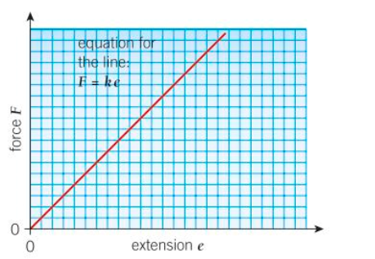
CwK
Tuesday, 22 September 2020
Force and extension of a spring
Do Now Activity
Describe the relationship shown in the graph

Slide 2
Self Assess
The graph shows that the relationship between force and extension are directly proportional, this is because the graph is a straight line though the origin.

Slide 3
Progress Indicators
Good Progress
Recall and apply F=ke Hooke’s Law
Calculate work done in stretching a spring up to the limit of proportionality by Applying Ee= ½ ke²
Outstanding Progress
Describe the difference between elastic deformation and inelastic deformation caused by stretching forces.

Slide 4
Word Consciousness
Deformation-to change shape and size

Slide 5

Elastic Object
When tennis players hit a tennis ball the ball changes shape.
The shape of an object can be changed by stretching, bending, twisting or compressing.
The tennis ball is classed as elastic because it goes back to its original shape
An object is elastic if it returns to its original shape when the forces deforming it are removed

Slide 6
What do the results show?

Slide 7
Hooke’s Law
The extension of a spring is directly proportional to the force applied, as long as its limit of proportionality is not exceeded.
Remember directly proportional on a graph is a straight line through the origin
Hooke’s law can be written as an equation
Force=spring constant x extension
F=ke
F=force-N
k=spring constant- N/m
e=extension-m

Slide 8
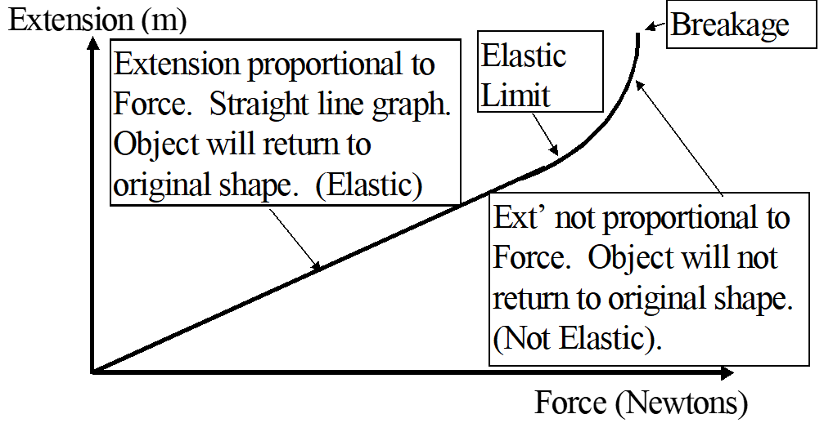
What does the graph show?
Limit of proportionality
Notes:
When you stretch a rubber band or a spring, the work you do is stored in it as elastic potential energy. The graph on the board shows how the force needed to stretch a spring varies with its extension. The graph obeys (on the board) the equation for Hooke’s law F=ke. Where k is the spring constant. You can use the graph to predict what the extension will be for any given force. But if the force is too big the spring stretches more than predicted. This is because the spring has been stretched beyond its limit of proportionality. The extension of a spring is directly proportional to the force applied as long as its limit of proportionality is not exceeded. For a stretched spring to an extension we can calculate the energy in its elastic potential energy store using the equation Ee= ½ke².

Slide 9
So how much work is done when we stretch a spring?
The work done is exactly the same as the elastic potential energy.
You have to do work (transfer energy) to stretch the spring and this energy is stored as elastic potential energy.
Equation given to you
Stored EPE = ½ke²

Slide 10
Calculating work done in stretching
When you stretch a spring or rubber band, the work you do is stored in its elastic potential energy.
For a spring stretched to an extension e, we can calculate the energy in its elastic potential energy store by using
Ee= ½ ke²
E= elastic potential energy-J
k=spring constant-N/m
e²= extension²-m

Slide 11
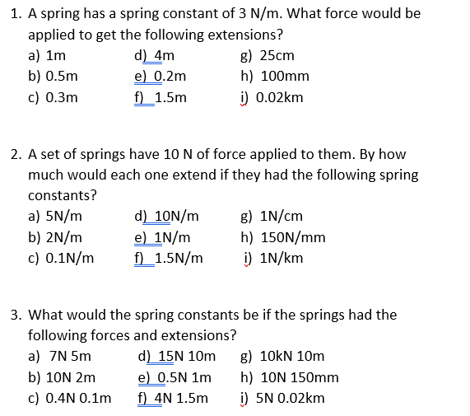

Slide 12
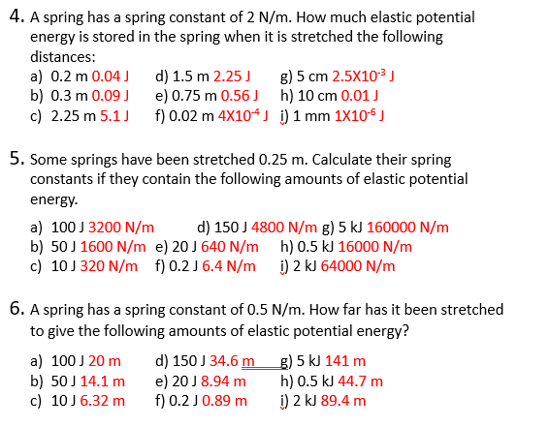

Slide 13
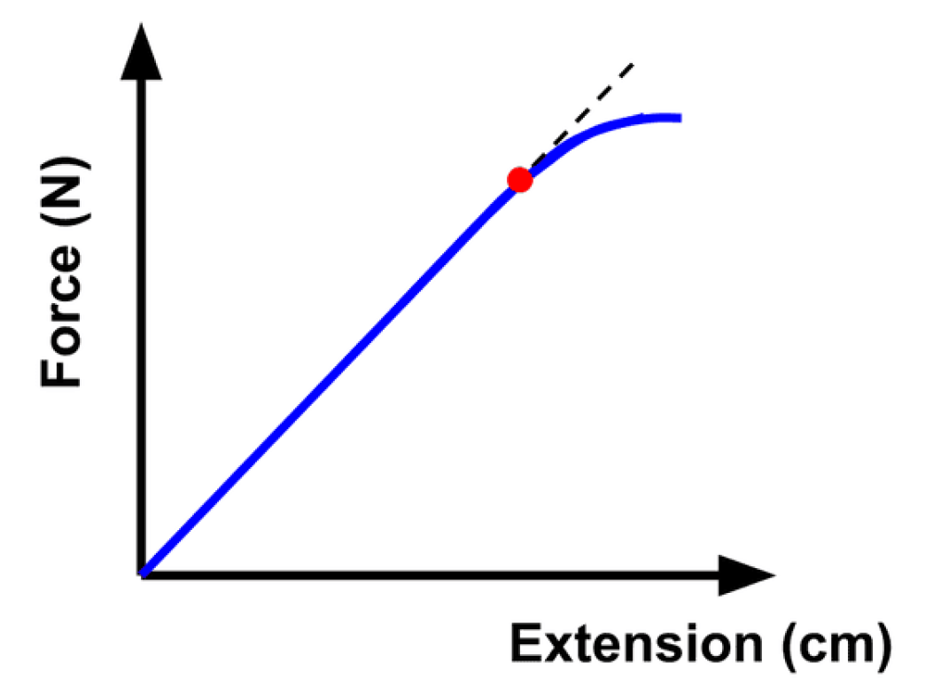
Describe the graph-6 marks

Slide 14
What great looks like
The graph shows Hooke’s Law and limit of proportionality on a force extension graph. The extension of the spring is on the x-axis and force is on the y-axis. The graph is a straight line that passes through the origin because, when no force acts on the spring, there is no extension.
Initially, when the line is straight, there is a linear relationship between force and extension. This means they are directly proportional. As the force on the spring increases, the spring reaches its limit of proportionality.
At the limit of proportionality, the relationship becomes non-linear. The extension will increase more rapidly for the same amount of force added to the spring as before. On the graph this is where the line begins to curve.

Slide 15
Plenary

