Slide 1
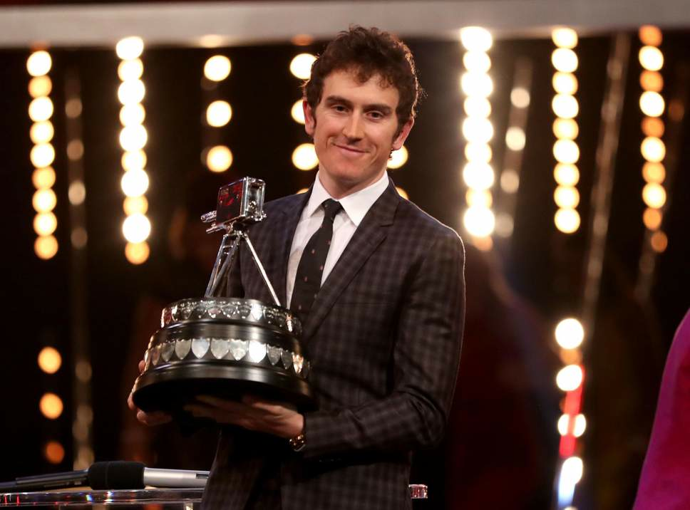
The Function of the Cardiovascular system
Progress Indicators
Good Progress | Outstanding Progress
Be able to explain the 3 functions of the CV system | Link the how the functions of the CV system could improve performance with an example (AO2)
DNA: Discuss how the ‘BBC Sports Personality of the year’ award could influence sponsorship for the winner

Slide 2
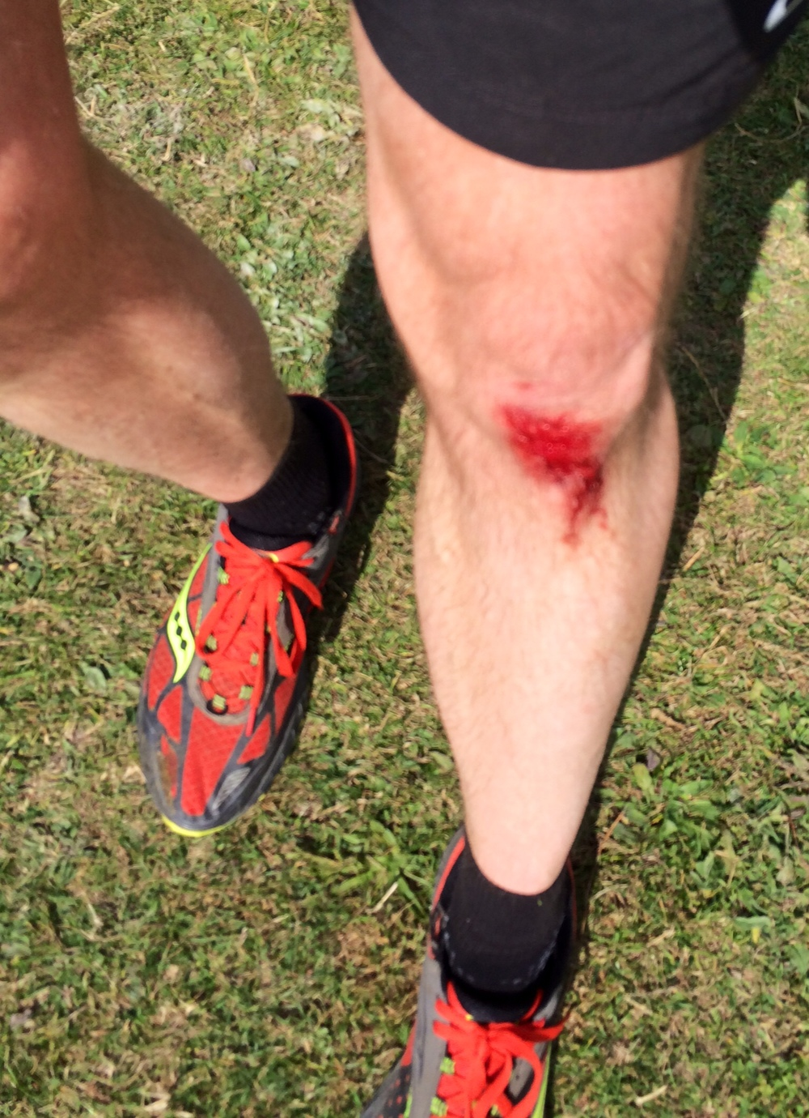
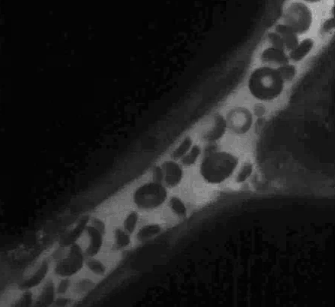
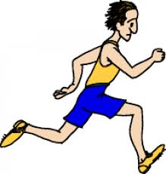
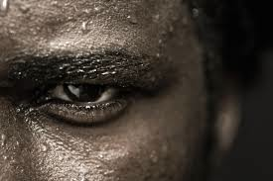
Transport of Oxygen,
Carbon Dioxide
& Nutrients
Clotting of
open wounds
Functions of Cardiovascular System
Regulation of
body temperature

Slide 3
Clotting of
open wounds
Transport of Oxygen,
Carbon Dioxide
& Nutrients
Platelets help clot the blood sealing wounds and forming scabs avoiding infection. Platelets allow performers to CONTINUE!
This gives the working muscles needed oxygen and allows waste products to be removed
Regulation of
body temperature
Moving more blood nearer the skin cools the body more quickly through skin poor's opening and releasing heat. This means you can exercise for a long time with overheating!

Slide 4
Why do we need blood:
Red blood Cells:
Plasma:
Role = carry oxygen, transport nutrients and waste products (Co2 and salt)
During exercise blood increases in thickness as water is removed as waste.
Role: Plasma is the fluid that transports cells in the blood stream
Makes up to 55% of the volume of blood.
During exercise hormones such as endorphins, adrenalin and testosterone are produced and transported to the plasma. Some making performance higher.
White blood Cells:
Platelets:
Role: In charge of clotting the blood
They clot the skins surface after a graze or cut. Stop us from internally bleeding to death
Role = Protect the body from infection, repair damaged tissue after an injury and destroy bacteria. There are fewer in the body than red blood cells.
Cells are produced in the marrow of long bones.

Slide 5
10

Slide 6
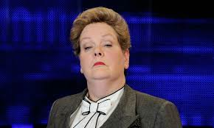
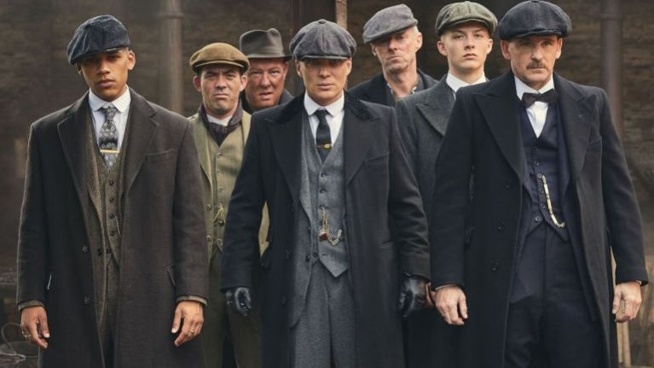
Chase 10! Task
Using your books from the past few weeks, create 5 questions within your book (write them down).
Once created, you will take it in turns (alternating questions) asking the questions with your face partner. If they get the question right (be harsh!) they get the relevant points for that questions.
First to
10 points wins!
Rules
Take it in turns asking questions (alternate)
Your questions should be graded on difficulty 1-3
(3 being most difficult).
If they get an incorrect answer they get 0 points
Vary the difficulty of questions
Make sure 10 points can be won!
1 x Peaky Blinders Card
You can play the card and look in your book for one Q!

Slide 7
SOME……….…
key topics from
Paper 2

