Slide 1



2.1 - Costs
Hyperlink(s)
Back button
Forward button

Slide 2
DNA
Pick a business from the list below. What costs the business money?
BMW
L’Oreal
Toni & Guy Salon
KFC
Alan’s of Netherton
Adidas
Staff
Adidas

Slide 3
Progress Indicators
Outstanding – I can calculate the fixed, variable and total costs for a given scenario
Good - I can define fixed, variable and total costs

Slide 4


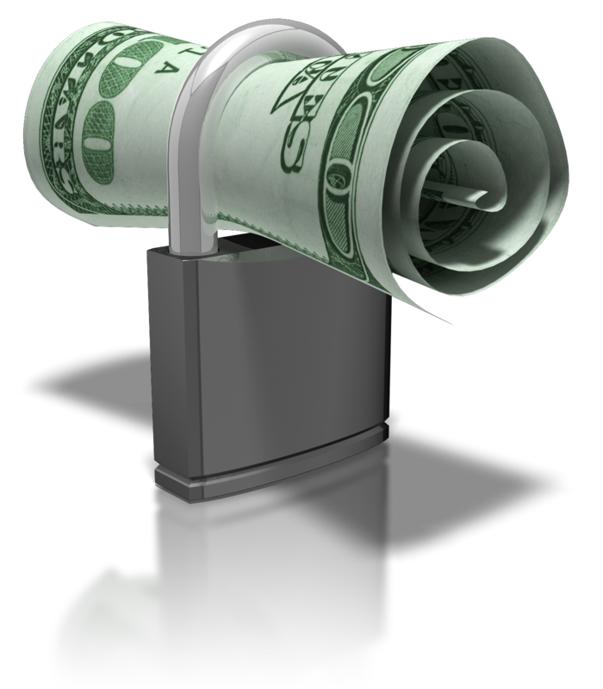
Costs
Write a definition for costs?
Costs refers to any money that is spent by a business in order to carry out their activities
Total Costs
+
=
Fixed Costs
Variable Costs
Notes:
Click on the relevant image to go directly to the slide explaining the different types of cost:
“Fixed Costs” takes you to slide 3
“Variable Costs” takes you to slide 5
Forward takes you to slide 7

Slide 5


Fixed Costs
Write a definition for fixed costs?
Are costs that are not directly related to the amount produced
  They can change
  But any change is not caused by an increase or decrease in production
  These costs must be paid even if no products/services are produced/provided
- rent
- loan repayment
- insurance
- advertising
- salaries
- utilities
Can you think of different examples of fixed costs
Use the business in your DNA to help you think of examples?

Slide 6
Variable Costs
Write a definition for variable costs?
Are costs that are directly related to the amount produced
  If no products/services are produced/provided they would be zero
  They will increase if more is produced
  But will decrease if less is produced
- raw materials
- components
- stock
- packaging
Can you think of different examples of variable costs
Use the business in your DNA to help you think of examples?

Slide 7
Sir Ramics: An Example of Fixed Costs
As a group, calculate the fixed, variable and total costs for Sir Ramics?
Sir Ramics is a small pottery business that produces coffee mugs
Last month it made 30,000 mugs and
to do so it spent money on:
  Rent (£400)
  Clay (8p per mug)
  Staff salaries (£9,500)
  Insurance (£100)
  Glaze (2p per mug)
Notes:
Click to reveal each stage of the calculation
Back returns you to slide 2

Slide 8
Sir Ramics: An Example of Fixed Costs
Sir Ramics is a small pottery business that produces coffee mugs
Last month it made 30,000 mugs and
to do so it spent money on:
  Rent (£400)
  Clay (8p per mug)
  Staff salaries (£9,500)
  Insurance (£100)
  Glaze (2p per mug)
The owner, Ken Coe, would
like to know what his fixed
costs were last month:
Fixed Costs
Those costs that aren’t directly linked to making the mugs. This will include:
:
Rent
£ 400
:
Staff Salaries
£ 9,500
:
Insurance
£ 100
=
£10,000
Fixed Costs Last Month
Sir Ramics fixed costs last month were £10,000
Note: The more mugs made, the higher the costs of the clay and glaze are as they are directly linked to making mugs, so are NOT fixed costs
Notes:
Click to reveal each stage of the calculation
Back returns you to slide 2

Slide 9
Sir Ramics: An Example of Variable Costs
Sir Ramics is a small pottery business that produces coffee mugs
Last month it made 30,000 mugs and
to do so it spent money on:
  Rent (£400)
  Clay (8p per mug)
  Staff salaries (£9,500)
  Insurance (£100)
  Glaze (2p per mug)
The owner, Ken Coe, would
like to know what his variable
costs were last month:
Variable Costs
Those costs that are directly linked to making the mugs. This will include:
:
Clay
£ 0.08 per mug
:
Glaze
£ 0.02 per mug
=
Variable Costs per Mug
£ 0.10 per mug
Since Sir Ramics made 30,000 mugs, the total variable costs last month were:
£ 0.10 X 30,000 = £3,000
Sir Ramics variable costs last month were 10p per mug, or a total of £3,000
Notes:
Click to reveal each stage of the calculation
Back returns you to slide 2

Slide 10
Sir Ramics: An Example of Total Costs
Last month it made 30,000 mugs and
to do so it spent money on:
  Rent (£400)
  Clay (8p per mug)
  Staff salaries (£8,500)
  Insurance (£100)
  Glaze (2p per mug)
The owner, Ken Coe, would
like to know what his total
costs were last month:
Total Costs
Total Costs = Fixed Costs + Variable Costs
Total Costs = £10,000 + £3,000
Total Costs = £13,000
Sir Ramics total costs last month were £13,000
This is the total amount that Sir Ramics had to pay out in order to make 30,000 mugs
Notes:
Click to reveal each stage of the calculation

Slide 11
Chocoholic
Last month it made 80,000 chocolate bars and to do so it spent money on:
  Rent (£800)
  Chocolate (3p per bar)
  Ingredients (8p per bar)
  Staff salaries (£12,500)
  Insurance (£500)
  Wrapping (2p per bar)
In pairs, Calculate the fixed, variable and total costs.
Notes:
Click to reveal each stage of the calculation
Back returns you to slide 2

Slide 12
Fix Me Car
Last month it completed 75 services on cars and to do so it spent money on:
  Rent (£1000)
  Staff salaries (£6,000)
  Screen wash (99p per service)
  Oil (£12 per service)
  Brake pads (£22 per service)
  Insurance (£750)
  Paperwork (1p per service)
On your own, Calculate the fixed, variable and total costs.
Notes:
Click to reveal each stage of the calculation
Back returns you to slide 2

Slide 13
Chocoholic
Last month it made 80,000 chocolate bars and to do so it spent money on:
Fixed Costs
  Rent (£800)
  Staff salaries (£12,500)
  Insurance (£500)
Variable Costs
  Chocolate (3p per bar)
  Ingredients (8p per bar)
  Wrapping (2p per bar)
Total Costs
  FC + VC = TC
FC = £800 + £12,500 + £500
VC = £0.03 + £0.08 + £0.02
VC per item = £0.13
Total VC = £0.13 x 80,000
Total VC = £10,400
TC = £13,800 + £10,400
Total Costs = £24, 200
FC = £13,800
Notes:
Click to reveal each stage of the calculation
Back returns you to slide 2

Slide 14
Fix Me Car
Last month it completed 75 services on cars and to do so it spent money on:
Variable Costs
  Paperwork (1p per service)
  Screen wash (99p per service)
  Oil (£12 per service)
  Brake pads (£22 per service)
Fixed Costs
  Rent (£1000)
  Staff salaries (£6,000)
  Insurance (£750)
Total Costs
  FC + VC = TC
FC = £1,000 + £6,000 + £750
VC = £0.01 + £0.99 + £12 + £22
VC per service = £35
Total VC = £35 x 75
Total VC = £2,625
TC = £7,750 + £2,625
Total Costs = £10,375
FC = £7,750
Notes:
Click to reveal each stage of the calculation
Back returns you to slide 2

Slide 15
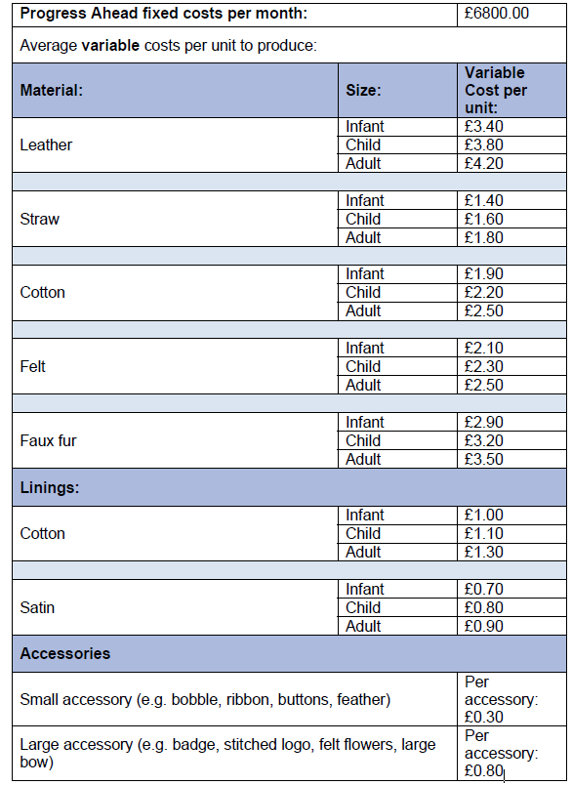
Costs
Calculate the Fixed and variable cost of your final hat design.
Use the sheet on the inside of your exercise books.

Slide 16
2.3 - Break-even
Hyperlink(s)
Back button
Forward button
Notes:
Please note that the symbols and buttons behave as follows:
HYPERLINKS – where there is a hyperlink this symbol will be shown in the margin. More information about the hyperlink is given in the notes for each slide
BACK BUTTON – used where hyperlinks have been used to move to a given slide. This button will take you back to the slide the link was from
FORWARD BUTTON – this allows you to move forward to the next section (if there is one) of the presentation. This may skip a number of slides that are linked to from the slide the button appears on.

Slide 17
Break-even
Write a definition for break even?
“The point at which profit is zero, so the revenue received from selling products/services is the same as the total costs incurred in producing/providing them.”
In effect, the business is NEITHER making a PROFIT or a LOSS when it breaks-even
It is important for a business to be aware of it’s break-even point
  As it can aid decisions about whether a product/service is worth producing/providing

Slide 18
The Break-even Point
The break-even point can be defined as:
“The level of production and sales at which profit is zero; the total revenue received is equal to the total cost incurred”
Once a firm knows its total costs and total revenue it can calculate the break-even point as:
Total Costs
=
-
0
Total Costs
Profit
Total Revenue
Add total costs to each side to cancel out the negative sign
Notes:
Click the mouse to visually show how we know that TR=TC at break-even point

Slide 19
Break-Even Formula
This is known as the break-even point, or the break-even level of output
  It can be calculated using this formula:
Knowing that the break-even point occurs when profit is zero is not that useful
  What businesses need to know is how many products they need to sell in order for profit levels to be zero
  They can then use this information to help them make decisions
=
FIXED COSTS
BREAK-EVEN POINT
SELLING PRICE PER UNIT - VARIABLE COST PER UNIT
Why is knowing the BEP important for businesses?

Slide 20
Sir Ramics: An Example Calculation
Ken Coe, the owner of Sir Ramics,
would like to be able to calculate
the break-even point quickly
He uses the following
information:
  Fixed Costs are £10,000 per month
  Variable Costs are £0.10 per mug
  Each mug is sold at a price of £0.50
=
FIXED COSTS
BREAK-EVEN
POINT
SELLING PRICE - VARIABLE COSTS
=
£10,000
BREAK-EVEN
POINT
£0.50- £0.10
=
£10,000
BREAK-EVEN
POINT
£0.40
BREAK-EVEN
POINT
=
25,000
Sir Ramics will need to sell 25,000 mugs a month in order to break-even
Calculate the BEP for Sir Ramics?
Notes:
Click to reveal each stage of the calculation

Slide 21
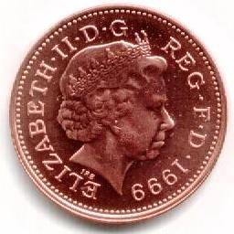
Sir Ramics: An Example Break-even Chart
Label the chart with the following information?
FC
TC
TR
BEP
Loss
Profit
20,000
TR
Break-even point
TC = TR
15,000
P R O F I T
TC
Costs and Revenue (£)
10,000
FC
L O S S
This shows that Sir Ramics must make AND sell 25,000 mugs per month to break-even
5,000
0
5,000 10,000 15,000 20,000 25,000 30,000 35,000 40,000
Output (Number of Mugs Produced)
Notes:
Click to reveal each step in plotting the break-even chart

Slide 22
What Affects the Break-Even Point?
Complete the table on the affects of changing the BEP?
CHANGE | EFFECT ON TOTAL COSTS | EFFECT ON TOTAL REVENUE | EFFECT ON BREAK-EVEN POINT
INCREASE IN COSTS | INCREASE | NO CHANGE | INCREASE
DECREASE IN COSTS | DECREASE | NO CHANGE | DECREASE
INCREASE IN REVENUE | NO CHANGE | INCREASE | DECREASE
DECREASE IN REVENUE | NO CHANGE | DECREASE | INCREASE
Red = Negative impact on the business
Green = Positive impact on the business

Slide 23
Illustrating an Increase In Fixed Costs
The impact of an increase in fixed costs from £2,000 to £3,000 is shown below:
The break-even point increases from 1,000 units to 1,500 units – which is not good!
(TR)
8000
7000
6000
5000
4000
3000
2000
1000
(TC)
Costs and Revenue (£)
(FC)
0
200 400 600 800 1000 1200 1400 1600 1800 2000
Output
Notes:
Click to reveal an animation illustrating the effect of a change in fixed costs

Slide 24
Illustrating a Decrease In Variable Costs
The impact of an decrease in variable costs from £2 to £1.50 is shown below:
The break-even point decreases from 1,000 units to 800 units – which is good!
(TR)
8000
7000
6000
5000
4000
3000
2000
1000
(TC)
Costs and Revenue (£)
(TC)
(FC)
0
200 400 600 800 1000 1200 1400 1600 1800 2000
Output
Notes:
Click to reveal an animation illustrating the effect of a change in fixed costs

Slide 25
Illustrating a Decrease In Total Revenue
The impact of a decrease in the price charged from £4 to £3.25 is shown below:
The break-even point increases from 1,000 units to 1,600 units – which is not good!
(TR)
8000
7000
6000
5000
4000
3000
2000
1000
(TR)
(TC)
Costs and Revenue (£)
(FC)
0
200 400 600 800 1000 1200 1400 1600 1800 2000
Output
Notes:
Click to reveal an animation illustrating the effect of a change in fixed costs

Slide 26
Margin of Safety
The margin of safety is defined as:
“The difference between the number of products/services actually sold, and the number of products/services that need to be sold to break-even”
It effectively measures how far sales can fall before a business stops making a profit, and is a useful way of using break-even
  It is calculated using the following formula:
MARGIN OF SAFETY
=
ACTUAL SALES – BREAK-EVEN OUTPUT

Slide 27
Sir Ramics: An Example Margin of Safety
Calculate the margin of safety for Sir Ramics?
The business knows that to
break-even it must sell 25,000
mugs each month
  Last month it sold all of the 30,000
  mugs it made for 50p each
The owner, Ken Coe, would like to
know what the margin of safety
was last month:
Margin of Safety
Margin of Safety = Actual Sales – Break-even Output
Margin of Safety = 30,000 – 25,000
Margin of Safety = 5,000
Sir Ramics margin of safety was 5,000 mugs last month
Notes:
Click to reveal each stage of the calculation

Slide 28
Sir Ramics: The Margin of Safety Visually
Sir Ramics margin of safety can be shown on their break-even chart:
20,000
TR
15,000
P R O F I T
TC
Costs and Revenue (£)
10,000
FC
L O S S
MARGIN OF SAFETY
5,000
0
5,000 10,000 15,000 20,000 25,000 30,000 35,000 40,000
Output (Number of Mugs Produced)
Notes:
Click to reveal the margin of safety

Slide 29
2.4 - Profit
Hyperlink(s)
Back button
Forward button
Notes:
Please note that the symbols and buttons behave as follows:
HYPERLINKS – where there is a hyperlink this symbol will be shown in the margin. More information about the hyperlink is given in the notes for each slide
BACK BUTTON – used where hyperlinks have been used to move to a given slide. This button will take you back to the slide the link was from
FORWARD BUTTON – this allows you to move forward to the next section (if there is one) of the presentation. This may skip a number of slides that are linked to from the slide the button appears on.

Slide 30
Profit and Loss
Write a definition for Profit?
“The financial gain obtained from producing/providing a good/service. It is the difference between the amount earned from selling a product/service and the cost of producing/providing it”

Slide 31
Calculating Profit
Businesses…
  Receive revenue from selling goods/services
  Incur costs making/providing goods/services
Profit is the difference between the two
  It can be calculated using the formula:
Write the formula to calculate profit?
=
-
PROFIT
TOTAL REVENUE
TOTAL COSTS
* Note that “Sales Revenue” can be used as an alternative term to “Total Revenue” in this formula

Slide 32

Profit or Loss?
The profit calculation will give either a positive or negative answer
  A POSITIVE answer – means a profit has been made
  A NEGATIVE answer – means a loss has been made
If a profit is being made…
If a loss is being made…
…then a business is selling products for less than it costs to make them.
Whilst a business may allow this to happen for a short time, it won’t want this to continue for long
`
`
…then a business is selling products for more than it is costing to make them.
This is exactly what most businesses will aim to do
Notes:
Click to reveal each “note”

Slide 33
Sir Ramics:
Calculate the profit for Sir Ramics?
Last month it sold all of the 30,000
mugs it made for 50p each
It also incurred the following costs:
  Fixed Costs of £10,000
  Variable costs of 10p per mug
The owner, Ken Coe, would like to
know what his profit was last month:
Profit
Profit = Total Revenue - Total Costs
Profit = (30,000 x £0.50) – (£10,000 + £3,000)
Profit = £15,000 - £13,000
Profit = £2,000
Sir Ramics made a profit last month of £2,000
Notes:
Click to reveal each stage of the calculation

Slide 34
Sir Ramics
Calculate the profit for Sir Ramics?
Last month it only managed to sell
20,000 mugs at a price of 50p each
It also incurred the following costs:
  Fixed Costs of £10,000
  Variable costs of 10p per mug
The owner, Ken Coe, is concerned
that the business made a loss
last month:
Loss
Profit = Total Revenue - Total Costs
Profit = (20,000 x £0.50) – (£10,000 + £2,000)
Profit = £10,000 - £12,000
Profit = - £2,000
A negative profit figure means that Sir Ramics made a loss of £2,000 last month
Notes:
Click to reveal each stage of the calculation
Back returns you to slide 3

Slide 35
Calculating the Profit Per Unit
What is the formula for profit per unit?
A business will need to ensure that all figures are converted to units
  This is easy for revenue, since it is the selling price
  For total costs it can be more complicated:
    Variable costs are often given per unit
    However, fixed costs are usually given as a total, which must be divided by the number of units produced
PROFIT PER UNIT
=
REVENUE PER UNIT (SELLLING PRICE)
-
TOTAL COST PER UNIT

Slide 36
Sir Ramics: An Example of Profit Per Unit
Calculate the profit per unit for Sir Ramics?
Last month it sold all of the 30,000
mugs it made for 50p each
It also incurred the following costs:
  Fixed Costs of £10,000
  Variable costs of 10p per mug
The owner, Ken Coe, would like to
know what his profit per unit was
last month:
Profit Per Unit
Profit per Unit = Price - Total Cost per unit
Fixed Cost per Unit = £10,000/30000 = £0.333
Profit per Unit = £0.50 – (£0.333+£0.10)
Profit per Unit = £0.50 - £0.433
Profit per Unit = £0.067
Sir Ramics made a profit last month of 6.7 pence per mug. This is the same as £2,000 total profit divided by the 30,000 mugs
Notes:
Click to reveal each stage of the calculation

Slide 37
The Importance of Understanding Finance
A basic understanding of finance is crucial for anyone who works in business
Why is profit important for business?
Approximately 60%* of new businesses fail
within 5 years
  Many are profit-making businesses
  But they usually run out of cash!
This is because many people don’t understand the
difference between profit and cash
* Source: Business demography 2015 from http://www.ons.gov.uk (release date 23 November 2016)
Notes:
Source of data: https://www.ons.gov.uk/businessindustryandtrade/business/activitysizeandlocation/bulletins/businessdemography/2015

