Slide 1
Person centred health and improvement plans
Good progress: You will consider the importance of a person-centred approach, and you will learn about the information that needs to be included in a health and wellbeing improvement plan.
Excellent progress: You will consider the importance of a person-centred approach, and you will learn about the information that needs to be included in a health and wellbeing improvement plan. You are able to understand how to set out a health and wellbeing improvement plan.

Slide 2
Improvement plans…
This is a plan to help an individual improve parts or all of their health and well being.
Reasons for an improvement plan are:
diet
exercise
smoking
alcohol
illegal drugs
prescription drugs
sleep problems
personal hygiene
unsafe sex
stress
specific health issues such as high blood pressure
Notes:
The factors listed on the PowerPoint can have a negative effect on a person's health and wellbeing. However, these effects can hopefully be rectified by the person following a health and wellbeing improvement plan.
Before showing this PowerPoint, check what students remember about lifestyle choices from Learning aim A. They may suggest and expand on diet, exercise, hygiene, alcohol, nicotine and so on. Tell them they will be considering these issues again as part of compiling their health and wellbeing improvement plans for individuals with specific issues, then show this PowerPoint®.
The next two PowerPoints® look at the features of a health and wellbeing improvement plan, along with how students can start one for a given individual.

Slide 3
Improvement plan prep…
Ask questions.
Make observations.
Collect information about:
lifestyle data
physiological indicators .
Notes:
The start of a health and wellbeing improvement plan is generally a statement of the problem(s) to be tackled (see PowerPoint® 4 in this presentation). However, an assessment of a person’s overall health will need to be made before that statement can be written.
The person writing the plan will need to ask the individual a range of questions about their health, as well as making observations. In the research, they will need to include lifestyle data about the individual and physiological indicators.
Lifestyle data are facts about how a person chooses to live their life – e.g. how much they might smoke or drink, the type of food they may eat.
Physiological indicators are measurements or observations that can be made to measure health. Some of these were covered in PowerPoint® presentations 4 to 7.

Slide 4
Improvement plan prep…
Ask questions.
Make observations.
Collect information about:
lifestyle data
physiological indicators .
Notes:
The start of a health and wellbeing improvement plan is generally a statement of the problem(s) to be tackled (see PowerPoint® 4 in this presentation). However, an assessment of a person’s overall health will need to be made before that statement can be written.
The person writing the plan will need to ask the individual a range of questions about their health, as well as making observations. In the research, they will need to include lifestyle data about the individual and physiological indicators.
Lifestyle data are facts about how a person chooses to live their life – e.g. how much they might smoke or drink, the type of food they may eat.
Physiological indicators are measurements or observations that can be made to measure health. Some of these were covered in PowerPoint® presentations 4 to 7.

Slide 5
Starting your plan…
Begin with a statement of the problem(s) to be tackled based on health and wellbeing assessment.
Example:
Lose 20 kg in weight to reduce risks to health and wellbeing.
Notes:
A person needing a health and wellbeing improvement plan will already have had some kind of assessment based on their physical measures of health and the factors that affect them. PowerPoint 3 in this presentation looks at the preparation needed in order to do this.
A good health and wellbeing improvement plan will start with a statement of the problem to be dealt with. There should be an overall goal or aim based on the individual’s assessment.
Ask students if, in groups, they can come up with another three statements that could begin their health and wellbeing improvement plan. They could look back at the list of risks on the second PowerPoint of this presentation and suggest a profile of an individual – e.g. an older person who is losing mobility and balance, and who has had minor falls recently, might have an opening statement of: Do regular exercises or take regular exercise classes to improve mobility and balance, which would reduce the risk of falls and serious injury.

Slide 6
Short and long term targets…
Targets can be used to motivate people. They are a key feature of good health and wellbeing improvement plans.
A short-term target is six months or less
A long-term target is more than six months
Example:
Lose 1 kg in Week 1 of diet and 10 kg by Month 7.
Long-term target
Short-term target
Notes:
Remind students that the health and wellbeing improvement plans they write will need to use both long- and short-term targets, and that these targets will need to be monitored.
In preparation for the next PowerPoint® slide, ask students what they can remember about SMART (Specific, Measurable, Achievable, Realistic and Time-related) targets. Can they remember what SMART stands for? (They will have covered this already in Component 2.) Now show slide 2.

Slide 7
Monitoring and reviewing targets…
Targets must be SMART (Specific, Measurable, Achievable, Realistic, Time-related)
Targets must be regularly monitored and the data noted down (e.g. weight loss/gain each week; number of minutes of exercise each day)
Targets should be reviewed according to progress
Notes:
Health and wellbeing plans should be monitored so a person knows how well they are progressing towards meeting their targets. This means they will be encouraged if they are doing well and can be given alternative strategies to follow if the ones given are not working
Targets should be SMART. Ask students what might happen if targets for health and wellbeing improvement plans are not SMART – for example, if there is no specific target, if the target isn’t able to be measured, if targets are not realistic or achievable, if there is no deadline. (It could give individuals an excuse not to start the plan and/or be very vague about its execution.)
Ask students who they think should monitor targets. (This is something that the individual can do for themselves. It is also something that another party can do alongside – for example, a group/organisation/club/health practitioner.)
Ask students why targets need to be reviewed. (This could happen for two reasons: an individual is making better progress than expected and is exceeding their targets, or they are not making progress for some reason. Either way, targets should be reviewed so that individuals are constantly working towards realistic outcomes.)
A health and wellbeing plan needs to include actions or ways to improve health and wellbeing, to ensure the person following it cannot give up, claiming that they have not understood what to do. Notes should be taken about targets, along with strategies for helping to stay on target.

Slide 8
targets…task
Notes:
Health and wellbeing plans should be monitored so a person knows how well they are progressing towards meeting their targets. This means they will be encouraged if they are doing well and can be given alternative strategies to follow if the ones given are not working
Targets should be SMART. Ask students what might happen if targets for health and wellbeing improvement plans are not SMART – for example, if there is no specific target, if the target isn’t able to be measured, if targets are not realistic or achievable, if there is no deadline. (It could give individuals an excuse not to start the plan and/or be very vague about its execution.)
Ask students who they think should monitor targets. (This is something that the individual can do for themselves. It is also something that another party can do alongside – for example, a group/organisation/club/health practitioner.)
Ask students why targets need to be reviewed. (This could happen for two reasons: an individual is making better progress than expected and is exceeding their targets, or they are not making progress for some reason. Either way, targets should be reviewed so that individuals are constantly working towards realistic outcomes.)
A health and wellbeing plan needs to include actions or ways to improve health and wellbeing, to ensure the person following it cannot give up, claiming that they have not understood what to do. Notes should be taken about targets, along with strategies for helping to stay on target.

Slide 9
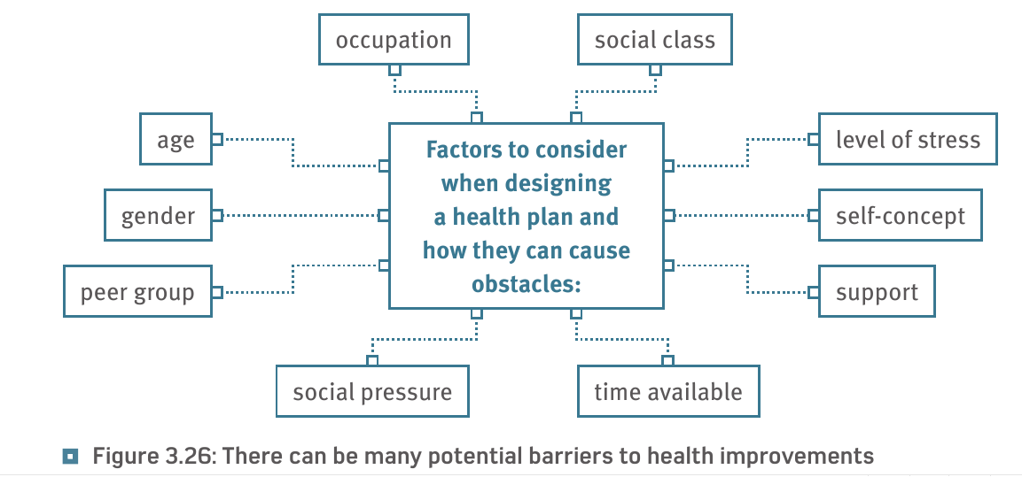
Factors to consider…

Slide 10
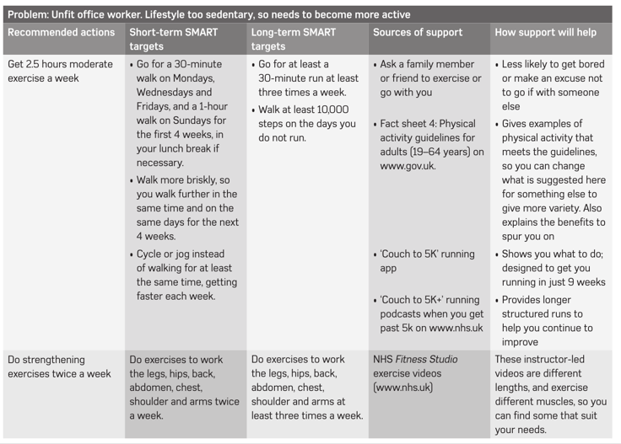
Improvement plan example…

Slide 11
Improvement plan example… task
(8)

Slide 12
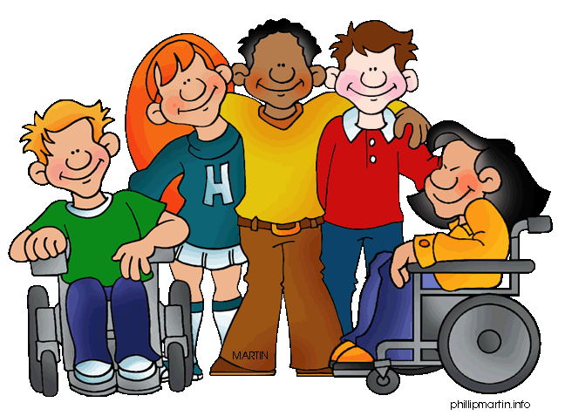
Sources and types of support…
Sources of support
Family, friends, partners
Professional carers and services
Community groups, voluntary and faith-based organisations
Types of support
Emotional
Information and advice
Practical help, e.g. financial assistance, childcare, transport
Formal and informal
It is very important to list the support available on an individual’s health and wellbeing improvement plan
Support can help a person to meet their targets

